Slide 1

Exploratory Data Analysis
Team 4

Slide 2
Exploratory Data Analysis
Exploratory Data Analysis (EDA) is an approach to analyzing data sets to summarize their main characteristics, often with visual methods.
• Maximize Insights • Uncover Underlying Structure • Extract Important Variables

Slide 3
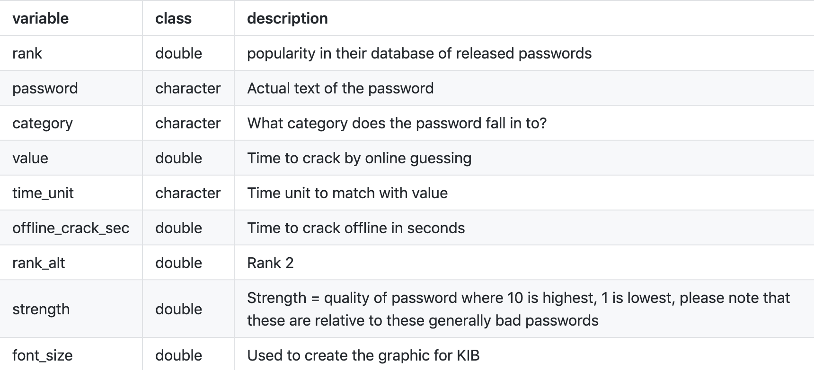
Password Dataset
Notes:
When presenting, state which variables we will be considering when answering our question.

Slide 4
Variable Types
Categorical | Continuous
Category | Offline_crack_sec
Time unit | Value
 | Strength
 | Font-Size

Slide 5
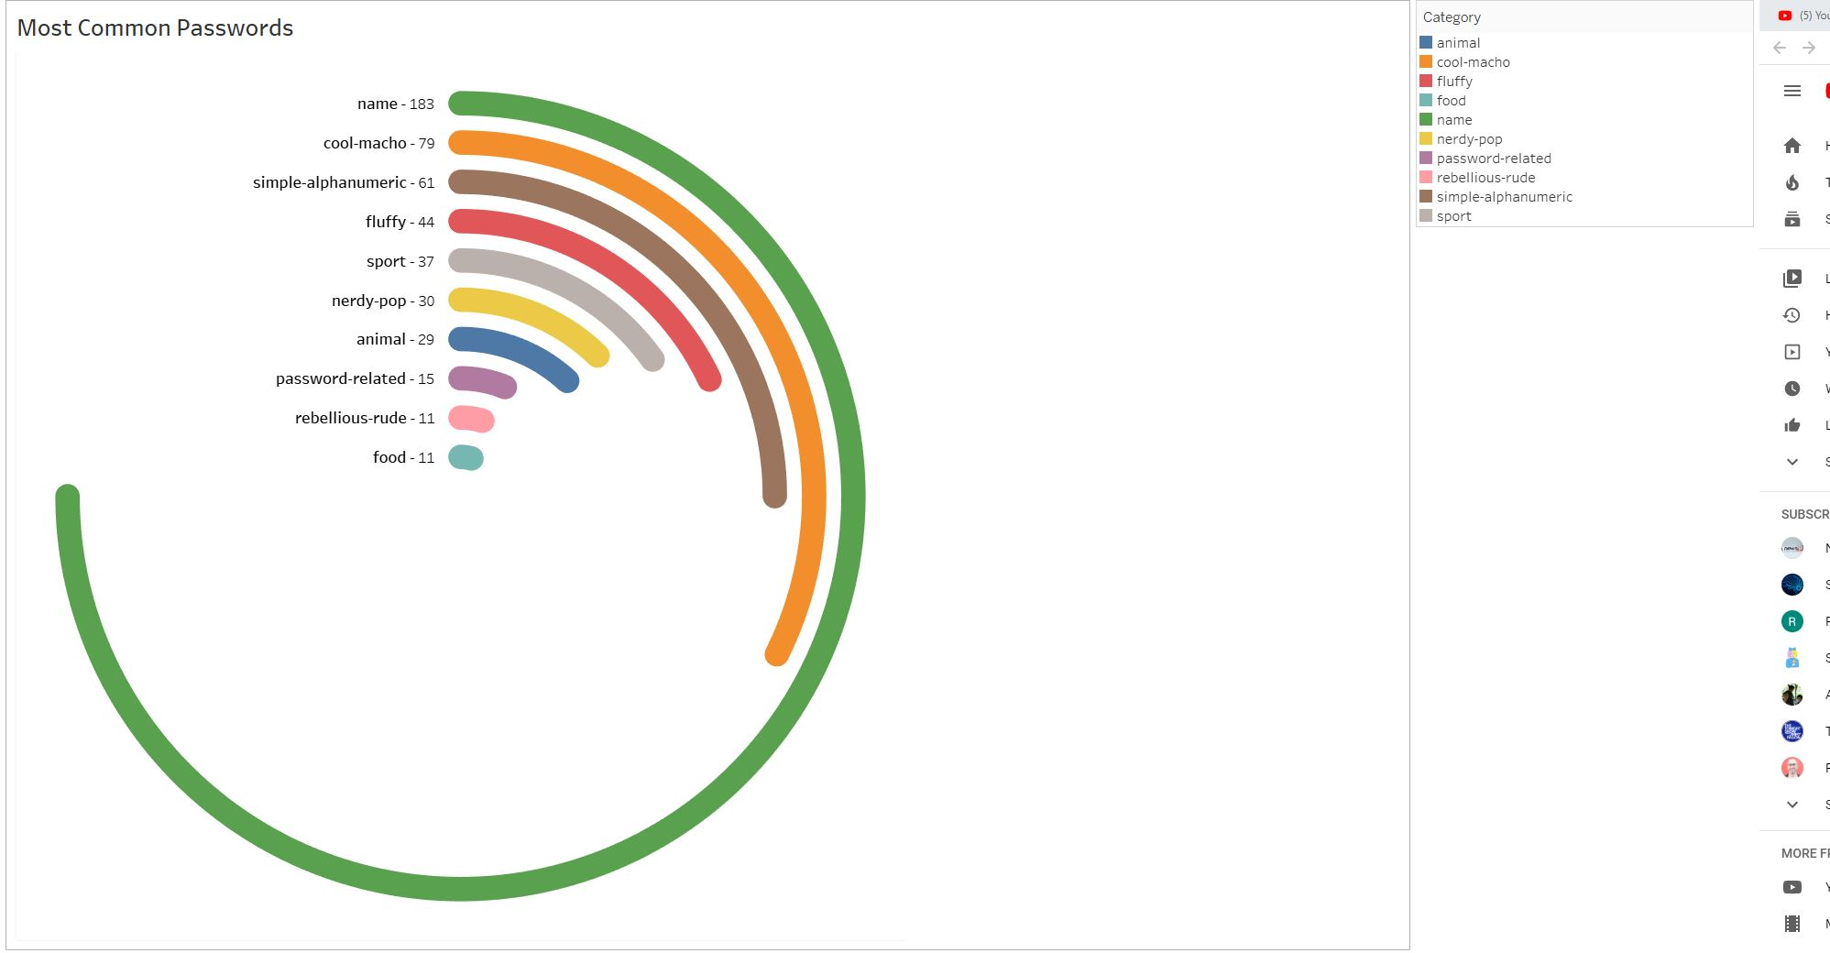
Radial Bar Chart
Most Common Category of password.

Slide 6
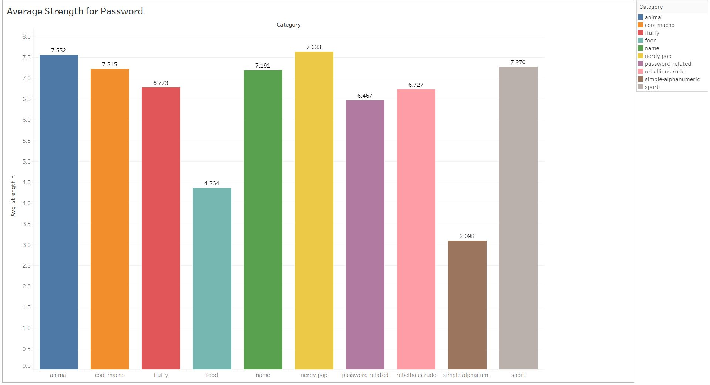
Which category has the strongest passwords?

Slide 7
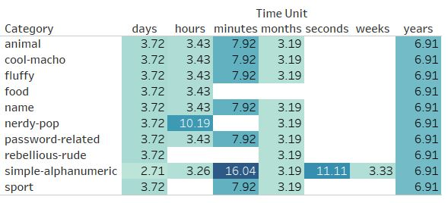
Categorical Vs Categorical (Frequency Table)

Slide 8
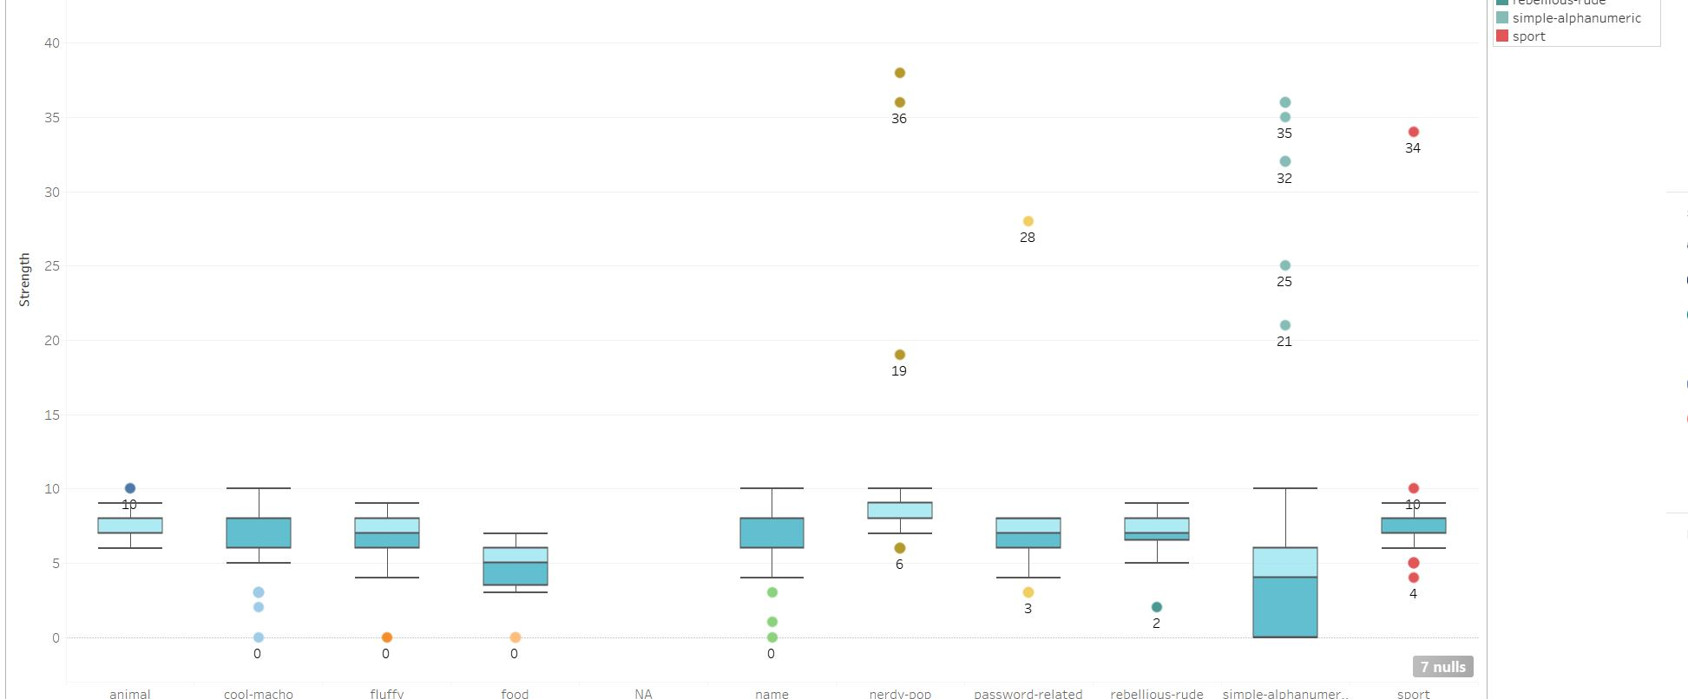
Categorical Vs Continuous (Box Plot)

Slide 9
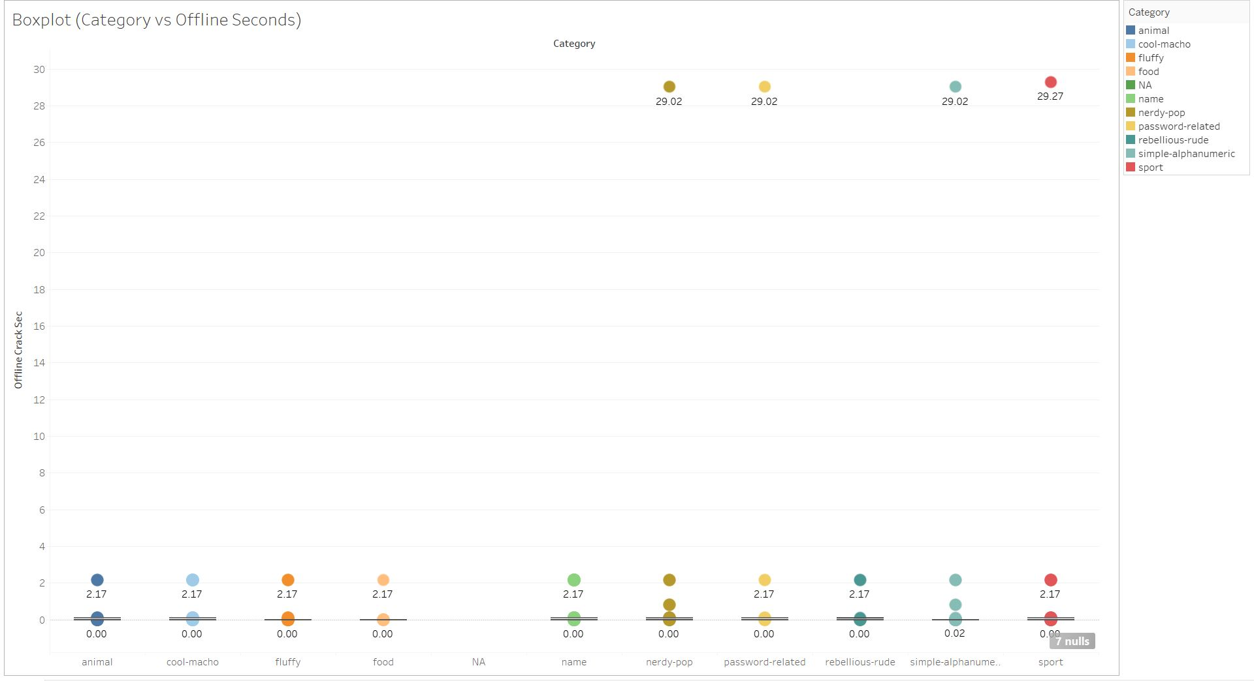
Categorical Vs Continuous (Box Plot)

Slide 10
Outliers And Missing Value
Last 7 rows deleted (All Columns are Missing)
For strength, 10 is highest & 1 is lowest
In rows there are outliers, other variables are valid
Replaced the outliers in 'strength' column with the median (7)
Offline – 3 rows were deleted (29.7)

Slide 11
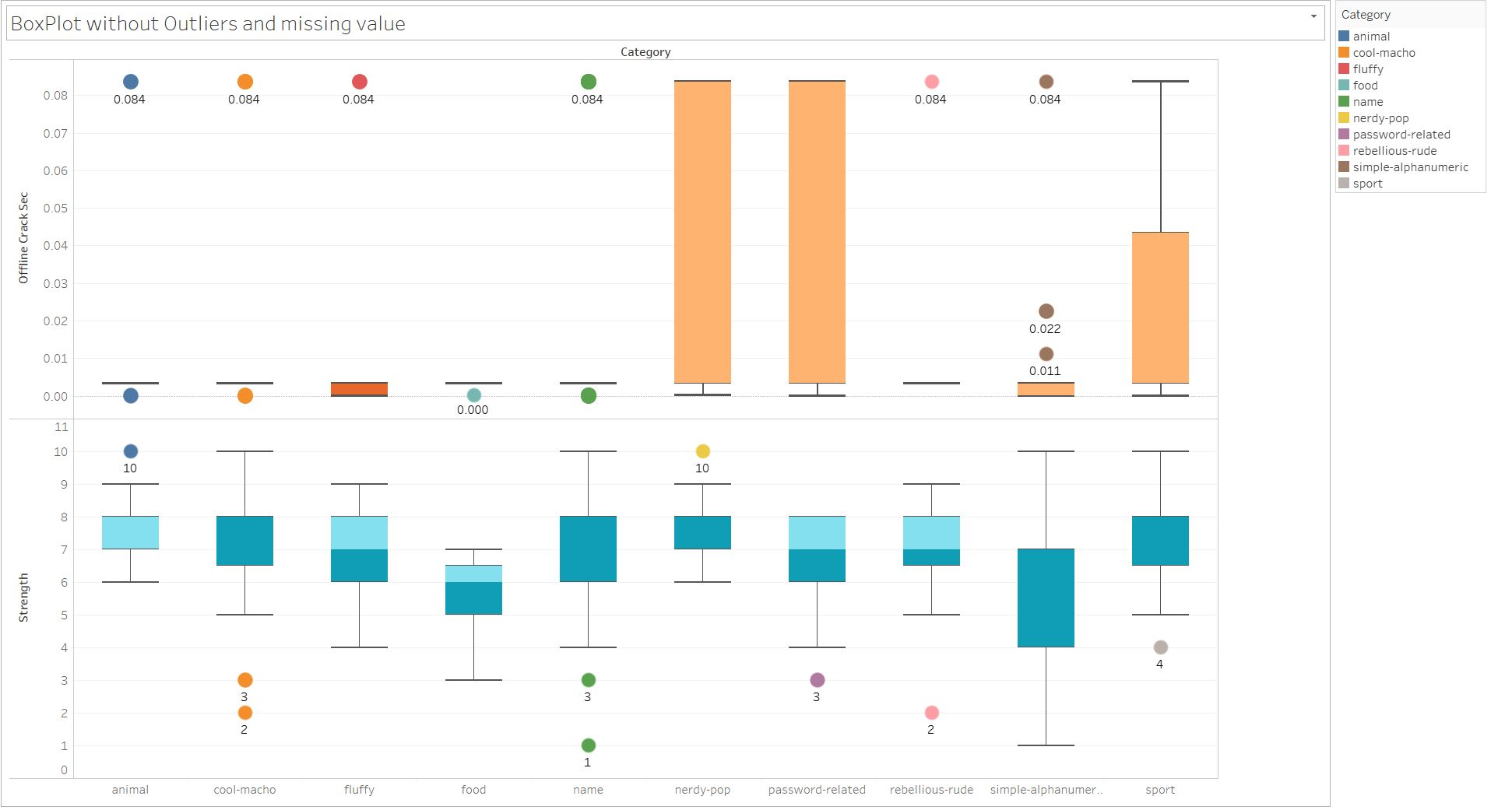
Boxplot (With Removed Outliers)

Slide 12
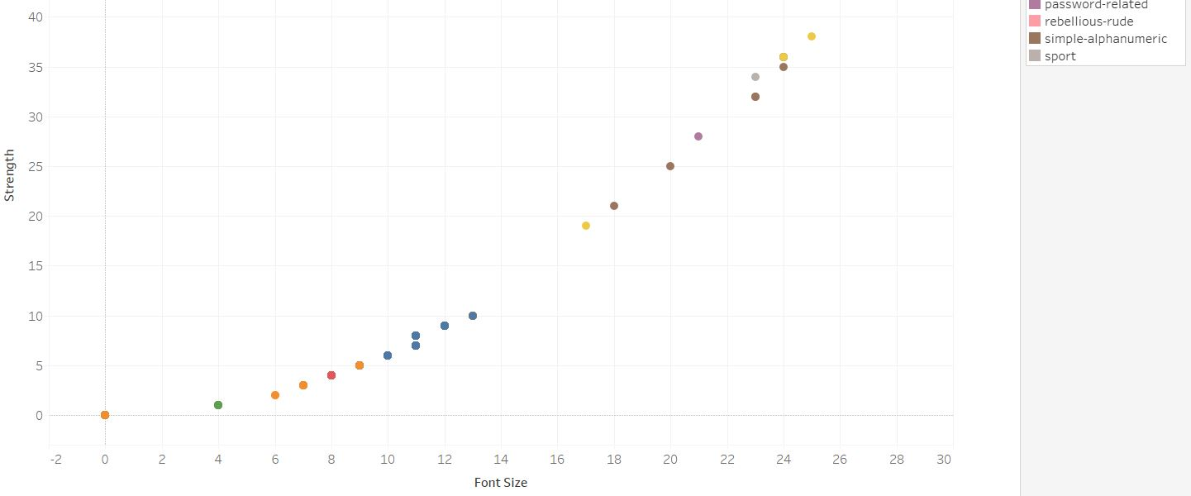
Continuous Vs Continuous (Scatter Plot)

Slide 13
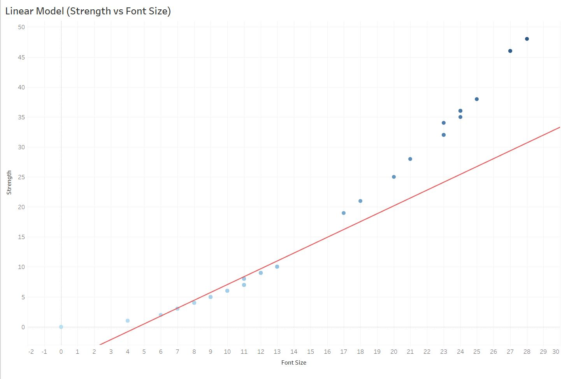
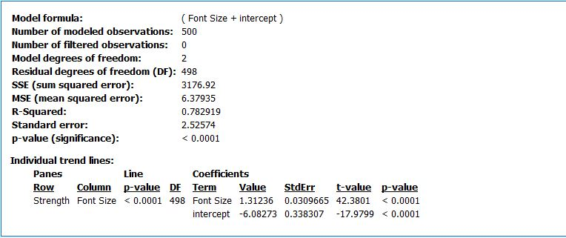
Linear Model

Slide 14
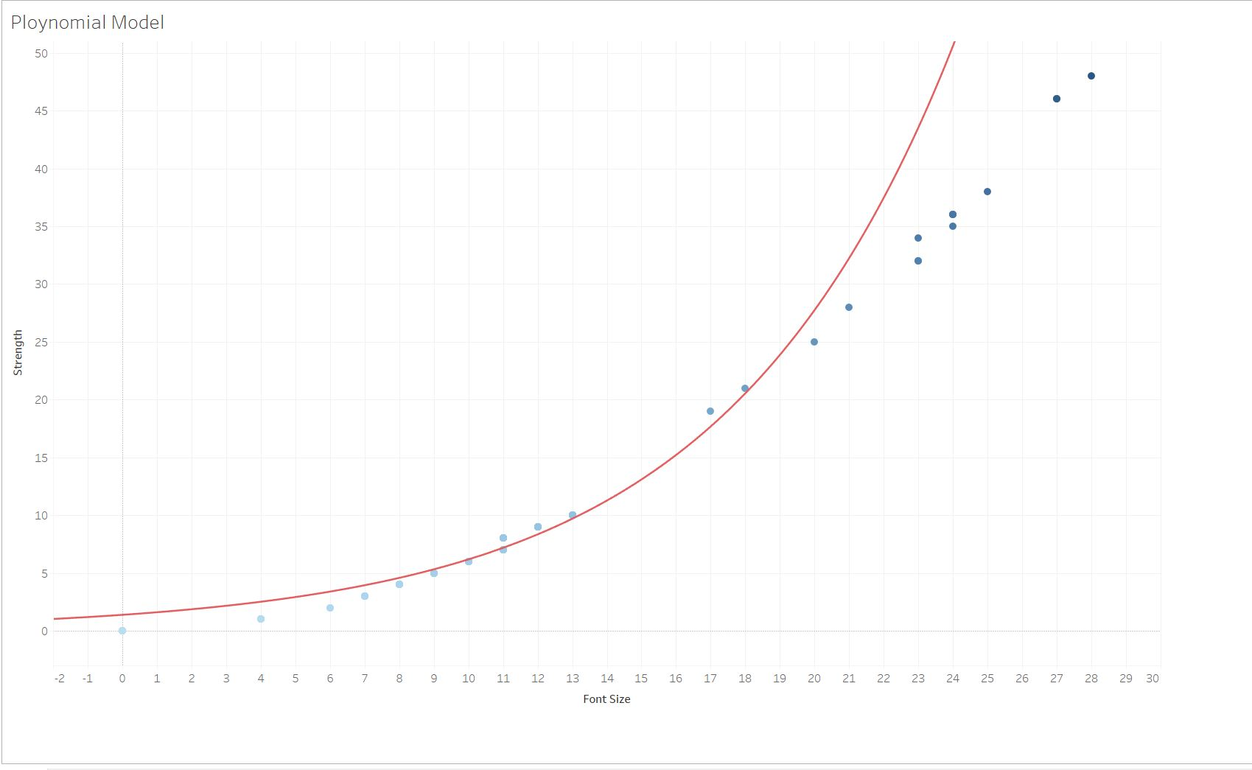
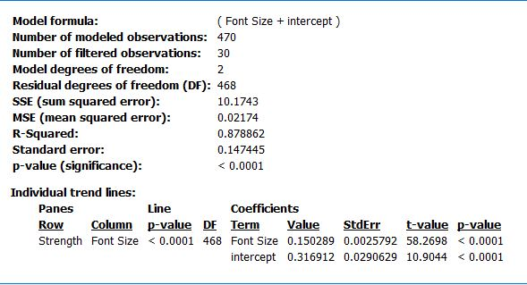
Polynomial Model

