Slide 1



Peak ETL
PostGIS + Martin: Building Open-source Mapping Applications
Jason Holden
www.peaketl.com
CEO, PRESENTOR
JASON@PEAKETL.COM | (918) 409-CODE (2633) | (719) 310-5240

Slide 2

About
Me
The Story (so far):
I started working with computers at the age of 13. Growing up in a small town in eastern Oklahoma, I acquired a reputation as the “computer kid.” Shortly after graduating high school, I got my first software development job working with Visual FoxPro. Since then, I’ve used numerous other languages and platforms to develop countless database applications and services. My newest endeavor is Peak ETL. At Peak ETL, we’re creating a subscription-based platform to aggregate and analyze public oil and gas data and deliver it to industry professionals for use in their operations.
Jason Holden
CEO & Founder

Slide 3








What We’re
Building
Overview
crimes.json
load_data.py
Spatial Database
Tile Server
Browser Map
CLI starts entire stack
MVT – fast at every zoom level
0$ / No API Keys

Slide 4

About this dataset
Lt. Joe Kenda (Homicide Hunter)
1
1973 – Joins Colorado Springs PD
2
1977 – Promoted to Homicide Det. after solving an
“unsolvable” double shooting
3
1977 - 1996 – Works 387 homicide cases,
closes 356 (92%)
4
1996 – Retires as Commander, Major Crimes Unit
5
2011 - 2020 – Homicide Hunter on
Investigation Discovery 144 episodes,
9 seasons

Slide 5
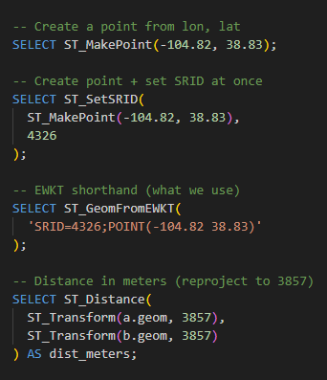
PostGIS
Concepts
PostGIS turns PostgreSQL into a spatial database for maps and GIS.
Key Functions:
Geometry Types
POINT (lon lat) – A Single Location
LINESTRING – roads, paths
POLYGON – neighborhoods, parcels
SRID / Coordinate Systems
4326 = WGS 84 (GPS lat/lon) – Use this!
3857 = Web Mercator (pixel coordinates)
Martin/MapLibre handle reprojection
Spatial Index
GiST index on the geom column
Required for tile serving performance
USING GIST (geom)

Slide 6
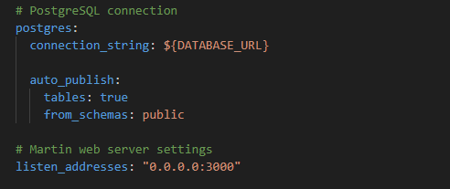
Martin
Concepts
Open-source PostGIS vector tile server
./containers/martin/martin.yaml
Vector Tiles (MVT)
Mapbox Vector Tile format (.mvt)
Binary, compressed – very fast to transfer
Tiles are /{z}/{x}/{y} – zoom / column / row
Browser renders them with WebGL (MapLibre)
Styling happens in the browser – no baked into the tile
Cacheable (CDN)
Martin Endpoints
/crimes TileJSON metadata
/crimex/{z}/{x}/{y} actual tile
/catalog lists all sources
/health health check

Slide 7
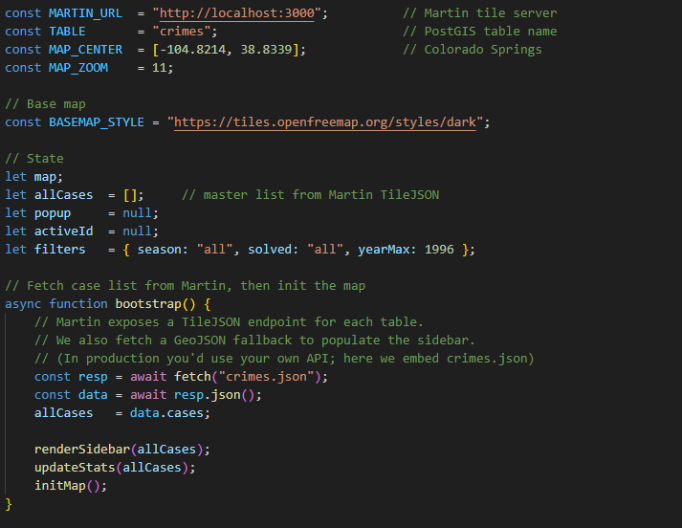
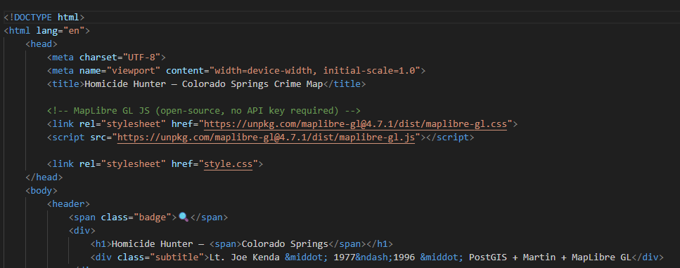
MapLibre GL JS
Concepts
./app.js
Open-source JS library for WebGL-based vector map rendering
History
Mapbox GL JS fork
Maintained by the MapLibre Organization
Backed by AWS, Microsoft, and Meta
Client-side Browser
WebGL rendering (GPU acceleration)
Consumes vector tiles directly
Styling and theming defined in JSON style specification
Dynamic styling
Vanilla JS
Fully open-source
./index.html

Slide 8
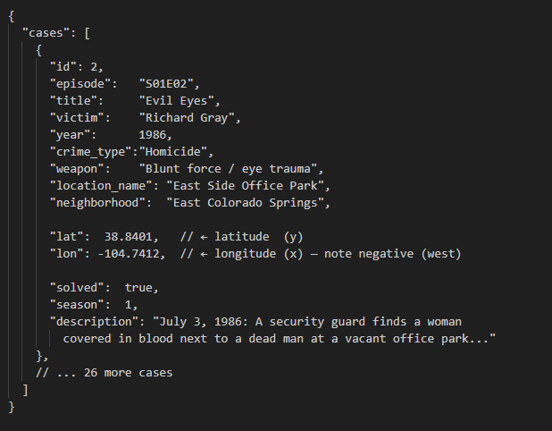
Dataset
Configuration
JSON File
./crimes.json
Easy to share
Versioning
Easy to load

Slide 9
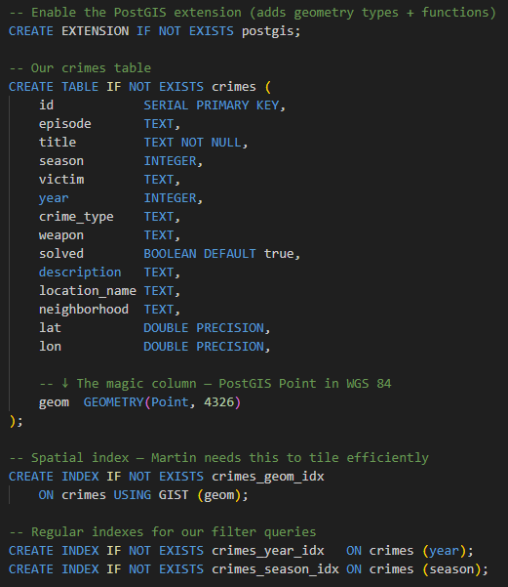
Database
Schema
./containers/postgis/schema.sql
PostGIS Schema
geom (The “magic” column – PostGIS Point in WGS 84)
Index for tile lookup efficiency
Index on Season/Year for filtering efficiency

Slide 10
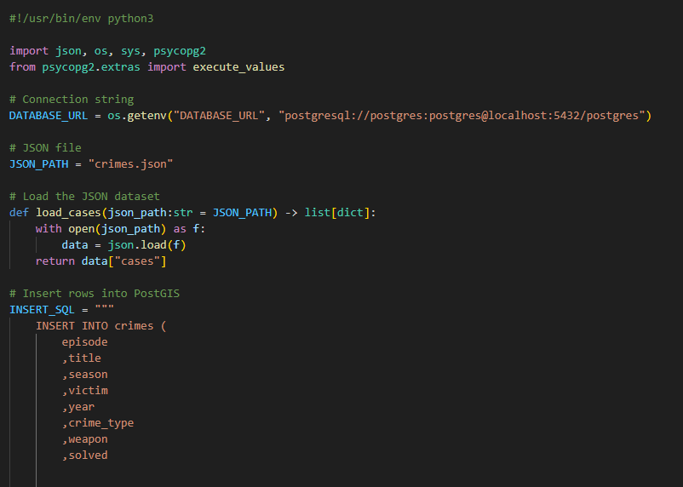
Data
Loader
Python Data Loader
./load_data.py
Executed on startup
Loads crimes.json
INSERT each case JSON dict into crimes table
Notes:
http://localhost:3000/crimes

Slide 11
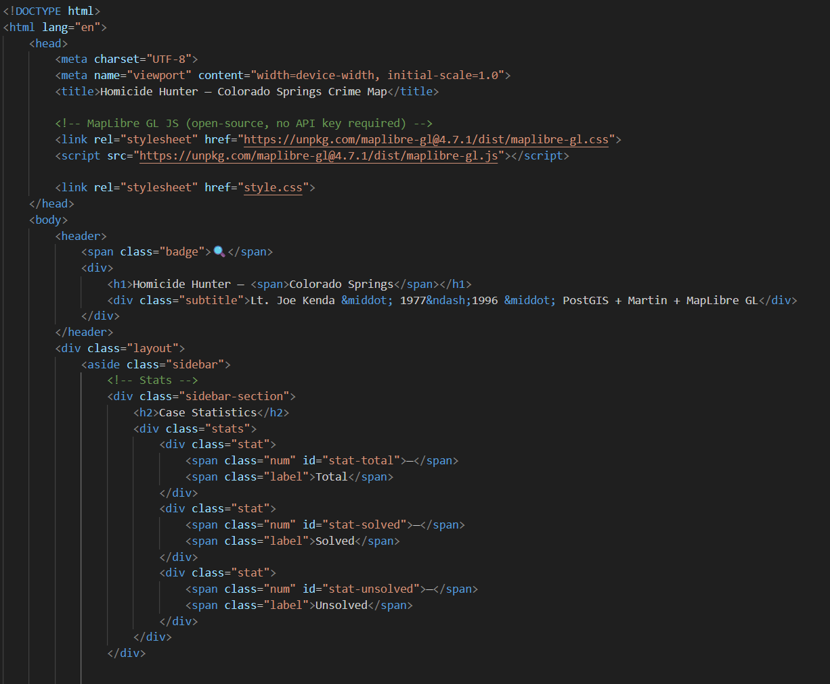
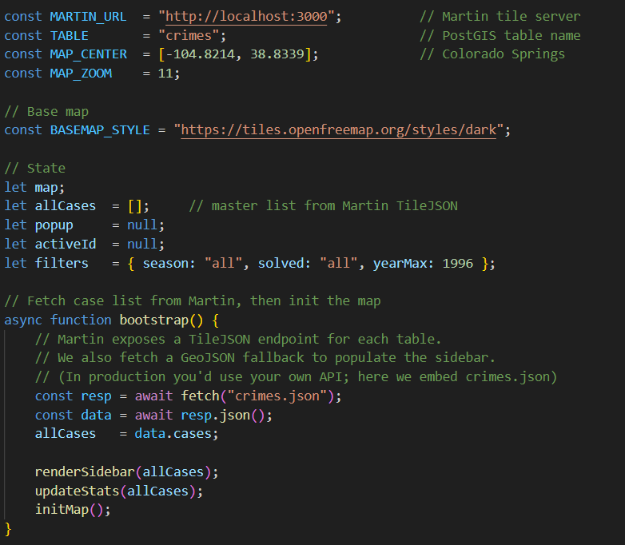
The
Code
./index.html
Vanilla JS + HTML + CSS
Vanilla JS – Integrates with any framework or browser-based application
Programmatic styling
Completely customizable
./app.js
Notes:
http://localhost:3000/crimes

Slide 12
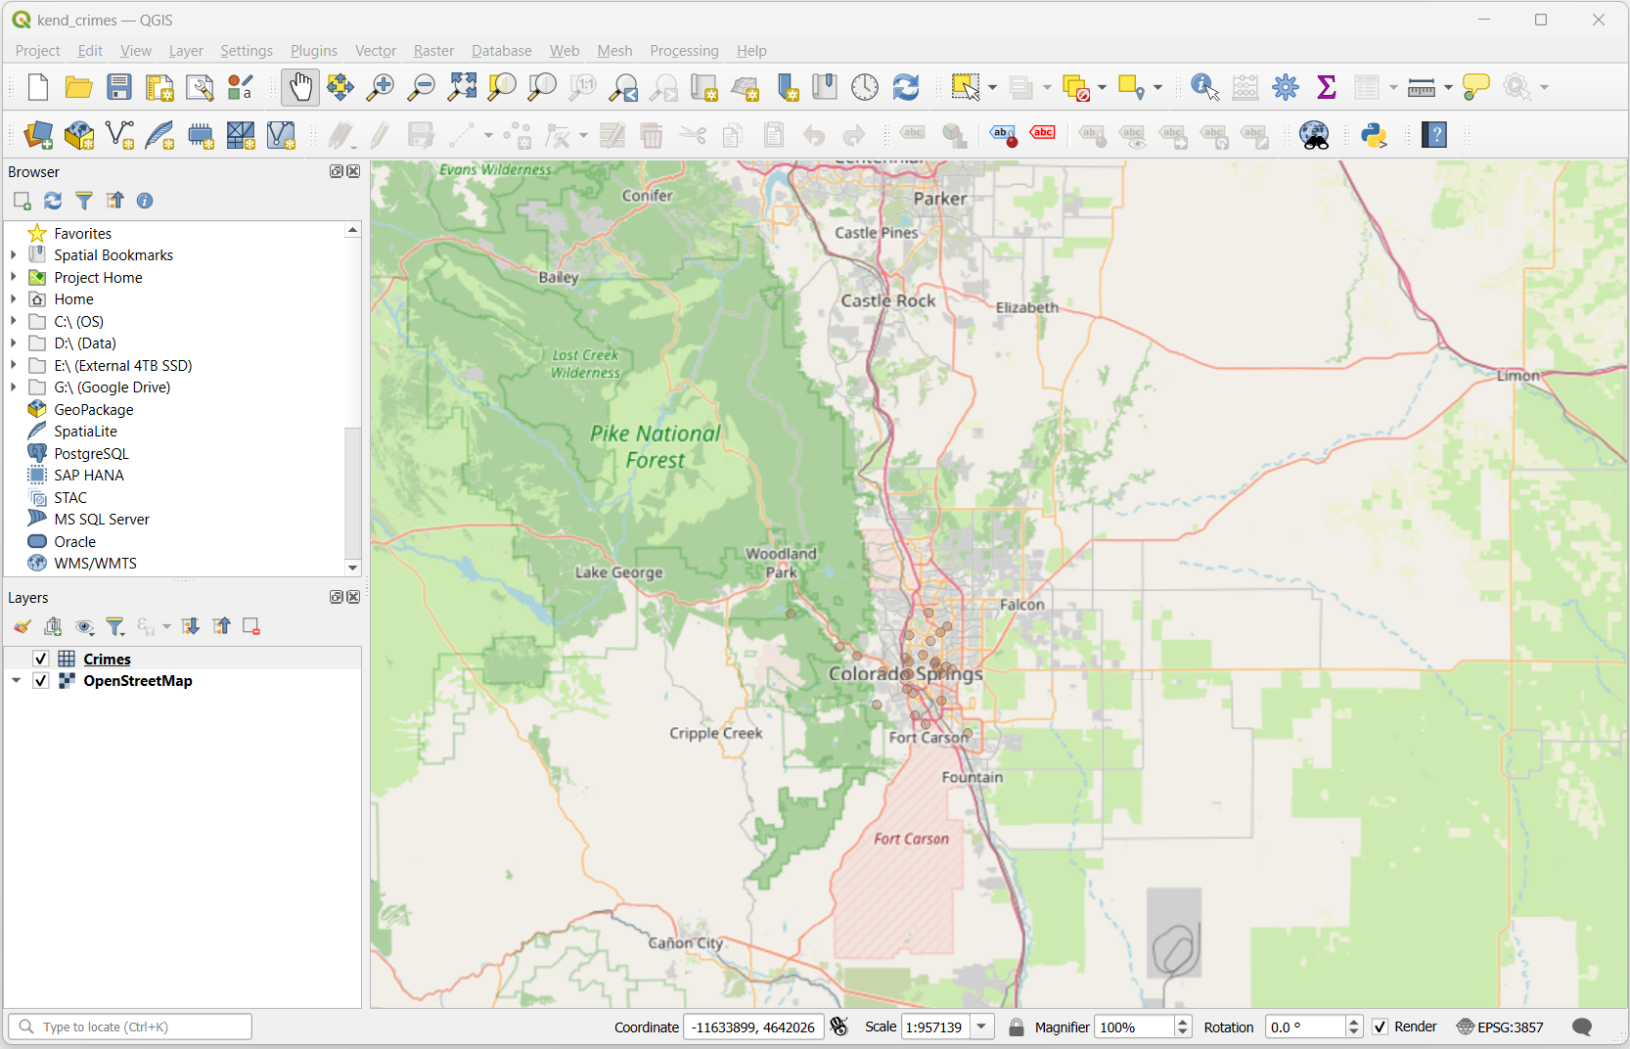
QGIS
Open-source GIS
Open-source Desktop Application
Debugging
Visually confirm geom points
Inspect features
Spot outliers
Data Quality
Run spatial queries
Cross-reference boundaries layers
Styling
Prototype symbology rules
Generate print-ready maps

Slide 13
Key
Take Aways
Going Further
PostGIS
ST_Buffer – radius around a point
ST_ClusterKMeans – cluster crimes
ST_Hexagon – hexbin aggregation
PostGIS raster support (elevation)
Spacial queries – PostGIS In Action (Manning Press)
pg_bouncer for connection pooling
Martin
Server SQL functions as tile sources
MbTiles file support (offline)
Sprint + glyph config for symbols
CDN tile caching
Qgis – Open-source Desktop special visualization (qgis.org)
MapLibre
GeoJSON sources for live data
Heatmap layers
3D terrain / extrusions
Deck.gl integration

Slide 14

Contact
Us
GitHub
https://github.com/peaketl/open-source-mapping-presentation
CONTACT
(719) 310-5240 (918) 409-CODE (2633)
www.peaketl.com
jason@peaketl.com

