Slide 1
Radar sleep monitoring system
Ha Minh Khue

Slide 2
1. Introduction
Vital sign
Heart rate
Breath rate
Health care for older people
Stroke detection
Survival detection
Diseases estimation (?)

Slide 3
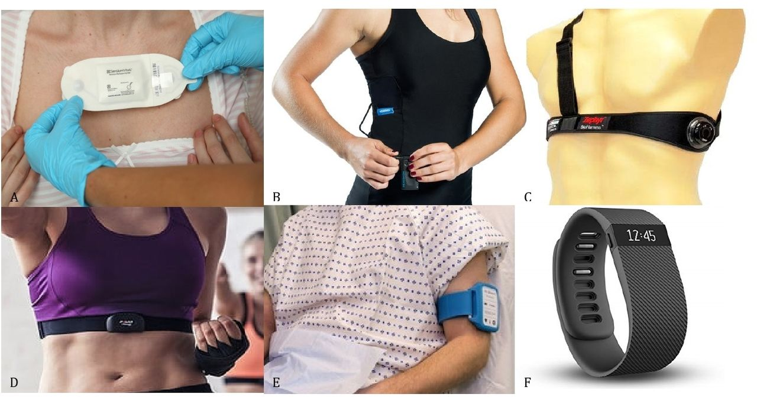
1. Introduction
Vital sign monitoring devices
Wearable devices
Medical Grade Adhesive Patch
Clothing with embedded sensors
Chest strap
Upper armband
Wristband
Wearable devices for remote vital signs monitoring in the outpatient setting: an overview of the field
http://dx.doi.org/10.1136/bmjinnov-2019-000354

Slide 4
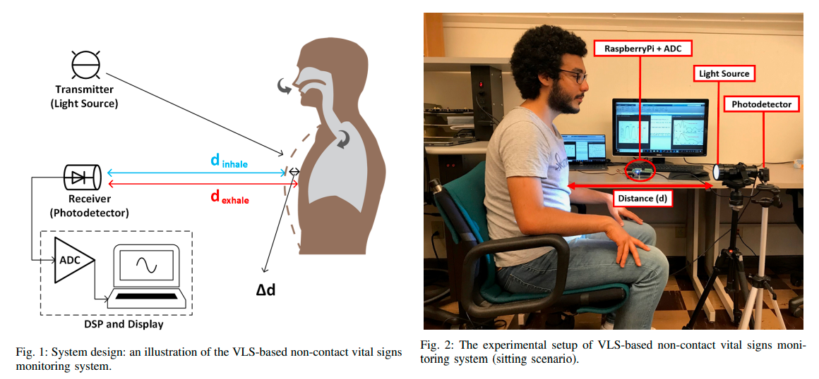
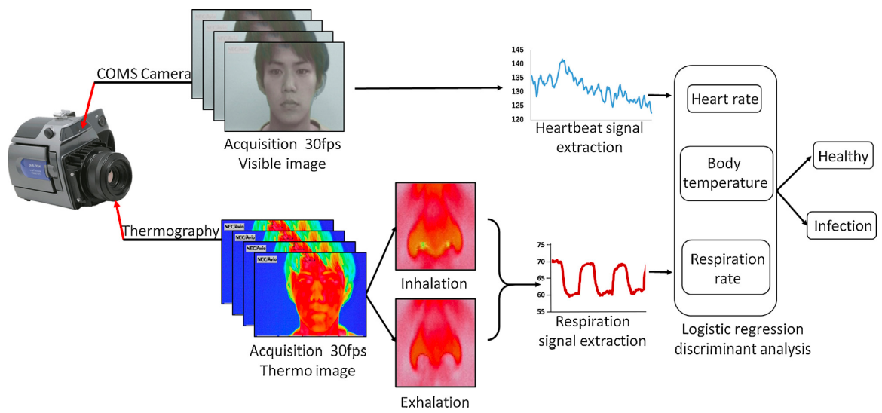
1. Introduction
Vital sign monitoring devices
Non-contact devices
Visible light sensing [1]
Camera [3]
RGB-Thermal Image Sensors [2]
Radar [5]
Non-Contact Vital Signs Monitoring Through Visible Light Sensing [1]
Contactless vital sign measurement system using a COMS camera [4]

Slide 5
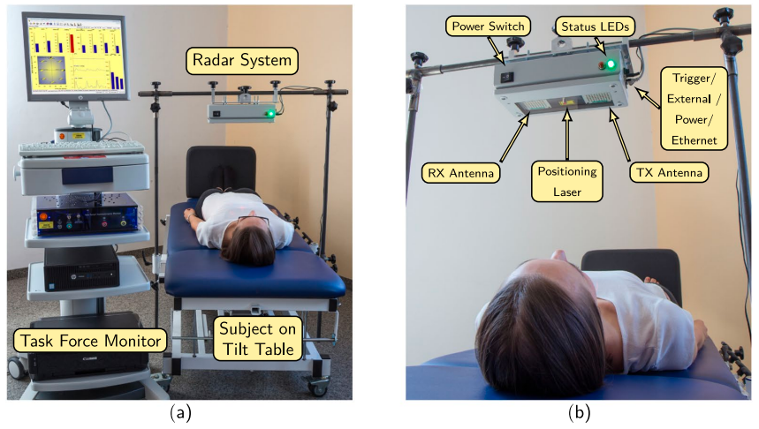
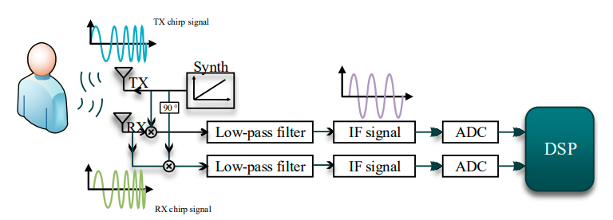
1. Introduction
Vital sign monitoring devices
Radar-based devices
Ultra Wide Band (UWB) radar [8]
FMCW radar [6, 7]
A dataset of clinically recorded radar vital signs with synchronised reference sensor signals [6]
Remote Monitoring of Human Vital Signs Based on 77-GHz mm-Wave FMCW Radar [7]

Slide 6
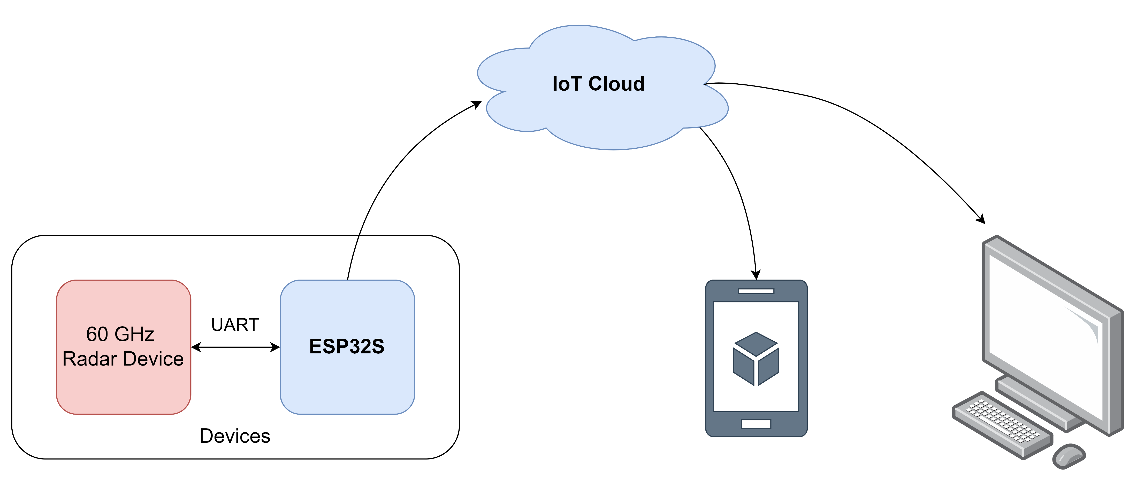
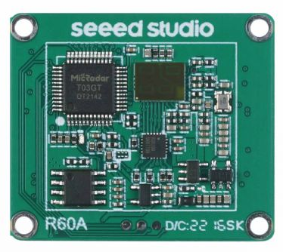
2. Approaches
IoT-based Radar health monitoring System
Use pre-built Radar module: 60GHz mmWave Sensor - Human Resting Breathing and Heartbeat Module (Seeed Studio)
Abnormal health status alert

Slide 7
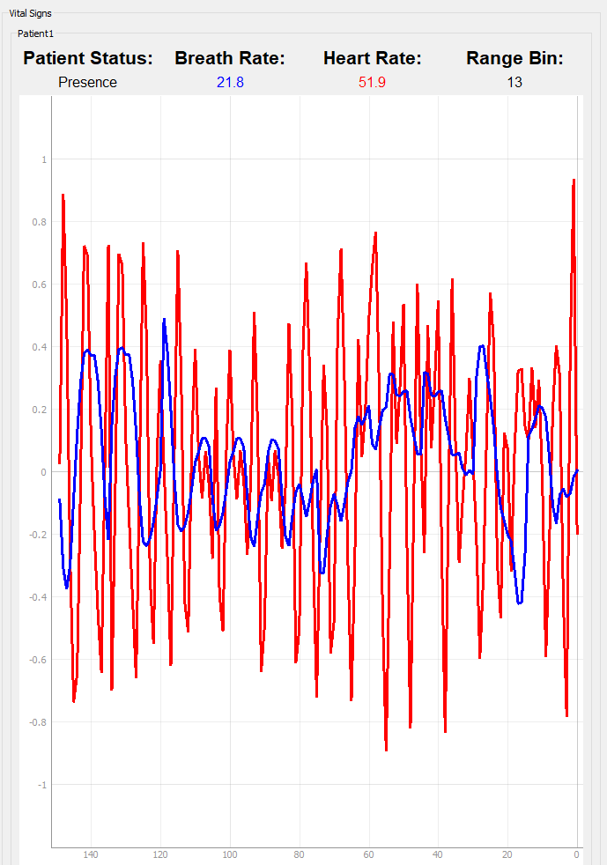
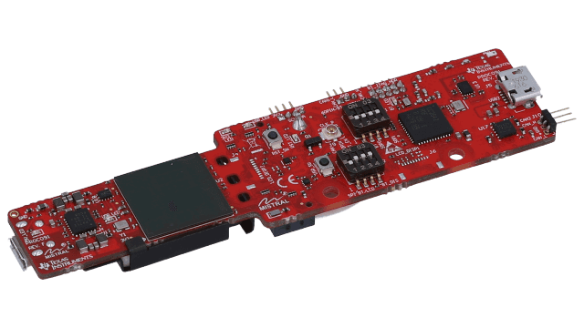
2. Approaches
Radar Vital sign estimation algorithm
Use Radar EVM: AWR6843AOP evaluation module for single-chip, 60-GHz to 64-GHz (TI)
Develop Signal processing flow for Heart rate and Breath rate estimation

Slide 8
References
[1] H. Abuella and S. Ekin, "Non-Contact Vital Signs Monitoring Through Visible Light Sensing," in IEEE Sensors Journal, vol. 20, no. 7, pp. 3859-3870, 1 April1, 2020.
[2] Negishi, T.; Abe, S.; Matsui, T.; Liu, H.; Kurosawa, M.; Kirimoto, T.; Sun, G. Contactless Vital Signs Measurement System Using RGB-Thermal Image Sensors and Its Clinical Screening Test on Patients with Seasonal Influenza. Sensors 2020, 20, 2171.
[3] Khanam, F.-T.-Z.; Perera, A.G.; Al-Naji, A.; Gibson, K.; Chahl, J. Non-Contact Automatic Vital Signs Monitoring of Infants in a Neonatal Intensive Care Unit Based on Neural Networks. J. Imaging 2021, 7, 122.
[4] Bahache, M., Lemayian, J. P., Wang, W., & Hamamreh, J. M. (2020). An Inclusive Survey of Contactless Wireless Sensing: A Technology Used for Remotely Monitoring Vital Signs Has the Potential to Combating COVID-19. RS Open Journal on Innovative Communication Technologies, 1(2).
[5] Wang, Y.; Wang, W.; Zhou, M.; Ren, A.; Tian, Z. Remote Monitoring of Human Vital Signs Based on 77-GHz mm-Wave FMCW Radar. Sensors 2020, 20, 2999.
[6] M. Alizadeh, G. Shaker, J. C. M. D. Almeida, P. P. Morita and S. Safavi-Naeini, "Remote Monitoring of Human Vital Signs Using mm-Wave FMCW Radar," in IEEE Access, vol. 7, pp. 54958-54968, 2019, doi: 10.1109/ACCESS.2019.2912956.
[7] Wang, Y.; Wang, W.; Zhou, M.; Ren, A.; Tian, Z. Remote Monitoring of Human Vital Signs Based on 77-GHz mm-Wave FMCW Radar. Sensors 2020, 20, 2999.
[8] Kim JD et al. 2019 “Non-contact respiration monitoring using impulse radio ultrawideband radar in neonates.” R. Soc. open sci. 6: 190149.

