Slide 1


Black-Box Software Testing (Part I)
Week #3 - Module #1
Speaker: Jerry Gao Ph.D.
Computer Engineering Department
San Jose State University
email: jerry.gao@sjsu.edu
URL: http://www.engr.sjsu.edu/gaojerry
Copyright © 2013, All Right Reserved by Jerry Gao, Ph.D.

Slide 2
Topic: Black Box Software Testing
Presentation Outline
- Introduction to Black Box Software Testing?
- Definition
- Why Black Box Testing?
- Testing Objectives and Focuses
- An Example
- Graph-based Testing Methods
- Equivalence Partitioning
- Boundary Value Analysis
Jerry Gao Ph.D.
All Rights Reserved

Slide 3
Topic: Black Box Software Testing
Introduction to Black Box Testing
What is black box testing?
- Black box testing also known as specification-based testing.
- Black box testing refer to test activities using specification-based testing methods and criteria to discover program errors based on program requirements and product specifications.
The major testing focuses:
- specification-based function errors
- specification-based component/system behavior errors
- specification-based performance errors
- user-oriented usage errors
- black box interface errors
interface
input
Black Box (Component
or System)
output
operation
Jerry Gao Ph.D.

Slide 4
Topic: Black Box Software Testing
Introduction to Black Box Testing
Under test units in black-box: Software components, subsystems, or systems
What do you need?
- For software components, you need component specification, user interface doc.
-For a software subsystem or system, you need requirements specification, and product specification document.
You also need:
- Specification-based software testing methods
- Specification-based software testing criteria
- good understanding of software components (or system)
Jerry Gao Ph.D.

Slide 5
Topic: Black Box Software Testing
An Example
Testing a triangle analyzer:
Program specification:
Input: 3 numbers separated by commas or spaces
Processing:
Determine if three numbers make a valid triangle; if not, print
message NOT A TRIANGLE.
If it is a triangle, classify it according to the length of the sides as scalene
(no sides equal), isosceles (two sides equal), or equilateral (all sides equal).
If it is a triangle, classify it according to the largest angle as acute (less than
90 degree), obtuse (greater than 90 degree), or right (exactly 90 degree).
Output: One line listing the three numbers provided as input and the classification
or the not a triangle message.
Example: 3,4,5 Scalene Right
6,1,6 Isosceles Acute
5,1,2 Not a triangle
Jerry Gao Ph.D.

Slide 6
Topic: Black Box Software Testing
An Example
Functional Test Cases:
Acute Obtuse Right
Scalene: 6,5,3 5,6,10 3,4,5
Isosceles: 6,1,6 7,4,4 1,2, 2^(0.5)
Equilateral: 4,4,4 Not possible Not possible
Functional Test Cases:
Input Expected Results
4,4,4 Equilateral acute
1,2,8 Not a triangle
6,5,3 Scalene acute
5,6,10 Scalene obtuse
3,4,5 Scalene right
6,1,6 Isosceles acute
7,4,4 Isosceles obtuse
1,1,2^(0.5) Isosceles right
Jerry Gao Ph.D.

Slide 7
Topic: Black Box Software Testing
An Example
Test cases for special inputs and invalid formats:
3,4,5,6 Four sides
646 Three-digit single number
3,,4,5 Two commas
3 4,5 Missing comma
3.14.6,4,5 Two decimal points
4,6 Two sides
5,5,A Character as a side
6,-4,6 Negative number as a side
-3,-3,-3 All negative numbers
Empty input
Jerry Gao Ph.D.

Slide 8
Topic: Black Box Software Testing
An Example
Boundary Test Cases:
(1) Boundary conditions for legitimate triangles
1,1,2 Makes a straight line, not a triangle
0,0,0 Makes a point, not a triangle
4,0,3 A zero side, not a triangle
1,2,3.00001 Close to a triangle but still not a triangle
9170,9168,3 Very small angle Scalene, acute
.0001,.0001,.0001 Very small triangle Equilateral, acute
83127168,74326166,96652988 Very large triangle, scalene, obtuse
Boundary conditions for sides classification:
3.0000001,3,3 Very close to equilateral, Isosceles, acute
2.999999,4,5 Very close to isosceles Scalene, acute
Boundary conditions for angles classification:
3,4,5.000000001 Near right triangle Scalene, obtuse
1,1,1.41141414141414 Near right triangle Isosceles, acute
Jerry Gao Ph.D.

Slide 9
Topic: Black Box Software Testing
Software Testing Principles
Davids [DAV95] suggests a set of testing principles:
- All tests should be traceable to customer requirements.
- Tests should be planned long before testing begins.
- The Pareto principle applies to software testing.
- 80% of all errors uncovered during testing will likely be traceable
to 20% of all program modules.
- Testing should begin “in the small” and progress toward testing “in the large”.
- Exhaustive testing is not possible.
- To be most effective, testing should be conducted by an independent third party.
Jerry Gao Ph.D.
All Rights Reserved

Slide 10
Topic: Black Box Software Testing
Software Testability
According to James Bach:
Software testability is simply how easily a computer program can be tested.
A set of program characteristics that lead to testable software:
- Operability: “the better it works, the more efficiently it can be tested.”
- Observability: “What you see is what you test.”
- Controllability: “The better we can control the software, the more the testing
can be automated and optimized.”
- Decomposability: “By controlling the scope of testing, we can more quickly
isolate problems and perform smarter retesting.”
- Simplicity: “The less there is to test, the more quickly we can test it.”
- Stability: “The fewer the changes, the fewer the disruptions to testing.”
- Understandability:”The more information we have, the smarter we will test.”
Jerry Gao Ph.D.
All Rights Reserved

Slide 11
Topic: Black Box Software Testing
Equivalence Partitioning
Equivalence partitioning is a black-box testing method
- divide the input domain of a program into classes of data
- derive test cases based on these partitions.
Test case design for equivalence partitioning is based on an evaluation of equivalence classes for an input domain.
An equivalence class represents a set of valid or invalid states for input condition.
An input condition is:
- a specific numeric value, a range of values
- a set of related values, or a Boolean condition
Jerry Gao Ph.D.
All Rights Reserved

Slide 12
Topic: Black Box Software Testing
Equivalence Partitioning
Equivalence partitioning is a black-box testing method
- divide the input domain of a program into classes of data
- derive test cases based on these partitions.
Test case design for equivalence partitioning is based on an evaluation of equivalence classes for an input domain.
An equivalence class represents a set of valid or invalid states for input condition.
An input condition is:
- a specific numeric value, a range of values
- a set of related values, or a Boolean condition
Valid inputs
system
Jerry Gao Ph.D. 7/20002
outputs
invalid inputs
All Rights Reserved
partition

Slide 13
Topic: Black Box Software Testing
Equivalence Classes
Equivalence classes can be defined using the following guidelines:
- If an input condition specifies a range, one valid and two invalid equivalence class are defined.
- If an input condition requires a specific value, one valid and two invalid equivalence classes are defined.
- If an input condition specifies a member of a set, one valid and one invalid equivalence classes are defined.
- If an input condition is Boolean, one valid and one invalid classes are defined.
Examples:
area code: input condition, Boolean - the area code may or may not be present.
input condition, range - value defined between 200 and 900
password: input condition, Boolean - a password nay or may not be present.
input condition, value - six character string.
command: input condition, set - containing commands noted before.
Jerry Gao Ph.D.
All Rights Reserved

Slide 14
Topic: Black Box Software Testing
Boundary Value Analysis
Boundary value analysis(BVA) - a test case design technique
- complements to equivalence partition
Objective:
Boundary value analysis leads to a selection of test cases that exercise bounding values.
Guidelines:
- If an input condition specifies a range bounded by values a and b,
test cases should be designed with value a and b, just above and below a and b.
Example: Integer D with input condition [-3, 10],
test values: -3, 10, 11, -2, 0
- If an input condition specifies a number values, test cases should be developed to exercise the minimum and maximum numbers. Values just above and below minimum and maximum are also tested.
Example: Enumerate data E with input condition: {3, 5, 100, 102}
test values: 3, 102, -1, 200, 5
Jerry Gao Ph.D.
All Rights Reserved

Slide 15
Topic: Black Box Software Testing
Boundary Value Analysis
- Guidelines 1 and 2 are applied to output condition.
- If internal program data structures have prescribed boundaries, be certain to design a test case to exercise the data structure at its boundary
Such as data structures:
- array input condition:
empty, single element, full element, out-of-boundary
search for element:
- element is inside array or the element is not inside array
You can think about other data structures:
- list, set, stack, queue, and tree
Jerry Gao Ph.D.
All Rights Reserved

Slide 16
Topic: Black Box Software Testing
One-Dimensional Domain Bugs in Open Boundaries
B
A
An Open Domain (A):
B
A
Closure Bug:
B
A
Boundary Shifted Right:
B
A
Boundary Shifted Left:
B
A
Missing Boundary:
B
A
Extra Boundary:
If the domain boundary is open, an off point is a point near the boundary but in the domain being tested.
Jerry Gao Ph.D.
All Rights Reserved

Slide 17
Topic: Black Box Software Testing
One-Dimensional Domain Bugs in Closed Boundaries
B
A
A Closed Domain (A):
B
A
Closure Bug:
B
A
Boundary Shifted Right:
B
A
Boundary Shifted Left:
B
A
Missing Boundary:
B
A
Extra Boundary:
If the domain boundary is closed, an off point is a point near the boundary but in the adjacent domain.
Jerry Gao Ph.D.
All Rights Reserved

Slide 18
Topic: Black Box Software Testing
Generic Domain Bugs in One-Dimensional Domains
Correct:
Incorrect:
Shifted Boundaries:
Tilted Boundaries:
Open/Close Error:
Extra Boundary:
Missing Boundary:
Jerry Gao Ph.D.
All Rights Reserved

Slide 19
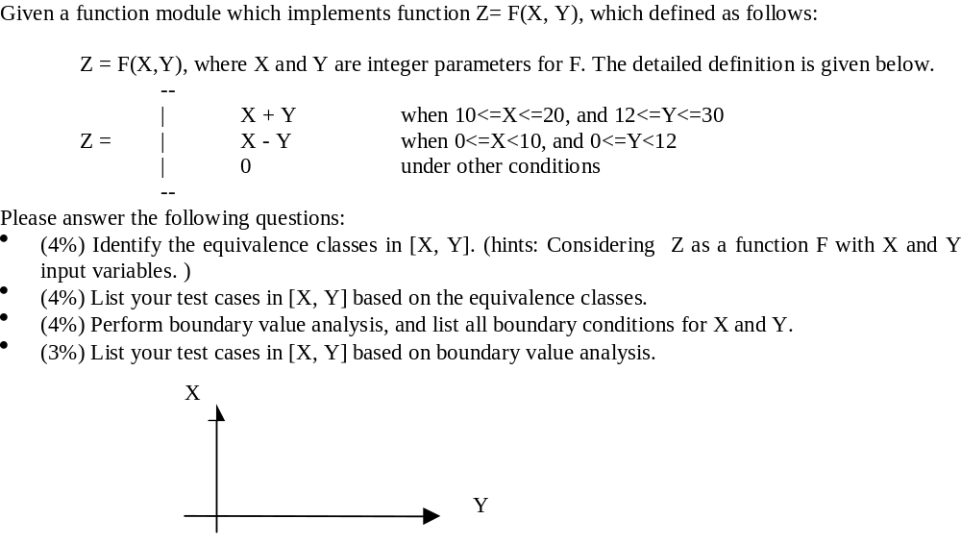
Topic: Black Box Software Testing
An Example
Jerry Gao Ph.D.
All Rights Reserved

Slide 20
Topic: Black Box Software Testing
Domain Boundary
Extreme point
Interior point
Boundary point
Off point
Two-dimension Domain Boundary
Jerry Gao Ph.D.
All Rights Reserved

Slide 21
Topic: Black Box Software Testing
Testing Two-Dimensional Domains
- Closure bug.
For example, using a wrong operator (for example, x >= k when x > k is intended or vise versa). This bug could be detected due to the testing of different boundaries or trying interior and off points.
- Shifted boundary:
For example, a boundary is shifted due to the use of an incorrect constant in a predicate, such as x+y>=17 when x + y >=7 was intended. The off point catches this bug.
- Titled boundary:
A tilted boundary occurs when coefficients in the boundary inequality are wrong. For example, 3x+7y > 17 when 7x + 3y > 17 was intended. Testing different domain points can detect the bug.
- Extra boundary:
An extra boundary is created by an extra predicate. Try different boundary points can detect this bug.
- Missing boundary:
A missing boundary is created by leaving a boundary predicate out.
Jerry Gao Ph.D.
All Rights Reserved

