Slide 1

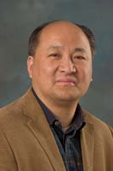
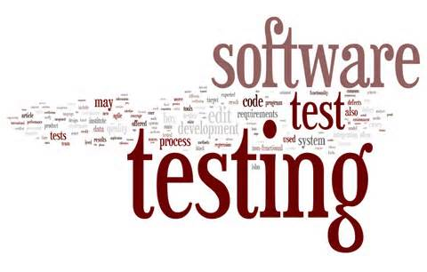
Module #1 – Introduction to Software Testing
Software Testing
Topic #1 – What is Software Testing?
Instructor: Jerry Gao, Ph.D., Professor
San Jose State University
Notes:
Software testing class includes a number of modules.
Each module may consists of several topics.
Topic #1 – What is software testing?

Slide 2
Topic #1 – What is Software Testing?
Software Testing
Validation vs. verification
Definitions about Software Testing
Software Testing Objectives and Focuses
Validation vs. Verification
Software Testing Scope
Notes:
This package discusses “What is software testing?”
For this topic, we will discuss four basic concepts:
(a) – Basic definitions of software testing
(b) - Software testing objectives and focuses
(c) - Validation VS. Verification
(d) - Software testing scope

Slide 3
Topic #1 – What is Software Testing?
Software Testing
Definitions:
“Testing is the process of establishing confidence that a program or system does what it is supposed to.” (by Hetzel 1973)
“Testing is the process of executing a program or system with the intent of finding errors.” (by Myers 1979)
“Testing is any activity aimed at evaluating an attribute or capability of a program or system and determining that it meets its required results.” (by Hetzel 1983)
Notes:
Here, we provide three definitions about software testing.
The first is given by Hetzel in 1973.
“Testing is the process of establishing confidence that a program or system does what it is supposed to.” (by Hetzel 1973)
The second one is given by Myers in 1979.
“Testing is the process of executing a program or system with the intent of finding errors.” (by Myers 1979)
The third one is given by Hetzel in 1983.
“Testing is any activity aimed at evaluating an attribute or capability of a program or system and determining that it meets its required results.” (by Hetzel 1983)

Slide 4
Topic #1 – What is Software Testing?
Software Testing
IEEE Definitions:
“Software testing is the process of analyzing a software item to detect the differences between existing and required conditions (that is, bugs) and to evaluate the features of the software item”.
“Reliability is the ability of a system or component to perform its required functions under stated conditions for a specified period of time.”

Slide 5
Topic #1 – What is Software Testing?
Software Testing
Verification: Are we building the product right?
Verification: the process of evaluating a system or component to determine whether the products of a given development phase satisfy the conditions imposed at the start of that phase
Validation: Are we building the right product?
Validation: process of evaluating a system or component during or at the end of the development process to determine whether it satisfies specified requirements

Slide 6
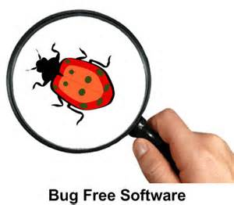



Topic #1 – What is Software Testing?
Software Testing
Major Objectives:
1
Requirement Confirmation
2
Bug Detection
Requirements
3
Product Quality Assurance
Software Product
Bug Reports
Software Product
Notes:
Now, let’s discuss major objectives of software testing.
There are three major objectives:
(1) Requirement Confirmation - Confirm the given software product requirements by testing based on the requirements
(2) Bug Detection – Detect as many bugs as possible through software testing
(3) Product Assurance quality – Assure the quality of a software product by testing

Slide 7


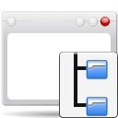


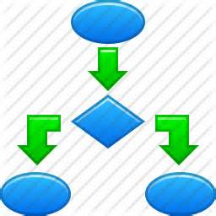

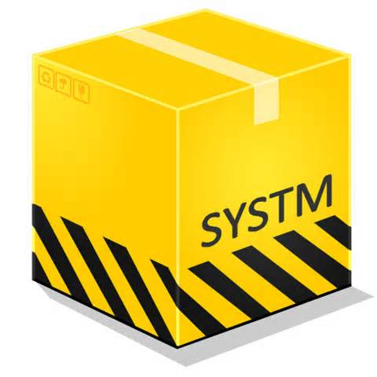
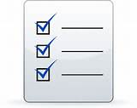
Topic #1 – What is Software Testing?
Software Testing
Primary Software Testing Focuses:
Check Program
Functions
Check Program
Behaviors
Reliability
Check Program
Logics/structures
Availability
Performance
Check System
Notes:
Primary software testing focuses:
(1) check program functions – Known as software function testing, in which engineers focus on each system function during their testing.
(2) check program behaviors – Known as software dynamic testing focusing on program dynamic behaviors.
(3) check program logics and structures – Known as white-box testing, where engineers
validate software by checking the correctness of program structures and logics
(4) check software system – known as system testing, in which engineers perform various system tests, including security, performance, reliability, availability, scalability, installation, and so on.

Slide 8
Topic #1 – What is Software Testing?
Software Testing
Software Testing Scope:
Software Testing
Management
Software Testing
Methods
Software Testing
Strategies
Configuration
Management
Software Testing
Processes
Software Test
Models
Software Problem
Management
Software Testing
Tools
Software Test
Criteria
Notes:
Software testing scope includes the following parts:
- Software testing processes – These testing processes can be used to control and manage various testing activities, deliverables and schedules.
Software testing methods – These refers to detailed techniques and methods useful to design diverse test cases and test data to achieve pre-selected test coverage criteria and software product quality goals.
Software testing tools – They are useful to automate software test operations and activities to speed up a test process.
Software testing strategies – These refer to well-defined test strategies to provide rational decisions in software test processes and test automation to achieve cost reduction and test operation efficiency.
Software test models – These models are defined and developed as a foundation to support test automation solutions and test coverage criteria establishment.
Software test criteria – These test criteria refer to software test coverage evaluation metrics and standards.
Software testing management – This refers to use a systematic approach and solution to manage
software test information.
Software configuration management – This refers to use a systematic approach and solution (or tool) to manage software product and test-ware.
Software problem management – This refers to the management solution and system to support software problem management in a systematic way.

