Slide 1


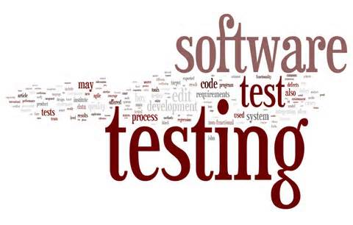
Module #1 – Introduction to Software Testing
Software Testing
Topic #3 – Software Test Process
Instructor: Jerry Gao, Ph.D., Professor
San Jose State University

Slide 2
Topic #3 – Software Testing Process
Software Testing
A Common Software Test Process
Who Does Software Testing?
Different Types of Software Testing
Notes:
This package focuses on Topic #3 – Software Testing Process.
In this package, we address three parts:
- A Common Software Test Process
Who Does Software Testing?

Slide 3
Topic #3 – Software Testing Process
Software Testing
A Common Software Test Process:
1
Test Planning
Test Plan
2
Test Design
Test
Design Doc.
3
Test Execution
Bug
Report
4
Test Evaluation
Test
Evaluation
Notes:
Notes:
A common software test process includes the following steps and activities:
Test planning: - In this stage, test engineers plan software testing activities and schedule, and write a test plan as its result document
Test design:
In this stage, engineers design software test cases and test data based on given software requirements specification document, and document them as a test design document.
Test execution:
In this stage, engineers execute test cases, document testing results, and report detected problems and write bug reports.
Test evaluation: - In this stage, engineers review and evaluate testing results and analyze software test coverage based on pre-selected criteria.

Slide 4



Topic #3 – Software Testing Process
Software Testing
Who Does Software Testing?
Quality
Assurance
Engineer
Test
Manager
Test
Engineer
Developer
Notes:
Notes:
Development Engineers - only perform unit tests and integration tests
Test manager’s responsibility includes: - manage and control a software test project
Software test engineer’s primary job includes: - define and specify a test plan
define test cases, write test specifications, run tests
document software problems and bugs
Quality assurance engineers’ job includes: - define software testing standards and quality control process
- perform system testing (sometime)

Slide 5
Topic #3 – Software Testing Process
Software Testing
A Software Product Test Life Cycle:
1
Unit Testing
Unit Test Report
2
Integration Testing
Integration Test
Report
3
Validation Testing
Validation Test
Report
4
System Testing
System Test
Report
Notes:
Notes:
A software product test life cycle:
Unit testing: - In unit testing, developers validate each software component at the unit level using both black-box and white-box approaches. The related test results are documented.
Integration testing:
In integration testing, engineers integrate validated software components together to form a complete system, and related bugs and results are reported in a document.
Validation testing:
In validation testing, engineers focuses on system functions and make sure that each of them is correctly performed, and document the results as a validation report.
System testing: - In system testing, engineers validate system non-function requirements to assure its system quality, and generate a system test report (or document).

Slide 6



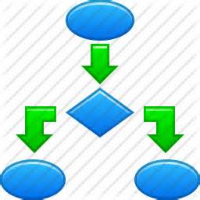
Topic #3 – Software Testing Process
Software Testing
Unit Testing
Software Component
Program
Logics &
Structures
Black-Box Testing
White-Box Testing
Primary Testing Focuses:
Component logics and structures
Component black-box interfaces
Component external functions
Component external behaviors
Notes:
Notes:
Unit testing:
- It only focuses on component validation at the unit level.
The major focuses on component unit validation includes:
- Component logics and structures
- Component black-box interfaces
- Component external functions
- Component external behaviors
There are two general approaches in component unit testing.
They are: black-box testing and white-box testing.
In black-box testing, engineers design test cases and data based on the given requirements
to detect software quality issues in external functions, behaviors, and interfaces.
In white-box testing, engineers design test cases and data based on software programs
to detect program-oriented quality issues in software program logics and structures.
This also known as structure-based testing or glass-based testing.

Slide 7



Topic #3 – Software Testing Process
Software Testing
Integration Testing
System
Component B
Component A
Primary Testing Focuses:
Interactions/APIs between components
Communications between components
System architecture
Integrated functions
Integrated system structure
Component C
Component integration
Notes:
Notes:
Integration testing
– integrate quality software components/modules together to form a complete system.
Its intention is to make that different system components work together properly.
The major focuses of system integration includes:
- Interactions between components
- Communications between components
- System architecture
- Integrated functions
- Integrated system structures

Slide 8






Topic #3 – Software Testing Process
Software Testing
System Function Validation
Software System
System
Function Testing
System
Behavior Testing
System GUI
Testing
System API
Testing
Primary Focuses:
System User Interfaces
System Functions
System Behaviors
System APIs
Notes:
Notes:
System Validation:
- System validation is only performed after system integration.
- The system validation activities check each system function, feature, and behavior.
The major focuses include the following items:
- System external visible functions
- System external functional behaviors
- System graphic user interfaces
- System function/service APIs

Slide 9






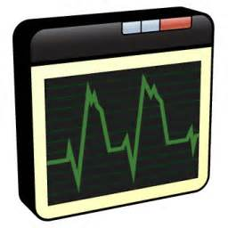

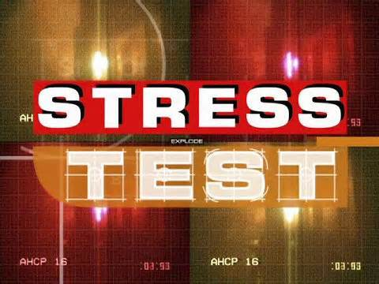
Topic #3 – Software Testing Process
Software Testing
System Testing
Installation
Testing
Security Testing
System Testing
Performance
Testing
Load Testing
Notes:
Notes:
System testing is performed after system function testing.
Installation testing – This validates system installation package and functions to make sure the under-test system/product can be correctly and successfully installed.
Performance testing - The major focuses on system non-function requirements to assure that
the under-test system performance meet the expected system speed, reliability, availability, and scalability.
Security testing – This refers to validation activities for system security functions,
behaviors and features to ensure system security.
Stress testing and load testing – This refers to validation activities for system performance
and behaviors under diverse system loads and stress.

