Slide 1



Module #2 – Software Testing Fundamentals
Software Testing
Topic #3 – Software Test Management
Instructor: Jerry Gao, Ph.D., Professor
San Jose State University
Notes:
In this section, we start to discuss topic 3 in Module #2 on Software Testing Fundamentals.

Slide 2
Topic #3 – Software Test Management
Software Testing
Software Test Management Process
Software Test Reporting and Analysis
Software Test Review
Software Test Management
Notes:
Welcome to software testing class. This is the third module of your testing class.
In this section, we focus on the first topic on Software Test Management in this module.
Here, we address four sub-topics:
Software Test Management Process
Software Test Review
Software Test Reporting and Analysis
Software Test Management

Slide 3

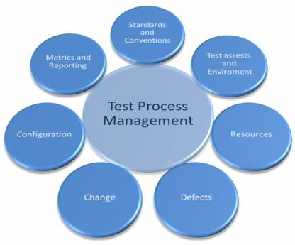


Topic #3 – Software Test Management
Software Testing
metrics
engineers
test set
hardware
test harness
software
Change notes
problems
Notes:
A common software test management process includes the following aspects:
(a) Software Testing/QA Standards and Conventions:
Engineers must be provided with well-defined software testing/QA standards for
naming, templates, and formats. For software test artifacts, documentation,
coding and test reporting.
The software test management process must keep a test repository, which contains
standard templates for all test artifacts including test plans, test cases, test execution logs, defect/issue logs, test reports and traceability matrices.
Moreover, the process also has well-defined guidelines for creating and using the test artifacts.
(b) A Software Test Repository for Test Assets and Test Environment:
Managing a software test process requires a software test repository and a testing environment (involves hardware, software and network), test cases/scripts and test data, including their configurations and security.
(c) Software Testing Resource Management:
The best practices revolve around optimizing the usage of the testing resource pool. It involves activities such as planning induction/training for the resources, sharing of resources across projects, developing detailed ramp up and ramp down plans and defining team structure and reporting mechanisms.
(d) Software Defect:
The defect management activities do not stop with detection and correction of defects, rather it encompasses root cause analysis and preventive measures to stop the defects from occurring in the first place. We follow a well-defined defect reporting and resolution process, an example of which is shown below.
(e) Change Management:
Change management is meant to prevent uncontrolled changes to the scope of work, and thus to the effort and schedule estimates. Engineers need to follow a defined change management process, of which the defect management process is a part. Defect review meetings are a key part of the process wherein defects and change requests are reviewed, segregated, prioritized and analyzed for impact on efforts and schedules. It is common for engineers to collaborative web-based tools for defect review and change management.
(d) Configuration Management:
Configuration management is important to track and control the test environment, builds, test cases/scripts and test data. The common practice is to use in a configuration management tool, such as Rational ClearCase, Tortoise SubVersion, CVS, SharePoint Server and VSS.
(e) Metrics and Reporting:
In a test management process, it is a good idea to define a framework which includes a comprehensive set of metrics that measures and can monitor both project-level and process-level metrics.
Project-level metrics such as defect statistics, test execution statistics and test coverage statistics provide inputs to assess the status of the ongoing project and of the quality of the product.
They help to make tactical decisions.
Process-level metrics are accumulated over several projects over longer periods of time. Examples include schedule variance, effort variance, test effectiveness, defects by causes, defects by phases and so on. These metrics provide insight into the effectiveness of the existing processes, and helps in making adjustments to the processes.
On the reporting side, this framework provides customizable dashboards that can report the project and process metrics as tables and/or graphs. The dashboards are web-based and can be easily shared with the customers.

Slide 4
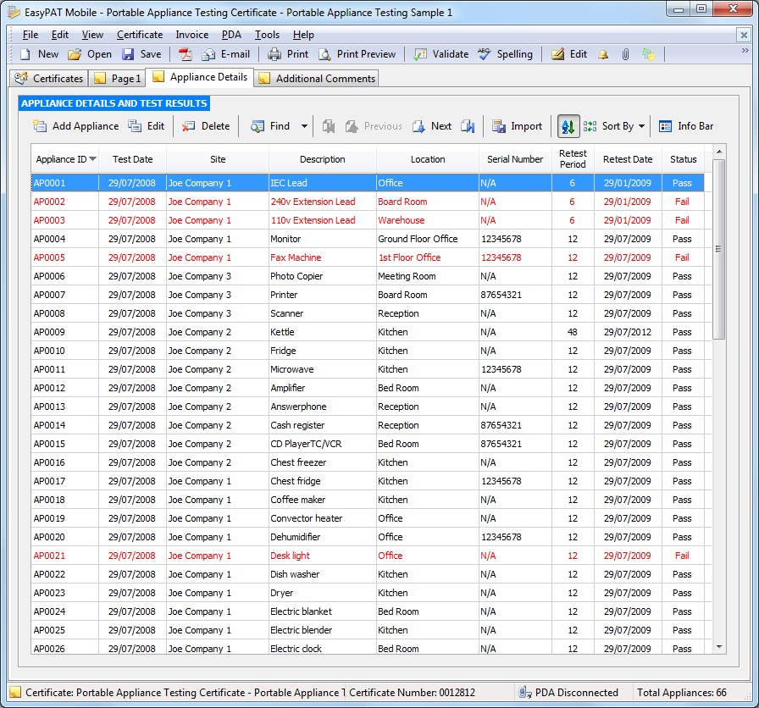
Topic #3 – Software Test Management
Software Testing
Software Test Record Sample
Notes:
A common software test management process includes the following aspects:
(a) Software Testing/QA Standards and Conventions:
Engineers must be provided with well-defined software testing/QA standards for
naming, templates, and formats. For software test artifacts, documentation,
coding and test reporting.
The software test management process must keep a test repository, which contains
standard templates for all test artifacts including test plans, test cases, test execution logs, defect/issue logs, test reports and traceability matrices.
Moreover, the process also has well-defined guidelines for creating and using the test artifacts.
(b) A Software Test Repository for Test Assets and Test Environment:
Managing a software test process requires a software test repository and a testing environment (involves hardware, software and network), test cases/scripts and test data, including their configurations and security.
(c) Software Testing Resource Management:
The best practices revolve around optimizing the usage of the testing resource pool. It involves activities such as planning induction/training for the resources, sharing of resources across projects, developing detailed ramp up and ramp down plans and defining team structure and reporting mechanisms.
(d) Software Defect/Problem Management:
The defect management activities do not stop with detection and correction of defects, rather it encompasses root cause analysis and preventive measures to stop the defects from occurring in the first place. We follow a well-defined defect reporting and resolution process, an example of which is shown below.
(e) Change Management:
Change management is meant to prevent uncontrolled changes to the scope of work, and thus to the effort and schedule estimates. Engineers need to follow a defined change management process, of which the defect management process is a part. Defect review meetings are a key part of the process wherein defects and change requests are reviewed, segregated, prioritized and analyzed for impact on efforts and schedules. It is common for engineers to collaborative web-based tools for defect review and change management.
(d) Configuration Management:
Configuration management is important to track and control the test environment, builds, test cases/scripts and test data. The common practice is to use in a configuration management tool, such as Rational ClearCase, Tortoise SubVersion, CVS, SharePoint Server and VSS.
(e) Metrics and Reporting:
In a test management process, it is a good idea to define a framework which includes a comprehensive set of metrics that measures and can monitor both project-level and process-level metrics.
Project-level metrics such as defect statistics, test execution statistics and test coverage statistics provide inputs to assess the status of the ongoing project and of the quality of the product.
They help to make tactical decisions.
Process-level metrics are accumulated over several projects over longer periods of time. Examples include schedule variance, effort variance, test effectiveness, defects by causes, defects by phases and so on. These metrics provide insight into the effectiveness of the existing processes, and helps in making adjustments to the processes.
On the reporting side, this framework provides customizable dashboards that can report the project and process metrics as tables and/or graphs. The dashboards are web-based and can be easily shared with the customers.

Slide 5
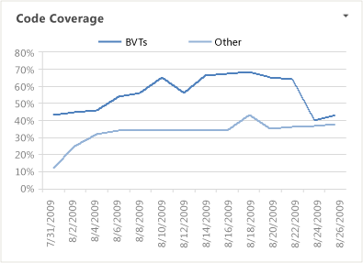
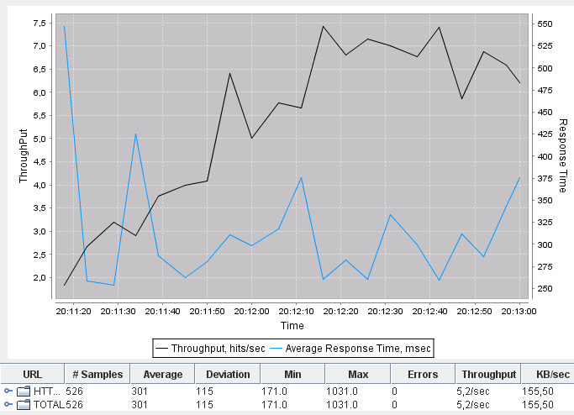
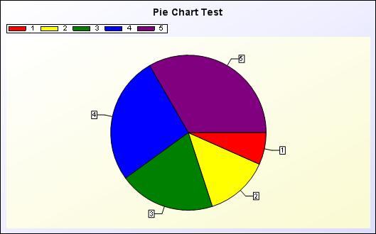
Topic #3 – Software Test Management
Software Testing
Software Test Analysis Report
Notes:
A common software test management process includes the following aspects:
(a) Software Testing/QA Standards and Conventions:
Engineers must be provided with well-defined software testing/QA standards for
naming, templates, and formats. For software test artifacts, documentation,
coding and test reporting.
The software test management process must keep a test repository, which contains
standard templates for all test artifacts including test plans, test cases, test execution logs, defect/issue logs, test reports and traceability matrices.
Moreover, the process also has well-defined guidelines for creating and using the test artifacts.
(b) A Software Test Repository for Test Assets and Test Environment:
Managing a software test process requires a software test repository and a testing environment (involves hardware, software and network), test cases/scripts and test data, including their configurations and security.
(c) Software Testing Resource Management:
The best practices revolve around optimizing the usage of the testing resource pool. It involves activities such as planning induction/training for the resources, sharing of resources across projects, developing detailed ramp up and ramp down plans and defining team structure and reporting mechanisms.
(d) Software Defect/Problem Management:
The defect management activities do not stop with detection and correction of defects, rather it encompasses root cause analysis and preventive measures to stop the defects from occurring in the first place. We follow a well-defined defect reporting and resolution process, an example of which is shown below.
(e) Change Management:
Change management is meant to prevent uncontrolled changes to the scope of work, and thus to the effort and schedule estimates. Engineers need to follow a defined change management process, of which the defect management process is a part. Defect review meetings are a key part of the process wherein defects and change requests are reviewed, segregated, prioritized and analyzed for impact on efforts and schedules. It is common for engineers to collaborative web-based tools for defect review and change management.
(d) Configuration Management:
Configuration management is important to track and control the test environment, builds, test cases/scripts and test data. The common practice is to use in a configuration management tool, such as Rational ClearCase, Tortoise SubVersion, CVS, SharePoint Server and VSS.
(e) Metrics and Reporting:
In a test management process, it is a good idea to define a framework which includes a comprehensive set of metrics that measures and can monitor both project-level and process-level metrics.
Project-level metrics such as defect statistics, test execution statistics and test coverage statistics provide inputs to assess the status of the ongoing project and of the quality of the product.
They help to make tactical decisions.
Process-level metrics are accumulated over several projects over longer periods of time. Examples include schedule variance, effort variance, test effectiveness, defects by causes, defects by phases and so on. These metrics provide insight into the effectiveness of the existing processes, and helps in making adjustments to the processes.
On the reporting side, this framework provides customizable dashboards that can report the project and process metrics as tables and/or graphs. The dashboards are web-based and can be easily shared with the customers.

Slide 6
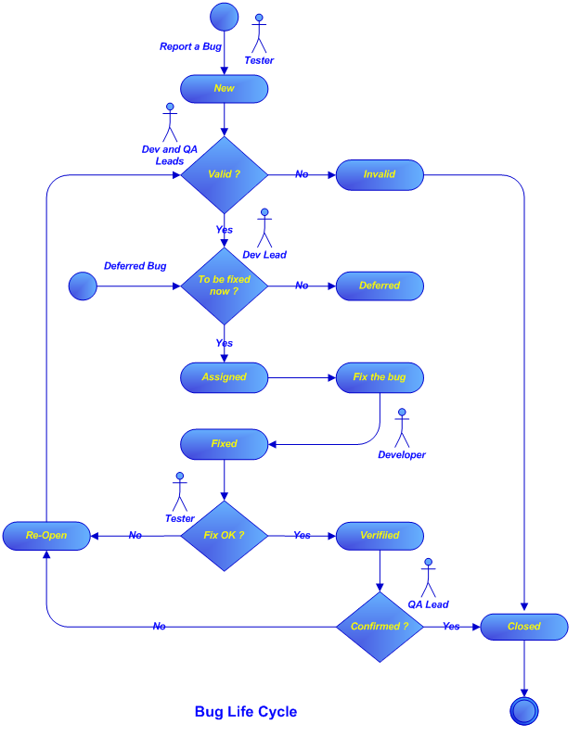
Topic #3 – Software Test Management
Software Testing
Software Bug Management Flow
Notes:
A common software test management process includes the following aspects:
(a) Software Testing/QA Standards and Conventions:
Engineers must be provided with well-defined software testing/QA standards for
naming, templates, and formats. For software test artifacts, documentation,
coding and test reporting.
The software test management process must keep a test repository, which contains
standard templates for all test artifacts including test plans, test cases, test execution logs, defect/issue logs, test reports and traceability matrices.
Moreover, the process also has well-defined guidelines for creating and using the test artifacts.
(b) A Software Test Repository for Test Assets and Test Environment:
Managing a software test process requires a software test repository and a testing environment (involves hardware, software and network), test cases/scripts and test data, including their configurations and security.
(c) Software Testing Resource Management:
The best practices revolve around optimizing the usage of the testing resource pool. It involves activities such as planning induction/training for the resources, sharing of resources across projects, developing detailed ramp up and ramp down plans and defining team structure and reporting mechanisms.
(d) Software Defect/Problem Management:
The defect management activities do not stop with detection and correction of defects, rather it encompasses root cause analysis and preventive measures to stop the defects from occurring in the first place. We follow a well-defined defect reporting and resolution process, an example of which is shown below.
(e) Change Management:
Change management is meant to prevent uncontrolled changes to the scope of work, and thus to the effort and schedule estimates. Engineers need to follow a defined change management process, of which the defect management process is a part. Defect review meetings are a key part of the process wherein defects and change requests are reviewed, segregated, prioritized and analyzed for impact on efforts and schedules. It is common for engineers to collaborative web-based tools for defect review and change management.
(d) Configuration Management:
Configuration management is important to track and control the test environment, builds, test cases/scripts and test data. The common practice is to use in a configuration management tool, such as Rational ClearCase, Tortoise SubVersion, CVS, SharePoint Server and VSS.
(e) Metrics and Reporting:
In a test management process, it is a good idea to define a framework which includes a comprehensive set of metrics that measures and can monitor both project-level and process-level metrics.
Project-level metrics such as defect statistics, test execution statistics and test coverage statistics provide inputs to assess the status of the ongoing project and of the quality of the product.
They help to make tactical decisions.
Process-level metrics are accumulated over several projects over longer periods of time. Examples include schedule variance, effort variance, test effectiveness, defects by causes, defects by phases and so on. These metrics provide insight into the effectiveness of the existing processes, and helps in making adjustments to the processes.
On the reporting side, this framework provides customizable dashboards that can report the project and process metrics as tables and/or graphs. The dashboards are web-based and can be easily shared with the customers.

Slide 7
Topic #3 – Software Test Management
Software Testing
Software Test Review
- A test review is a typical verification activity in a test process to assure the quality of generated test cases for a software product. - Participants in a review take full responsibility for results.
There are two types of test reviews: - Formal reviews: - use a well-defined review method (or technique)
- inspection review and walk-through
- generate formal review results - Informal reviews - use a desk-check approach - generate informal review results
Notes:
What is a review? - A review is a verification activity to assure a correct method has been used to create a software product. - Participants in a review take full responsibility for results. There are two types of reviews: - Formal reviews: - use a well-defined review method (or technique) - generate formal review results - Informal reviews - use a desk checking approach - conduct an informal review - generate information review results

Slide 8
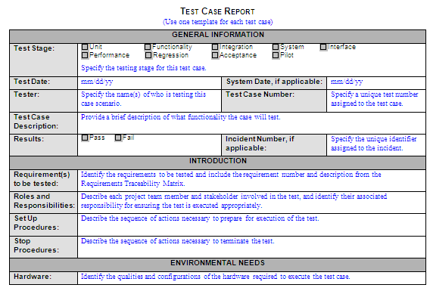
Topic #3 – Software Test Management
Software Testing
Software Test Case Sample
Notes:
Products should be reviewed during software testing: Test Plan Test Design Specification Test Procedure Specification Test Report Problem Reports What do reviews accomplish? - Reviews provide the primary mechanism for reliably evaluating progress. - Reviews train and educate the participants and have a significant positive effect on staff competence. - Reviews give early feedback and prevent more serious problems from arising. - Reviews bring individual capability to light.

Slide 9
Topic #3 – Software Test Management
Software Testing
Software Test Review
The following deliverables must be reviewed in a software test process: Test Plan Test Design Specification Test Report Problem/bug Reports
What does test reviews accomplish? - Test reviews provide the primary mechanism for evaluating generated test cases. - Test reviews train and educate the participants to receive a positive effect. - Reviews give early feedback and prevent more serious problems from arising. - Reviews bring individual capability to light.
Notes:
Products should be reviewed during software testing: Test Plan Test Design Specification Test Procedure Specification Test Report Problem Reports What do reviews accomplish? - Reviews provide the primary mechanism for reliably evaluating progress. - Reviews train and educate the participants and have a significant positive effect on staff competence. - Reviews give early feedback and prevent more serious problems from arising. - Reviews bring individual capability to light.

Slide 10


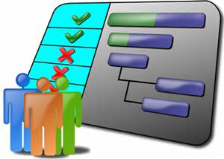

Topic #3 – Software Test Management
Software Testing
Software Test Management
test team management
test process management
test project management
- Play as a leadership role in: - planning projects - setting up a direction -motivating people - build a team - manage engineers - Play as a controller in: - product evaluation - performance evaluation - changing to a new direction - Play as a supporter in: - assist and train engineers - train engineers - enforce and control test methods, standards, and criteria - select and develop test tools
test manager
Notes:
Test management encompass: - management of a test team - management of a test process - management of test projects A test manager’s role: - Play as a leadership role in: - planning projects - setting up a direction -motivating people - build a team - manage engineers - Play as a controller in: - product evaluation - performance evaluation - changing to a new direction - Play as a supporter in: - assist and train engineers - train engineers - enforce and control test methods, standards, and criteria - select and develop test tools

Slide 11
Topic #3 – Software Test Management
Software Testing
Software Test Management - I
- Management - Manage test projects - Manage team members - Manage test processes - Motivation - Motivate quality work from team members - Simulate for new ideas and creative solutions - Methodology - Control of setting up test methodology, process, standards. - Control of establishing test criteria - Mechanization - Control the selection and development of test tools - Mechanism for the configuration management of test suites - Control of setting up an integrated test environment - Measurement - Measure test cost, complexity and efforts - Measure engineer performance - Measure test effectiveness - Measure product quality
Notes:
- Management - Manage test projects - Manage team members - Manage test processes - Motivation - Motivate quality work from team members - Simulate for new ideas and creative solutions - Methodology - Control of setting up test methodology, process, standards. - Control of establishing test criteria - Mechanization - Control the selection and development of test tools - Mechanism for the configuration management of test suites - Control of setting up an integrated test environment - Measurement - Measure test cost, complexity and efforts - Measure engineer performance - Measure test effectiveness - Measure product quality

Slide 12
Topic #3 – Software Test Management
Software Testing
Software Test Management - II
Management: Do you plans address testing? Do you know who is responsible? Have you published your testing policy? Motivation: Do you provide incentive for people do quality work? Do you encourage people to take advantage of training opportunities in testing methods? Methodology: Are your engineers trained to use test methods? Are you aware of new testing techniques and use them?
Mechanization: Do you sufficient hardware and equipment to support testing? Have you provided appropriate software testing tools and aids? Do you evaluate automated testing aids on an ongoing basis? Measurement: Do you track errors, faults, and failures? Do you know what testing costs? Do you quantitatively measure testing performance?
Notes:
Management: Do you plans address testing? Do you know who is responsible? Have you published your testing policy? Motivation: Do you provide incentive for people do quality work? Do you encourage people to take advantage of training
opportunities in testing methods? Methodology: Are your engineers trained to use test methods? Are you aware of new testing techniques and use them?
Mechanization: Do you sufficient hardware and equipment to support testing? Have you provided appropriate software testing tools and aids? Do you evaluate automated testing aids on an ongoing basis? Measurement: Do you track errors, faults, and failures? Do you know what testing costs? Do you quantitatively measure testing performance?

