Slide 1



Module #3 – Software White-Box Testing Methods
Software Testing
Topic #1 – Software White-Box Testing
Instructor: Jerry Gao, Ph.D., Professor
San Jose State University
Notes:
From this session, we start to Module #2 on Software White-Box Testing Methods.
This is the first pack in Module #2, we focus on Topic #1 – Introduction to Software White-Box Testing.
In this package, we discuss some basic concepts on white-box testing.

Slide 2
Topic #1 – Software WHITE-BOX Testing
Software Testing
What Is White-Box Testing?
White-Box Testing Focuses
Why Is White-Box Testing Important?
Who Does White-Box Testing?
White-Box Testing Coverage
Notes:
This is the first package in Module 3 for Software Testing Class. It provides an introduction to software white-box testing. It covers the following
What is white-box testing?
Why Is white-box testing important?
Who does white-box testing?
White-box testing focuses
White-box testing coverage

Slide 3



Topic #1 – Software White-BOX testing
Software Testing
What is software white-box testing?
White-box testing, also known as glass-box testing or program-based testing.
Definition: Software white-box testing refers to test design based on program source code structures, data, and internal program logics.
What do you need for white-box testing?
A white-box testing model and test criteria
A white-box test design and generation method
Program source codes

Slide 4



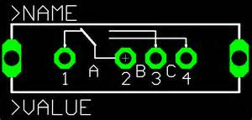
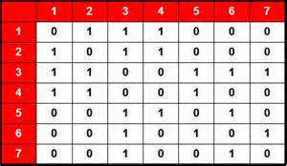
Topic #1 – Software WHITE-BOX Testing
Software Testing
White-Box Testing Focuses
Program paths
Program branches
Software
Program data
Program logics
Notes:
White-box software testing focuses on the following areas:
– Program control/execution paths → to make sure that executable program control flows
can be correctly executed.
Program data → to make sure that program data parameters and values are properly set-up and
accessed.
– Program branches → to make sure that program branches are correctly implemented and exercised.
- Program logics → to make sure that the diverse program logics are correctly implemented and computed.

Slide 5
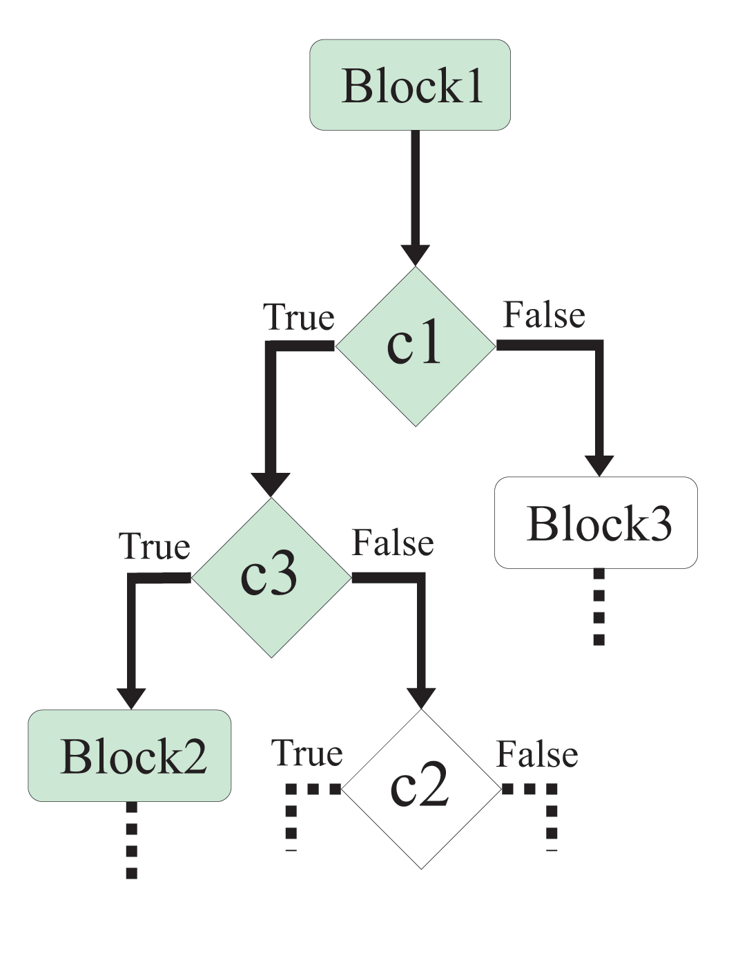


Topic #1 – Software WHITE-BOX Testing
Software Testing
Why Is White-Box Program Testing Important?
Answer: - Achieve certain program code coverage
- Assure software program-based test adequacy
Exercise program
control flows
Check program
branches
Software
Cover different
program data and
their values
Discover deadlock codes
Notes:
Why white-box software testing is important?
The major purpose is to achieve pre-defined program code coverage for white-box testing. Here are the typical objectives and reasons:
– Cover different program control flows and execution paths
Cover different program data and their value set-up and usage
Cover various program branches and logics
Uncover the deadlock program codes and cases in software

Slide 6

Topic #1 – Software WHITE-BOX Testing
Software Testing
Who Does White-Box Program Testing?
Developers perform white-box program testing, not test engineers.
They only target to software components/modules they created.
They only use white-box testing methods and tools
They need to use software program codes
They must select and achieve white-box program code coverage
White-box
Tests
Source codes

Slide 7


Topic #1 – Software WHITE-BOX Testing
Software Testing
White-Box Program Coverage
Program Source
Code Line Coverage
Program Branch
Coverage
Program Control
Path Coverage
Program Source codes
Data Flow
Test Coverage
Program Logics
Coverage

