Slide 1


White-Box Software Testing
Week #5 - Module #1
Speaker: Jerry Gao Ph.D.
Computer Engineering Department
San Jose State University
email: jerry.gao@sjsu.edu
URL: http://www.engr.sjsu.edu/gaojerry
Copyright © 2013, All Right Reserved by Jerry Gao, Ph.D.

Slide 2
Topic: White-Box Software Testing Methods
Presentation Outline
- What is White-Box Testing?
- Testing Focuses
- Who Perform White-Box Testing?
- Basis-Path Program Testing
- Branch-Based Program Testing
- Data Flow Program Testing
- Syntax-Based Program Testing
- State-Based Program Testing
- Testing Coverage
Jerry Gao Ph.D. 7/20002
All Rights Reserved

Slide 3
Topic: White-Box Software Testing
What is White-Based Software Testing?
What is white-box software testing?
--> White-box testing, also known as glass-box testing.
Basic idea is to test a program based on the structure of a program.
What do you need for white-box testing?
- A white-box testing model and test criteria
- A white-box test design and generation method
- Program source code
White-box testing methods can be classified into:
- Traditional white-box testing methods
- Object-oriented white-box testing methods
- Component-oriented white-box testing methods
Jerry Gao Ph.D.

Slide 4
Topic: White-Box Software Testing
White-Box Testing Objectives
The Major objective of white-box testing is to focus on internal program structure, and discover all internal program errors.
The major testing focuses:
- Program structures
- Program statements and branches
- Various kinds of program paths
- Program internal logic and data structures
- Program internal behaviors and states.
Jerry Gao Ph.D.

Slide 5
Topic: White-Box Software Testing
Traditional White-Based Software Testing Methods
Test Model: control program chart (graph)
Test case design:
Various white-box testing methods generate test cases
based on on a given control program graph for a program
The goal is to:
- Guarantee that all independent paths within a module have been exercised at least once.
- Exercise all logical decisions one their true and false sides.
- Execute all loops at their boundaries and within their operational bounds.
- Exercise internal data structures to assure their validity.
- Exercise all data define and use paths.
Jerry Gao Ph.D.

Slide 6
Topic: White-Box Software Testing
White-Box Software Testing Methods
Basic path testing (a white-box testing technique):
- First proposed by TomMcCabe [MCC76].
- Can be used to derive a logical complexity measure for a procedure design.
- Used as a guide for defining a basis set of execution path.
- Guarantee to execute every statement in the program at least one time.
Branch Testing:
Exercise predicate nodes of a program flow graph to make sure
that each predicate node has been exercised at least once.
Loop Testing:
Exercise loops of a program to make sure that the inside and outside of loop body are executed.
State-Based Testing:
Basic idea is to use a finite state machine as a test model to check the state behaviors of a program process.
Jerry Gao Ph.D.

Slide 7
Topic: White-Box Software Testing
Program Flow Graph (Control Flow Diagram)
C
If C Then S1 else S2;
Sequential statement block
S1
S2
C
Case C of
L1: S1;
L2: S2;
…
Kn: Sn;
end;
C
If C Then S1;
S1
Sn
S1
Jerry Gao Ph.D.

Slide 8
Topic: White-Box Software Testing
Program Flow Graph (Control Flow Diagram)
I = 1
C
For loop:
for I = 1 to n do S;
While C do S;
F
S
S
T
yes
I <=n
no
S1
Do loop:
do S1 until C;
F
C
T
Jerry Gao Ph.D.

Slide 9
Topic: White-Box Software Testing
Cyclomatic Complexity
Cyclomatic complexity is a software metric
-> provides a quantitative measure of the global complexity of a program.
When this metric is used in the context of the basis path testing, the value
computed for cyclomatic complexity defines the number of independent paths
in the basis set of a program.
Three ways to compute cyclomatic complexity:
- The number of regions of the flow graph correspond to the cyclomatic complexity.
- Cyclomatic complexity, V(G), for a flow graph G is defined as
V(G) = E - N +2
where E is the number of flow graph edges and N is the number of flow graph nodes.
- Cyclomatic complexity, V(G) = P + 1
where P is the number of predicate nodes contained in the flow graph G.
Jerry Gao Ph.D.

Slide 10
Topic: White-Box Software Testing
An Example
1
node
No. of regions = 4
(considering the universal region)
No. of edges = 9
No. of nodes = 7
No. of predicate nodes = 3
V(G) = P + 1 = 3 + 1 = 4
V(G) = E – N + 2 = 9 - 7 + 2 = 4
edge
2
3
4
5
region
6
7
Jerry Gao Ph.D.

Slide 11
Topic: White-Box Software Testing
Deriving Test Cases
Step 1 : Using the design or code as a foundation, draw a corresponding flow graph.
Step 2: Determine the cyclomatic complexity of the resultant flow graph.
Step 3: Determine a minimum basis set of linearly independent paths.
For example,
path 1: 1-2-4-5-6-7
path 2: 1-2-4-7
path 3: 1-2-3-2-4-5-6-7
path 4: 1-2-4-5-6-5-6-7
Step 4: Prepare test cases that will force execution of each path in the basis set.
Step 5: Run the test cases and check their results
Jerry Gao Ph.D.

Slide 12
Topic: White-Box Software Testing
An Example
1 2 3 4 5 6 7
1 a
2 b d
3 c
4 e i
5 f
6 g h
7
1
node
a
b
edge
2
3
d
c
4
e
i
1 2 3 4 5 6 7
1 1
2 1 1
3 1
4 1 1
5 1
6 1 1
7
5
g
f
region
1 - 1 = 0
2 - 1 =1
1 -1 = 0
2 - 1 =1
1 -1 = 0
2 -1 = 1
--------
3 +1 = 4
6
h
7
Jerry Gao Ph.D.

Slide 13
Topic: White-Box Software Testing
Data Flow Software Testing
Major Objective:
Focus data value definitions and its uses in a program control flow charts.
Major purpose:
Data flow test criteria is developed to improve the data test coverage of a program.
Basic idea:
For a given Var has been assigned the correct value at some point in the program if no test data cause the execution of a path from the assignment point to a usage point in a program flow chart.
Basic Test Model: Program Control Flow Chart (Graph)
Test Criteria: Various data flow test criteria
They are stronger than branch testing but weaker than path testing.
Jerry Gao Ph.D.

Slide 14
Topic: White-Box Software Testing
Data Flow Software Testing
Basic Definitions:
V = the set of variables.
N = the set of nodes
E = the set of edges
def(i) = { x in V | x has a global definition in block I}
c-use(i) = { x in V | x has a global c-use in block i }
p-use(i,j) = { x in V } x has a p-use in edge (i,j) }
dcu(x, j) = { j in N | x in c-use(j) and there is a def-clear path wrt x from i to j }
dpu(x, j) = {(j,k) in E | x in p-use(j,k) and there is a def-clear path wrt x from i to (j,k) }
Jerry Gao Ph.D.

Slide 15
Topic: White-Box Software Testing
Data Flow Software Testing
1
2
read(x,y)
i:=1;
i<=2
3
i>2
4
5
writeln(“hello”);
i:= i+1;
y>=0
y<0
6
7
8
writeln(x);
9
10
Jerry Gao Ph.D.

Slide 16
Topic: White-Box Software Testing
Data Flow Software Testing
Path With Respect to Executable
(1,2) input ^ Yes
(2,3,4) i Yes
(2,3,5) i No
(4,3,4) i Yes
(4,3,5) i Yes
(2,3,5,6,7,9,10) input ^ No
(2,3,5,6,8,9,10) input ^ No
Program demonstrating that (all-du-paths)* fails to include the other criteria
Jerry Gao Ph.D.

Slide 17
Topic: White-Box Software Testing
Data Flow Software Testing
1
read(x,y)
x:=sqr(x);
x<0
2
x>=0
read(y);
3
4
y<>0
5
y=0
6
7
writeln(x);
8
9
Program demonstrating that (all-p-uses)* fails to include (all-edges)*
Jerry Gao Ph.D.

Slide 18
Topic: White-Box Software Testing
Relationships among the Data Flow Software Testing Criteria
All-Paths
All-DU-Paths
All-Uses
All-C-Uses/Some-P-Uses
All-P-Uses/Some-C-Uses
All-C-Uses
All-DEFS
All-P-Uses
All-Edges
All-Nodes
Jerry Gao Ph.D.

Slide 19
Topic: White-Box Software Testing
Branch Testing
What is branch testing for software? (known as decision testing in programs)
Design test cases to exercise each branch-based path in a program flow graph.
Test focus is on: Each branch in a program structure
Test coverage: For each decision in a program structure, each branch must be exercised at least once.
Test model: Program control flow graph
Limitation: - Treats a compound conditional as a single statement
      - Ignores implicit paths that result from compound conditionals.
Jerry Gao Ph.D.

Slide 20
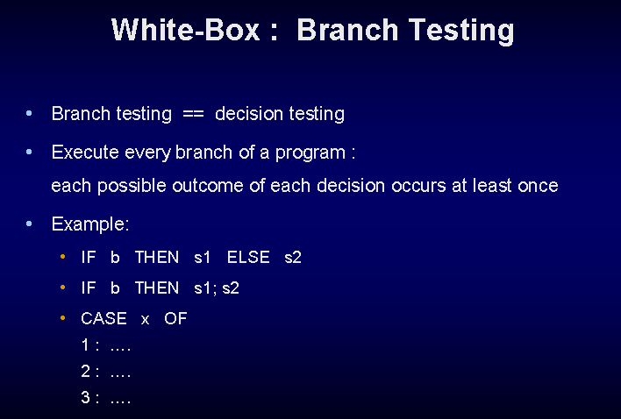
Topic: White-Box Software Testing
Jerry Gao Ph.D.

Slide 21
Topic: White-Box Software Testing
Branch Testing Example
** Branch Testing Exercise
* Create test cases using branch test method for this program
*/
1. declare Length as integer
2. declare Count as integer
3. READ Length;
4. READ Count;
5. WHILE (Count <= 6) LOOP
6. IF (Length >= 100) THEN
7. Length = Length - 2;
8. ELSE
9. Length = Count * Length;
10. END IF
11. Count = Count + 1;
12. END Loop;
13 PRINT Length;
14. End of program
Branch | Possible outcome | T1 | T2 | T3
Count <=6 | T | X | X
 | F |  |  | X
Length >=100 | T | X
 | F |  | X
Jerry Gao Ph.D.

Slide 22
Topic: White-Box Software Testing
Branch Testing Example
Test Case # | Input values - Count | Input values - Length | Expected Outcomes | Actual Outcomes
T1 | 5 | 101 | 594
T2 | 5 | 99 | 493
T3 | 7 | 99 | 99
Jerry Gao Ph.D.

Slide 23
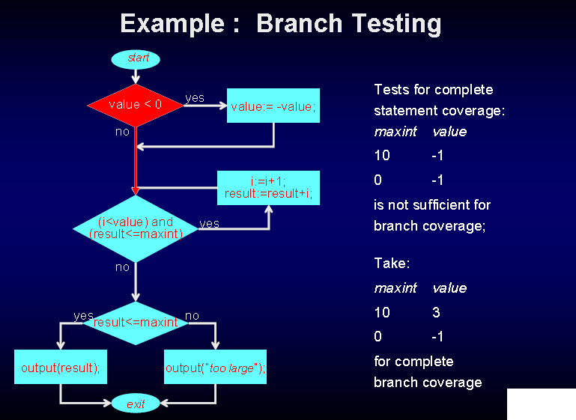
Topic: White-Box Software Testing
Jerry Gao Ph.D.

Slide 24
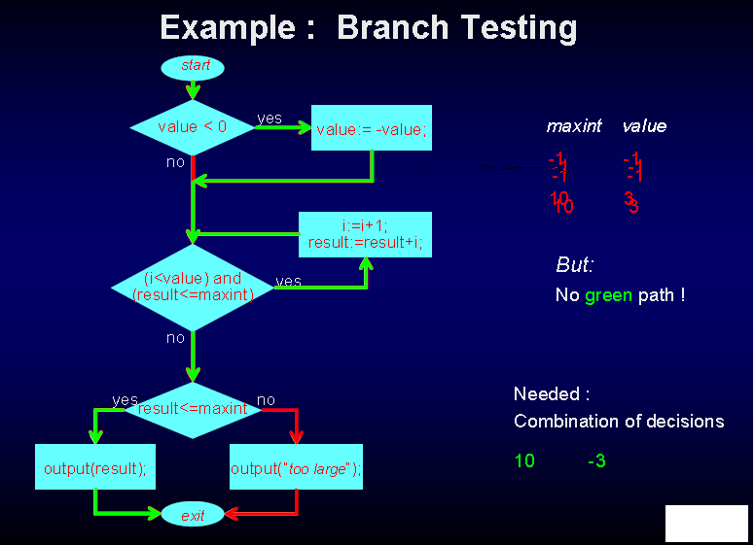
Topic: White-Box Software Testing
-1 -1
10 3
Jerry Gao Ph.D.

Slide 25
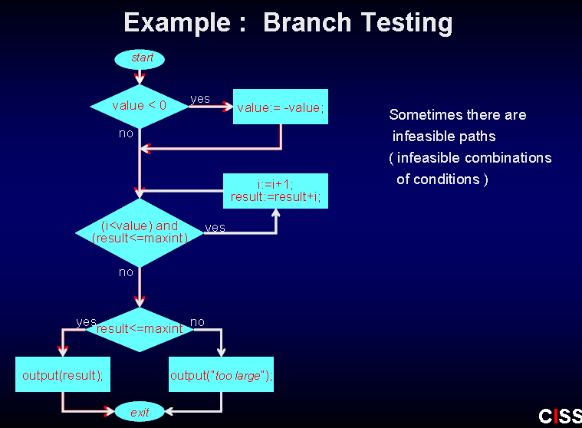
Topic: White-Box Software Testing
Jerry Gao Ph.D.

Slide 26
Topic: White-Box Software Testing
Condition Testing For Software
What is condition testing software?
Design test cases to exercise each logic condition in a program.
Test focus is on: incorrect logic in Boolean expressions of branch nodes.
- Boolean variable errors
- Boolean parenthesis errors
- Boolean operator errors
- Relational operator errors
- Arithmetic expression errors
Test coverage:
For a compound condition C, the True and False branches of C and every simple condition in C need to be executed at least once.
Jerry Gao Ph.D.

Slide 27
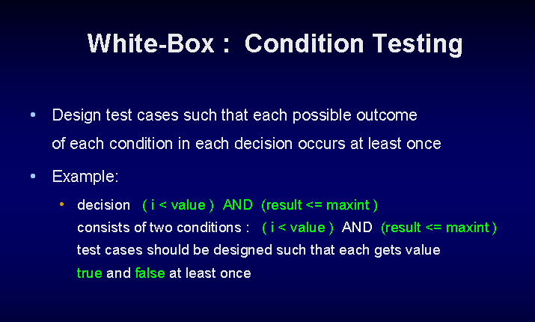
Topic: White-Box Software Testing
Jerry Gao Ph.D.

Slide 28
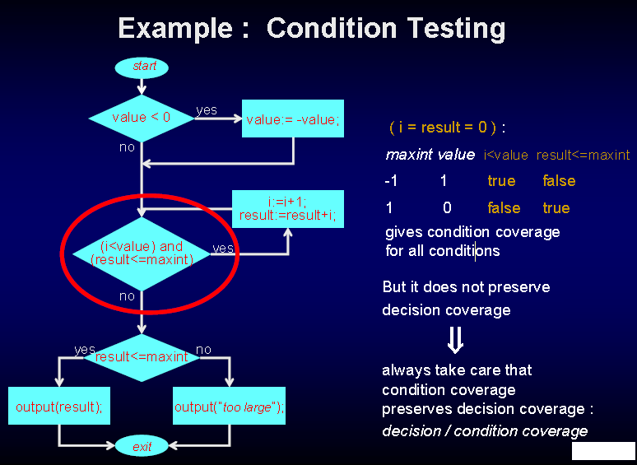
Topic: White-Box Software Testing
Jerry Gao Ph.D.

Slide 29
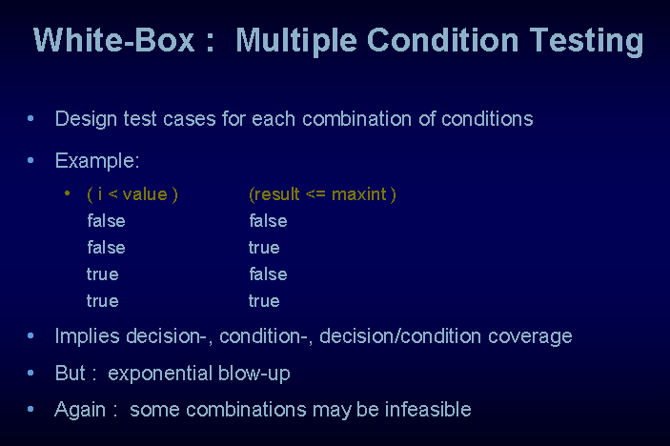
Topic: White-Box Software Testing
Jerry Gao Ph.D.

Slide 30
Topic: White-Box Software Testing
Condition Testing for Software
Condition: ( A AND B Or C )
C?
T
T
F
B?
T
F
T
TRUE
C?
F
A?
T
T
C?
F
F
FALSE
B?
F
T
C?
F
Jerry Gao Ph.D.

Slide 31
Topic: White-Box Software Testing
Condition Testing For Software
A B C A&B or C
TRUE TRUE TRUE TRUE
TRUE TRUE FALSE TRUE
TRUE FALSE TRUE TRUE
TRUE FALSE FALSE FALSE
FALSE TRUE TRUE TRUE
FALSE TRUE FALSE FALSE
FALSE FALSE TRUE TRUE
FALSE FALSE FALSE FALSE
Jerry Gao Ph.D.

Slide 32
Topic: White-Box Software Testing
Loop Testing For Software
Simple Loops, where n is the maximum number of allowable passes through the loop.
  Skip loop entirely
  Only one pass through loop
  Two passes through loop
  m passes through loop where m<n.
  (n-1), n, and (n+1) passes through the loop.
Nested Loops
  Start with inner loop. Set all other loops to minimum values.
  Conduct simple loop testing on inner loop.
  Work outwards
  Continue until all loops tested.
Concatenated Loops
  If independent loops, use simple loop testing.
  If dependent, treat as nested loops.
Unstructured loops
  Don't test - redesign.
Jerry Gao Ph.D.

Slide 33
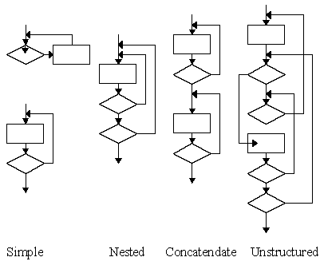
Topic: White-Box Software Testing
Loop Testing For Software
Examples:
Jerry Gao Ph.D.

Slide 34
Topic: White-Box Software Testing
Syntax-Based Software Testing
What is syntax testing?
Syntax testing is a powerful software testing technique for testing command-driven software and similar applications. There is a number of commercial tools.
Test model:
BNF-based graph is used as a test model to generate tests.
Test coverage:
- Node coverage - not very useful
- Link coverage - very important due to loops.
Jerry Gao Ph.D.

Slide 35
Topic: White-Box Software Testing
Syntax-Based Software Testing
Syntax Graph for <real_number>:
<digital>
.
<digital>
E
e
<digital>
D
+
d
-
Jerry Gao Ph.D.

Slide 36
Topic: White-Box Software Testing
Syntax-Based Software Testing
Dirty Syntax Testing:
It includes twofold: a) to exercise a good sample of single syntactic errors
in all commands in an attempt to break the software.
b) to force every diagnostic message appropriate to that
command to be executed.
Example test cases:
Try to come out test cases without loops:
.05, 1., 1.1e
Try to come out test cases with loops:
12345678901.1, 1.1234567890123, 1.1e1234
Jerry Gao Ph.D.

Slide 37
Topic: White-Box Software Testing
State-Based Software Testing
What is state-based software testing?
A software testing method in which a well-defined state machine (or a state graph) is used as a test model to check the state-based behavior of a program.
A state machine is used to define test cases and test criteria to uncover the incorrect state behavior of a program.
Coverage criteria:
- State node coverage
- Transition path coverage
Applications:
- Very useful to check protocol-based program communications.
- Good to check problems in state-driven or event-driven application programs.
Jerry Gao Ph.D.

Slide 38
Topic: White-Box Software Testing
State-Based Software Testing
A State Machine Example:
OK/NONE
OK/NONE
1
OK/NONE
5
ERROR/ERASE
6
ERROR/OUT
7
OK/NONE
ERROR/
REWRITE
OK/
NONE
3
OK/
NONE
ERROR/ERASE
ERROR/
REWRITE
2
4
ERROR/REWRITE
TAPE CONTROL RECOVERY ROUTINE STATE GRAPH
Jerry Gao Ph.D.

Slide 39
Topic: White-Box Software Testing
State-Based Software Testing
Making sure the correctness of your state graphs.
Checking the following problems in state machines:
- Dead lock state, a state can never be left.
- Non-reachable state, a state is not reachable from an initial state.
- Impossible and incorrect states.
Some combinations of factors may appear to be impossible.
For example: (for a car)
GEAR R, N, 1, 2, 3, 4 = 6 factors
DIRECTION FORWARD, REVERSE, STOPPED = 3 factors
ENGINE RUNNING, STOPPED = 2 factors
TRANSMISSION Okay, Broken = 2 factors
ENGINE Okay, Broken = 2 factors
Total = 144 states
Jerry Gao Ph.D.

Slide 40
Topic: White-Box Software Testing
State-Based Test Generation
T02
T24
S4
S0
S0
T01
T02
S2
T01
T12
T32
S1
S2
T23
T11
T13
S1
S3
T12
T13
S1
S3
T33
S2
T11
T23
T24
Test cases:
Level #1: S0->T01->S1
S0->T02>S2
Level #2: S0->T01->S1->T11->S1
S0->T01->S1->T12->S2
S0->T01->S1->T13->S3
…….
S3
S4
T33
T32
S3
S2
Jerry Gao Ph.D.

Slide 41
Topic: White-Box Software Testing
State-Based Software Testing
We can use the state-based testing method to uncover the following issues:
Wrong number of states.
Wrong transition for a given state-input combination.
Wrong output for a given transition.
Pairs of states or sets of states that are inadvertently made equivalent (factor lost).
States or sets of states that are split to create inequivalent duplicates.
States or sets of states that have become dead.
States or sets of states that have become unreachable.
Jerry Gao Ph.D.

Slide 42
Topic: White-Box Software Testing
State-Based Software Testing
Principles:
The starting point of state testing is:
Define a set of covering input sequences that get back to the initial state when starting from the initial state.
For each step in each input sequence, define the expected next state, the expected transition, and the expected output code.
A set of tests, then, consists of three sets of sequences:
1. Input sequences
2. Corresponding transitions of next state names.
3. Output sequences.
  Insist on a specification of transition and output for every combination of
  input and states.
  Apply a minimum set of covering tests.
  Instrument the transitions to capture the sequence of states and not just
  sequence of outputs.
  Count the states.
Jerry Gao Ph.D.

Slide 43
Topic: White-Box Software Testing
White-Box Software Testing Criteria
Statement test coverage criteria
Branch testing coverage criteria
Condition test coverage criteria
Basis-path test coverage criteria
Loop test coverage criteria
Dataflow testing coverage criteria
Syntax testing coverage criteria
State testing coverage criteria
Jerry Gao Ph.D.

