Slide 1

Psycholinguistic Cues in
AI‑Authorship Perception
and L2 Text Memory
语言线索如何影响 AI 作者身份判断，以及 AI / 人类文本在英文二语阅读中的记忆差异
psycholinguistics · L2 reading · working memory
Research Proposal Presentation
01
Notes:
Slide 1：大家好，我今天的题目是 Psycholinguistic Cues in AI-Authorship Perception and L2 Text Memory。这个题目关注两个层面：第一，读者如何根据语言线索判断一段英文文本是不是 AI 写的；第二，对于中英双语学生来说，AI 文本和人类文本在英文二语阅读中是否会造成不同的记忆编码效果。

Slide 2

Why this is a psycholinguistic question
研究对象不是 AI 工具，而是读者的语言加工与作者身份推断
Core framing
•
Reading is not only decoding words; readers also infer voice, intention, and source.
•
“AI‑like” may be a perception created by fluency, regular structure, low emotion, and weak personal voice.
•
In L2 reading, these cues may also affect encoding, working memory, and later recall.
心理语言学连接点
language perception · reading comprehension · pragmatics · second‑language memory
02
Notes:
Slide 2：这个题不是单纯的 AI detection。我真正要研究的是读者如何在阅读过程中把语言形式转换成作者身份判断。这属于 language perception 和 reading；同时因为被试是中英双语学生，阅读材料是英文，所以第三部分也涉及 second-language processing 和 working memory。

Slide 3
Research questions and variables
从“能不能识别 AI”推进到“依赖什么语言线索，以及是否影响二语记忆”
RQ1
Which linguistic cues make an English text sound AI‑generated to bilingual readers?
RQ2
Do AI‑generated and human‑written texts differ in L2 memory encoding?
Independent variable
Mediating cues
Dependent variables
Text type
Human / AI / Hybrid
fluency · structure · emotion · voice
judgment accuracy · memory accuracy · RT
03
Notes:
Slide 3：我的研究问题有两个。第一，哪些语言线索让英文文本听起来像 AI？第二，在中英双语者的二语阅读中，AI 文本和人类文本是否会造成不同的记忆编码效果。自变量是文本类型，关键中介线索是流畅度、结构、情绪和个人声音，因变量包括作者判断、记忆准确率和反应时。

Slide 4
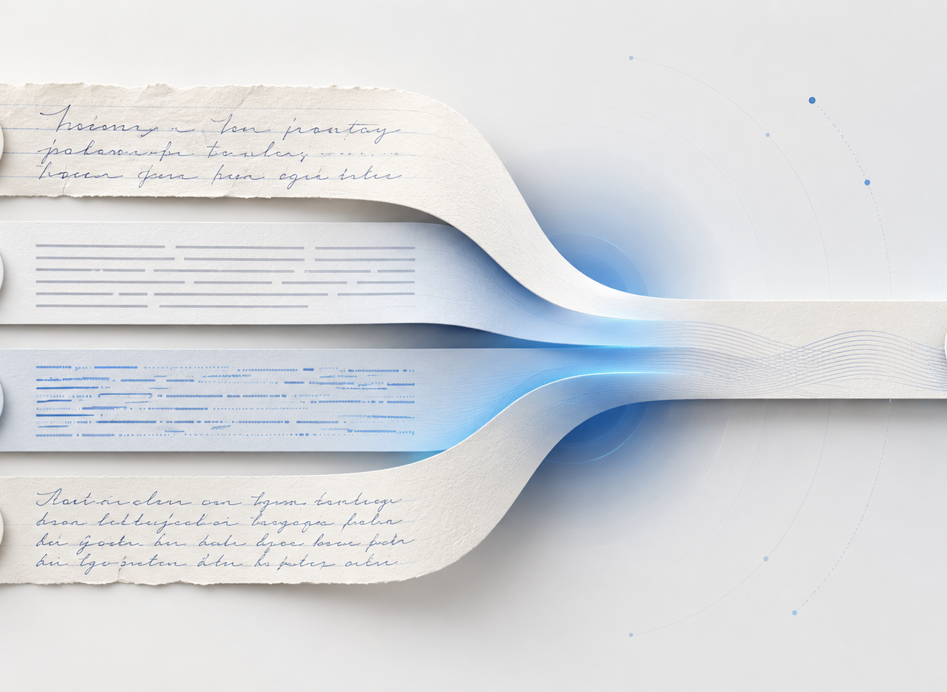
Stimulus materials: paired and controlled texts
控制材料是整个实验可信度的关键
One content base → matched versions
1
Human baseline
Write / collect short student-style English paragraphs on neutral topics.
2
AI-generated version
Use the same topic, length limit, and vocabulary level in a fixed prompt.
3
Human–AI hybrid
Apply a standardized rule: polish language without changing content, or replace a fixed proportion of sentences.
Matched for topic, length, and approximate vocabulary difficulty to reduce confounds.
04
Notes:
Slide 4：材料准备是最容易被质疑的一部分，所以我会用配对和标准化流程控制。先准备人类文本，再用相同话题和字数限制生成 AI 版本。人机混合版本也不会随意修改，而是使用固定规则，例如只润色语言不改变内容，或者统一替换固定比例的句子。这样能减少不可控变量。

Slide 5
Experiment 1: AI‑authorship judgment
测量读者对文本来源的直觉分类
Task
Read one English passage → choose the perceived source
Human-written
AI-generated
Human with AI editing
Not sure
Main measures
•
Judgment accuracy
•
Misclassification rate by text type
•
AI-likelihood rating: 1–5
05
Notes:
Slide 5：第一个实验是作者身份判断。被试看一段英文短文本，然后判断它是人类撰写、AI 生成、人类经过 AI 编辑，还是不确定。这个任务测量的是最直接的 authorship perception，包括判断准确率、误判率，以及每类文本被判断为 AI 的比例。

Slide 6
Experiment 2: Linguistic cue rating
把模糊的“AI 感”拆成可量化的心理语言线索
Likert scale: 1 = strongly disagree, 5 = strongly agree
Fluency — 文本是否流畅
Structural regularity — 结构是否规整
Clarity — 表达是否清晰
Emotional expression — 情感是否具体
Personal voice — 是否有个人声音
Genericness — 是否模板化
Naturalness — 是否自然
Analysis goal: correlate cue ratings with AI-likelihood judgments to identify what actually drives “AI-like” perception.
06
Notes:
Slide 6：第二个实验是语言线索评分。被试用 1 到 5 分评价同一段文本的流畅度、结构规整性、清晰度、情感表达、个人声音、模板感和自然度。这样我可以把“像 AI”这个主观感觉拆成可量化的心理语言线索，并分析哪些线索最能预测 AI 判断。

Slide 7

Live demo: where the experiment becomes measurable
建议在这里切到网页 demo，展示 40–60 秒
Demo script
Background screen
1
Show bilingual screening: English level, Chinese level, AI use frequency.
2
One sample trial
Show reading page, authorship judgment, and cue rating scale.
3
L2 memory section
Show distractor task + sentence recognition / word-order reconstruction.
After demo: return to Slide 8 to explain Experiment 3 formally
07
Notes:
Slide 7：这里是 demo 的最佳位置。讲完实验一和实验二后，先展示网页，让老师看到这个方案可以落地。展示顺序很简单：先给大家看语言背景问卷，然后点进一个 trial，展示阅读、作者判断和量表评分，最后展示干扰任务和记忆测试。整个 demo 控制在一分钟以内，然后回到下一页正式讲第三个实验。

Slide 8
Experiment 3: L2 text memory task
比较 AI 生成文本与人类文本在英文二语阅读中的编码与记忆差异
Read
Distractor
Memory test
Record
Human / AI English passage
odd-even or vowel task
recognition + word order
accuracy + reaction time
Why this strengthens the psycholinguistic focus
Hypothesis
•
Participants process English as an L2, so the task measures second-language reading.
AI texts may be easier to process because of regular structure, but human texts may be remembered better if they contain more emotional specificity and personal voice.
•
Sentence recognition and word-order reconstruction tap memory encoding and working memory.
08
Notes:
Slide 8：第三个实验是 L2 text memory task。被试看人类文本和 AI 文本，之后先做一个短暂干扰任务，避免直接复述，然后进入记忆测试。记忆测试可以是句子再认，也可以是乱序词重组。因变量是记忆准确率和反应时。这个任务是最能体现心理语言学的部分，因为它测量的是二语阅读中的编码、句子加工和工作记忆。

Slide 9
Expected analysis and interpretation
用简单统计回答三个层次的问题：判断、线索、记忆
Data structure
Question
Measure
Interpretation
Can readers classify source?
accuracy / misclassification
authorship perception
What cues drive AI-likeness?
ratings + correlation
psycholinguistic cue use
Which text is remembered better?
memory accuracy / RT
L2 encoding difference
Possible finding
Readers may not directly detect authorship; they may infer it from fluency, regularity, emotion, and voice. Those same cues may also shape L2 memory performance.
09
Notes:
Slide 9：数据分析会很基础但结构清楚。实验一比较判断准确率和误判率；实验二看语言线索评分和 AI 可能性判断之间的关系；实验三比较 AI 文本和人类文本在记忆准确率和反应时上的差异。最终我要回答的是，读者到底是在识别真实作者，还是在利用语言风格进行推断。

Slide 10
Scope, feasibility, and contribution
小规模预实验，但研究逻辑完整且可落地
Feasibility
Controls
Contribution
•
20–50 bilingual high school students
•
Bilingual screening questionnaire
•
AI detection reframed as language perception
•
8–12 short English passages
•
Matched topic, length, vocabulary level
•
Connects AI writing with L2 processing
•
Static web demo + CSV export
•
Standardized AI / hybrid generation rules
•
Measures judgment, cue use, and memory
Conclusion: “AI‑like” may be a psycholinguistic perception, not a direct detection of authorship.
10
Notes:
Slide 10：最后总结一下，这个研究小规模但可落地。被试是中英双语高中生，材料是短英文文本，网页可以直接收集判断、评分、反应时和记忆结果。研究贡献是把 AI 检测问题重新转化为心理语言学问题：所谓 AI 感可能不是对作者身份的直接识别，而是读者基于语言线索形成的一种感知。

