Slide 1
Minimum Graph Coloring Approximation

Slide 2
Pseudocode For Our Approximation
Approx_min_colors(G, V): // G is the graph, V is # of vertices
result[V] // stores coloring of each node
available_colors[V] // tracks which colors are available for each iteration
result[0] = 0
for each vertex u in G:
for each vertex v adjacent to u:
set coloring of v to unavailable
color = 0
while color < V:
if color is available:
break
color += 1
result[u] = color
for C in available_colors:
set C as Available

Slide 3
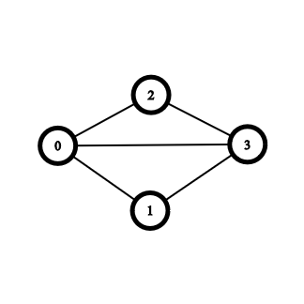
How it Works
Result:
0 1 2 3 4 5
0 | -1 | -1 | -1 | -1 | -1
Available_Colors:
0 1 2 3 4 5
F | F | F | F | F | F

Slide 4
How it Works
Result:
0 1 2 3 4 5
0 | -1 | -1 | -1 | -1 | -1
Available_Colors:
0 1 2 3 4 5
T | F | F | F | F | F

Slide 5
How it Works
Result:
0 1 2 3 4 5
0 | 1 | -1 | -1 | -1 | -1
Available_Colors:
0 1 2 3 4 5
T | F | F | F | F | F

Slide 6
How it Works
Result:
0 1 2 3 4 5
0 | 1 | -1 | -1 | -1 | -1
Available_Colors:
0 1 2 3 4 5
F | F | F | F | F | F

Slide 7
How it Works
Result:
0 1 2 3 4 5
0 | 1 | -1 | -1 | -1 | -1
Available_Colors:
0 1 2 3 4 5
T | F | F | F | F | F

Slide 8
How it Works
Result:
0 1 2 3 4 5
0 | 1 | 1 | -1 | -1 | -1
Available_Colors:
0 1 2 3 4 5
T | F | F | F | F | F

Slide 9
How it Works
Result:
0 1 2 3 4 5
0 | 1 | 1 | -1 | -1 | -1
Available_Colors:
0 1 2 3 4 5
F | F | F | F | F | F

Slide 10
How it Works
Result:
0 1 2 3 4 5
0 | 1 | 1 | -1 | -1 | -1
Available_Colors:
0 1 2 3 4 5
T | F | F | F | F | F

Slide 11
How it Works
Result:
0 1 2 3 4 5
0 | 1 | 1 | -1 | -1 | -1
Available_Colors:
0 1 2 3 4 5
T | T | F | F | F | F

Slide 12
How it Works
Result:
0 1 2 3 4 5
0 | 1 | 1 | 2 | -1 | -1
Available_Colors:
0 1 2 3 4 5
T | T | F | F | F | F

Slide 13
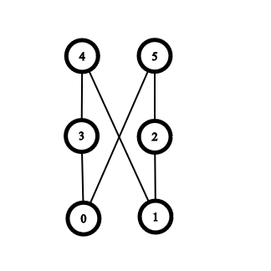
How it Works with a “Bad” ordering
Result:
0 1 2 3 4 5
0 | -1 | -1 | -1 | -1 | -1
Available_Colors:
0 1 2 3 4 5
F | F | F | F | F | F

Slide 14
How it Works with a “Bad” ordering
Result:
0 1 2 3 4 5
0 | 0 | -1 | -1 | -1 | -1
Available_Colors:
0 1 2 3 4 5
F | F | F | F | F | F

Slide 15
How it Works with a “Bad” ordering
Result:
0 1 2 3 4 5
0 | 0 | -1 | -1 | -1 | -1
Available_Colors:
0 1 2 3 4 5
F | F | F | F | F | F

Slide 16
How it Works with a “Bad” ordering
Result:
0 1 2 3 4 5
0 | 0 | -1 | -1 | -1 | -1
Available_Colors:
0 1 2 3 4 5
T | F | F | F | F | F

Slide 17
How it Works with a “Bad” ordering
Result:
0 1 2 3 4 5
0 | 0 | 1 | -1 | -1 | -1
Available_Colors:
0 1 2 3 4 5
T | F | F | F | F | F

Slide 18
How it Works with a “Bad” ordering
Result:
0 1 2 3 4 5
0 | 0 | 1 | -1 | -1 | -1
Available_Colors:
0 1 2 3 4 5
F | F | F | F | F | F

Slide 19
How it Works with a “Bad” ordering
Result:
0 1 2 3 4 5
0 | 0 | 1 | -1 | -1 | -1
Available_Colors:
0 1 2 3 4 5
T | F | F | F | F | F

Slide 20
How it Works with a “Bad” ordering
Result:
0 1 2 3 4 5
0 | 0 | 1 | 1 | -1 | -1
Available_Colors:
0 1 2 3 4 5
T | F | F | F | F | F

Slide 21
How it Works with a “Bad” ordering
Result:
0 1 2 3 4 5
0 | 0 | 1 | 1 | -1 | -1
Available_Colors:
0 1 2 3 4 5
F | F | F | F | F | F

Slide 22
How it Works with a “Bad” ordering
Result:
0 1 2 3 4 5
0 | 0 | 1 | 1 | -1 | -1
Available_Colors:
0 1 2 3 4 5
T | T | F | F | F | F

Slide 23
How it Works with a “Bad” ordering
Result:
0 1 2 3 4 5
0 | 0 | 1 | 1 | 2 | -1
Available_Colors:
0 1 2 3 4 5
T | T | F | F | F | F

Slide 24
How it Works with a “Bad” ordering
Result:
0 1 2 3 4 5
0 | 0 | 1 | 1 | 2 | 2
Available_Colors:
0 1 2 3 4 5
T | T | F | F | F | F

Slide 25
How it Works with a “Bad” ordering

Slide 26
Big O of our Approximation
Approx_min_colors(G, V):
result[-1 * V]
available_colors[false * V]
result[0] = 0
for each node u:
for each node v adjacent to u:
set coloring of v to unavailable
color = 0
while color < V:
if color is available:
break
color += 1
result[u] = color
for C in available_colors:
set C as Available
O(V^2 * E)
Loop Through V Times
Loop Through E Times
Loop Through V Times
Loop Through V Times

Slide 27
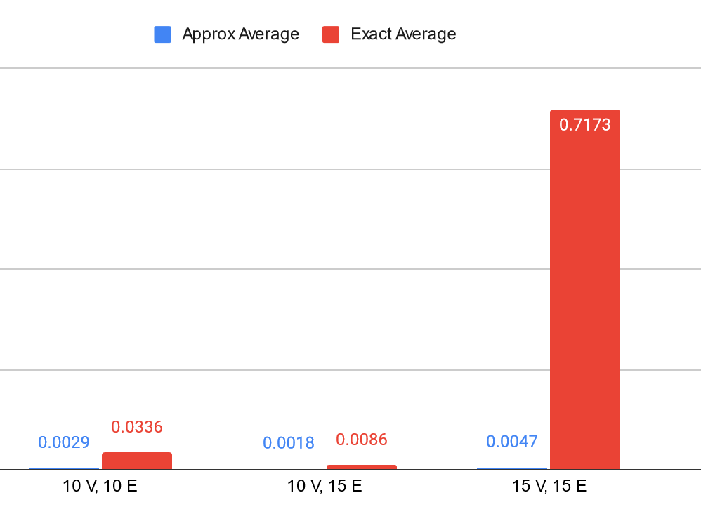
Runtime Comparison
Runtime average for 20 V, 20 E: 425s
Runtime average for 20 V, 30 E: 5992s (~100 minutes)

Slide 28
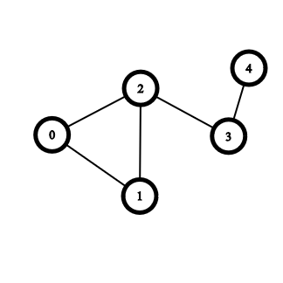
Lower Bound
The Maximum Clique can serve as a lower bound
Maximum Clique approximations could help us find how accurate our approximation is in polynomial time

Slide 29
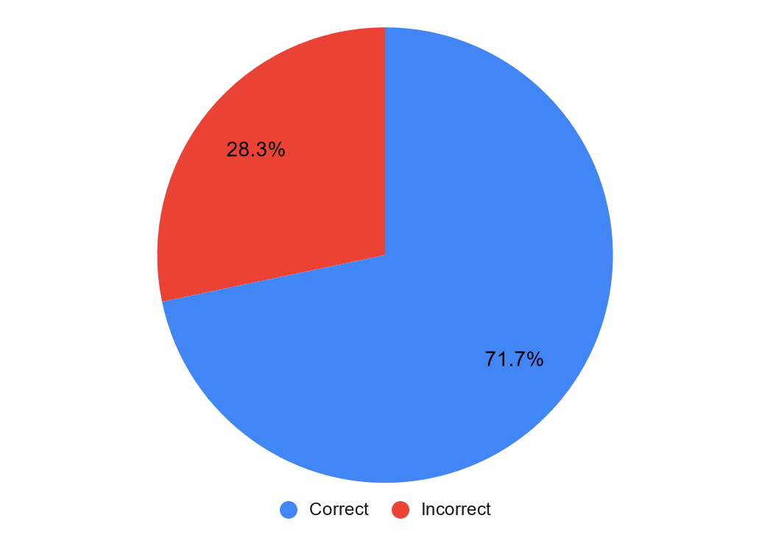
Result Comparison
Output is almost always correct or off by one

