Slide 1
Minimum Graph Coloring Problem
CS 412 Spring 2022

Slide 2
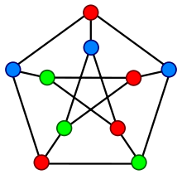
Problem Outline
Problem Description:
Given a graph G with 10 vertices and 15, can I color the graph using 3 unique colors?
Optimization Problem:
Given a graph G with n number of vertices and k colors, what is the smallest value of k such that each vertex is connected to a differently-colored vertex?

Slide 3
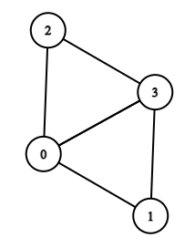
Inputs and Outputs
4
0 1 2 3
1 3
2 3
3 0

Slide 4
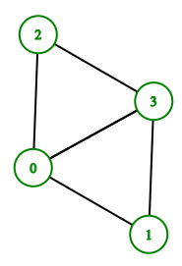
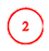
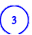
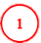
Inputs and Outputs
Vertex 0 ---> Color 0
Vertex 1 ---> Color 1
Vertex 2 ---> Color 1
Vertex 3 ---> Color 2
Minimum number of colors: 3

Slide 5
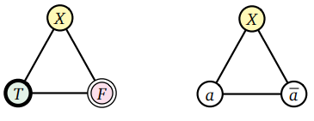
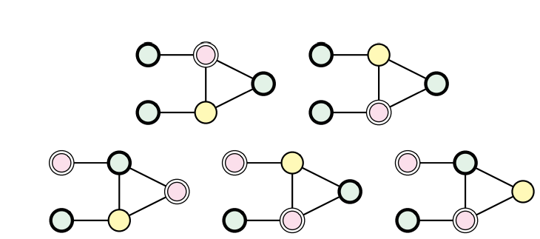
Reduction to 3-Sat
Reduction Problem: 3-Coloring
Images retrieved from Erickson Algorithms Textbook

Slide 6
Pseudo-code solution
exact_min_coloring(colors, G, V):
generate possible clauses
for x in clauses:
save clause with k-color value
np = isNP(G, colors)
if np:
return True, colors
else:
return False, {}
isNP(G, colors):
for vertex in graph:
for adjacent vertex in graph:
if the color is the same:
return False
return True

Slide 7
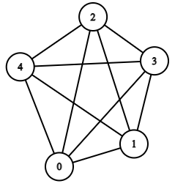
Worst Case Performance

Slide 8
Function Analysis and Test Cases

