Slide 1
Approximation Presentation
Corwin Willms

Slide 2
pseudocode for the approximation
Approx_min_colors(G, V):
result[-1 * V]
available_colors[false * V]
result[0] = 0
for u in range(1, V):
for each node x that is adjacent to u:
if result[x] != -1: // if the node has been assigned a color
available_colors[result[x]] = true
// Find next available color and assign it to that nodes result
color = 0
while color < V:
if available_colors[color] == false:
break
color += 1
result[u] = color

Slide 3
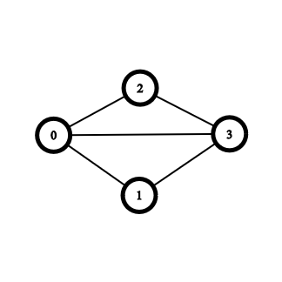
How it Works
Result:
0 1 2 3 4 5
0 | -1 | -1 | -1 | -1 | -1
Available_Colors:
0 1 2 3 4 5
F | F | F | F | F | F

Slide 4
How it Works
Result:
0 1 2 3 4 5
0 | -1 | -1 | -1 | -1 | -1
Available_Colors:
0 1 2 3 4 5
T | F | F | F | F | F

Slide 5
How it Works
Result:
0 1 2 3 4 5
0 | 1 | -1 | -1 | -1 | -1
Available_Colors:
0 1 2 3 4 5
T | F | F | F | F | F

Slide 6
How it Works
Result:
0 1 2 3 4 5
0 | 1 | -1 | -1 | -1 | -1
Available_Colors:
0 1 2 3 4 5
F | F | F | F | F | F

Slide 7
How it Works
Result:
0 1 2 3 4 5
0 | 1 | -1 | -1 | -1 | -1
Available_Colors:
0 1 2 3 4 5
T | F | F | F | F | F

Slide 8
How it Works
Result:
0 1 2 3 4 5
0 | 1 | 1 | -1 | -1 | -1
Available_Colors:
0 1 2 3 4 5
T | F | F | F | F | F

Slide 9
How it Works
Result:
0 1 2 3 4 5
0 | 1 | 1 | -1 | -1 | -1
Available_Colors:
0 1 2 3 4 5
F | F | F | F | F | F

Slide 10
How it Works
Result:
0 1 2 3 4 5
0 | 1 | 1 | -1 | -1 | -1
Available_Colors:
0 1 2 3 4 5
T | F | F | F | F | F

Slide 11
How it Works
Result:
0 1 2 3 4 5
0 | 1 | 1 | -1 | -1 | -1
Available_Colors:
0 1 2 3 4 5
T | T | F | F | F | F

Slide 12
How it Works
Result:
0 1 2 3 4 5
0 | 1 | 1 | 2 | -1 | -1
Available_Colors:
0 1 2 3 4 5
T | T | F | F | F | F

Slide 13
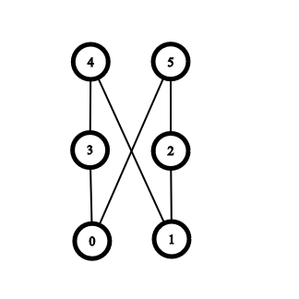
How it Works with a “Bad” ordering
Result:
0 1 2 3 4 5
0 | -1 | -1 | -1 | -1 | -1
Available_Colors:
0 1 2 3 4 5
F | F | F | F | F | F

Slide 14
How it Works with a “Bad” ordering
Result:
0 1 2 3 4 5
0 | 0 | -1 | -1 | -1 | -1
Available_Colors:
0 1 2 3 4 5
F | F | F | F | F | F

Slide 15
How it Works with a “Bad” ordering
Result:
0 1 2 3 4 5
0 | 0 | -1 | -1 | -1 | -1
Available_Colors:
0 1 2 3 4 5
F | F | F | F | F | F

Slide 16
How it Works with a “Bad” ordering
Result:
0 1 2 3 4 5
0 | 0 | -1 | -1 | -1 | -1
Available_Colors:
0 1 2 3 4 5
T | F | F | F | F | F

Slide 17
How it Works with a “Bad” ordering
Result:
0 1 2 3 4 5
0 | 0 | 1 | -1 | -1 | -1
Available_Colors:
0 1 2 3 4 5
T | F | F | F | F | F

Slide 18
How it Works with a “Bad” ordering
Result:
0 1 2 3 4 5
0 | 0 | 1 | -1 | -1 | -1
Available_Colors:
0 1 2 3 4 5
F | F | F | F | F | F

Slide 19
How it Works with a “Bad” ordering
Result:
0 1 2 3 4 5
0 | 0 | 1 | -1 | -1 | -1
Available_Colors:
0 1 2 3 4 5
T | F | F | F | F | F

Slide 20
How it Works with a “Bad” ordering
Result:
0 1 2 3 4 5
0 | 0 | 1 | 1 | -1 | -1
Available_Colors:
0 1 2 3 4 5
T | F | F | F | F | F

Slide 21
How it Works with a “Bad” ordering
Result:
0 1 2 3 4 5
0 | 0 | 1 | 1 | -1 | -1
Available_Colors:
0 1 2 3 4 5
F | F | F | F | F | F

Slide 22
How it Works with a “Bad” ordering
Result:
0 1 2 3 4 5
0 | 0 | 1 | 1 | -1 | -1
Available_Colors:
0 1 2 3 4 5
T | T | F | F | F | F

Slide 23
How it Works with a “Bad” ordering
Result:
0 1 2 3 4 5
0 | 0 | 1 | 1 | 2 | -1
Available_Colors:
0 1 2 3 4 5
T | T | F | F | F | F

Slide 24
How it Works with a “Bad” ordering
Result:
0 1 2 3 4 5
0 | 0 | 1 | 1 | 2 | 2
Available_Colors:
0 1 2 3 4 5
T | T | F | F | F | F

Slide 25
analytical run time analysis (big-O) of your approximation algorithm
Approximation: O(V^2 * E)
Why is this the big O???
The algorithm loops through all vertices.
Within that loop it loops through the colors of which there are V
It also loops through the Edges

Slide 26
lower bound analysis of the problem and the approximation
Use maximum click approximation for lower bound
Return from maximum click approximation is no more than half of the actual correct answer for min graph color.
Compare approximation return to return from max click approximation to figure out how accurate approximation solution is
O(n(log log n)²/log³n) – max clique approximation???

Slide 27
plots that illustrate the run-time (wall clock) performance of your exact solution versus the approximation solution on your test cases

Slide 28
plots that compare the result/solution of your exact solution versus the approximation on your test cases.

