Slide 1
Georgetown dormancy normalisation and batch correction

Slide 2
Normalisation
Given that some samples were fresh-frozen and others from FFPE material, normalisation was performed independently on these two batches as follows
fRMA
Feature selection of probes that passed a detection threshold (important because FFPE RNA likely to be degraded in comparison to FF samples)
LOESS normalisation
We now use this normalised data to check for batch effects

Slide 3
Pre-ComBat Figures

Slide 4
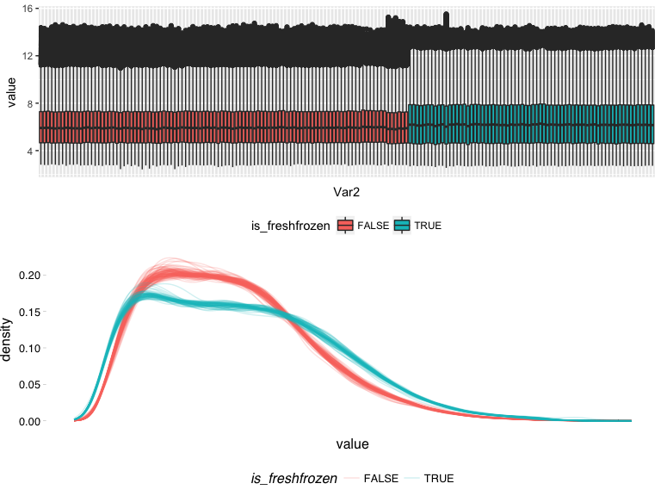
Expression distributions – FF vs FFPE

Slide 5
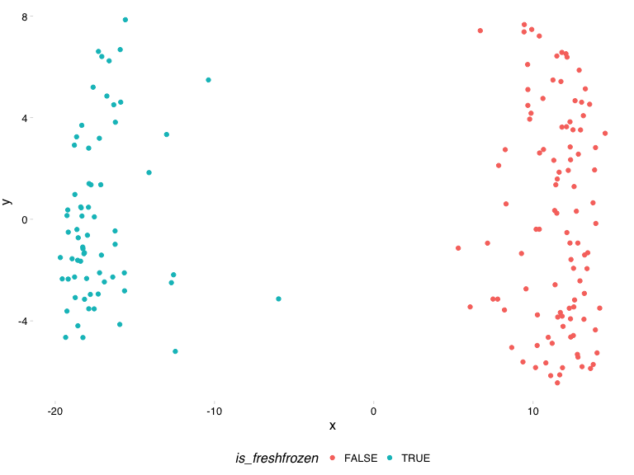
MDS for 500 most variant genes across all samples

Slide 6
We clearly have two distinct groups, of FF and FFPE samples as expected, but intra-material samples are relatively well normalised.
We can also check for biological signal by checking for sample clustering by time point. This is the same plot with alternative colouring
colours: diagnostic (day 0), on-treatment (~day 14) and long-term (>120 days)

Slide 7
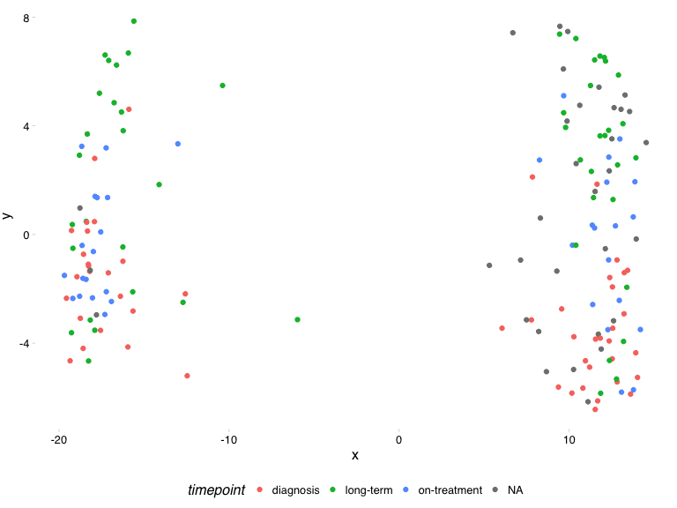
MDS for 500 most variant genes across all samples

Slide 8
Diagnostic and long-term samples appear to be clustering at the extreme ends of the collection of samples – good!
Now we’ll use ComBat to remove the FF vs FFPE batch effect

Slide 9
Post-ComBat Figures

Slide 10
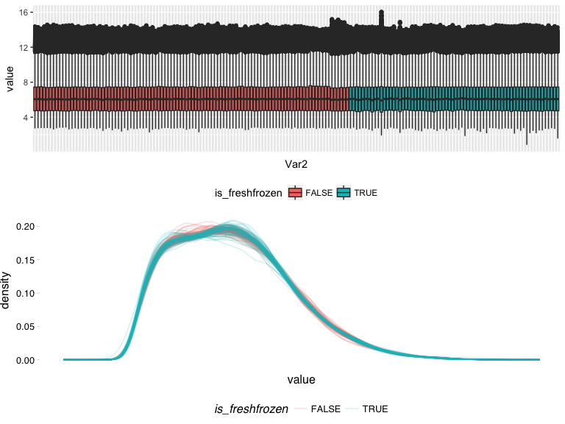
Expression distributions – FF vs FFPE

Slide 11
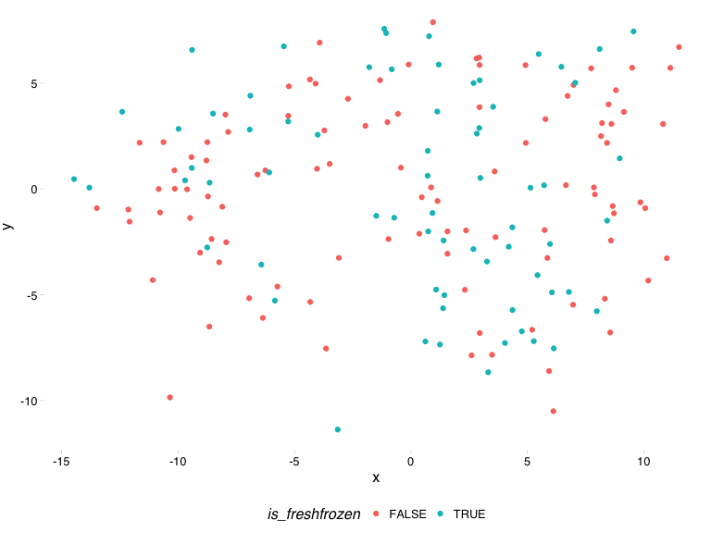
MDS for 500 most variant genes across all samples

Slide 12
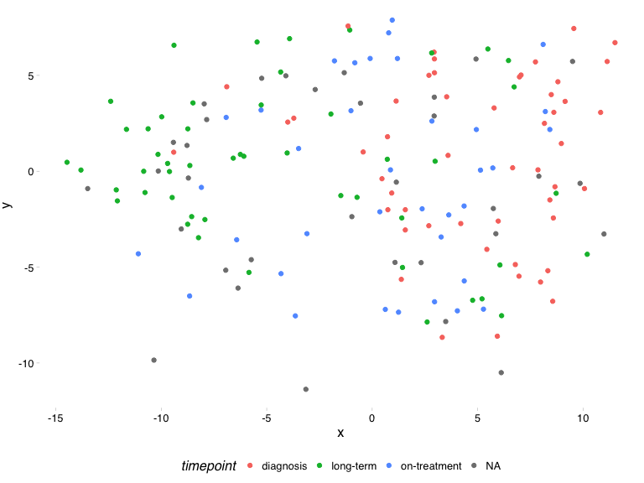
MDS for 500 most variant genes across all samples

Slide 13
So we’ve seemingly removed our FF vs FFPE batch effects but conserved our biological signal (i.e. clustering by timepoint)
Importantly, included in the cohort were several samples that were replicated across FF and FFPE materials, therefore, post-ComBat these samples should very accurately cluster with one another
In the next figure samples are again displayed using the principle components of their 500 most variable genes but are now coloured by patient (i.e. blues should cluster together, greens etc). FF or FFPE material is visualised by the size of the point

Slide 14
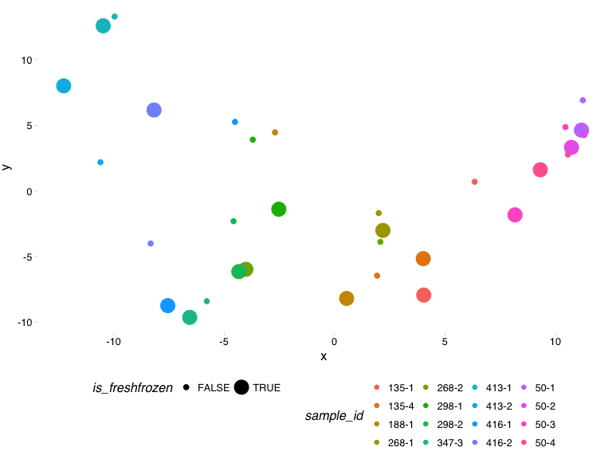
MDS for 500 most variant genes across replicate samples

Slide 15
We can additionally demonstrate this statistically using sample correlations
We can loosely define the batch-specific inter-patient and intra-patient heterogeneity as biological variation, just as the replicate sample variation can be almost entirely attributed to technical variation or noise. Additionally, the overall variability will be explained by a combination of the above.
Therefore, post-ComBat, if the 'biological' variation/correlation remains constant post-ComBat, whilst the technical variation is removed/correlation improves, we can be confident that our correction has been effective but not to the degree of removing biological signal.

Slide 16
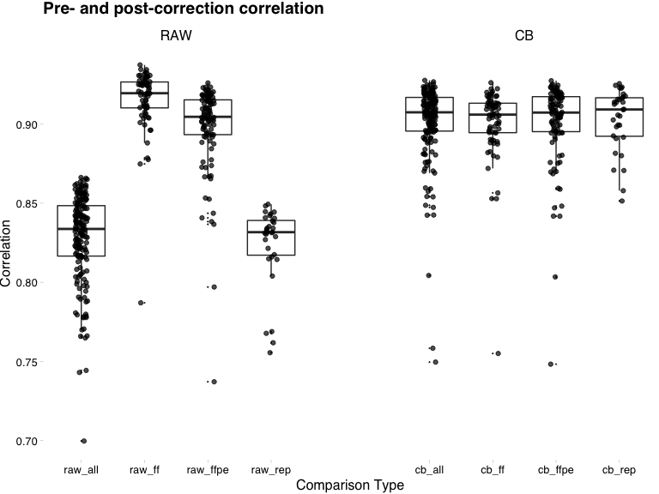
Sample correlations pre- and post-ComBat
_all = all samples
_ff = fresh-frozen samples
_ffpe = FFPE samples
_rep = replicate samples that are found in both the FF and FFPE subsets

