Slide 1
The Driverless Car
Liam Pearce

Slide 2
Google Driverless Car
http://www.youtube.com/watch?v=cdgQpa1pUUE

Slide 3

Quick Overview of Driverless Car
Project by Google to obtain a self-driving car.
Bring led by Google engineer Sebastian Thrun.
Nevada, Florida and California have so far legalized the testing of the autonomous cars.
Only 2 accidents have occurred so far, both near Google HQ in Mountain View, CA. The first incident it was rear-ended at a traffic light and the 2nd time it was being driven manually (both not a result of the self-driving car).
BUT is has logged over 435,000 test miles.

Slide 4


Continued…
At least 10 vehicles equipped for testing (6 Toyota Prius’, Audi TT & Lexus RX450h).
Googled asked for 2 bills to be passed in Nevada. The first one being to amend the licensing and testing of autonomous vehicles in the state and the second bill to allow passengers to send text messages behind the wheel.
It is speculated that Nevada was selected because of the Las Vegas auto show and the Consumer Electronics Show and it is rumoured that Google will present the first commercial product at either or both of these events. But these speculations are only rumoured and not yet confirmed.
As seen both BMW and Volvo have started the production of their own self-driving vehicle.

Slide 5
BMW Driverless Car
http://www.youtube.com/watch?v=glT26E_fZ0I

Slide 6
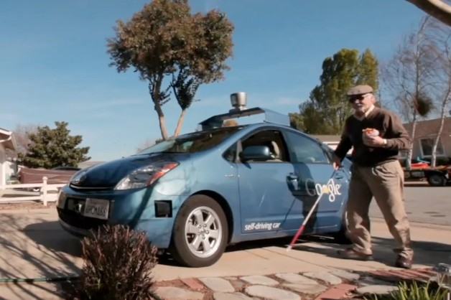
Practicality
For people like Steve Mahan who are visually impaired and unable to operate motor vehicles.
Other practical uses include the
ease of not having to worry about
what’s going on around you on the
road. As well as having the freedom to do what you please in the drivers seat such as making calls, texting, easily communicating with passengers (if laws are passed).
If technology advances it can even be more safe than we are while driving (no drinking, distractions, better reflexes and awareness).

Slide 7
Volvo Driverless Car
http://www.youtube.com/watch?v=0bWG-sQna80
Volvo has taken a different approach at the autonomous driving.
(stop at 3:13)

Slide 8
Morals and Ethics
Most of the time ethics and law are in sync with one another, but in the real world we all know that from time to time they get broken
For instance, jaywalking and speeding are illegal, but they don’t always seem unethical. If there was no traffic or you were in an emergency you would like to break the law.
If a tree fell down in the middle of the road you would like to just drive around it but the car instead stops because it won’t drive into the opposite lane crossing the double-solid yellow lines and breaking traffic laws.

Slide 9
Social Issues
We can say that the biggest social problem that arises here is that it takes away the essence of driving a vehicle. Some people feel attached and closer to there vehicle when they are driving it therefore they will feel safer.
Another aspect is insurance companies which rely on human errors, and this technology could lessen the number of jobs in a large market.
As well Google said that they monitor every vehicle which may invade privacy issues knowing that one’s movements and destinations are being sent back to Google’s headquarters.
The government will also have to invest millions of dollars to innovating roads and highways in order for these driverless vehicles to perform the way they were built too.

Slide 10
Still some issues…
Car still has difficulties staying in between the lines on snow-covered ground or in bad weather.
Has difficulties identifying street signs and pedestrians.
WHAT’S NEXT???
Robots as humans for war missions has also already started to take place with technology advancing rapidly.

Slide 11
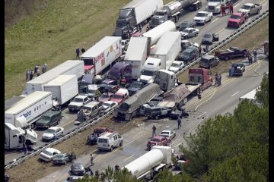
Other questions to be asked
Like any other technology, is it fool-proof? Can a human hack into the computing system of these cars and re-program them? That could create tragic losses.
Or even if the system simply crashes.

Slide 12
How much faith do we have in technology?

