Slide 1

E-TALKING BEST FOR YOU
Analyzing Literature
How to Give a Personal Response to Literature
view

Slide 2

E-TALKING BEST FOR YOU
INTRODUCTION

Slide 3

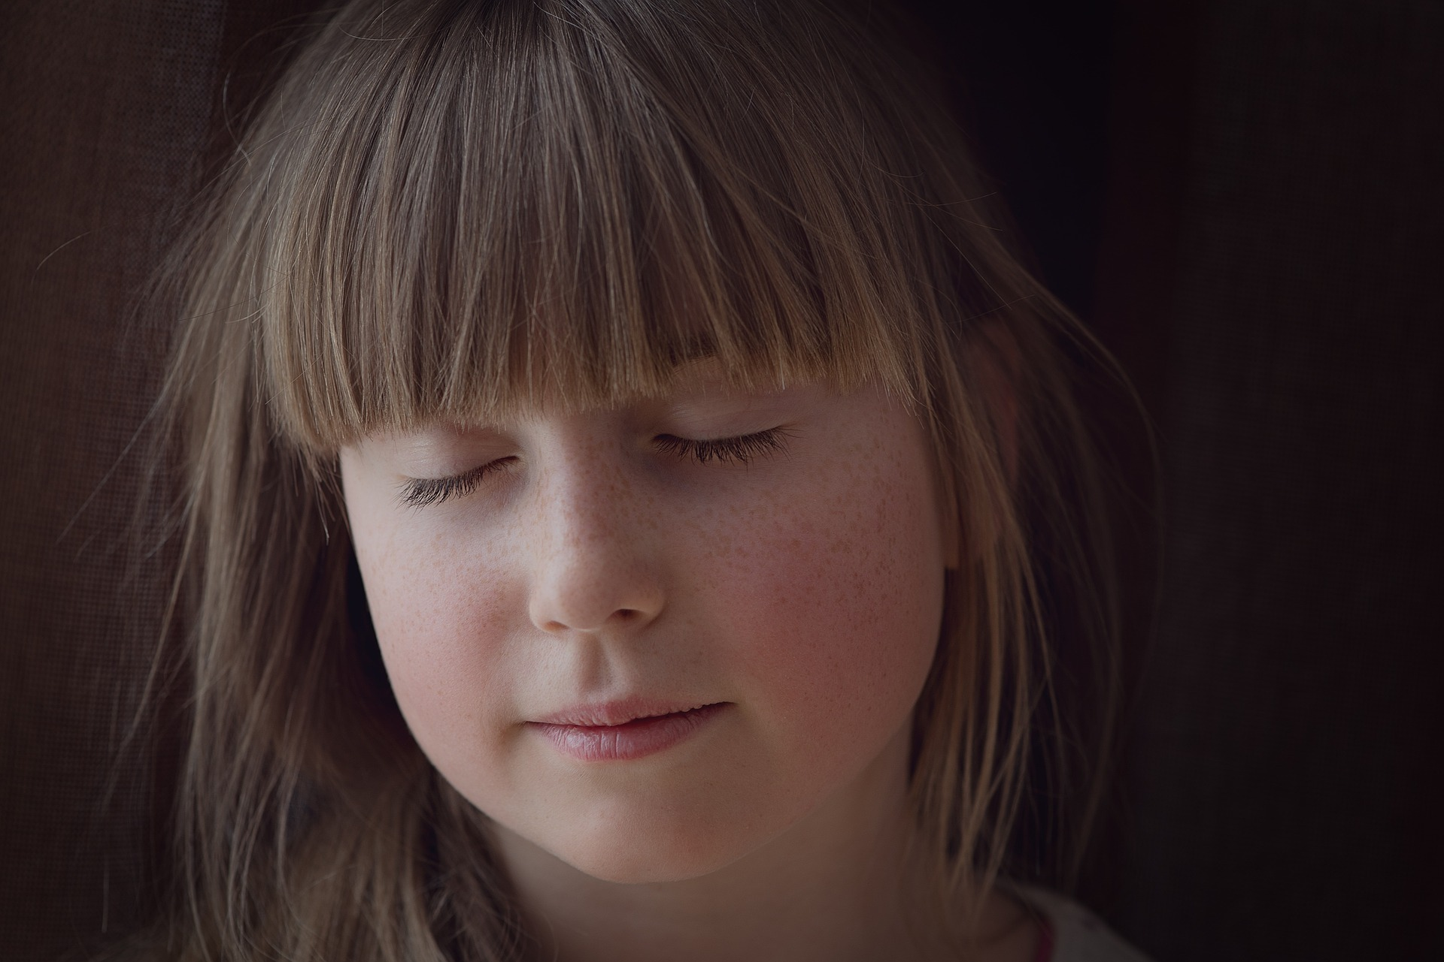
E-TALKING BEST FOR YOU
Give A Personal Response
After reading a book or piece of literature, you can share your understanding and reaction to what you have just read. This is called your personal response. This may include your feelings about a certain character, your impressions of the story, and similarities between the events of the story and your own life.
START

Slide 4

E-TALKING BEST FOR YOU
VOCABULARY
Lets check whether you know each following word.

Slide 5

E-TALKING BEST FOR YOU
E-TALKING BEST FOR YOU
Story (Noun) A real or imaginary account of events.
Impressed (Verb) Admiration and respect.
Particular (Adjective) To single out an individual person or item.
Literature (Noun) Written works.
Vocabulary

Slide 6

E-TALKING BEST FOR YOU
Focus Your Response According To The Posted Question
You should decide whether you want to respond to either the entire story or to a certain character or a particular event. You should think about the scene that most impressed you. Questions to think of are, did it remind you of your own life, and what did it make you think or feel?

Slide 7

E-TALKING BEST FOR YOU
Prompts To Get
You Going
Sample questions to think about when starting your prompt are what you liked or disliked about the piece of literature, what you wish happened in the story, your opinion of the characters, what you felt as you read, what you noticed as you read, and questions that you had after reading.
START

Slide 8

E-TALKING BEST FOR YOU
REVIEW DISCUSSION
Have you ever written a personal response to a book before?
Do you think it is a useful skill to have?
Why?

Slide 9

E-TALKING BEST FOR YOU
SPEAKING TASK
Think about the last story you read. Write a personal response to it including information on the characters, what you felt about the story, why you felt this way, and what questions you had afterwards.

Slide 10

E-TALKING BEST FOR YOU
ASSESSMENT
Complete the sentences using the vocabulary words from this lesson:

Slide 11

E-TALKING BEST FOR YOU
literature / story / impressed / particular
Harry Potter is a good for children.
My teacher was with the quality of my writing.
I love reading Shakespeare’s Romeo and Juliet because I think it is a great piece of .
I am a bit of a snob when it comes to literature as I am very as to which stories I read.
ASSESSMENT

Slide 12


E-TALKING BEST FOR YOU
Thank you !

