Slide 1


E-TALKING BEST FOR YOU
Top Family Vacation Locations
Discussion on Trips That Families Tend to Enjoy
view

Slide 2

E-TALKING BEST FOR YOU
INTRODUCTION
CEFR Learning Goal: Describe landmarks / talk about landmarks where you live

Slide 3


E-TALKING BEST FOR YOU
After the excitement of the idea of going on vacation has died down, most families find it a little overwhelming to plan all the details. When it comes to family vacations it is hard to know what to expect and if what you have planned really will be family-friendly. The first step to getting your vacation to work out is finding the right family-friendly location. In this lesson, we will read about two family-friendly travel destinations.
START

Slide 4

E-TALKING BEST FOR YOU
VOCABULARY
Lets check whether you know each following word.

Slide 5

E-TALKING BEST FOR YOU
E-TALKING BEST FOR YOU
Variety (adjective) a wide selection
Inclusive (adjective) amount includes everything
Daunting (adjective) seeming difficult or frightening with
Patient (adjective) able to stay calm and not get angry
Rich (adjective) containing a lot of something that is important or valuable
Vocabulary

Slide 6
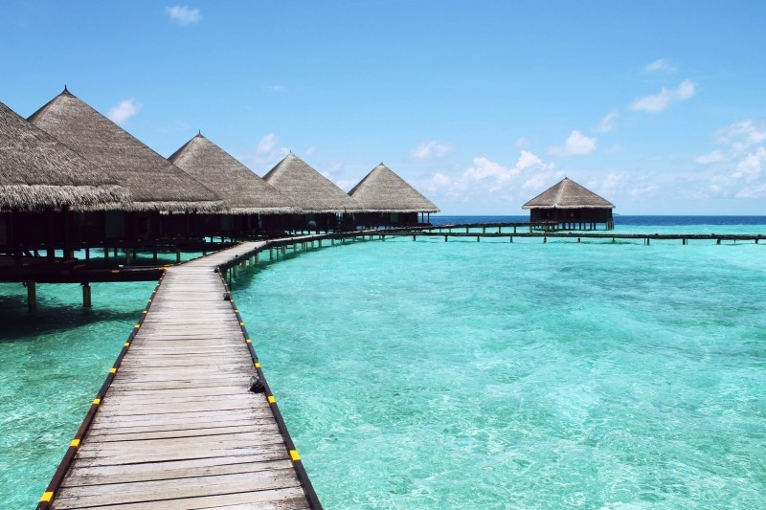
E-TALKING BEST FOR YOU
Head to the Caribbean Islands
The Turks & Caicos should be on your list for Caribbean vacations. There are a variety beach resorts that are all-inclusive and have kids’ programs to allow the parents to get a moment to enjoy their own vacation while their kids are busy all day long. If not the Turks & Caicos, try the U.S. Virgin Islands, the Florida Keys, or even Hawaii.

Slide 7

E-TALKING BEST FOR YOU
DISCUSSION
Is there a specific age that children should be in order to enjoy this vacation?
Do you think that a family vacation should include children-only and parent-only activities?
Does this defeat the purpose of a family vacation?

Slide 8
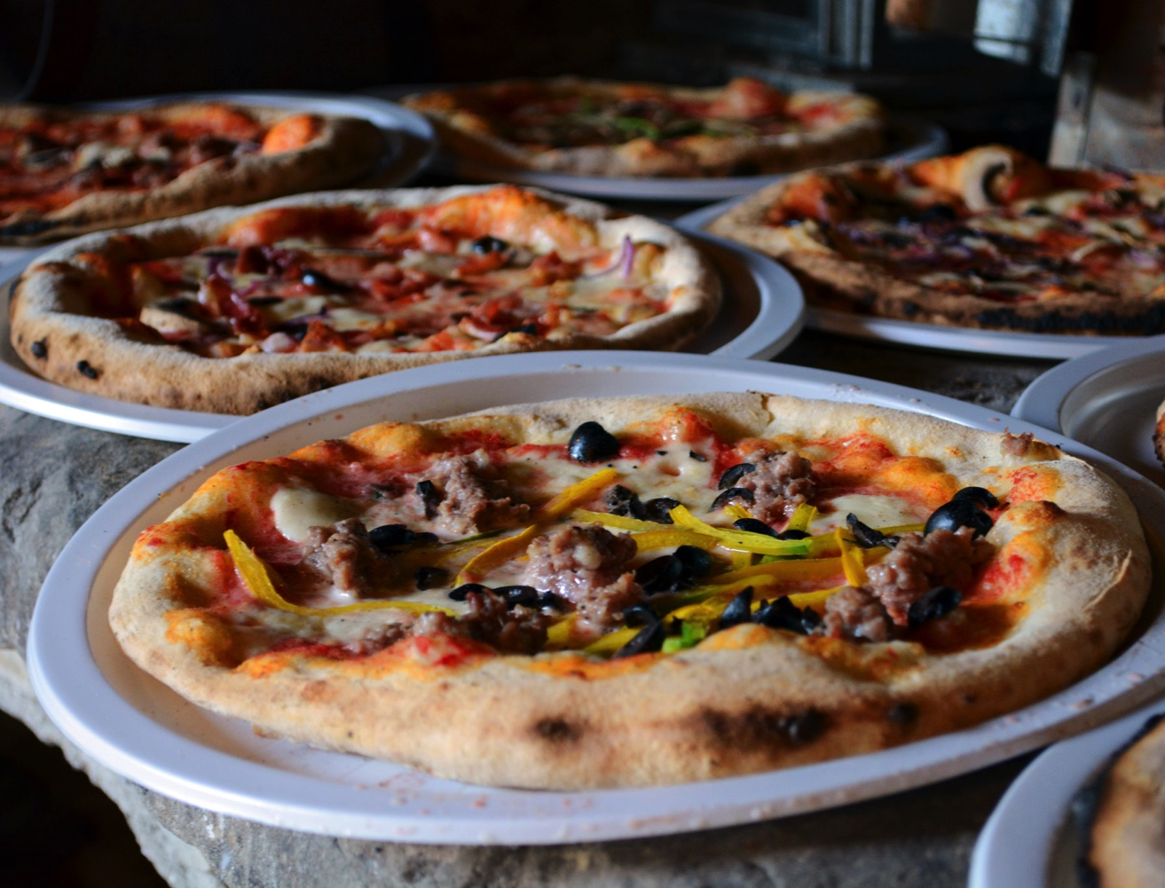
E-TALKING BEST FOR YOU
Taste Real Spaghetti and Pizza : Italy
While it may seem a bit daunting to take your family to Europe, Italy is considered one of the most kid-friendly destinations in Europe. One of the reasons is Italians seem to be a bit more patient with children; maybe that’s because it’s not hard to feed children in Europe. After all, who doesn’t like spaghetti or pizza? Italy has a rich history, which provides a lot of things for families to do and see, and of course there are the beaches and hillsides to explore.

Slide 9
E-TALKING BEST FOR YOU
DISCUSSION
Do you like Italian food? Do you have a favorite?
In your opinion, why would children like to visit Italy?
How about adults?

Slide 10
E-TALKING BEST FOR YOU
REVIEW DISCUSSION
Think about the two destinations we just read about.
As a group, discuss and rank the destinations as better or worse in these three different categories.
Category 1: More educational vacation for children to learn something new
Category 2: More stress-free and enjoyable vacation for parents with children
Category 3: Better overall family destination

Slide 11

E-TALKING BEST FOR YOU
SPEAKING TASK
Tell a story about a family vacation you had in your country. Describe the landmarks you saw. How would you describe the trip?
Were there any memorable experiences?
Were these experiences positive or negative?

Slide 12

E-TALKING BEST FOR YOU
ASSESSMENT

Slide 13

E-TALKING BEST FOR YOU
variety / inclusive / daunting / patient / rich
Summarizing and Vocabulary
Discuss the destinations you learned about in this reading. Use the 5 vocabulary words within your description.
ASSESSMENT

Slide 14


E-TALKING BEST FOR YOU
Thank you !

