Slide 1
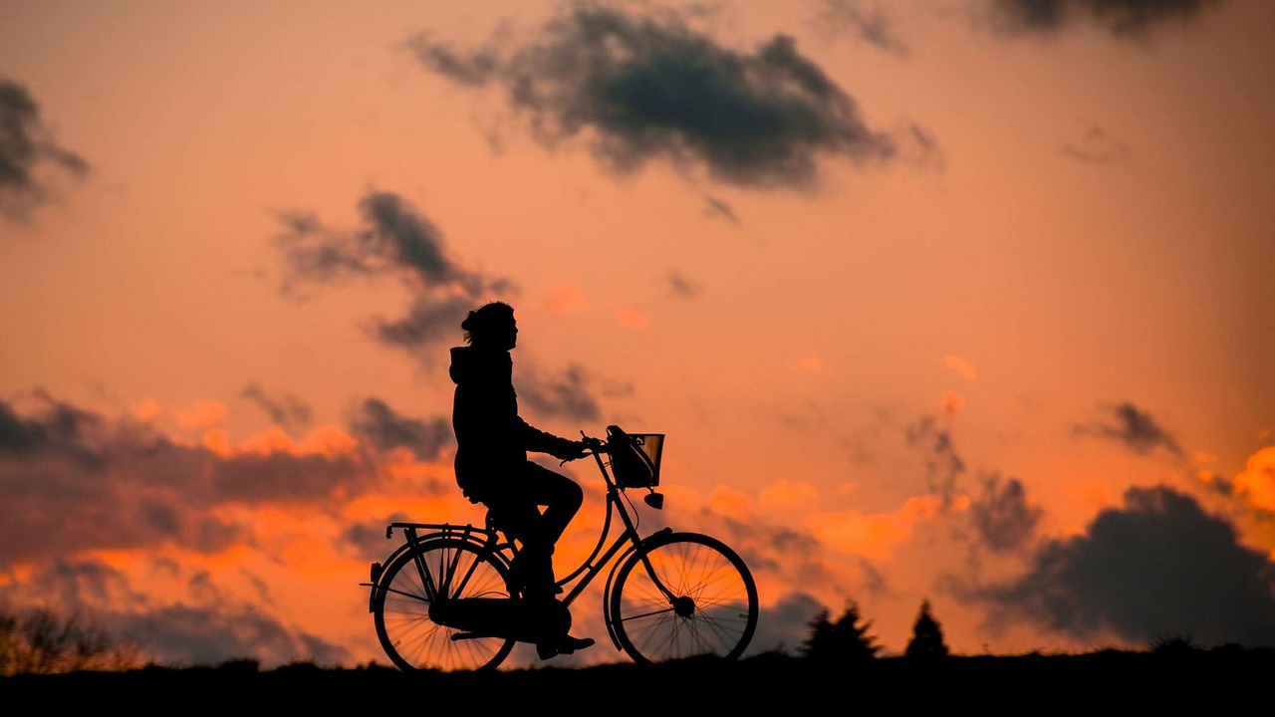
E-TALKING BEST FOR YOU
Staying Fit As A Family Ways to Get Fit With Your Family
view

Slide 2

E-TALKING BEST FOR YOU
INTRODUCTION
CEFR Learning Goal: Suggest changes to a plan

Slide 3
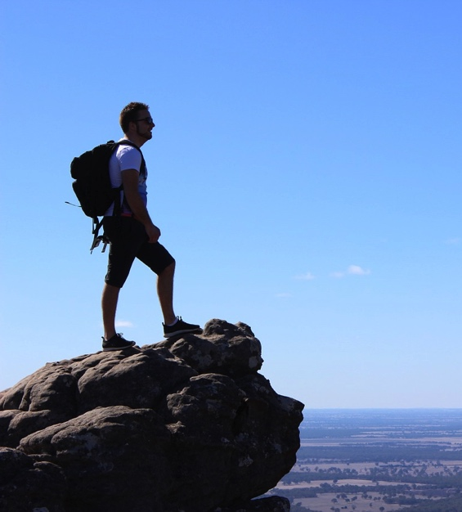
E-TALKING BEST FOR YOU
To make working out and exercising seem like less of a chore to be done all by yourself, you can explore ways to get fit with activities that you can do with your family. This allows your family to spend time together and to do something good for your bodies at the same time. In this lesson, we will read about ways to be active that the whole family can do together.
START

Slide 4

E-TALKING BEST FOR YOU
VOCABULARY
Lets check whether you know each following word.

Slide 5

E-TALKING BEST FOR YOU
E-TALKING BEST FOR YOU
Trick (verb) to deceive someone
Interactive (adjective) involving communication between people
Bond (verb) to develop a strong relationship with someone
Extended (adjective) longer
Collage (noun) a piece of art made by sticking various different materials such as photographs and pieces of paper or fabric onto a backing
Accumulate (verb) to increase in amount over a period of time
Vocabulary

Slide 6
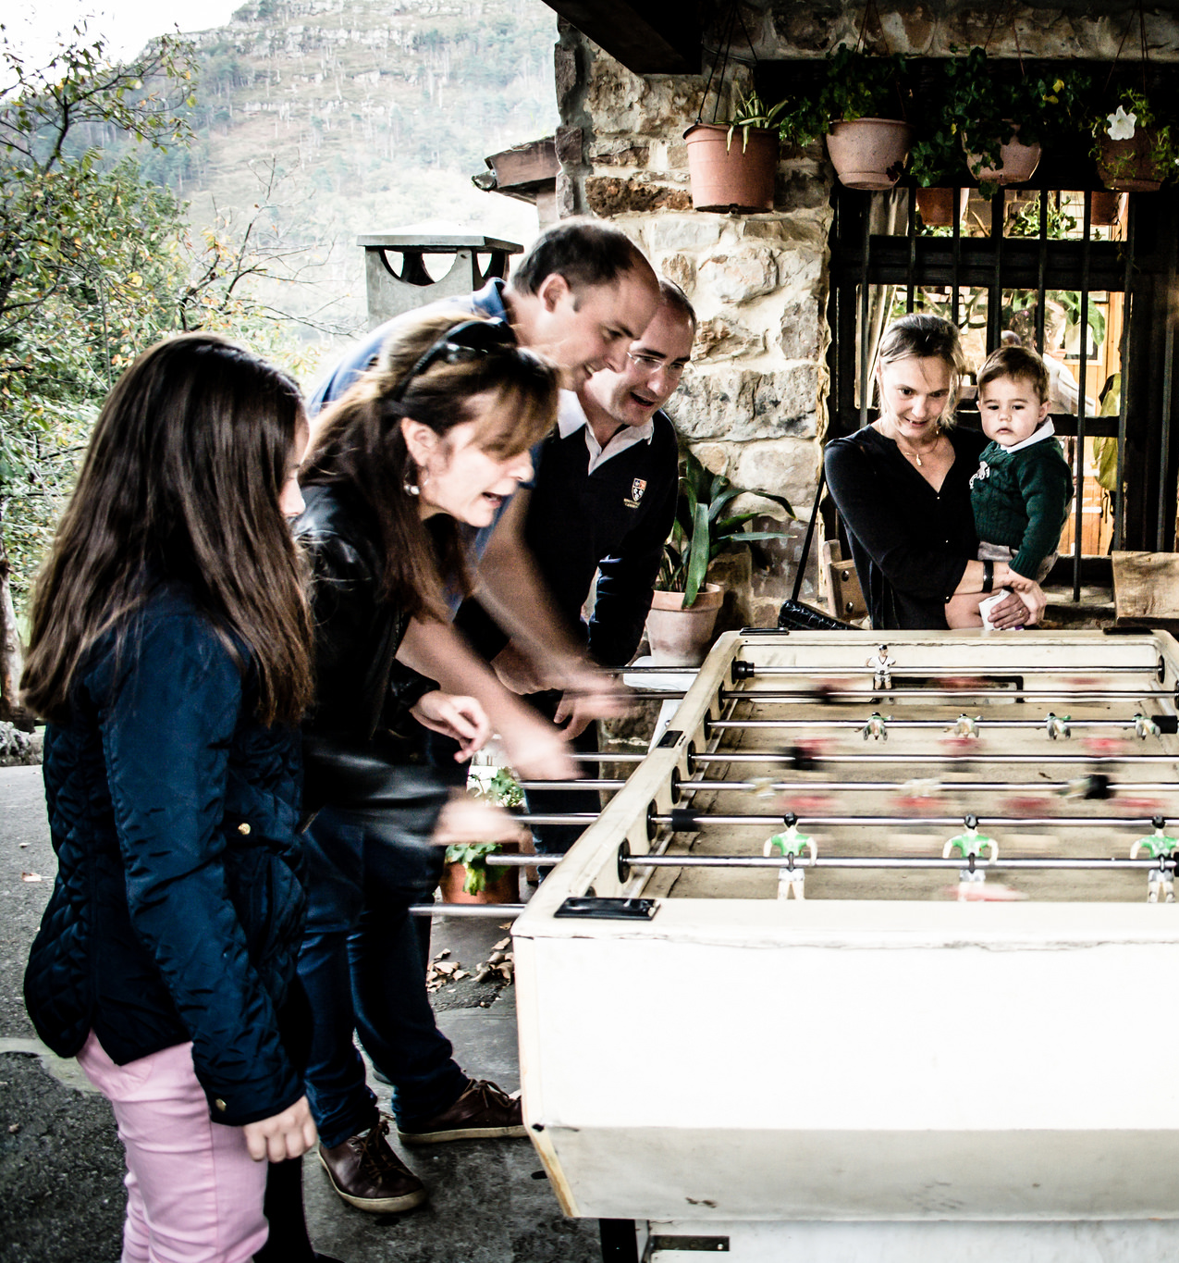
E-TALKING BEST FOR YOU
Game Time
In case your family needs to be tricked into being active, turn your game nights into an active experience by playing interactive games that require a little movement. Some examples could be charades or Wii fitness games that require you to move about. Have each family member take turns choosing an activity for game night and let everyone bond while burning some calories.

Slide 7

E-TALKING BEST FOR YOU
DISCUSSION
What games are both fun and promote physical activity? Do you and your family have a regular time that you spend together? If you do, do you think you and your family would enjoy playing more active games together? Why or why not? If you don't, do you think you could convince them to change and make time for it? Why or why not?

Slide 8
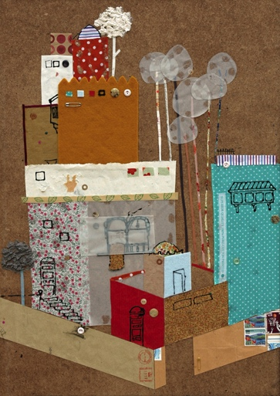
E-TALKING BEST FOR YOU
Make It Competitive
Since almost everyone is competitive, families can create a scavenger hunt that turns a normal visit to a nearby park into an extended adventure. See who in the family can find or identify the most landmarks, animals, or certain type of trees or flowers. If you are on a trip with your family, you can build a collage or create a scrapbook to remember the trip after you return home. Another way to make use of your family’s competitive nature is to hold contests to see which family member accumulated the most miles walked during a day. There are several apps available to download for your smartphone to help keep count. If you don’t want to count miles walked per day, you could instead hold a contest to see who burned the most calories during their normal daily routine.

Slide 9
E-TALKING BEST FOR YOU
DISCUSSION
If you and your family were to do a scavenger hunt, what landmarks, animals, plants, or other sights could you add onto your family’s list for a scavenger hunt? How might collecting ticket stubs or photographs from a vacation promote physical fitness? Would these suggestions be a good plan for fitness for your family? Why or why not?

Slide 10
E-TALKING BEST FOR YOU
REVIEW DISCUSSION
How active is your family?
How do you normally spend your free time?
Do you prefer to be active outdoors, to work out, or to be inside watching movies and snacking?
How much of your free time do you spend together with your family and how much do you spend apart?

Slide 11

E-TALKING BEST FOR YOU
SPEAKING TASK
Pick a day of the week and talk about your family’s schedule for that day. Discuss the time spent together and the time spent individually. Which parts of the schedule could be seen as exercise or being active? Add some suggestions from the lesson into your daily schedule.

Slide 12

E-TALKING BEST FOR YOU
ASSESSMENT
Match the vocabulary words from the reading with their appropriate definition.

Slide 13

E-TALKING BEST FOR YOU
Words
Trick
Interactive
Bond
Extended
Collage
Accumulate
Definitions
a piece of art made by sticking various different materials such as photographs and pieces of paper or fabric onto a backing
to develop a strong relationship with someone
involving communication between people
to increase in amount over a period of time
to deceive someone
longer
ASSESSMENT

Slide 14


E-TALKING BEST FOR YOU
Thank you !

