Slide 1
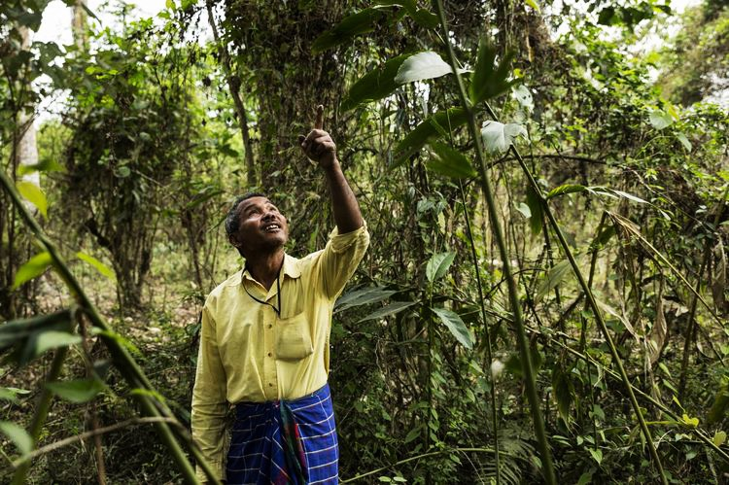
E-TALKING BEST FOR YOU
Nature , Science , India
Amazing Man Creates New Forest
view

Slide 2

E-TALKING BEST FOR YOU
INTRODUCTION
Can do:
Give opinions

Slide 3

E-TALKING BEST FOR YOU
GETTING START
Do you think being kind to the environment is important? Why or why not?
If yes, what can someone do to care for a forest near their home?

Slide 4
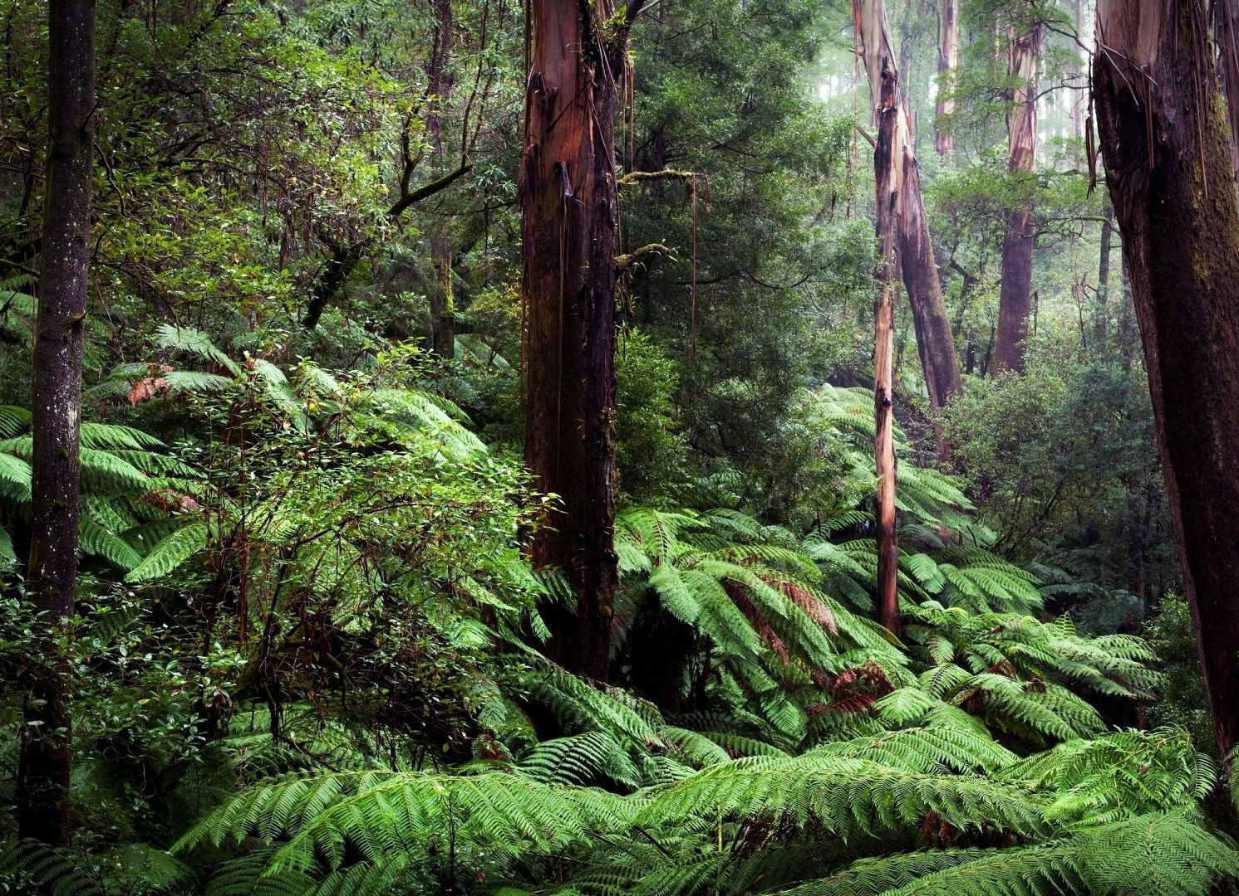

E-TALKING BEST FOR YOU
Vocabulary
Burying (verb): to hide something in the ground
Sandbar (noun): a raised area of sand with a top that is near or just above the surface of the water
Devote (verb): to decide that something will be used for a special purpose
Jungle (noun): a tropical forest where plants and trees grow very thickly

Slide 5
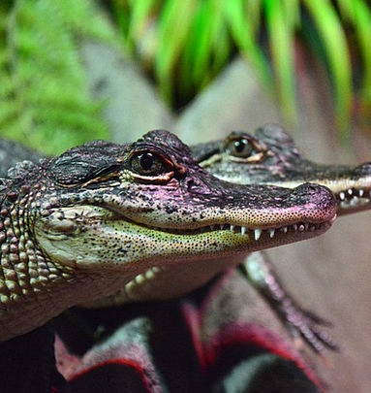
E-TALKING BEST FOR YOU
Vocabulary
Reptiles (noun): an animal that has cold blood, that lays eggs, and that has a body covered with scales
Shade (noun): an area of slight darkness that is produced when something blocks the light of the sun
Department (noun): one of the major parts of a company, organization, government, or school
Wildlife (noun): animals living in nature

Slide 6
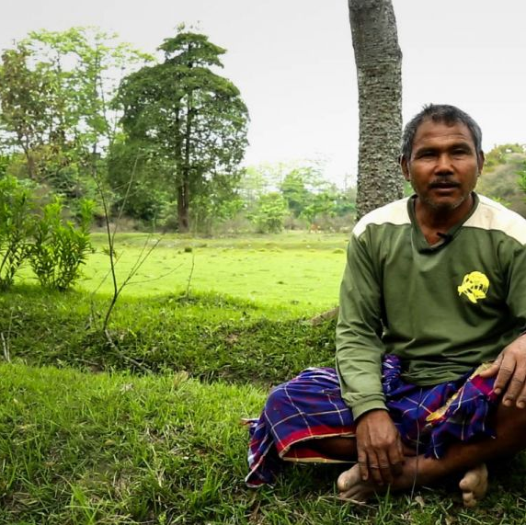
E-TALKING BEST FOR YOU
Reading time : Let’s read more about how a man created a forest
30 years ago a young man named Jadav "Moldai" Payeng started burying seeds along a sandbar near his home in India. Jadav wanted to make a refuge for wildlife. He decided to devote his life to this goal and moved to the site. This way, he could work full-time to create a forest. Today the spot has 1,360 acres of jungle that Payeng planted, alone.

Slide 7
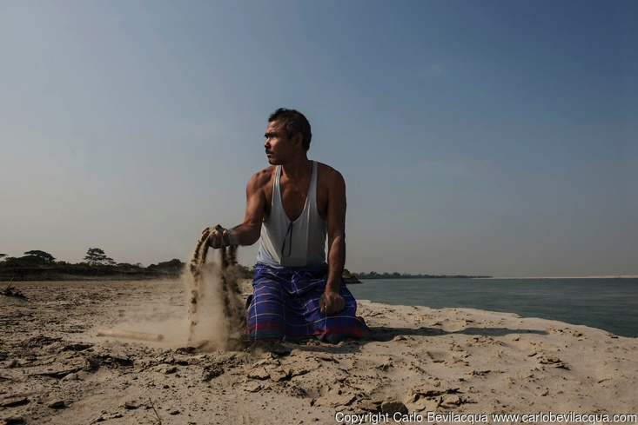
E-TALKING BEST FOR YOU
Reading time
In 1979 floods washed a large number of snakes onto the sandbar. Later, Payeng, who was 16 years old, found the sandbar had many dead reptiles. He cried over their dead bodies. He knew they died in the heat because they had no shade from trees. He went to the forest department and they said trees wouldn't grow on the sandbar.

Slide 8
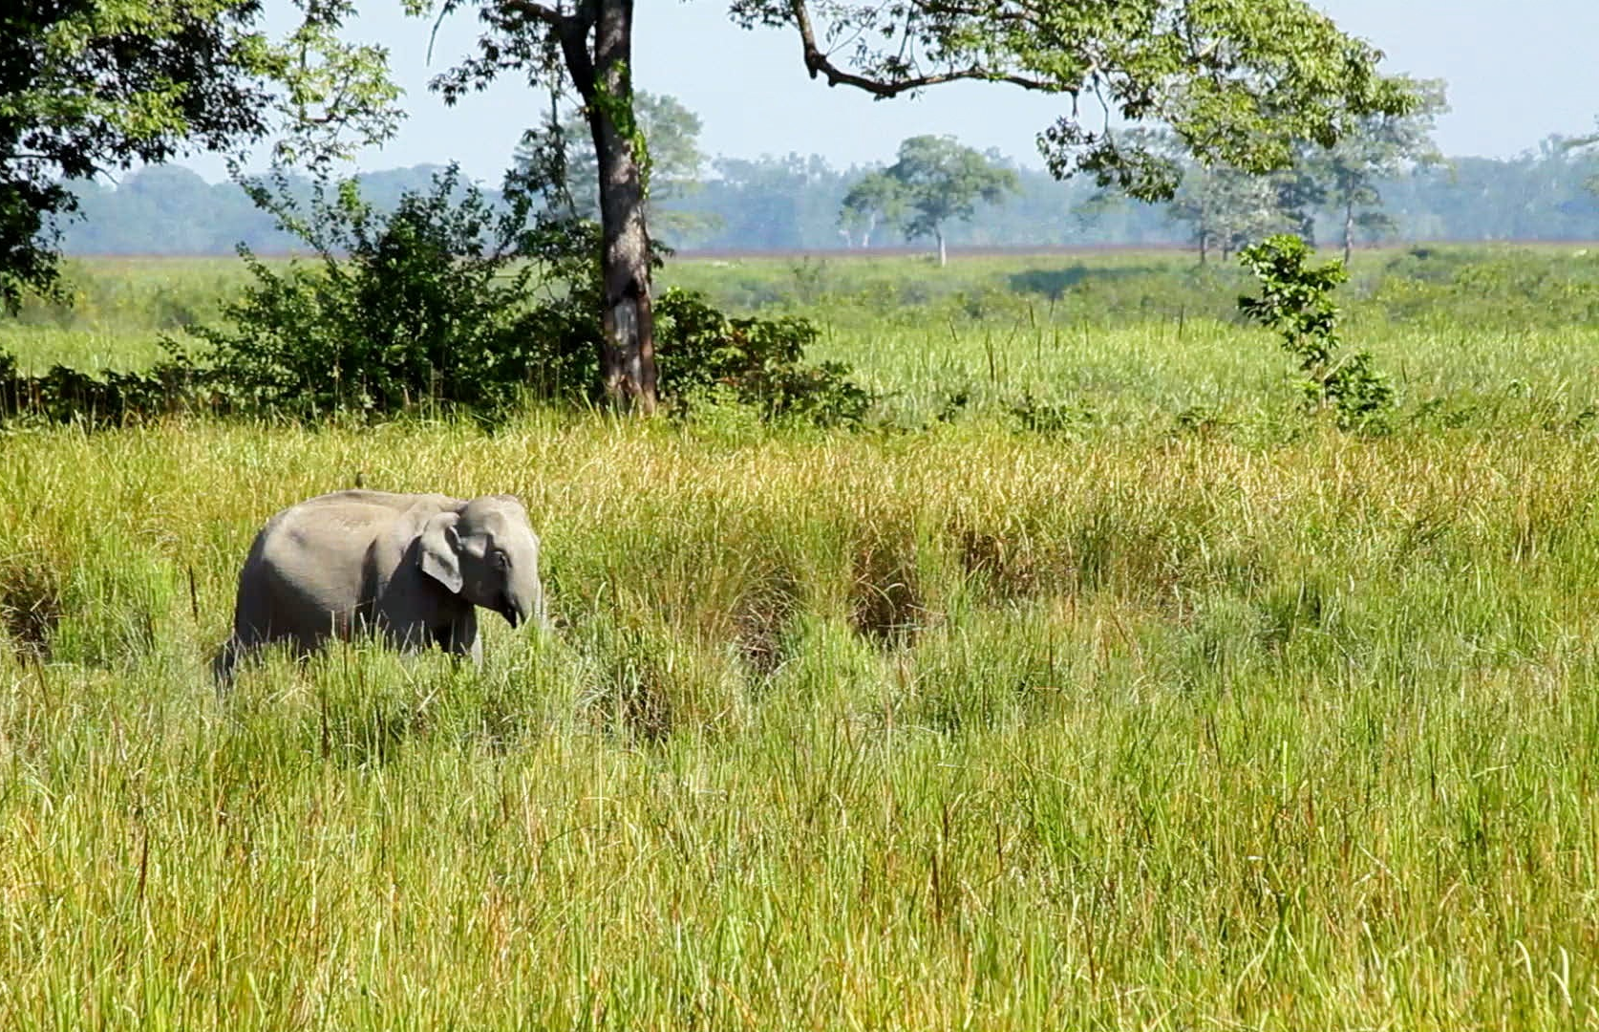
E-TALKING BEST FOR YOU
Reading time
They told Payeng to try to grow bamboo. “It was painful, but I did it. There was nobody to help me. Nobody was interested," says Payeng. Now the forest is home to wildlife like deer, birds, and other animals.

Slide 9
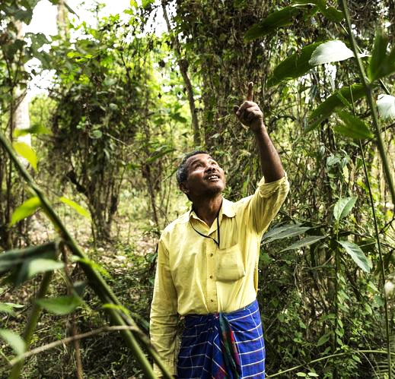
E-TALKING BEST FOR YOU
Comprehension questions :
What did Jadav Payeng do with seeds 30 years ago?
What did he want to make?
How many acres of jungle did Jadav plant?
Why did the animals die in 1979?
What animals live in the forest now?

Slide 10

E-TALKING BEST FOR YOU
REVIEW DISCUSSION
Is there a forest near your home or city?
What kinds of animals and wildlife live in your country?
How do you take care of your environment?

Slide 11

E-TALKING BEST FOR YOU
SPEAKING TASK
Summarize the article and add your opinion.

Slide 12

E-TALKING BEST FOR YOU
ASSESSMENT
Put it into practice

Slide 13

E-TALKING BEST FOR YOU
Department shade reptiles burying sandbar devote
1 . The dog started _____________ his bones in the backyard.
2. We were able to walk out to the ____________ in the ocean.
3. The girl ____________s an hour of her day to reading fairy tales.
4. The animals in the _____________ ran away when they heard the lion.
5. The boy loves __________ and was very happy to get a turtle.
6. The trees provide ____________ for the animals that live under them.
7. When you get to the hospital, go directly to the X-ray ____________.
ASSESSMENT

Slide 14


E-TALKING BEST FOR YOU
Thank you !

