Slide 1

E-TALKING BEST FOR YOU
Meetings
How to schedule meetings in English
view
Image from : www.solararesort.ca

Slide 2

E-TALKING BEST FOR YOU
INTRODUCTION
Students can interact properly during meeting discussions.

Slide 3
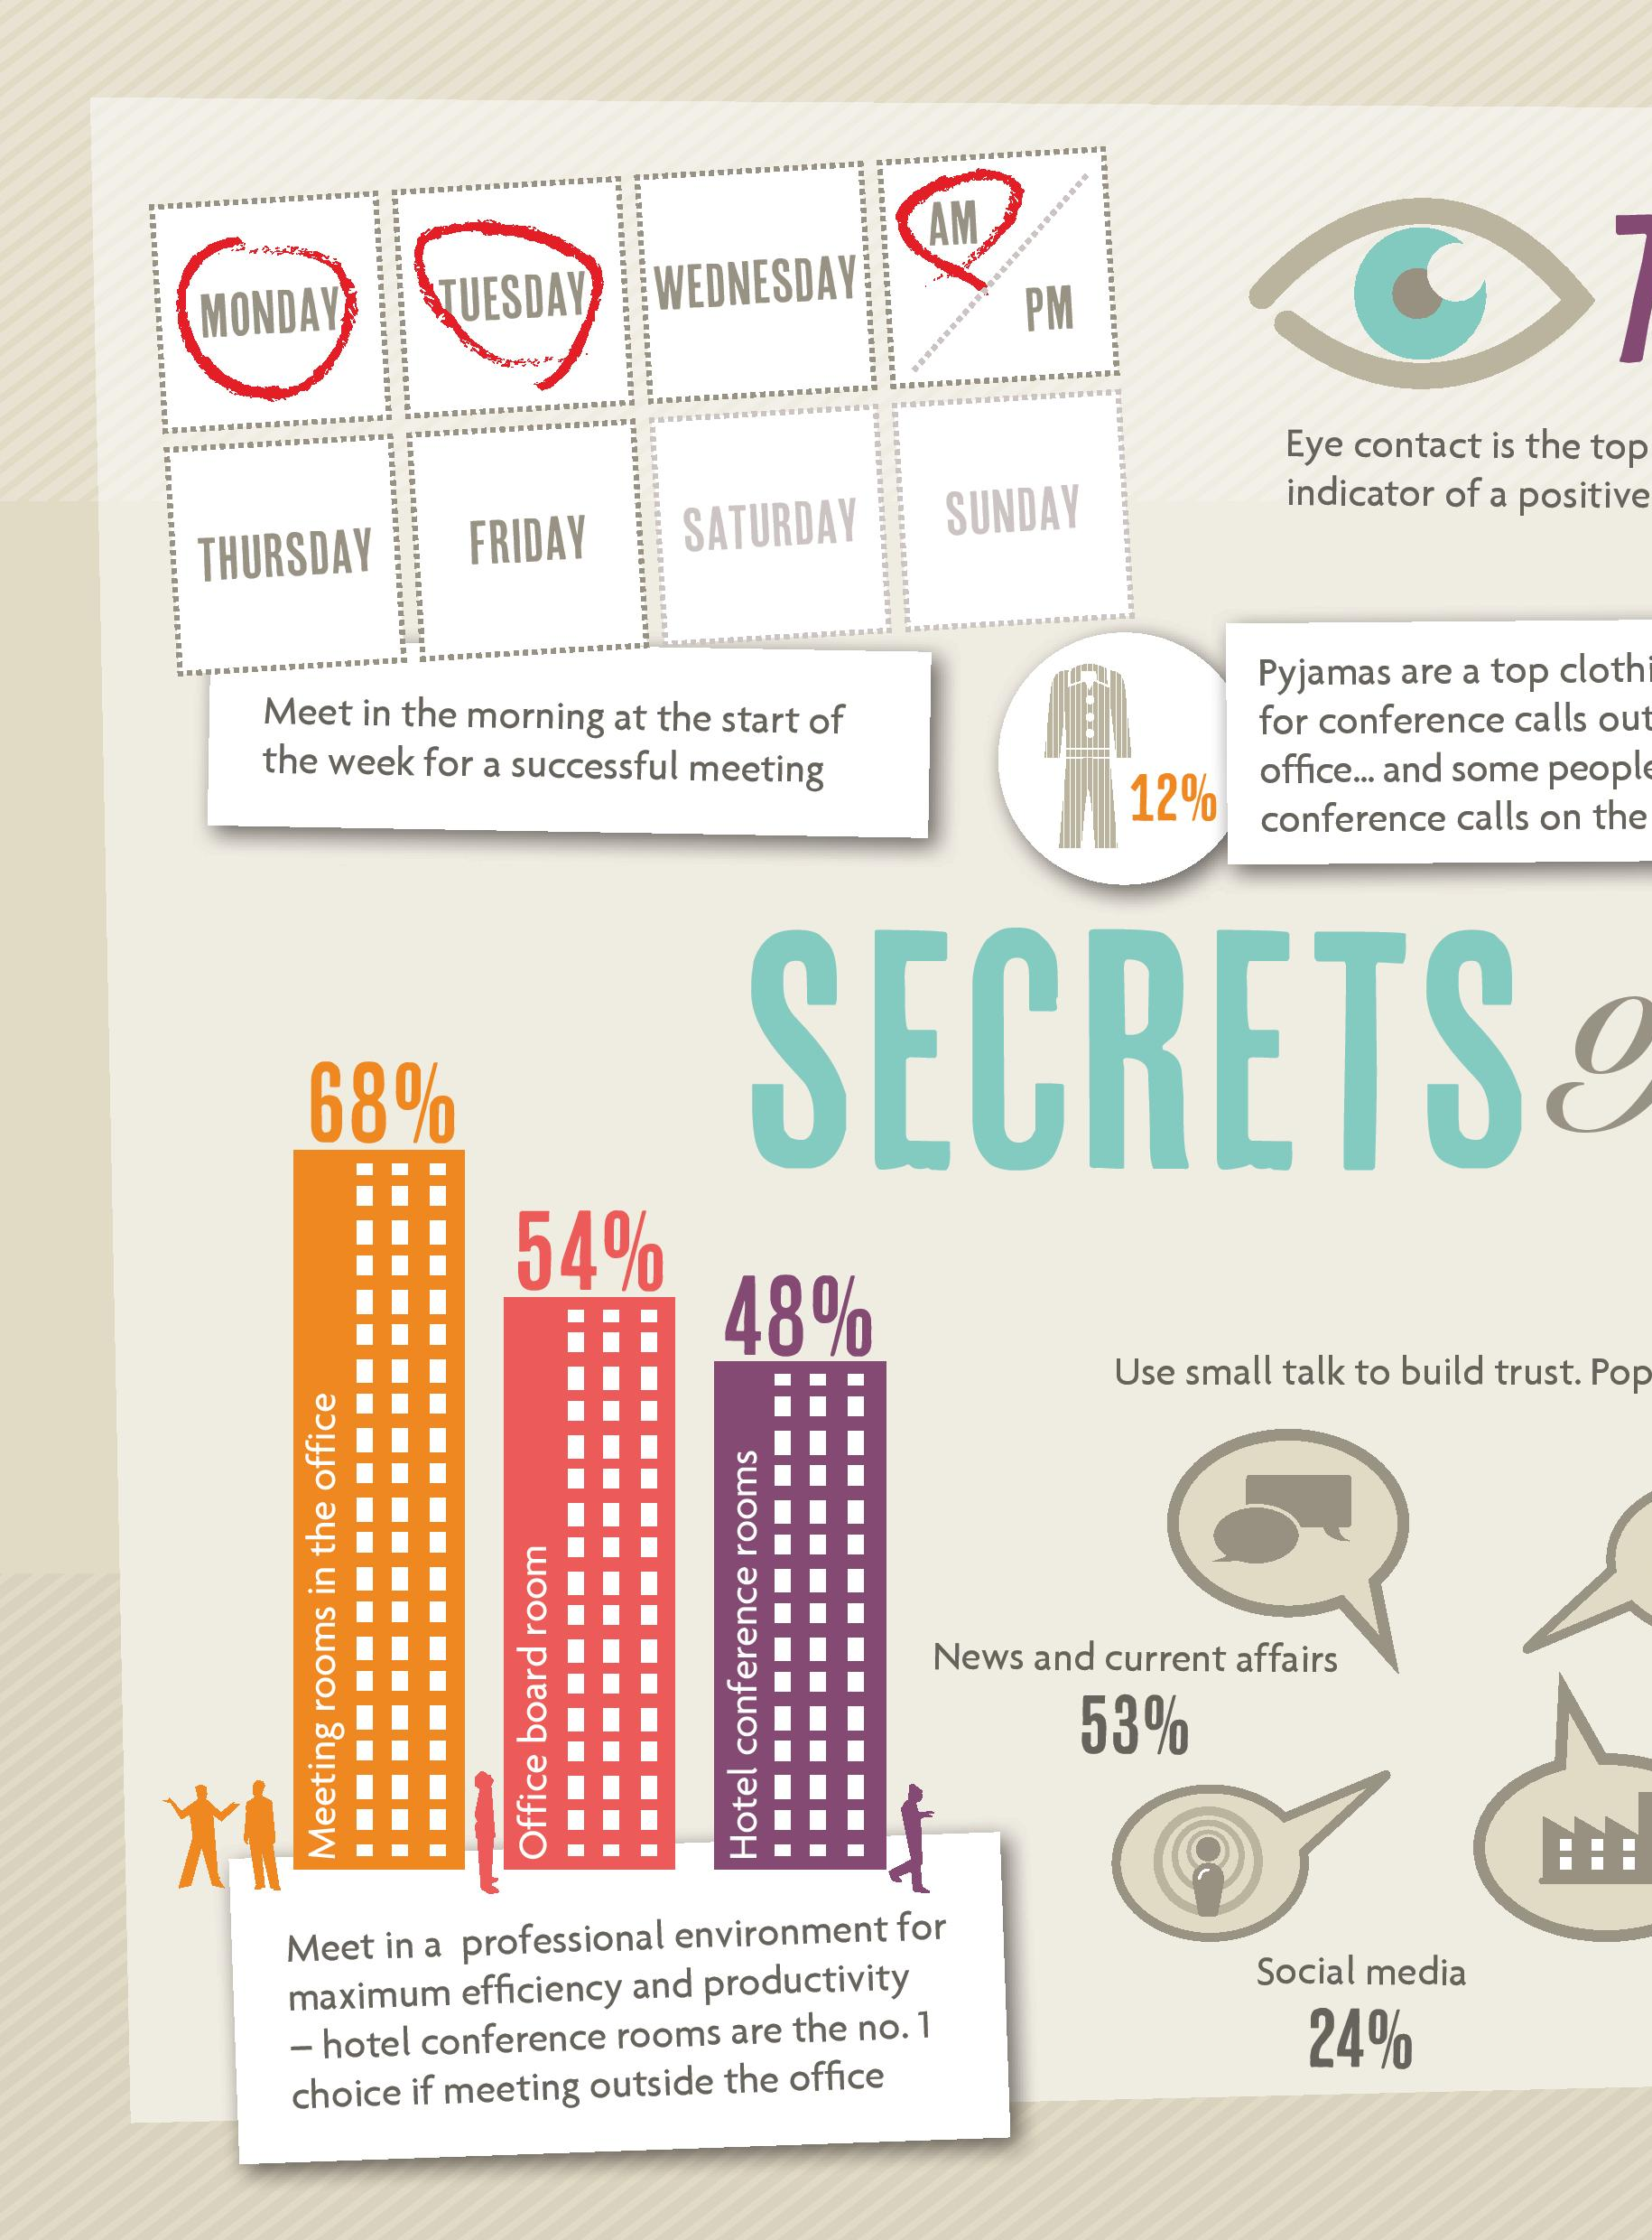

E-TALKING BEST FOR YOU
START
Inconclusive Meetings
It takes a lot of efforts to successfully schedule a business meeting. Getting enough people to form a quorum, especially when it involves top executive members is not easy. Inconclusive meetings can be problematic. You will have to take the pains to decide how to schedule another meeting before you can reach a conclusion. This signals trouble.
Quorum (noun) Minimum number of people for making decisions in a meeting
Take the pains (expression) Make an effort
Signal (verb) a sign of something
Image from : www.meetingsbooker.com

Slide 4

E-TALKING BEST FOR YOU
WARM-UP
Have you attended a business meeting before?
Who was the person you found the hardest to understand?

Slide 5

E-TALKING BEST FOR YOU
GETTING STARTED
Imagine you are in the context of a meeting. Politely request a business partner to repeat what he/she has just said during the course of the discussion. Write out six polite phrases you would use to be polite.

Slide 6

E-TALKING BEST FOR YOU
01 Keeping Track of
Meeting Discussions
During a meeting discussion, it may happen that you lose track of what the current point being discussed is. You may find it difficult to understand a particular person. You might want to stop the meeting from running on, otherwise, you may end up missing the necessary points.
Lose track (expression/verb) Not follow what was said
Current (adjective) Now
Particular (adjective) This person and not another
Image from : www.hrmasia.com

Slide 7
E-TALKING BEST FOR YOU
01 Keeping Track of
Meeting Discussions
Phrases such as “Sorry I missed that,” “Could you please say that again?” “Sorry I’m not with you,” “Could you go over that again?” are used to make sure what someone just said.
Lose track (expression/verb) Not follow what was said
Current (adjective) Now
Particular (adjective) This person and not another
Image from : www.hrmasia.com

Slide 8

E-TALKING BEST FOR YOU
DISCUSSION
Form some sentences, beginning with the phrase “Sorry I…,” to check what someone has said during a meeting.
01

Slide 9

E-TALKING BEST FOR YOU
02 How to Clarify
Important Points
When you decide to check what someone has said in a meeting, saying “I don’t understand.” “I’m not with you” is insufficient, especially when it involves discussing facts and figures. In this kind of situation, you need to be more specific.
Insufficient (adjective) Not enough
Situation (noun) Condition
Fact (noun) Truth
Figure (noun) Statistic
Image from : www.cinfo.ch

Slide 10
E-TALKING BEST FOR YOU
DISCUSSION
How to be specific about a particular point when you check
what someone has said in a business meeting? You can use the following words: what, who, where, how long, how much.
02

Slide 11

E-TALKING BEST FOR YOU
03 Speaking Fluently
You need to be able to speak correct English by using the right words and putting them in the correct order for people to get what you are trying to say during a meeting. Learning and reading business English passages will go a long way in improving your written and spoken English.
Order (noun) One step after another
Improve (verb) Increase
Image from : www.imodernbusinessenglish.com

Slide 12

E-TALKING BEST FOR YOU
04 Querying Information
It is a normal thing for people to disagree during a meeting. You can politely query the wrong thing that was said by saying it again and asking a question on it. For instance, the point could be about a particular figure in 2005. So, you could say something like, “2005? Don’t you mean 2007? The speaker can then possibly reply you by simply saying, “No, I mean 2005.”
Disagree (verb) Say something differently
Instance (noun) Example
Image from : www.huffingtonpost.com

Slide 13
E-TALKING BEST FOR YOU
DISCUSSION
How do you politely query the following wrong information?
1. China is the largest city in the world.
2. Mexico is located in South America.
3. Toronto is in USA.
03

Slide 14

E-TALKING BEST FOR YOU
SPEAKING TASK
Group the following under superlative or comparative.
bestselling, fewer, more, nearest, oldest, biggest, greater, most,

Slide 15

E-TALKING BEST FOR YOU
ASSESSMENT
Complete the sentences using the vocabulary words from this lesson:

Slide 16

E-TALKING BEST FOR YOU
particular, situation, track, insufficient, disagree
It may be possible to lose ______ of what the current point of
discussion is.
2. You may find it difficult to understand a __________ person.
3. It is __________ to say, “I’m not with you.”
4. In this kind of _________, you need to be more specific.
5. It is a normal thing for people to __________ during a meeting.
ASSESSMENT

Slide 17


E-TALKING BEST FOR YOU
Thank you !

