Slide 1
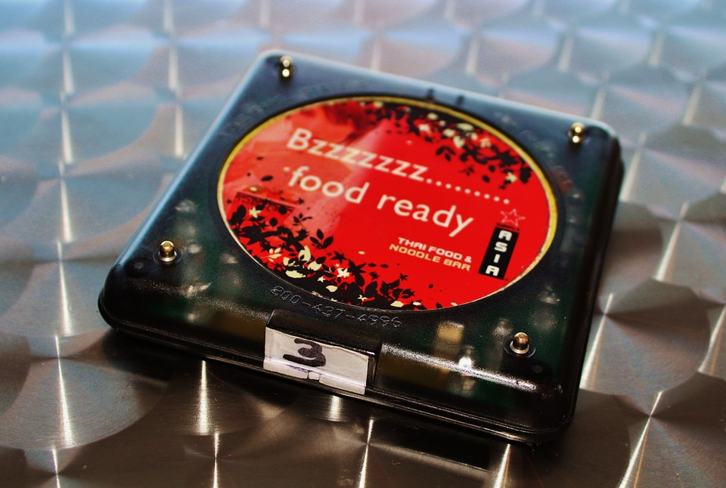
E-TALKING
BEST
FOR YOU
Networking
Eating out
view
Image from : pixabay.com

Slide 2

E-TALKING
BEST
FOR YOU
INTRODUCTION
Students can understand what Eating Out is all about.

Slide 3
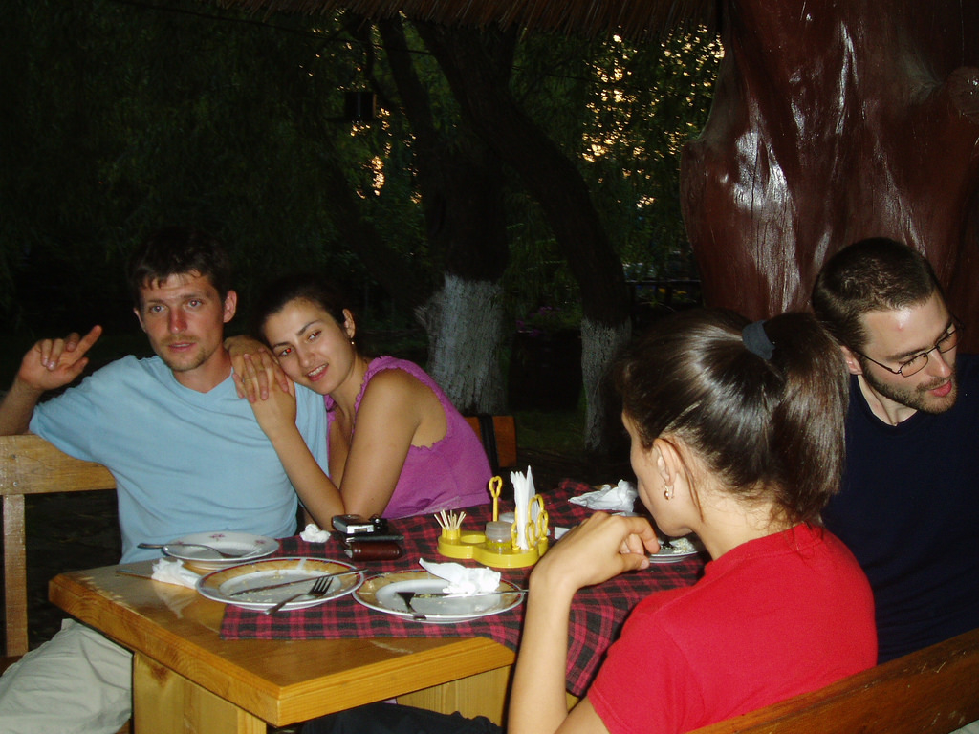
E-TALKING
BEST
FOR YOU
Meaning of Eating Out
Eating out can take the form of a lunch. It can also be a business lunch. You can invite a foreign friend to enjoy your local cuisine. Or, you and your partner can go out and grab a quick bite, like a pizza.
START
Image from : flickr.com

Slide 4

E-TALKING
BEST
FOR YOU
WARM-UP
Have you ever eaten out? How was it?

Slide 5

E-TALKING
BEST
FOR YOU
GETTING STARTED
Give some suggestions on a nice place to eat out.

Slide 6
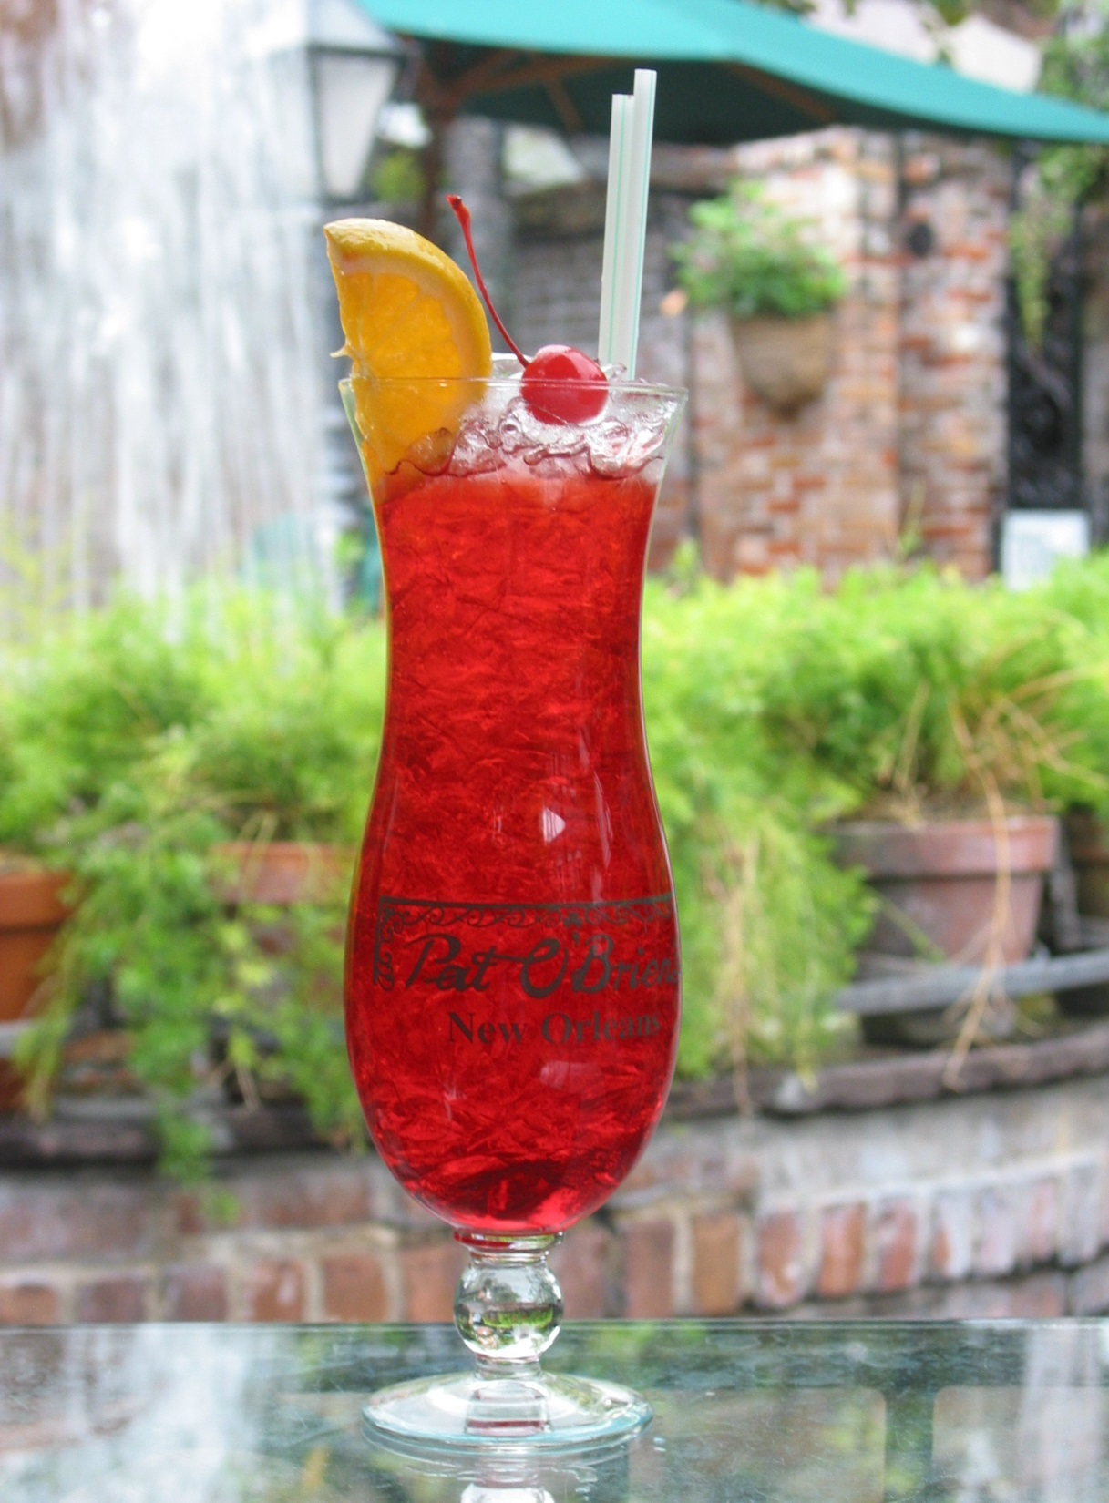

E-TALKING
BEST
FOR YOU
01 Table Manners
Are you culturally aware? For instance, Russians would typically sit down for a cocktail party. The Japanese will not want to tip. A Frenchman, however, wouldn't eat out without leaving a tip.
Aware (noun) Have knowledge of something
Dinner (noun) The evening meal
Instance (noun) An example of
Cocktail (noun) A formal party with drinks
Leave a tip (verb) Give a small amount to the waiter
Image from : en.wikipedia.org

Slide 7

E-TALKING
BEST
FOR YOU
DISCUSSION
Explain what is normal to do during a meal in your culture.
01

Slide 8
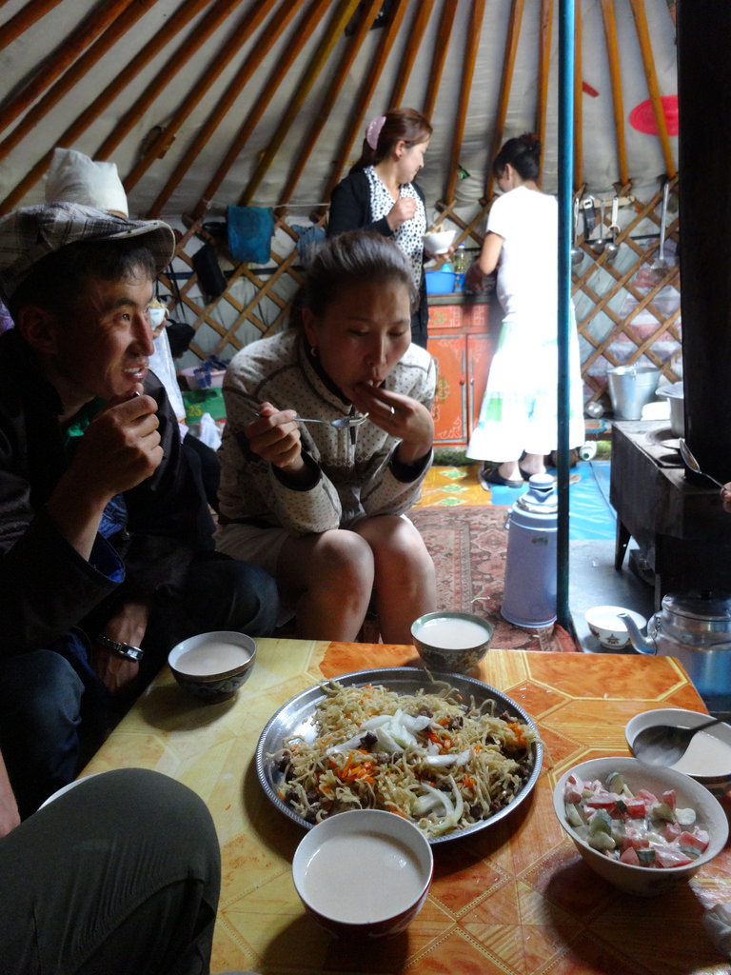
02 Sticky Situations
E-TALKING
BEST
FOR YOU
Eating out may create sticky situations when people from different countries discuss matters of interest. Although conversation may be a hindrance to fully enjoying your meal out, you just have to tolerate it while dealing with people from other cultures.
Sticky (adjective) Involving problems
Hindrance (noun) Delay
Conversation (noun) Talk
Tolerate (verb) Put up with
Image from : flickr.com

Slide 9
E-TALKING
BEST
FOR YOU
DISCUSSION
Is it a good or bad table manner to talk while eating?
How is it seen in your culture?
02

Slide 10
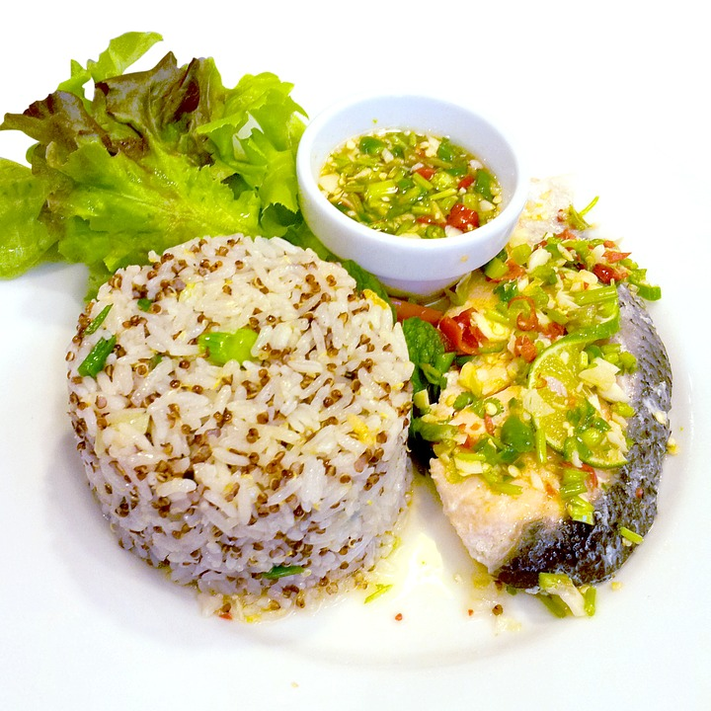
E-TALKING
BEST
FOR YOU
03 A Healthy Diet
Diet is not just what you want to eat. You need to watch what you eat, and not just take what you like. There are some foods people don’t like having, whereas such foods are good for them and could improve their health.
Diet (noun) What you eat
Whereas (conjunction) In opposite with the fact
Improve (verb) Make better
Image from : pixabay.com

Slide 11
E-TALKING
BEST
FOR YOU
DISCUSSION
Which foods do you like to take?
Explain the type of nutrients they include.
03

Slide 12
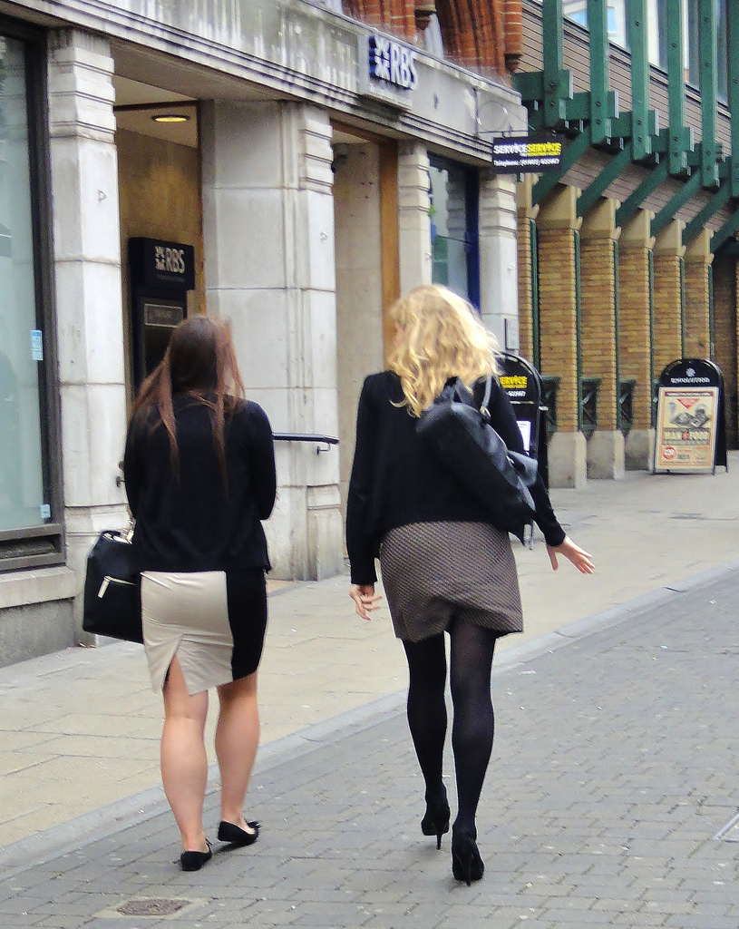
E-TALKING
BEST
FOR YOU
04 Out to Lunch
To organize a proper meal out, you need to prepare a menu. You can ask your guests to pick what they like from the menu. The items on a menu depend on the foods available.
Organize (verb) Arrange
Guest (noun) A person invited to an event
Items (noun) Something
Image from : flickr.com

Slide 13
E-TALKING
BEST
FOR YOU
DISCUSSION
What kind of menu would you prepare for a business lunch? Would you include special diets?
04

Slide 14

E-TALKING
BEST
FOR YOU
SPEAKING TASK
Form five sentences that talk about eating out by completing the following expression. Here is an example for you to follow.
There is/I know a really nice restaurant where you can get hot dog.
There is a really nice ...

Slide 15

E-TALKING
BEST
FOR YOU
ASSESSMENT
Complete the sentences using the vocabulary words from this lesson:

Slide 16

E-TALKING
BEST
FOR YOU
Match the vocabulary words with their meanings.
Diet Make better
Hindrance Something
Guest What you eat
Items Delay
Improve A person invited to an event
ASSESSMENT

Slide 17


E-TALKING
BEST
FOR YOU
Thank you !

