Slide 1
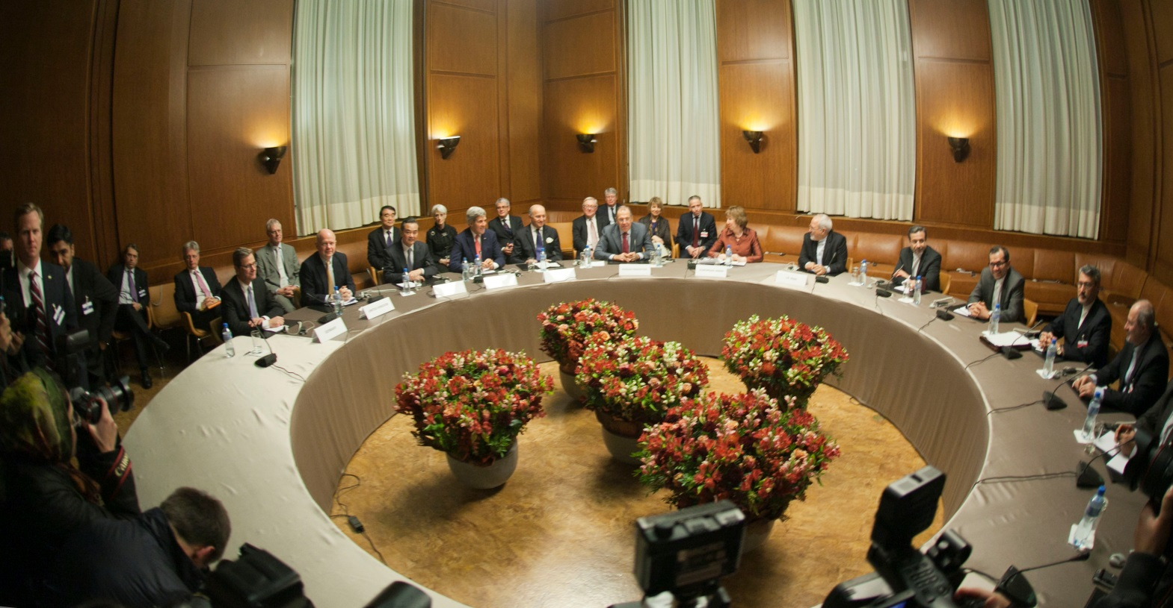
E-TALKING BEST FOR YOU
Meetings
Negotiating
view
Image from : en.wikipedia.org

Slide 2

E-TALKING BEST FOR YOU
INTRODUCTION
Students can identify the negotiation process.

Slide 3

E-TALKING BEST FOR YOU
Meaning of Negotiation
Any person who wants to enter a negotiation should be optimistic. There is no way you can avoid negotiations as you engage in business transactions. Negotiation requires determination in order to win! You need to win your boss, your customers, and even your business partner, to your side to be successful.
START
Image from : youtube.com

Slide 4

E-TALKING BEST FOR YOU
WARM-UP
Give an instance where you negotiated a deal with your business partner. What was the experience like?

Slide 5

E-TALKING BEST FOR YOU
GETTING STARTED
Practice negotiating your salary in order to arrive at a particular deal.

Slide 6


E-TALKING BEST FOR YOU
01 Directness
Do you go straight to the point when you negotiate or use a diplomatic approach? Either way, it depends on your personal goal and cultural background. This will determine whether a decision will be reached or not.
Negotiate (verb) Obtain by discussion
Diplomatic (adjective) Skilled in dealing with matters
Approach (noun) How you do something
Decision (noun) A conclusion
Image from : flickr.com

Slide 7

E-TALKING BEST FOR YOU
DISCUSSION
Which one do you think works better in negotiations, going straight to the point or using a diplomatic approach? Discuss.
01

Slide 8
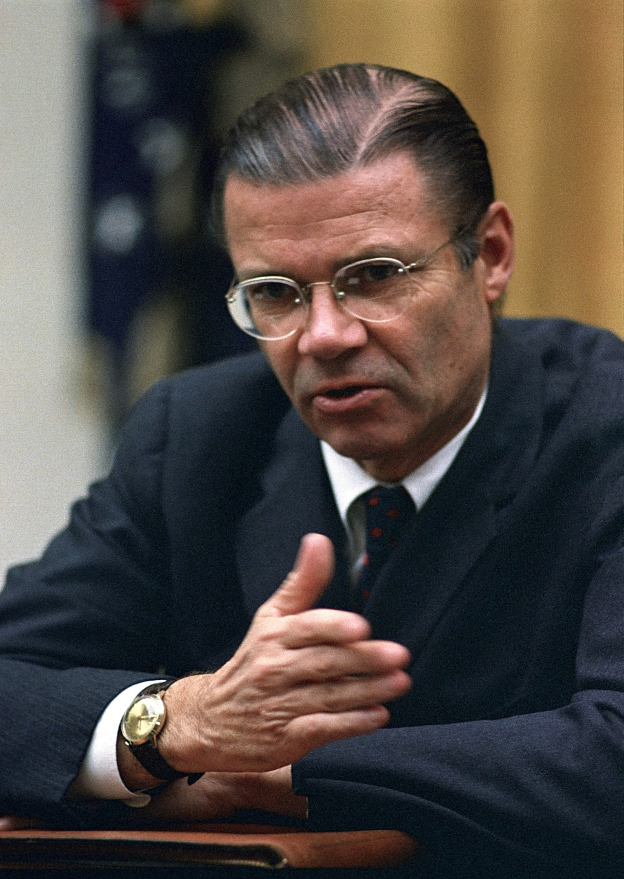
E-TALKING BEST FOR YOU
02 The Language of Negotiations
Some expressions are very useful in negotiating. For example, “What if you’re offered an …?” “So, how much are we talking about here …?” and so on. This is the language of negotiation.
Image from : en.wikipedia.org

Slide 9
E-TALKING BEST FOR YOU
DISCUSSION
Give another four examples of expression that can be used during negotiations.
02

Slide 10

E-TALKING BEST FOR YOU
03 Example of Negotiation
Footballers, today, are rock stars. They are able to strike good deals with their football clubs as a result of the ability to negotiate well. Many of them get million dollars packages due to skillful negotiation.
Strike a deal (verb) Reach an agreement
Deal (noun) Business agreement
Package (noun) Job contract
Skillful (adjective) Good
Image from : en.wikipedia.org

Slide 11
E-TALKING BEST FOR YOU
DISCUSSION
Imagine trying to convince someone who doesn't like football to watch a game with you. Practice your negotiating skills!
03

Slide 12
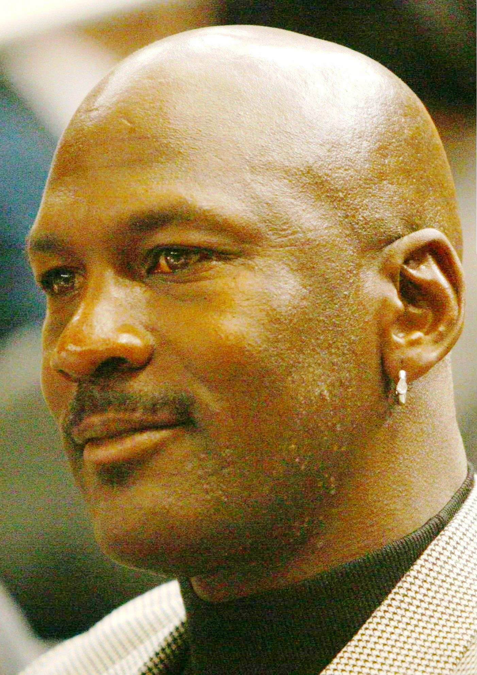
E-TALKING BEST FOR YOU
04 Getting Goals
As you negotiate your way through business deals, you can attain your goals. Attaining your goals is the crown of business negotiation, and huge profits are the dividends.
Crown (noun) Success
Attain (verb) Achieve
Multiple (adjective) Many
Huge (adjective) Very big
Image from : en.wikipedia.org

Slide 13
E-TALKING BEST FOR YOU
DISCUSSION
How do you think good negotiation helps to attain goals?
04

Slide 14

E-TALKING BEST FOR YOU
SPEAKING TASK
Match up the following words.
Critical negotiation
Long-term demand
Win-win relationship
One-off situation

Slide 15

E-TALKING BEST FOR YOU
ASSESSMENT
Complete the sentences using the vocabulary words from this lesson:

Slide 16

E-TALKING BEST FOR YOU
Complete the following sentences using the vocabulary words from the lesson.
negotiate, attain, diplomatic, through, negotiations
Do you go directly to the point when you _________ or use a ___________ approach?
There are some languages that are very useful in __________ .
As you negotiate your way ________ the business world, you can _______ your goals.
ASSESSMENT

Slide 17


E-TALKING BEST FOR YOU
Thank you !

