Slide 1
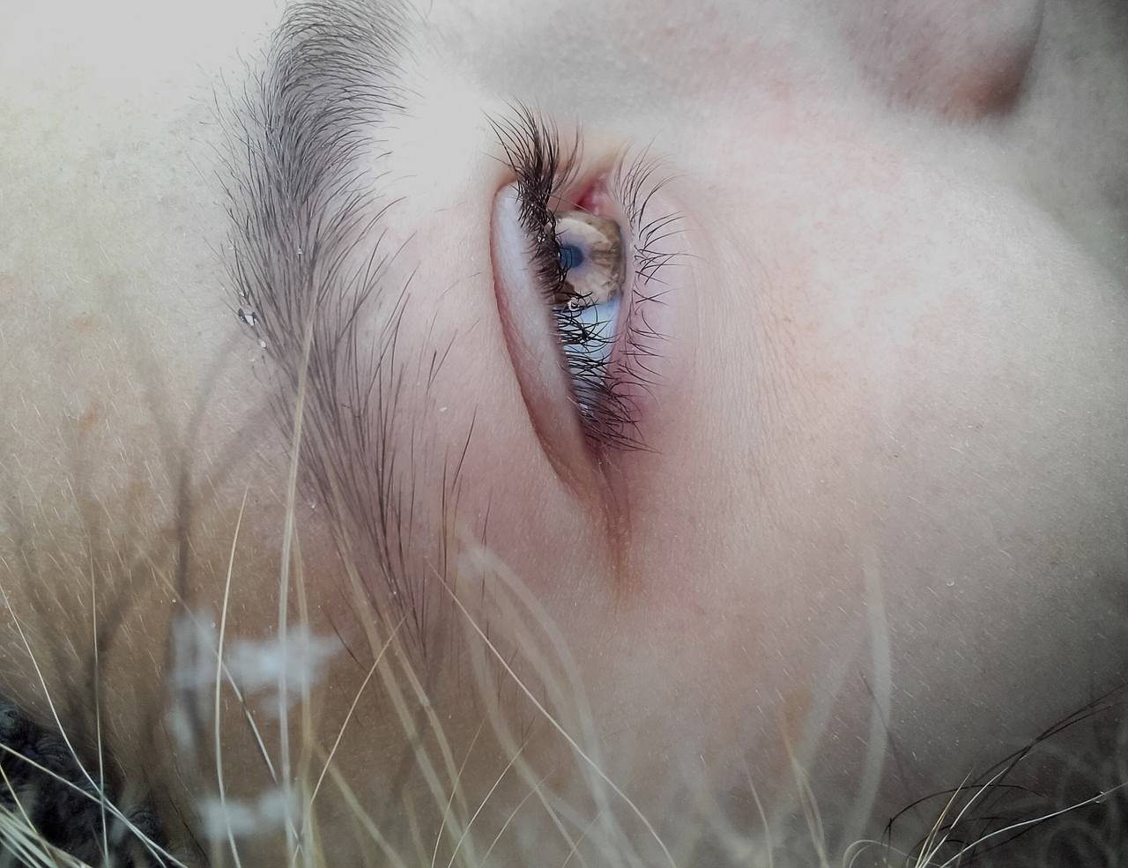
E-TALKING BEST FOR YOU
The Importance of Memory How to Share Your Experiences
view

Slide 2

E-TALKING BEST FOR YOU
INTRODUCTION

Slide 3

E-TALKING BEST FOR YOU
Recalling Your Experiences
Everybody experiences different things throughout their lives. Some are good, and some are bad. Some are life-changing, while some are relatively insignificant. Recalling these experiences is a useful tool, especially in practicing memory skills. It can also be useful in helping you learn from past experiences.
START

Slide 4

E-TALKING BEST FOR YOU
VOCABULARY
Lets check whether you know each following word.

Slide 5

E-TALKING BEST FOR YOU
E-TALKING BEST FOR YOU
Peaceful (adjective) Quiet, non-violent and calm.
Holiday (noun) A break from work or school.
Detailed (adjective) Containing lots of information.
Memory (noun) Something we remember from the past.
Growth (noun) The way we develop.
Vocabulary

Slide 6
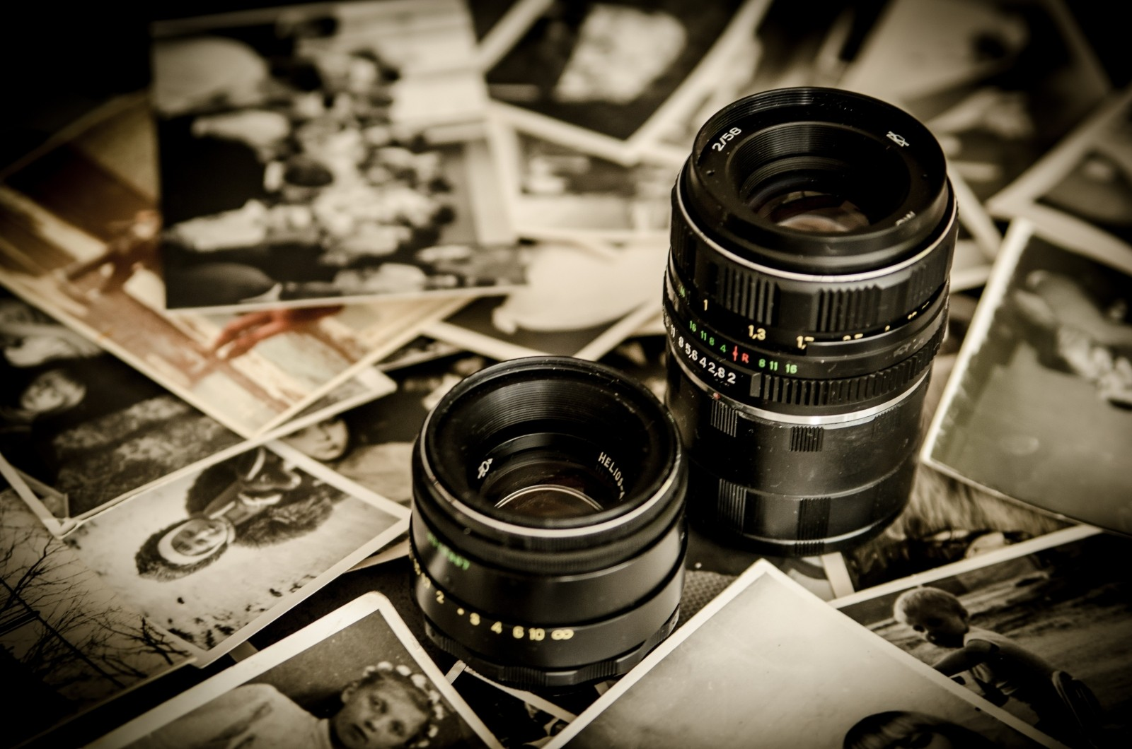
E-TALKING BEST FOR YOU
Remembering Events
Remembering past events can be tricky. The first step is to find a quiet, peaceful place and to sit with a pen and paper handy. Then think through one step at a time, for example, when remembering a holiday, first remember when you went, where you went, and whom you went with, then build up to more detailed memories such as what you did, what you enjoyed, what you didn’t like, etc. Write everything down so you remember them.

Slide 7

E-TALKING BEST FOR YOU
Using Past Experiences
Remembering past experiences is a useful skill as it allows you to increase your memory, and memory is an important talent for many jobs. It also allows for personal growth and for you to realize which events have happened in your life that have shaped and changed you to become what you are today. This is important for personal improvement.

Slide 8

E-TALKING BEST FOR YOU
REVIEW DISCUSSION
Do you enjoy thinking of past experiences?
Do you think that being able to recall past events is a
useful skill to have or not?

Slide 9

E-TALKING BEST FOR YOU
SPEAKING TASK
Think of a positive event from five years ago. Using the tips in this lesson try to remember as much as you can about the experience and write it down. Be sure to include what lesson you learned and how the experience affected you.

Slide 10

E-TALKING BEST FOR YOU
ASSESSMENT
Complete the sentences using the vocabulary words from this lesson:

Slide 11

E-TALKING BEST FOR YOU
peaceful / holiday / detailed / memory / growth
The day I got married is my favorite .
I have a good memory and the memories I recall are usually very .
Memory recall is good for personal .
I am going on to Europe soon.
I like Taipei because it’s a very place.
ASSESSMENT

Slide 12


E-TALKING BEST FOR YOU
Thank you !

