Slide 1


E-TALKING BEST FOR YOU
CEO Search
Recruiting the best people for the best companies.
view
Image from : http://www.lorenzanoandyannes.com/?page_id=104

Slide 2

E-TALKING BEST FOR YOU
E-TALKING BEST FOR YOU
INTRODUCTION
Lesson objectives: Learning to talk about and describe work experiences.
Being able to use the present perfect simple and present perfect continuous tenses.

Slide 3
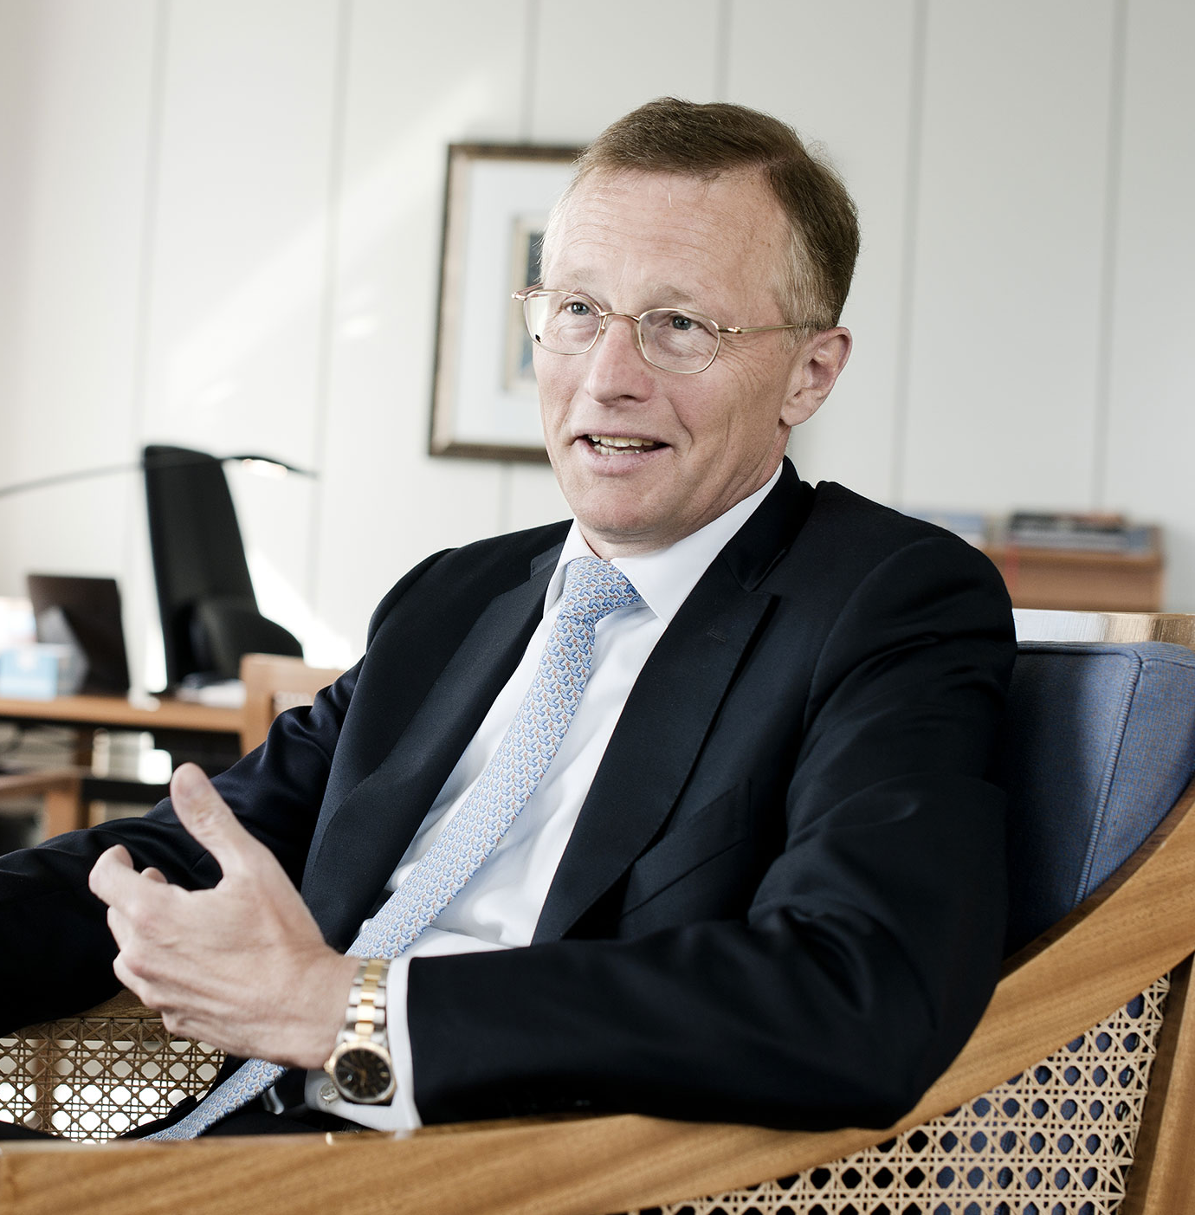
E-TALKING BEST FOR YOU
E-TALKING BEST FOR YOU
We all need to work. In today’s lesson, you will talk about work experiences and learn how to describe your job.
START
Image from : http://www.maersk.com/en/the-maersk-group/about-us/publications/maersk-post/2014-3/innovation-happens-every-day

Slide 4

E-TALKING BEST FOR YOU
E-TALKING BEST FOR YOU
WARM-UP
What kind of job do you have?
How did you find your current position?
Have you ever used a recruiter or an agent?

Slide 5

E-TALKING BEST FOR YOU
E-TALKING BEST FOR YOU
GETTING STARTED
Name yourself CEO of any company you wish.
Tell the class why you chose this company, and what you would do differently as a CEO.

Slide 6


E-TALKING BEST FOR YOU
01 Simple is Perfect
E-TALKING BEST FOR YOU
Mark the following sentences as either present perfect simple or present perfect continuous.
I have spoken with the manager.
The CEO has asked us to attend a meeting this afternoon.
Manager (noun) Someone who directs others.
Lawyer (noun) Someone that practices law.
To attend (verb) To be present at.
Image from : http://www.livescience.com/11345-top-ten-unexplained-phenomena.html

Slide 7
E-TALKING BEST FOR YOU
01 Simple is Perfect
E-TALKING BEST FOR YOU
The manager has been talking with the company’s lawyers for an hour.
Lately, the company has not been doing its job properly.
The job has been given to another candidate.
Properly (adverb) The correct way.
Candidate (noun) A job applicant; someone that applies for a job.
Image from : http://www.livescience.com/11345-top-ten-unexplained-phenomena.html

Slide 8

E-TALKING BEST FOR YOU
E-TALKING BEST FOR YOU
DISCUSSION
Do you find it difficult to use the present perfect tense?
How does this compare to other languages?
01

Slide 9

E-TALKING BEST FOR YOU
02 For, Since and Ago
E-TALKING BEST FOR YOU
Learn to use for, since and ago. Complete the following sentences with one of these three words.
We have lived in Canada ______________ 11 years.
To live (verb) To stay in a place.
To move (verb) to travel to another place to live.
Grade (noun) Year of school; the level of.
Image from : http://www.achfood.com/canada.cfm

Slide 10
E-TALKING BEST FOR YOU
02 For, Since and Ago
E-TALKING BEST FOR YOU
They’ve lived here _______________ 2002.
The Johnson family moved here 8 years ____________.
I have been teaching _____________ 13 years.
They have been studying grammar ________________ the sixth grade.
To live (verb) To stay in a place.
To move (verb) to travel to another place to live.
Grade (noun) Year of school; the level of.
Image from : http://www.achfood.com/canada.cfm

Slide 11
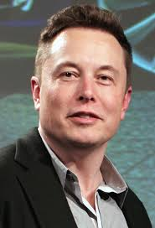
03 Elon Musk
E-TALKING BEST FOR YOU
E-TALKING BEST FOR YOU
Elon Musk is one of the most well-known CEOs in the world today. He was born in South Africa and today works and lives in North America. He is the CEO of several companies, including SpaceX, and Tesla Motors.
Well-known (adjective) Widely known; famous
To reduce (verb) To make smaller.
Human (noun) Man or woman.
Extinction (noun) Reduced to zero
Mars (noun) The name of the Solar System’s 4th planet.

Slide 12
E-TALKING BEST FOR YOU
03 Elon Musk
E-TALKING BEST FOR YOU
His goals include reducing global warming by lowering greenhouse gas emissions, and reducing the risk of human extinction by colonizing Mars.
Well-known (adjective) Widely known; famous
To reduce (verb) To make smaller.
To Lower (verb) To reduce in numbers.
Human (noun) Man or woman.
Extinction (noun) Reduced to zero
Mars (noun) The name of the Solar System’s 4th planet.

Slide 13
E-TALKING BEST FOR YOU
E-TALKING BEST FOR YOU
DISCUSSION
How do you feel about Elon Musk?
Would you drive one of his electric cars?
Do you think humans will really colonize Mars?
03

Slide 14

E-TALKING BEST FOR YOU
04 For Revisited
E-TALKING BEST FOR YOU
In English we sometimes add an ‘a’ after using ‘for’, but not always. Take a look at the following sentences.
I have been here for a few months.
I have been here for three years.
Overtime (noun) Time worked after normal hours.
Couple (noun) 2 things.
Image from :http://www.huffingtonpost.com/2013/06/14/working-overtime-marlo-thomas-poll_n_3442793.html

Slide 15
E-TALKING BEST FOR YOU
04 For Revisited
E-TALKING BEST FOR YOU
What have you been doing for the last few days?
They have been working overtime for a couple of weeks.
Overtime (noun) Time worked after normal hours.
Couple (noun) 2 things.
Image from :http://www.huffingtonpost.com/2013/06/14/working-overtime-marlo-thomas-poll_n_3442793.html

Slide 16
E-TALKING BEST FOR YOU
DISCUSSION
Now practice making sentences with ‘for’ and ‘for a’
04

Slide 17

E-TALKING BEST FOR YOU
05 The Job Interview
E-TALKING BEST FOR YOU
You will pretend to be an executive recruitment consultant, and the other person will pretend to be a job applicant. Feel free to blow the interview!
Image from : http://gnlszinfolt.blog.hu/2016/03/07/hogyan_legyunk_sikeresek_egy_allasinterjun

Slide 18

E-TALKING BEST FOR YOU
E-TALKING BEST FOR YOU
ASSESSMENT
Complete the sentences using the vocabulary words from this lesson:

Slide 19

E-TALKING BEST FOR YOU
E-TALKING BEST FOR YOU
overtime/extinction/reduce/Mars/well-known/living/move/grade
_______________ is the fourth planet from the Sun.
We have been _____________ in Taiwan for 12 years.
Tim Cook is a ________________ CEO.
My son is in the first ____________ at the local elementary school.
I have been working a lot of _________________ recently.
I hope the future doesn’t include a human ________________.
We need to ________________ the amount of CO2 that we produce.
The Watsons will _______________ to New York City next year.
ASSESSMENT

Slide 20


E-TALKING BEST FOR YOU
E-TALKING BEST FOR YOU
Thank you !
See you tomorrow

