Slide 1
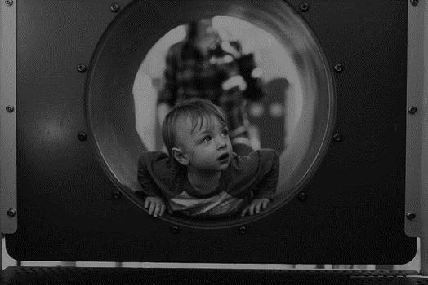
E-TALKING BEST FOR YOU
E-TALKING BEST FOR YOU
Does Thomas want to…..?
Vocabulary about activities, invitation dialogue, invitation phrases
view

Slide 2

E-TALKING BEST FOR YOU
E-TALKING BEST FOR YOU
INTRODUCTION
CEF Learning Goal: Getting familiar with “Does he/she”….sentence patterns

Slide 3

E-TALKING BEST FOR YOU
E-TALKING BEST FOR YOU
Invitations
START
Image from : pexels.com

Slide 4

E-TALKING BEST FOR YOU
E-TALKING BEST FOR YOU
WARM-UP
Have you ever invited someone to go to a party with you?
How would you ask someone to go to a party with you?

Slide 5

E-TALKING BEST FOR YOU
E-TALKING BEST FOR YOU
GETTING STARTED
Fill in the blanks
Do you want to go to the gym?
Yes, I __________.
_______ John want to go to the gym, too?
Yes, he __________.

Slide 6



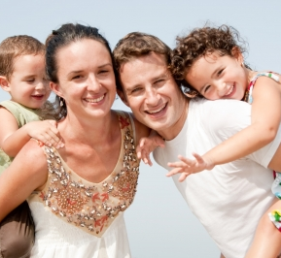

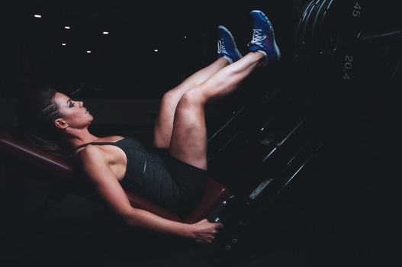
E-TALKING BEST FOR YOU
01 Vocabulary
E-TALKING BEST FOR YOU
- cinema - gym - dinner
- party - football game - concert - to go shopping
Image from : pexels.com
Image from : pexels.com
Image from : pexels.com

Slide 7

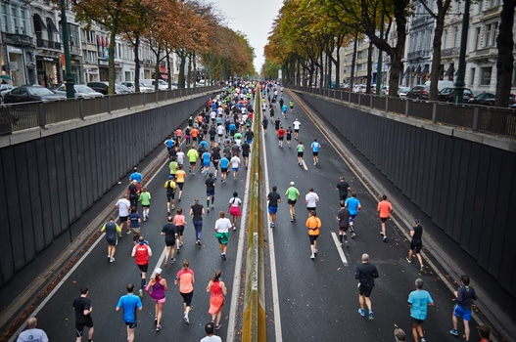
E-TALKING BEST FOR YOU
E-TALKING BEST FOR YOU
01 Vocabulary:
Practice
Tell us about some activities you like to do?
Image from : http://www.sfgate.com/education/article/Cuts-in-programs-to-help-inmates-questioned-3199585.php#photo-2338768

Slide 8
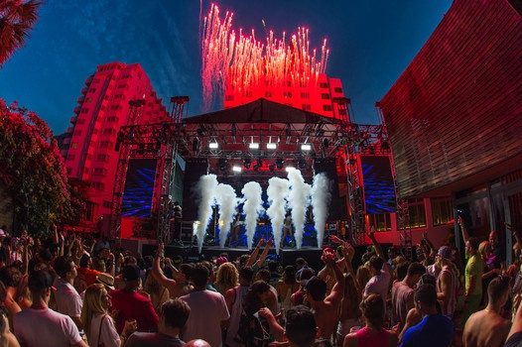
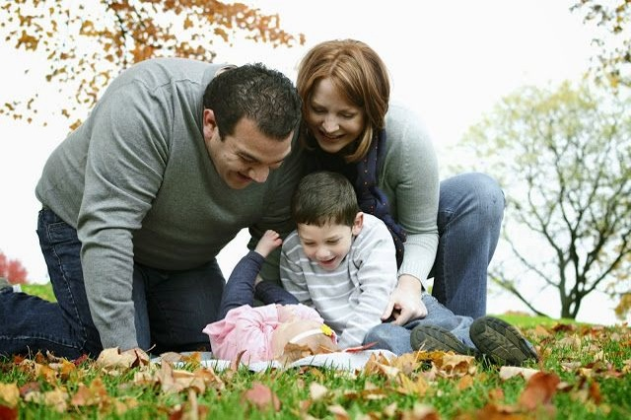

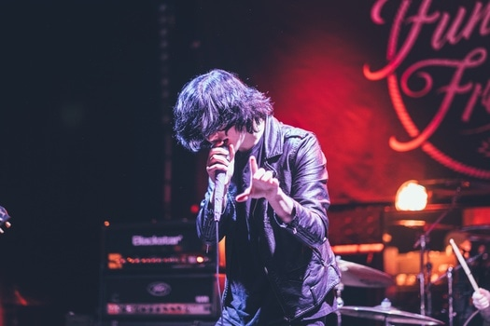
E-TALKING BEST FOR YOU
E-TALKING BEST FOR YOU
02 Grammar: Does he/she…?
1. Does he want to go to the concert?
Yes, he does. No, he doesn’t.
2. Does she want to go to the concert?
Yes, she does. No, she doesn’t.
Image from: pexels.com

Slide 9
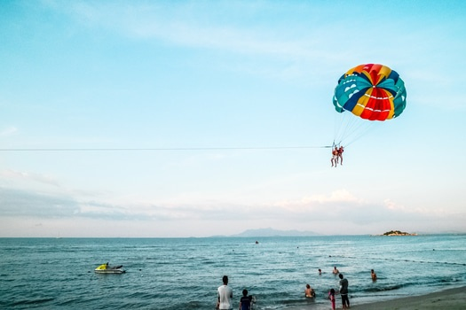
E-TALKING BEST FOR YOU
E-TALKING BEST FOR YOU
02 Grammar: Does he/she…?
Practice
A: Bon Jovi’s concert is this weekend!
_______Alan want to go?
B: Yes, he ________.
*Make more sentences with the new activities we learnt today.
Image from : pexels.com

Slide 10
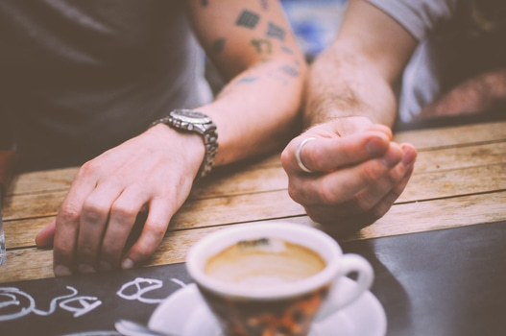
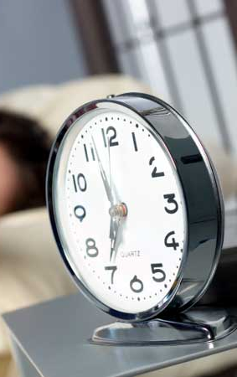
E-TALKING BEST FOR YOU
03 Reading
E-TALKING BEST FOR YOU
Anna and Scott are talking in the campus.
Anna: Listen, Scott! April Day are at our school on Saturday.
Scott: April Day? Who are they?
Anna: My friends, Sean’s band. They are really great.
Do you want to come? Let’s go together.
Scott: No, thanks. How about having dinner in town?
Image from : pexels.com

Slide 11
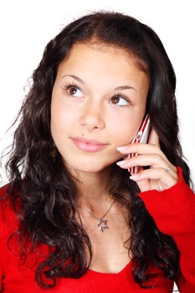
E-TALKING BEST FOR YOU
03 Reading
E-TALKING BEST FOR YOU
(Phone Ringing)
Anna (Speaking on the phone): Oh, hi, Fiona. Yes, isn’t it fantastic?
Of course I want to go! See you all on Saturday night. Bye~
Anna: Guess what, Fiona: Chris and Mark also
want to go to the concert!
Scott: Does Thomas want to go to the concert, too?
Anna: Yes, he does.
Scott: Hmmmm. I think I want to go, too.
Image from : pexels.com

Slide 12

E-TALKING BEST FOR YOU
E-TALKING BEST FOR YOU
03 Reading
Practice
Read out the above dialogue nice and loud.
Image from : http://www.sfgate.com/education/article/Cuts-in-programs-to-help-inmates-questioned-3199585.php#photo-2338768

Slide 13

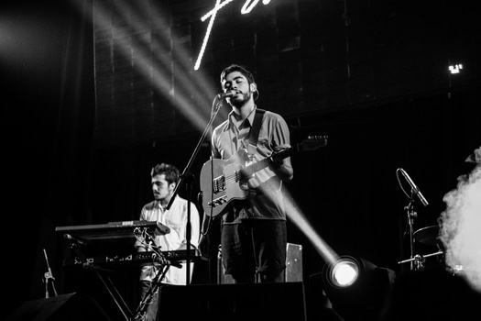
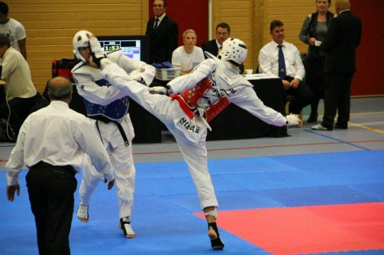
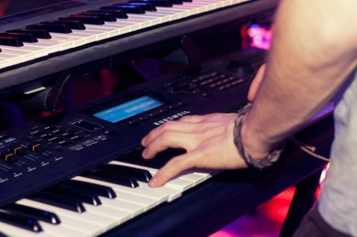
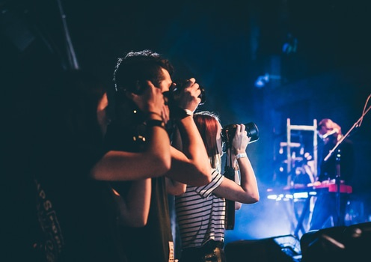
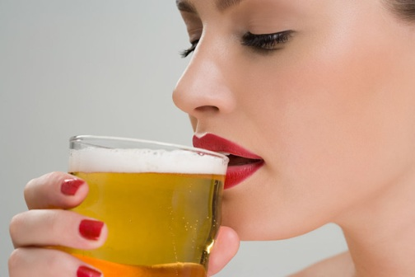
E-TALKING BEST FOR YOU
E-TALKING BEST FOR YOU
04 Reading Comprehension
True of False
1. Anna doesn’t like April Day.
2. Scott doesn’t want to go to the concert.
3. April Day’s concert is on Friday.
4. Fiona, Chris and Mark all want to go to the concert.
Image from: pexels.com

Slide 14

E-TALKING BEST FOR YOU
E-TALKING BEST FOR YOU
04 Reading Comprehension
Practice:
Answer the following questions:
1. What is the event?
2. When is the concert?
3. If you go to the concert, who would you probably meet?
Image from : pexels.com

Slide 15
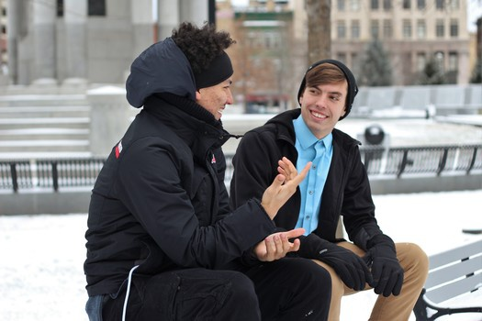


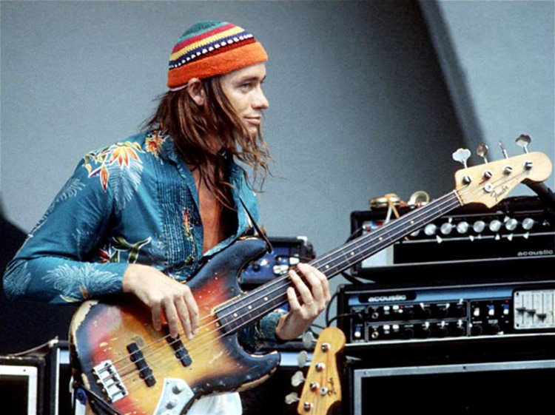
E-TALKING BEST FOR YOU
05 Invitation Phrases
E-TALKING BEST FOR YOU
- Let’s go together! - What about you?
- Of course I want to go! - Guess what?
Image from : https://www.youtube.com/watch?v=sqNITpNZZ3E

Slide 16

E-TALKING BEST FOR YOU
E-TALKING BEST FOR YOU
05 Invitation Phrases
Practice
Fill in the blanks
________what?
Amei’s coming to school this weekend!
b. Great! ______go together.
c. Do you want to go?
d. __________ I want to go!
Image from : http://www.sfgate.com/education/article/Cuts-in-programs-to-help-inmates-questioned-3199585.php#photo-2338768

Slide 17

E-TALKING BEST FOR YOU
E-TALKING BEST FOR YOU
SPEAKING TASK
What’s your favorite hobby? Why?

Slide 18

E-TALKING BEST FOR YOU
E-TALKING BEST FOR YOU
ASSESSMENT
Answer the following questions:

Slide 19

E-TALKING BEST FOR YOU
E-TALKING BEST FOR YOU
Does Ken enjoy playing video games? (Yes)
Does Alicia like to go shopping (Yes)
Does Sean like playing tennis? (No)
Does Sarah like to eat French food? (No)
Does Kerry study English at school? (Yes)
ASSESSMENT

Slide 20


E-TALKING BEST FOR YOU
E-TALKING BEST FOR YOU
Thank you !
See you tomorrow

