Slide 1
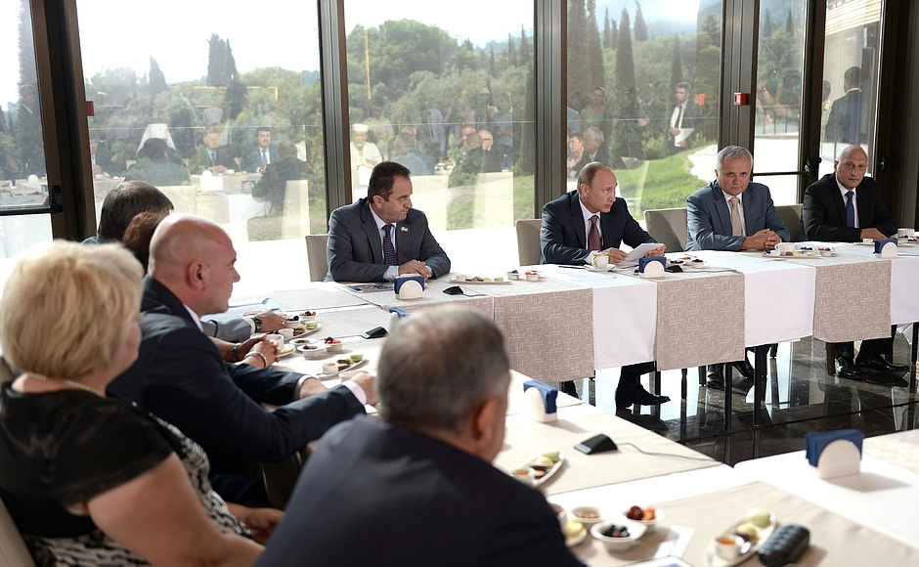
E-TALKING BEST FOR YOU
Presentation I
How to structure the body of your presentation
view
Image from : en.kremlin.ru

Slide 2

E-TALKING BEST FOR YOU
INTRODUCTION
Students can understand how to structure the body of a presentation.

Slide 3

E-TALKING BEST FOR YOU
The Body Structure.
There are certain rules that govern the proper functioning of any body. The body of a presentation as well should abide by certain guidelines. One of the rules you should follow when giving a presentation is not to rush. Try to look friendly, and ensure you keep to the structure you have established.
START
Image from : en.wikipedia.org

Slide 4

E-TALKING BEST FOR YOU
WARM-UP
How can you carry your audience along during a presentation?

Slide 5

E-TALKING BEST FOR YOU
GETTING STARTED
State other things a presenter need to take note of while giving a presentation.

Slide 6


E-TALKING BEST FOR YOU
01 Approach It Well
After a successful introduction to your presentation, you can relax and start your presentation steadily. Be enthusiastic, and get your visual aids organized.
Successful (adjective) Full of stress
Relax (verb) Be without tension
Steadily (adjective) Slow and balanced
Visual aids (noun) Diagrams and pictures
Image from : commons.wikimedia.org

Slide 7

E-TALKING BEST FOR YOU
DISCUSSION
Discuss how you can be get your visuals organized while giving a presentation.
01

Slide 8
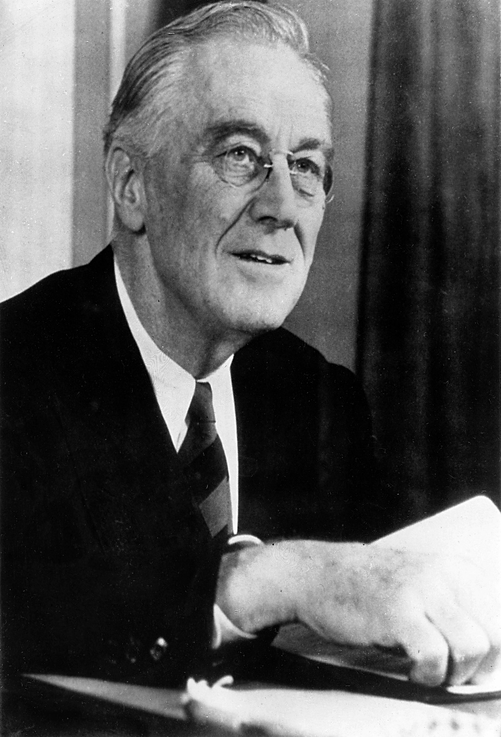
E-TALKING BEST FOR YOU
02 You Can Use Proper Body Language
As the presentation progresses, use body language to carry your audience along. Try to establish eye contact with your audience. You should endeavor to adjust your voice so it is not too loud nor too low. Put on a friendly look on your face!
Progress (noun) Onward movement
Establish (verb) Make something happen
Endeavor (verb) Try
Image from : en.wikipedia.org

Slide 9
E-TALKING BEST FOR YOU
DISCUSSION
Suggest other forms of body language you can use during a presentation.
02

Slide 10

E-TALKING BEST FOR YOU
03 Keep to Your Structure
Do not go off the point, except when the situation warrants it. Always stick to your structure. Make adequate use of the notes you've prepared.
Except (adverb) Unless
Structure (noun) Components of a body
Adequate (adjective) Proper
Image from : flickr.com

Slide 11
E-TALKING BEST FOR YOU
DISCUSSION
What do you think can happen if you don’t keep to the structure of your presentation?
03

Slide 12
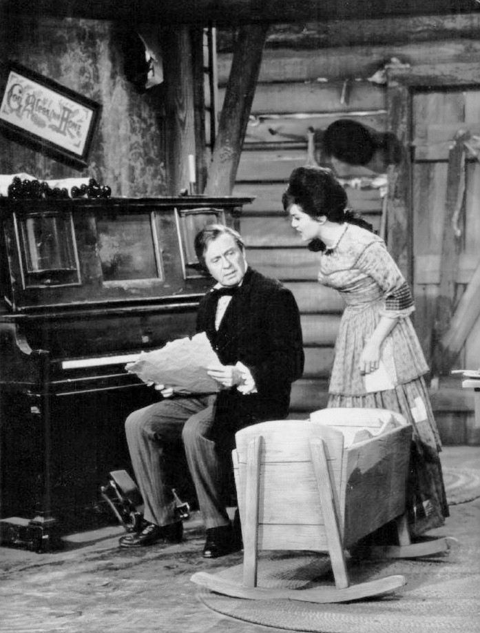
E-TALKING BEST FOR YOU
04 Remain Polite
There are times when you will have to handle difficult situations. No matter how difficult the situation may appear, do your utmost to remain polite to your audience.
Polite (adjective) Courteous
Seem (verb) Look like
Utmost (adjective) The most
Audience (noun) People listening to a presentation
Image from : en.wikipedia.org

Slide 13
E-TALKING BEST FOR YOU
DISCUSSION
What are some difficult situations you need to prepare against when airing a presentation?
04

Slide 14

E-TALKING BEST FOR YOU
SPEAKING TASK
Make sentences with the following words.
visuals, relaxed, polite, audience, structure

Slide 15

E-TALKING BEST FOR YOU
ASSESSMENT
Complete the sentences using the vocabulary words from this lesson:

Slide 16

E-TALKING BEST FOR YOU
Answer the following questions based on today’s lesson.
Briefly discuss the major rules you need to observe while giving your presentation.
ASSESSMENT

Slide 17


E-TALKING BEST FOR YOU
Thank you !

