Slide 1


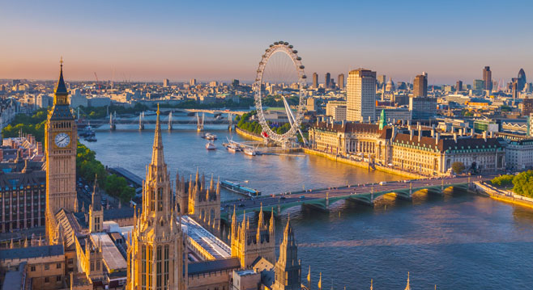
E-TALKING BEST FOR YOU
E-TALKING BEST FOR YOU
Getting Around
Getting Information in Places You Visit.
view
Image from : http://www.emirates.com/english/destinations/flights-to-london.aspx

Slide 2

E-TALKING BEST FOR YOU
E-TALKING BEST FOR YOU
INTRODUCTION
CEF Learning Goal: Being able to ask others for directions

Slide 3
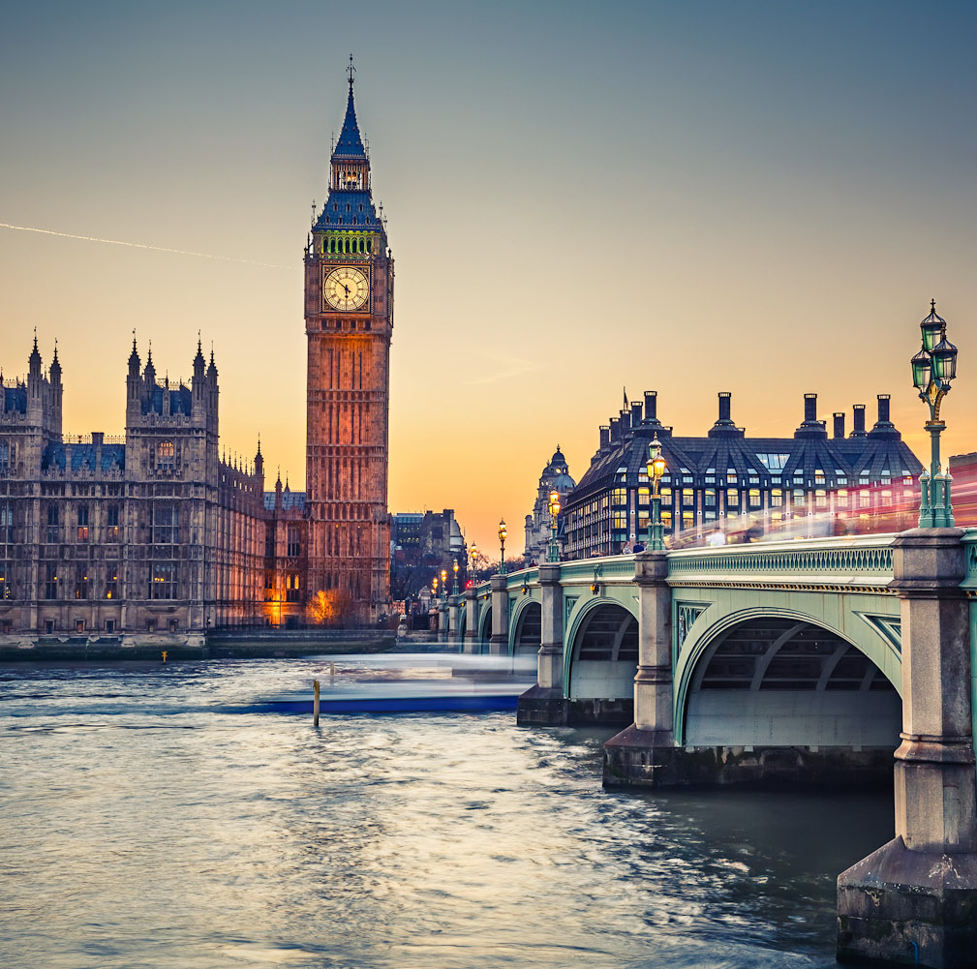
E-TALKING BEST FOR YOU
E-TALKING BEST FOR YOU
Traveling to a new place can be a very stressful experience. There are new sounds, new people and new places to explore. One way to keep the stress level low and enjoy your trip is to ask locals for help.
START
Image from : http://www.internationaltravellermag.com/europe/united-kingdom/england/london/

Slide 4

E-TALKING BEST FOR YOU
E-TALKING BEST FOR YOU
WARM-UP
Do you like to travel? Why or why not?
What is the hardest part about traveling in a new place?
Where did you go for your last vacation?
How did you get around on your last vacation?
Did you get lost on your vacation? Explain.

Slide 5

E-TALKING BEST FOR YOU
E-TALKING BEST FOR YOU
GETTING STARTED
Name some places that tourists usually need to visit when traveling to a new city:
(Example: museums)
__________
__________
__________
__________

Slide 6
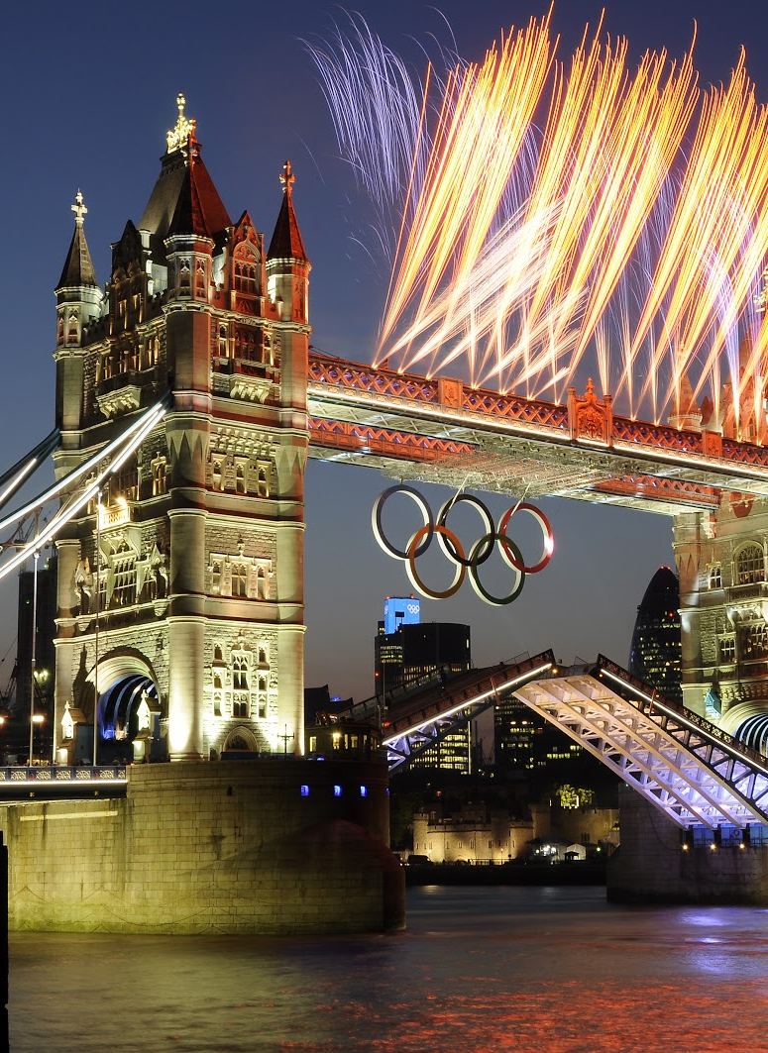

01 Marie goes to London
E-TALKING BEST FOR YOU
E-TALKING BEST FOR YOU
Marie has just arrived in London for her week-long vacation. Her English is not great and she has never traveled alone so she is a bit nervous about asking others for help.
The city centre (noun): The central part of a city; usually contains the most popular attractions in a city.
The underground (noun): The subway or metro system of a city.
To cycle (verb): To ride a bike or motorcycle.
Image from : http://kimboltonfireworks.blogspot.tw/

Slide 7
01 Marie goes to London
E-TALKING BEST FOR YOU
E-TALKING BEST FOR YOU
She was told by her friends that the best way to travel around the city was to take the underground or subway, but she is thinking about renting a bike and cycling to the city centre instead.
The city centre (noun): The central part of a city; usually contains the most popular attractions in a city.
The underground (noun): The subway or metro system of a city.
To cycle (verb): To ride a bike or motorcycle.
Image from : http://kimboltonfireworks.blogspot.tw/

Slide 8

E-TALKING BEST FOR YOU
E-TALKING BEST FOR YOU
DISCUSSION
How long does Marie plan to stay in London?
Why is she nervous about traveling?
Who told her that she should use the underground?
Does Marie listen to her friends and ride the subway?
How does she plan on reaching the city centre?
01

Slide 9
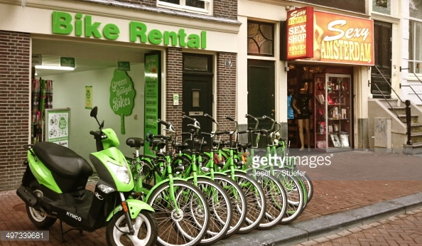
02 Finding the Best Bike Rental Shop
E-TALKING BEST FOR YOU
E-TALKING BEST FOR YOU
Marie is now looking for a bike rental shop and it harder than she thought it would be. Until now, she has not asked anyone for help due because she is nervous but decides that she must get help before it gets too late.
To know(verb): To be aware of something through experience or observation.
Nearest(adjective): Something that is located closest to you.
Image from : http://www.gettyimages.com/pictures/bike-rental-and-sex-shop-in-central-amsterdam-news-photo-497339681

Slide 10
E-TALKING BEST FOR YOU
02 Finding the Best Bike Rental Shop
E-TALKING BEST FOR YOU
She walks up to a friendly-looking British woman and asks:
“Excuse me, do you know where the nearest bike rental shop is?
Yes, there’s on near Victoria’s Square, you can take bus 310 from here.
Okay, thank you very much!”
Image from : http://www.gettyimages.com/pictures/bike-rental-and-sex-shop-in-central-amsterdam-news-photo-497339681

Slide 11
E-TALKING BEST FOR YOU
E-TALKING BEST FOR YOU
DISCUSSION
Why does Marie finally decide to ask someone for help?
Who does she ask for help?
Why do you think she asks this person in particular?
How does she get to the bike rental shop?
02

Slide 12
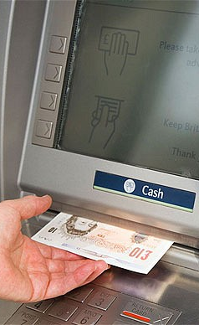
E-TALKING BEST FOR YOU
03 At the Bike Shop
E-TALKING BEST FOR YOU
After stopping at a cash machine to take out money, Marie finally gets to the bike shop and finds a nice bike to ride into the city centre. After she pays the fee for her bike, she asks the shopkeeper, “Excuse me, but how do I get to the city centre from here?”
Cash machine (noun): Also known as an ATM; a machine from which a person can take out cash from their bank account.
Image from : http://www.telegraph.co.uk/finance/personalfinance/bank-accounts/11227240/Why-the-3-cash-machine-fee-is-dying-out.html

Slide 13
E-TALKING BEST FOR YOU
03 At the Bike Shop
E-TALKING BEST FOR YOU
The shopkeeper replies,
“Oh, it’s quite simple. Just turn right in front of this shop and keep going until reach Guildhall.
How long does it take to get there?
If you take your bike it’s about a 20-minute ride.
Great! Thank you!”
20-minute/hour/day(adjective): A way of express how long it takes to do something/go somewhere/etc.
Image from : http://www.telegraph.co.uk/finance/personalfinance/bank-accounts/11227240/Why-the-3-cash-machine-fee-is-dying-out.html

Slide 14
E-TALKING BEST FOR YOU
E-TALKING BEST FOR YOU
DISCUSSION
Does Marie go right to the bike rental shop? How do you know?
What directions does the shopkeeper give her?
How long will it take for Marie to get to the city centre?
03

Slide 15
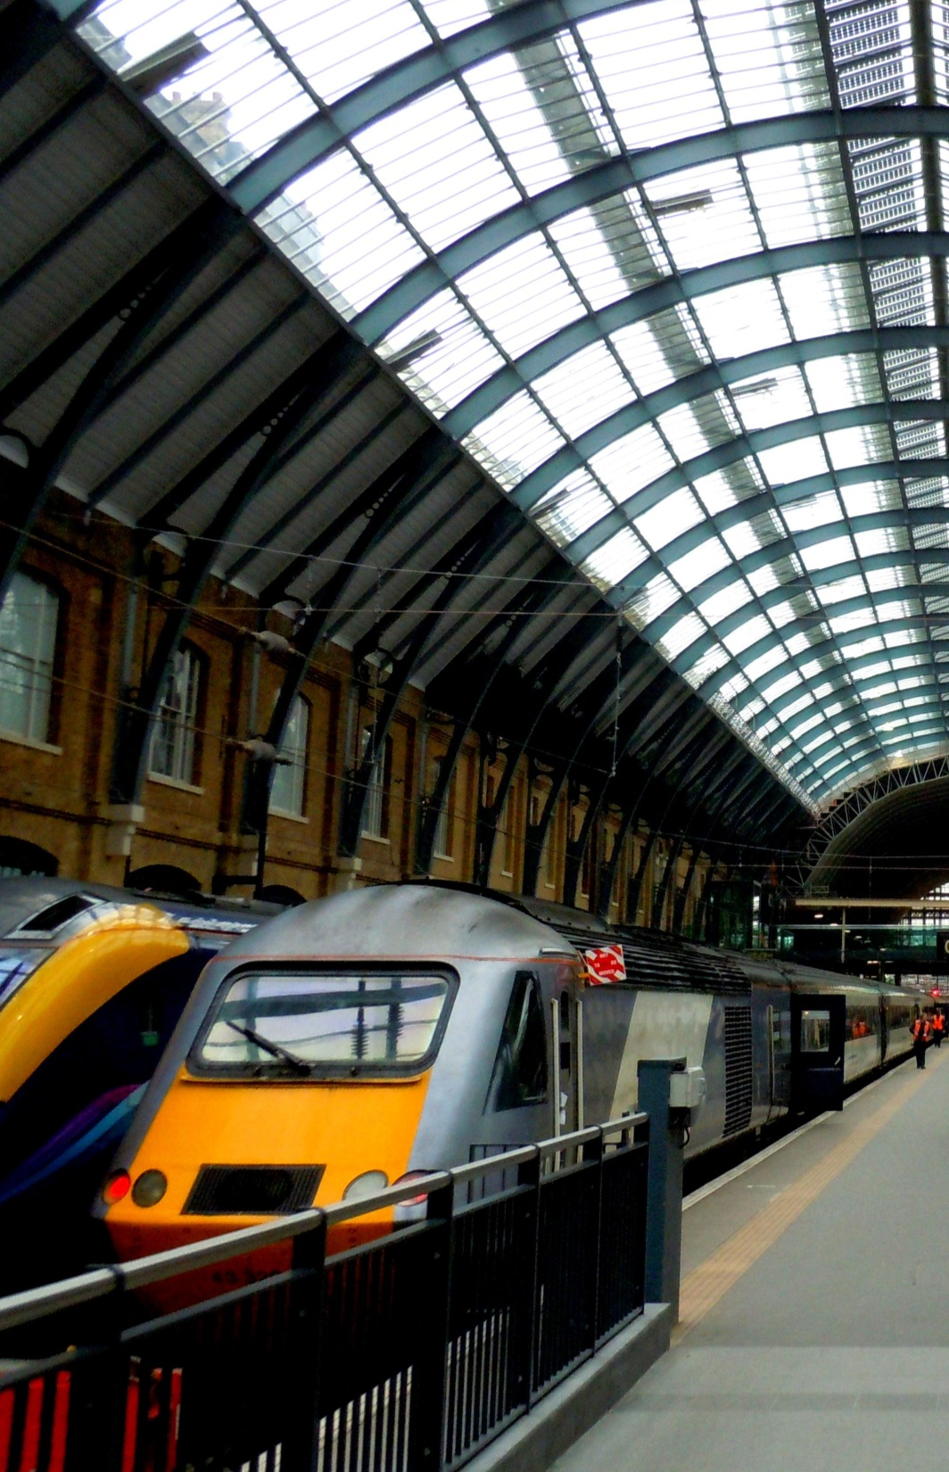
E-TALKING BEST FOR YOU
04 On the way…
E-TALKING BEST FOR YOU
Marie is now going to the city centre, and she is very happy that she decided to cycle and did not take the underground. On the way, she sees the Bank of England, Westminster Abbey,
Cathedral(noun): a Christian church that is run by a bishop.
Image from :https://commons.wikimedia.org/wiki/File:Kings_Cross_Train_Station_London_England.jpg

Slide 16
E-TALKING BEST FOR YOU
04 On the way…
E-TALKING BEST FOR YOU
St Paul’s Cathedral, beautiful train stations and some very beautiful parks. Of course, she stops along the way to take pictures.
Cathedral(noun): a Christian church that is run by a bishop.
Image from :https://commons.wikimedia.org/wiki/File:Kings_Cross_Train_Station_London_England.jpg

Slide 17
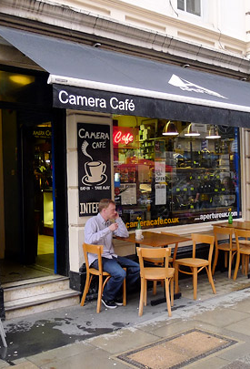
05 Finally here
E-TALKING BEST FOR YOU
E-TALKING BEST FOR YOU
After a 30-minute ride through the city, Marie finally gets to the city centre and is ready to take a break. She is very hungry and wants to get something to eat at the nearest café before she begins her tour of the city centre.
To take a break (verb phrase): when someone stops what they are doing to take a rest.
Tour (noun): A circuit that takes you to new place to see different attractions.
Image from : http://www.urban75.org/blog/a-fantastic-cafe-for-central-london-the-old-cafe-takes-over-rays-jazz-in-the-former-foyles-store/

Slide 18
E-TALKING BEST FOR YOU
E-TALKING BEST FOR YOU
DISCUSSION
Why do you think it took Marie 30 minutes and not 20 minutes like the bike rental shopkeeper said?
Why does Marie want to take a break when she gets to the city centre?
05

Slide 19
E-TALKING BEST FOR YOU
E-TALKING BEST FOR YOU
How do you get there?
How do you usually get to work/school?
(ex. Take a bus, cycle, etc.)
Is there a bank near your home?
How do you get there?
How do you get to the best café in your town/city?
Are there any cathedrals in your town?
Where’s the train station in your town?
Can you walk to your school/workplace?

Slide 20

E-TALKING BEST FOR YOU
E-TALKING BEST FOR YOU
ASSESSMENT
Try to answer the following questions based on the information given during this lesson.

Slide 21

E-TALKING BEST FOR YOU
E-TALKING BEST FOR YOU
Is there a cash machine near the hotel?
How long does it take to get to the Bank of England?
What’s the best way to get to the city centre?
Where’s St. Paul’s Cathedral?
Answers:
It’s about a 45-minute bus ride.
It’s near Buckingham Palace.
There isn’t one near the hotel, but you can try to go to the bank instead.
The underground is the fastest and easiest way to get there.
ASSESSMENT

