Slide 1
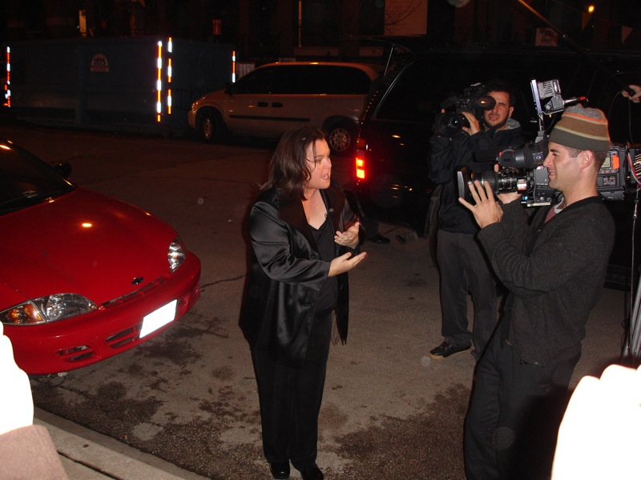
E-TALKING BEST FOR YOU
E-TALKING BEST FOR YOU
Emphasis and Audience
How to Correctly Use the Active and the Passive Voice.
view
Image from : commons.wikimedia.org

Slide 2
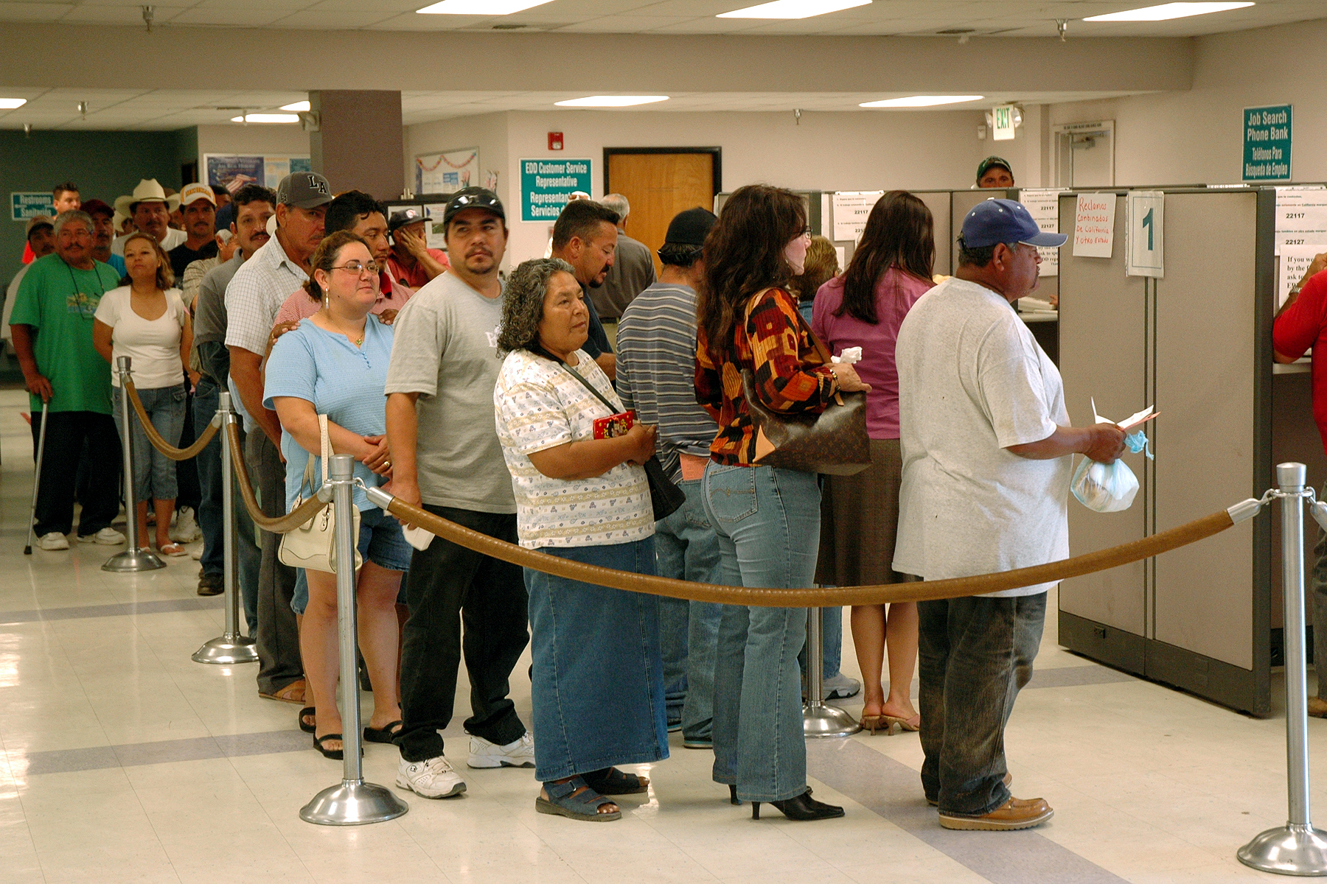
E-TALKING BEST FOR YOU
E-TALKING BEST FOR YOU
Active or Passive Voice?
Generally, we express our ideas through either the active or the passive voice. They are used in different ways according to the purpose of speech and writing. The active voice tells what a person or thing does, whereas the passive voice tells what is done to someone or something.
START
Image from : en.wikipedia.org

Slide 3

E-TALKING BEST FOR YOU
E-TALKING BEST FOR YOU
WARM-UP
Which of the two; active and passive voice; are more frequently used in oral speech? How about in writing? Why do you think so?

Slide 4

E-TALKING BEST FOR YOU
E-TALKING BEST FOR YOU
GETTING STARTED
Compare the following two sentences, which of them sound more personal to you?
Tom will finish his project by tomorrow.
His project will be finished by Tom tomorrow.

Slide 5
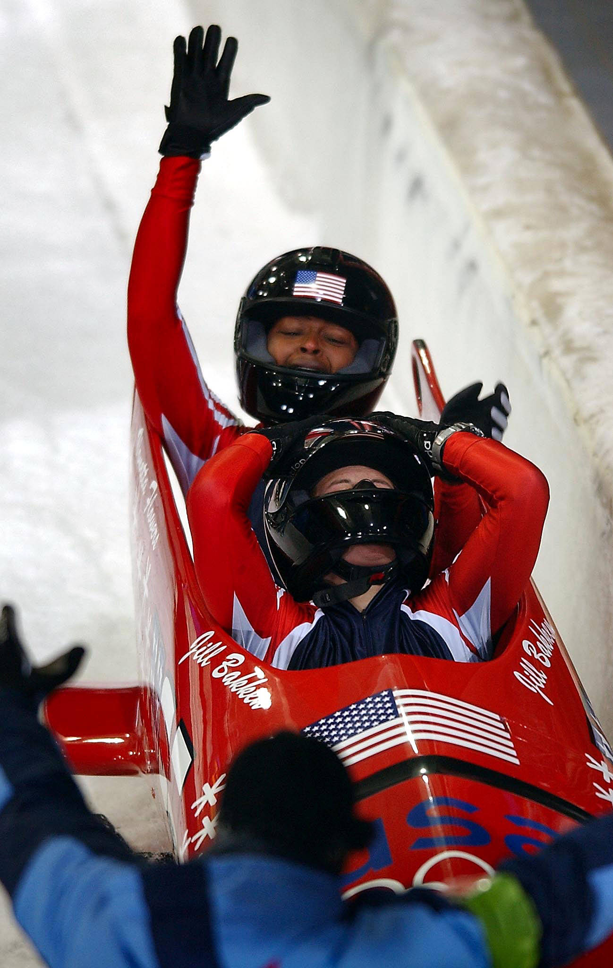

E-TALKING BEST FOR YOU
01 How Personal is it?
E-TALKING BEST FOR YOU
We use the active voice in speech and writing to describe actions and events. In general, the active form is more personal than the passive. Thus, it is commonly used in non-scientific writing. Using active voice makes your meaning clear for readers and keeps the sentences from becoming too complicated or wordy.
Complicated (adjective) Hard to understand.
Wordy (adjective) Using to many words.
Image from : commons.wikimedia.org

Slide 6
E-TALKING BEST FOR YOU
E-TALKING BEST FOR YOU
01 How Personal is it?
In active voice, the subject performs the action and typically comes before the action (verb).
Examples:
No one responded to my sales ad.
The team will celebrate their victory tomorrow.
Perform (verb) To complete something
Image from : commons.wikimedia.org

Slide 7
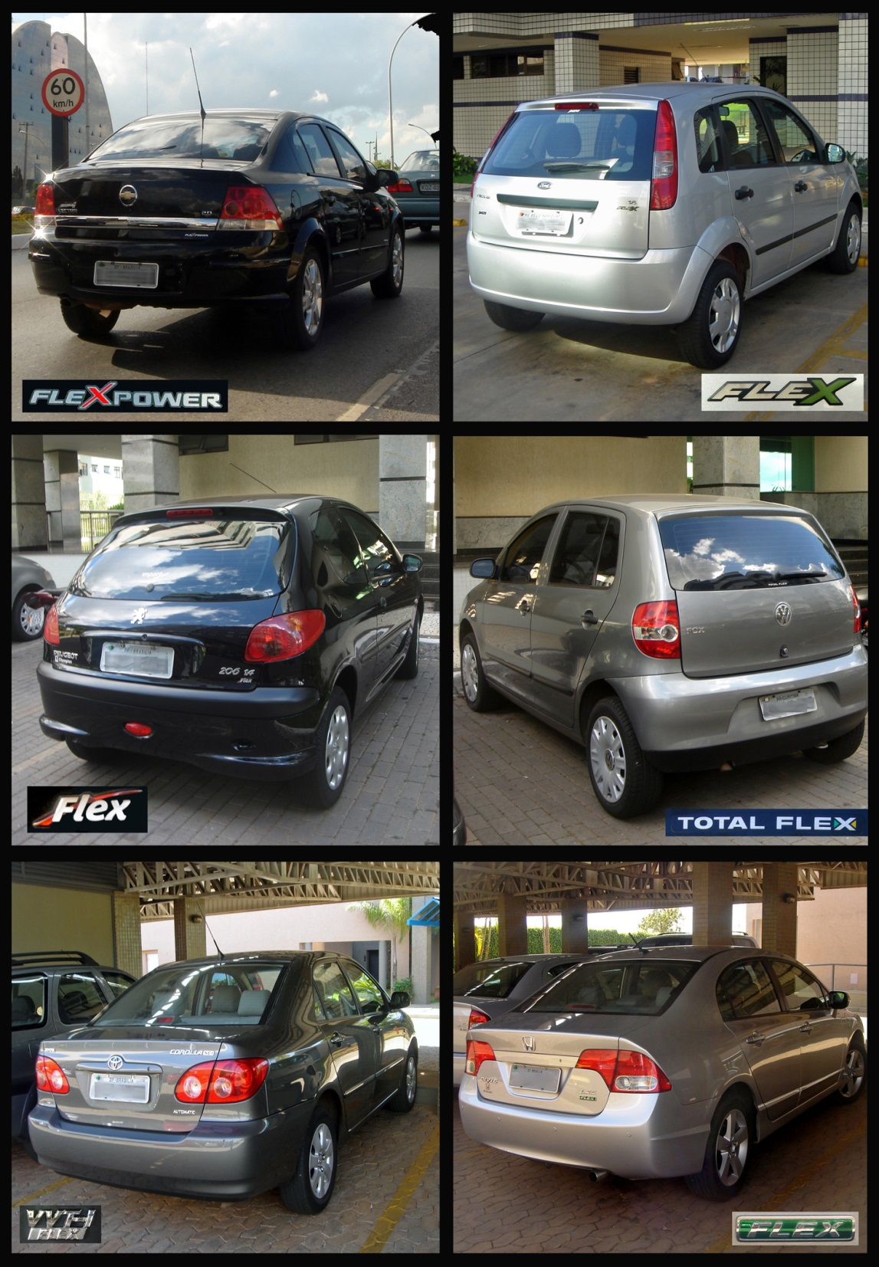
E-TALKING BEST FOR YOU
02 Not Interested in the Doer
E-TALKING BEST FOR YOU
Compared to the active voice, sentences using the passive voice are often hard to understand. Passive sentences usually have more words than active ones, which is one reason the reader or listener has to work harder to get at the meaning. However, since more emphasis is placed on the object and action, in some cases the ‘doer’ or subject can be eliminated in passive sentences.
Emphasis (noun) Special attention given to something.
To eliminate (verb) To take out.
Image from : en.wikipedia.org

Slide 8
E-TALKING BEST FOR YOU
E-TALKING BEST FOR YOU
02 Not Interested in the Doer
For instance, instead of saying ‘The first cars were delivered to distributors by delivery men,’ we can simply say ‘The first cars were delivered to the distributors.’
To deliver (verb) To carry to and leave at the proper place
Image from : en.wikipedia.org

Slide 9

E-TALKING BEST FOR YOU
E-TALKING BEST FOR YOU
DISCUSSION
Discuss with the classmates on how to convert the following active sentences into passive sentences:
Mark donated money to the homeless shelter.
He faxed his application for a new job.
The staff is required to watch a safety video.
01

Slide 10

E-TALKING BEST FOR YOU
03 Process Descriptions
E-TALKING BEST FOR YOU
The passive voice is also used in the description of the steps in a process. Again, since we are not interested in the doer, the subject can be left out. In addition, when we want to present objective, fact-based discourse,
Description (noun) A statement that gives details. about someone or something
Objective (adjective) Without bias.
Discourse (noun) A discussion about a topic.
Image from :en.wikipedia.org

Slide 11
E-TALKING BEST FOR YOU
E-TALKING BEST FOR YOU
03 Process Descriptions
we use passive voice so that our presented information does not look or sound limited or biased by individual perspectives or personal interests.
Examples:
First the door is primed, and then rubbed down using sandpaper.
The analysis was done based on the available data.
Image from :en.wikipedia.org

Slide 12

E-TALKING BEST FOR YOU
E-TALKING BEST FOR YOU
SPEAKING TASK
Introduce a dish that you know how to cook. Describe to the classmates the detailed steps of the cooking process by using the passive voice.

Slide 13

E-TALKING BEST FOR YOU
E-TALKING BEST FOR YOU
ASSESSMENT
Complete the sentences using the vocabulary words from this lesson:

Slide 14

E-TALKING BEST FOR YOU
E-TALKING BEST FOR YOU
complicated/wordy/perform/emphasis/eliminate/deliver/description/objective/ discourse
It seems this ____________ situation will not blow over soon.
The report was long and very ______________.
Everyone is asked to ___________ in the show at the year-end party.
We are required to go through a series of training with ___________ on teamwork skills.
For now, let’s _____________ from the discussion the possibility of failure.
He is responsible for _____________ the packages to other branches.
The email entails a detailed _____________ of the project.
I try to remain _____________ in all circumstances.
I listened very carefully to their _____________ on foreign policy.
ASSESSMENT

Slide 15


E-TALKING BEST FOR YOU
E-TALKING BEST FOR YOU
Thank you !

