Slide 1
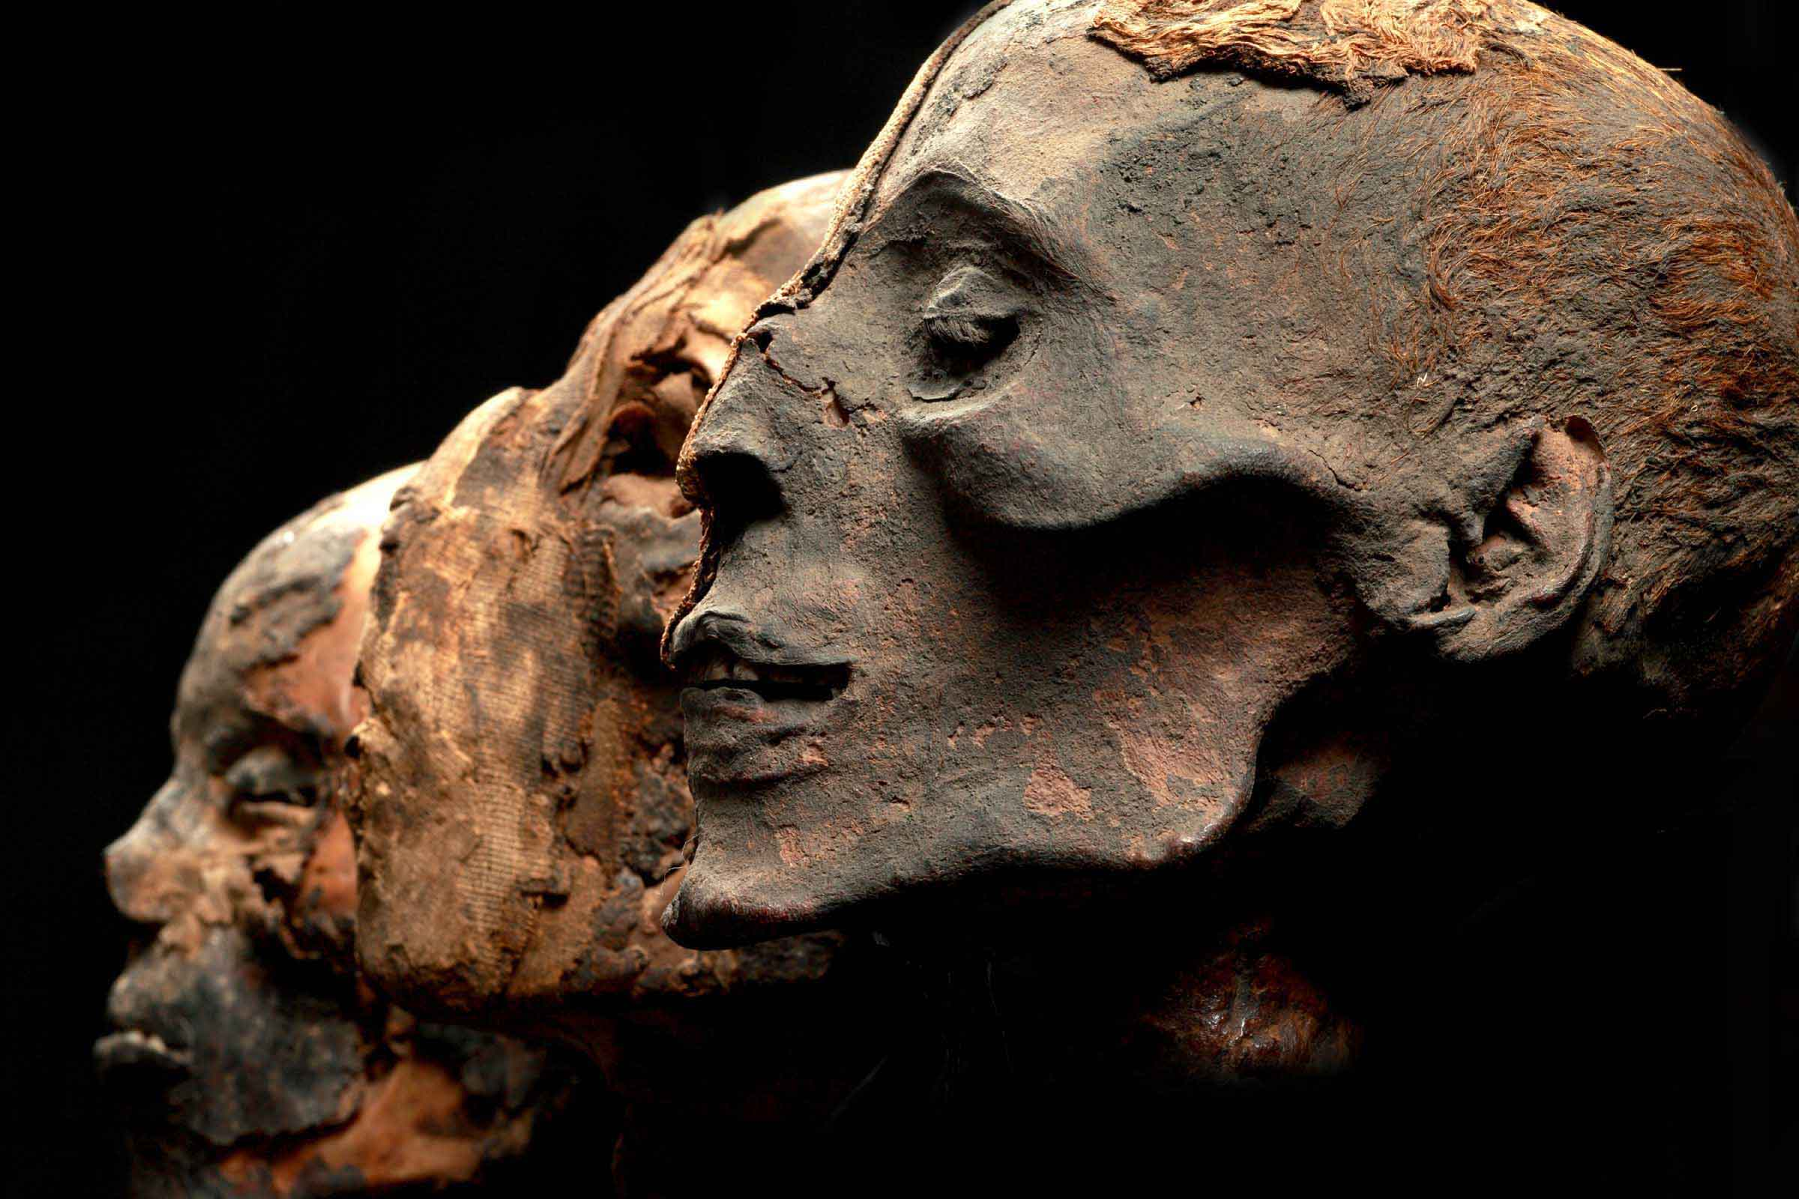
E-TALKING BEST FOR YOU
Mummy Head Shows Signs
of Skin Bleaching
view

Slide 2

E-TALKING BEST FOR YOU
INTRODUCTION
CEF Learning Goal: Talk about skin bleaching in ancient Egypt.
Talk about your opinions relating to this topic.
Learn topic-related vocabulary.

Slide 3
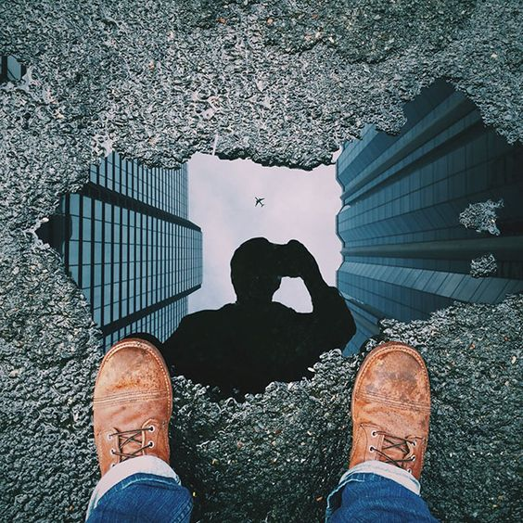
E-TALKING BEST FOR YOU
START
Image from : apple.com

Slide 4

E-TALKING BEST FOR YOU
WARM-UP

Slide 5

E-TALKING BEST FOR YOU
GETTING STARTED
What are some things that you know about Egypt?
Do you think Egyptian culture is similar to your culture in some ways?
Why or why not?

Slide 6
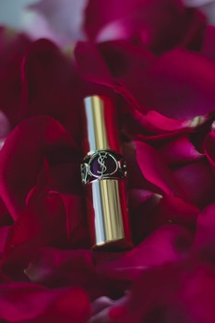
E-TALKING BEST FOR YOU
01 VOCABULARY CORNER
Mummy (n.): a dead body of a person or animal prepared for burial in the manner of the ancient Egyptians by treating it with oils and wrapping it in strips of cloth
Ancient (adj.): of, coming from, or belonging to a time that was long ago in the past
Cosmetics (n.): a substance (such as a cream, lotion, or powder) that you put on your face or body to improve your appearance
Discover (v.): to see, find, or become aware of (something) for the first time
Image from : pexels.com

Slide 7

E-TALKING BEST FOR YOU
01 VOCABULARY CORNER
Lump (n.): an area of swelling or growth on your body
Disorder (n.): a physical or mental condition that is not normal or healthy
Bleach (v.): a strong chemical that is used to make something clean or white
Society (n.): the people of a particular country, area, time, etc., thought of especially as an organized community
Image from : pexels.com

Slide 8

E-TALKING BEST FOR YOU
DISCUSSION
01

Slide 9
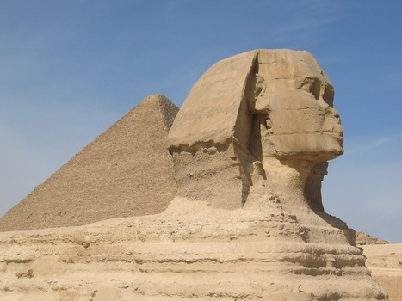
E-TALKING BEST FOR YOU
02 Reading
3,500-year-old mummy head seems to show that the ancient Egyptians used deadly cosmetics to make their skin whiter.
The head that scientists discovered belonged to an unknown woman who was about 20-25 years old. The head shows tiny lumps under the cheeks and at the back of the neck that may be from a possible skin disorder which is caused by using a lot of skin bleaching cosmetics.
Image from : pexels.com

Slide 10
E-TALKING BEST FOR YOU
DISCUSSION
02

Slide 11
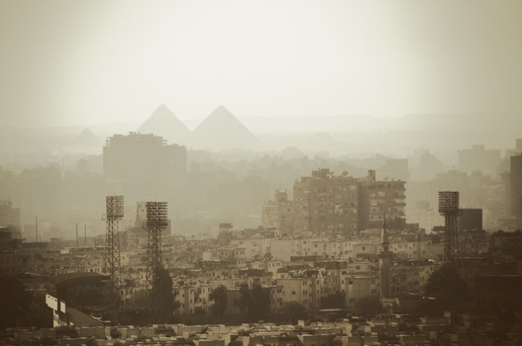
E-TALKING BEST FOR YOU
03 Reading time cont…
History suggests that whiter skin may have been important in Egyptian society. Some scientists think that it showed that people were high in society because they did not do hard work outdoors which like people who were in lower parts of society. The same can be seen today in many Eastern societies.
Egyptians used many cosmetics and many reasons, and unfortunately, many of those cosmetics were bad for their health.
Image from : pexels.com

Slide 12
E-TALKING BEST FOR YOU
DISCUSSION
03

Slide 13
E-TALKING BEST FOR YOU
REVIEW DISCUSSION
Based on the article, what interesting fact have scientists
discovered about ancient Egyptians?
About how old was the woman to whom the head belonged?
How did scientists know that this woman bleached her skin?
Why did many women in high society bleach their skin?
Were these bleaching cosmetics safe to use? How do you know?

Slide 14

E-TALKING BEST FOR YOU
SPEAKING TASK
Are you surprised that ancient Egyptians bleached their skin?
Do people in your society bleach their skin? Why or why not?
In many cultures, women still use deadly skin bleaching cosmetics.
Why do you think that it?
Have you ever bleached your skin? Why or why not?

Slide 15
E-TALKING BEST FOR YOU
SPEAKING TASK
Take turns summarizing the passage that we just read.
Who/What is the article about?
What interesting fact is being discussed?
Explain why you do or do not agree with skin bleaching.

Slide 16

E-TALKING BEST FOR YOU
ASSESSMENT
Put it into practice

Slide 17

E-TALKING BEST FOR YOU
Mummy Ancient Cosmetics Discover Lump Disor­der Bleach Society
Christopher Columbus ___________ America in 1492, however, many people believe that others had discovered it before him .
Using bleaching cosmetics can result in a __________ that causes lumps to grow on the neck and back.
Scientists found that the __________ had been buried with its crown on.
Many Asian women ____________ their skin because they think that white skin is beautiful.
Many Asian women believe that South Korea has the best ____________ in the world.
Scientists have found an ________ city buried under the sea!
ASSESSMENT

Slide 18


E-TALKING BEST FOR YOU
Thank you !

