Slide 1
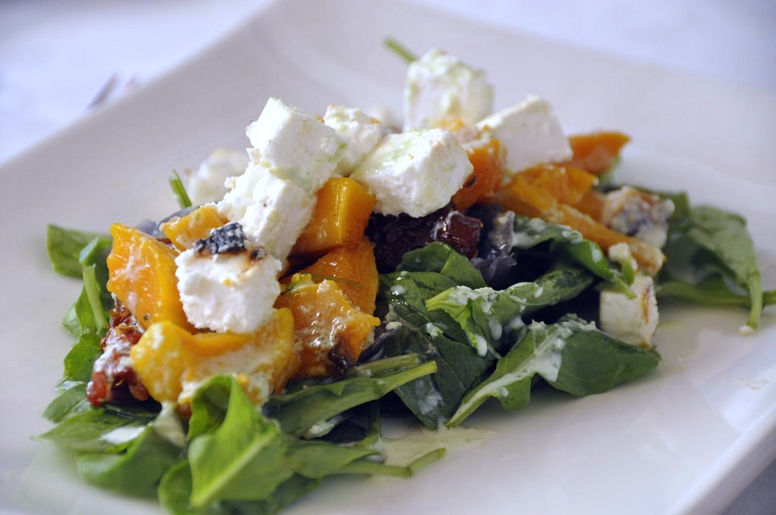
E-TALKING BEST FOR YOU
Customs and Cultures of
South Africa
South African Cuisine
view

Slide 2

E-TALKING BEST FOR YOU
INTRODUCTION
CEFR Learning Goal: Talk about food and eating

Slide 3

E-TALKING BEST FOR YOU
WARM-UP
What is your favorite food or dish?
How do you celebrate birthdays or weddings?
Do you make specific meals or dishes at certain events?
Do you often socialize with friends over a meal?
Have you ever been to a country where they served unusual meals at an event?

Slide 4

E-TALKING BEST FOR YOU
GETTING START
After answering the questions above,
do you think that food plays an important part in your social life?
Do you think it plays an important part in your household or family?
Does it play an important part in your culture as a whole?
Discuss this with a partner who is from the same culture as you to see if they agree with your answers.
Then discuss it with someone who is of a different culture to see how their answers may differ from yours.

Slide 5
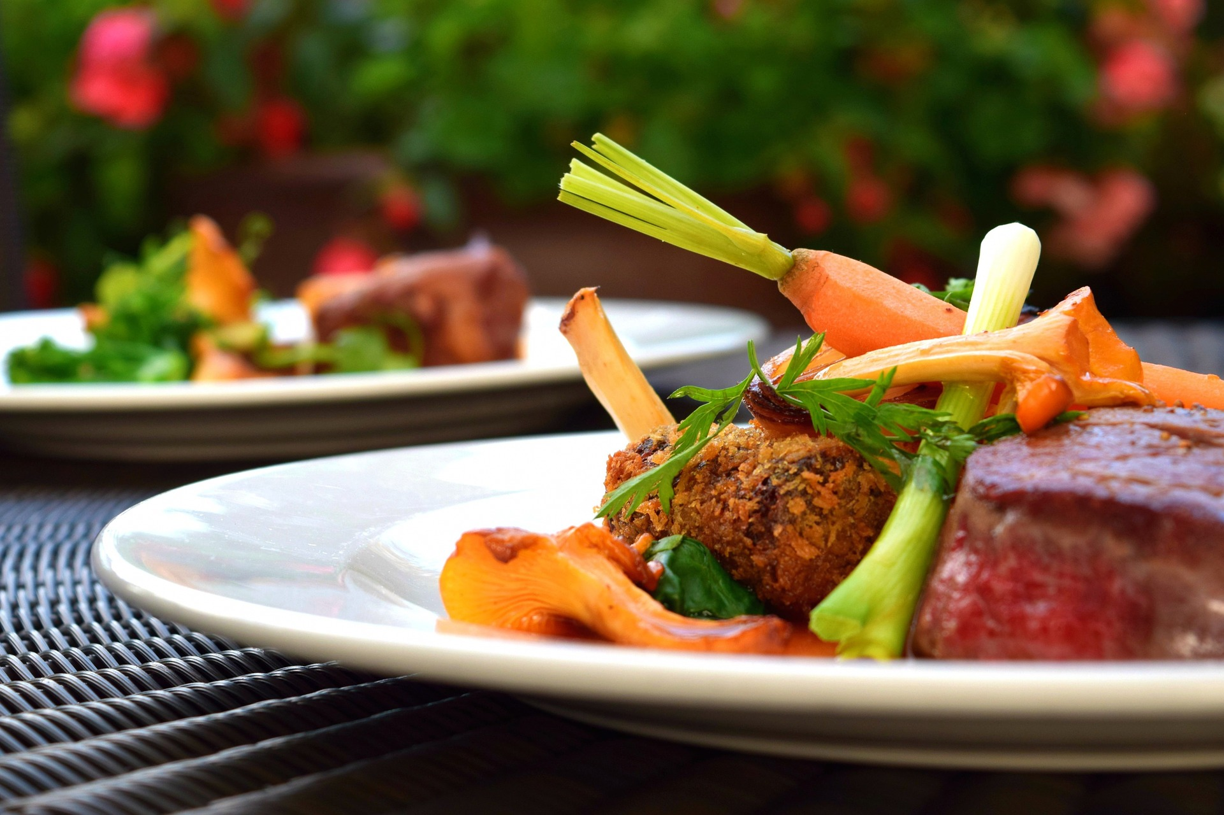
E-TALKING BEST FOR YOU
We all have a favorite food or dish that we love to eat. In many cultures eating is a social event and people gather to share and enjoy meals. Major holidays in various countries are often celebrated with specific meals or dishes. Life events such as birthdays, weddings and even business events are often accompanied by a meal with or without drinks. Different countries and cultures have different food customs.
START

Slide 6
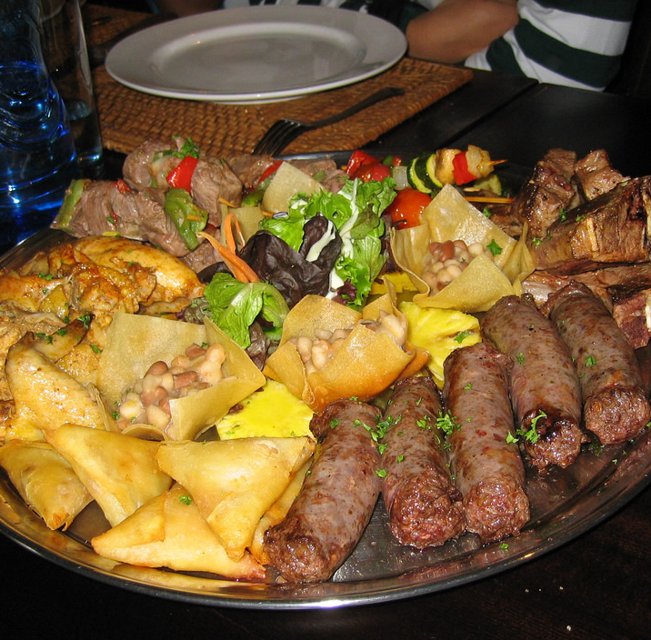

E-TALKING BEST FOR YOU
South African Cuisine
In South Africa there are many different dishes from various cultural backgrounds and some dishes include several cultural influences in one dish. The most popular social event is called a braai which translates to “barbeque” in English. In South Africa the term braai is used by almost everyone, regardless of their preferred language, even though it is an Afrikaans term.
Influence (noun) the power to affect people
or things; a person who can affect others
Preferred (adjective) liked or wanted more than anything else
Afrikaans (noun) the language spoken in South Africa

Slide 7

E-TALKING BEST FOR YOU
DISCUSSION
Can you think of a popular social event in your culture?
Do you have a specific term for such an event that everyone uses?
01

Slide 8
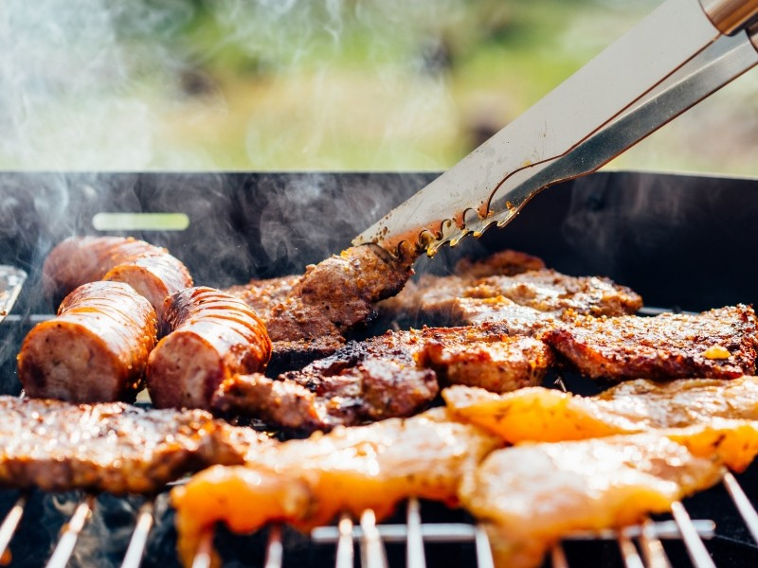
E-TALKING BEST FOR YOU
South African Cuisine
In South Africa there are many customs around the braai that you should be aware of when invited to a braai. South Africans mostly braai during the long summer months, but it is such a big social event that people have started to build indoor braais so that they can braai during the winter months as well. Usually the men gather outside around the braai, or grill, to talk and drink. Only one man will be in charge of cooking the meat; the others may not interfere unless specifically asked for help. Women tend to gather in the kitchen to prepare the side dishes.
Customs (noun) a way of behaving or a belief which has been established for a long time
Interfere (verb) to involve yourself in a situation when your involvement is not wanted or needed

Slide 9
E-TALKING BEST FOR YOU
DISCUSSION
Think about your answers to the previous questions.
Do any of the social events you thought of have specific customs? At which times of the year do these events mostly occur?
02

Slide 10
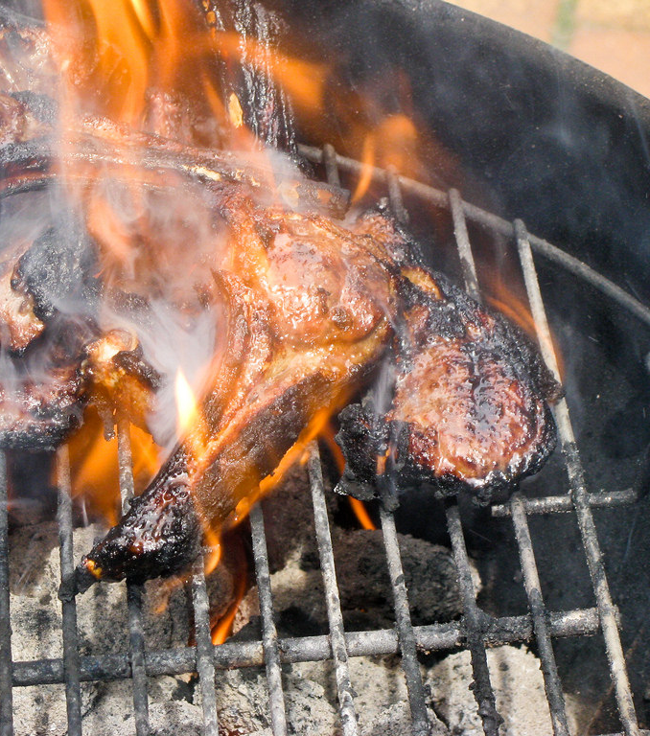
E-TALKING BEST FOR YOU
South African Cuisine
The braai is often heavily meat-based. South Africans enjoy a braai with boerewors, or sausages, kebabs, steak, marinated chicken, pork and lamb chops and even fish or rock lobster in more coastal areas. Side dishes at such an event can include salads, potato bakes, vegetable dishes, bread with preserves as well as pap. Pap is a staple food of black South Africans and is a thickened porridge made from finely ground corn/maize. It may be eaten with a tomato and onion sauce or a spicier chakalaka sauce, favored by the Indian community. Desserts can include ice cream with fresh fruit and chocolate sauce or more traditional pastries such as koeksisters or milk tart.
Marinated (adjective) a mixture of oil, vinegar and spices or herbs that is poured over meat to flavor it
Staple (adjective) basic or main; standard or regular

Slide 11
E-TALKING BEST FOR YOU
DISCUSSION
What is the staple food in your household or in your country?
How do you add flavor to your dishes?
03

Slide 12
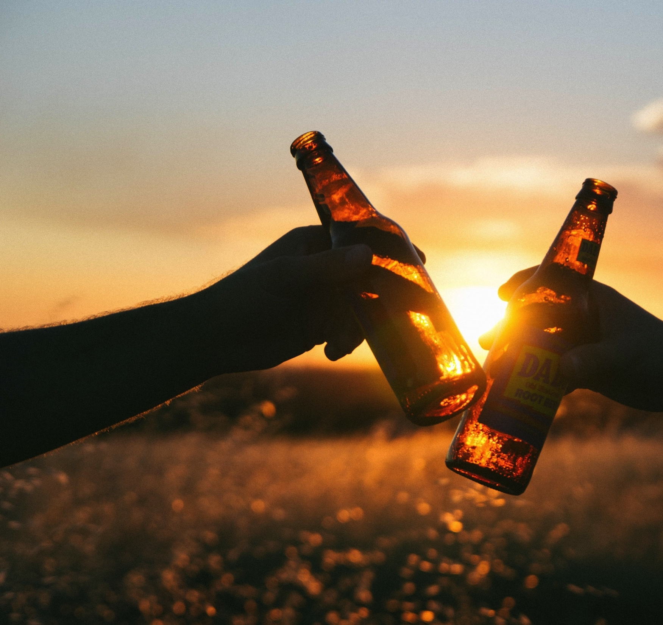
South African cuisine
E-TALKING BEST FOR YOU
If you are invited to a braai you should confirm the arrangements and the occasion beforehand. South Africans are known to have a braai for important occasions such as graduation parties or birthdays. In such cases you may have to dress more formally and may not be required to bring anything. They also have a braai during major sporting events, or simply as a social event with friends. For such an event you will likely have to bring your own meat, side dish and/or drinks and you can dress casually. An event like this can also be called a “bring and braai” which means you bring your own meat and we will braai it; or a “dop en tjop” where dop refers to alcoholic drinks and tjop refers to meat. If you are not sure, always check with your hosts.
Confirm (verb) to make an arrangement or meeting certain
Formally (adverb) according to tradition or etiquette; to wear smarter clothes
Casually (adverb) not formal or for special occasions

Slide 13
E-TALKING BEST FOR YOU
DISCUSSION
Is there a social event that is considered suitable for both formal
and casual events in your country?
Do you have gatherings where people are required to bring their own food or drinks?
05

Slide 14
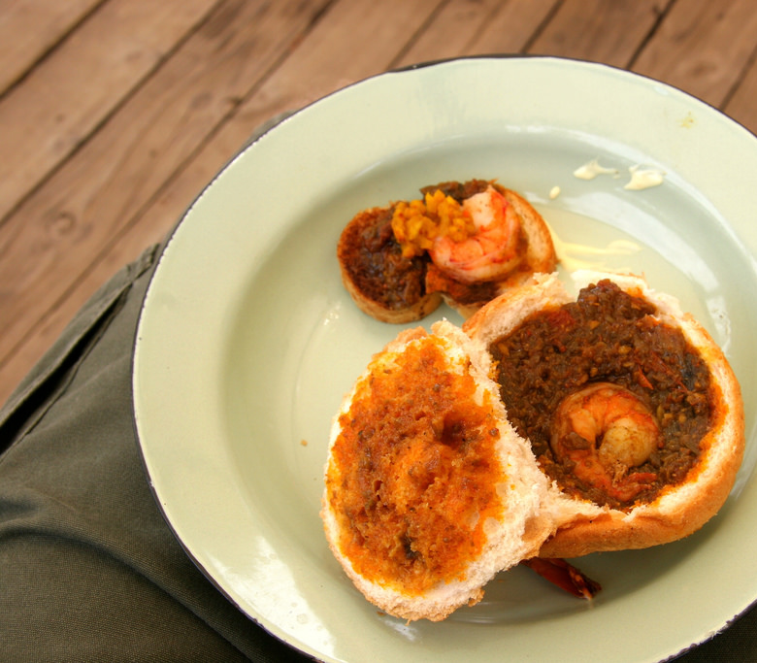
South African cuisine
E-TALKING BEST FOR YOU
There are many other dishes favored by South Africans. The local Indian community enjoys strong curries and is mainly based in Durban in the Kwa-Zulu Natal province. A favorite dish among them is called “bunny chow” which consists of hollowed-out bread filled with curry. The Portuguese population has made peri-peri chicken a favorite for all South Africans. Wine and beer are popular alcoholic beverages at social events. South Africa is a major wine producer with production mainly in Cape Town. Wine-tasting is a common event among tourists and locals and often includes interesting combinations such as sparkling wine with marshmallow treats. South Africa also has a large beer production with major producers as well as smaller breweries that make more specialized beers.
Popular (adjective) liked, enjoyed or supported by many people
Beverages (noun) a drink of any type
Breweries (noun) a company that makes beer or a place where beer is made

Slide 15
E-TALKING BEST FOR YOU
DISCUSSION
Do different cultures enjoy different dishes in your country?
Which beverages are popular at your social events?
06

Slide 16
E-TALKING BEST FOR YOU
REVIEW DISCUSSION
Discuss with your partner how you would invite a foreigner to one of your social events.
How would you help them to know of the customs or traditions around such an event?
Would you tell them about it first or would you let them come to the event without telling them anything?
How would you ask your host or hostess about the arrangements if you were invited to a South African braai?

Slide 17

E-TALKING BEST FOR YOU
SPEAKING TASK
Turn to another friend and invite them to one of your social events using the information from the previous activity.
Then invite them to a South African braai and see if you can include useful information such as the dress code and what they should bring.

Slide 18

E-TALKING BEST FOR YOU
ASSESSMENT
Match the vocabulary word with its definition by writing the letter next to the word.

Slide 19

E-TALKING BEST FOR YOU
ASSESSMENT

