Slide 1
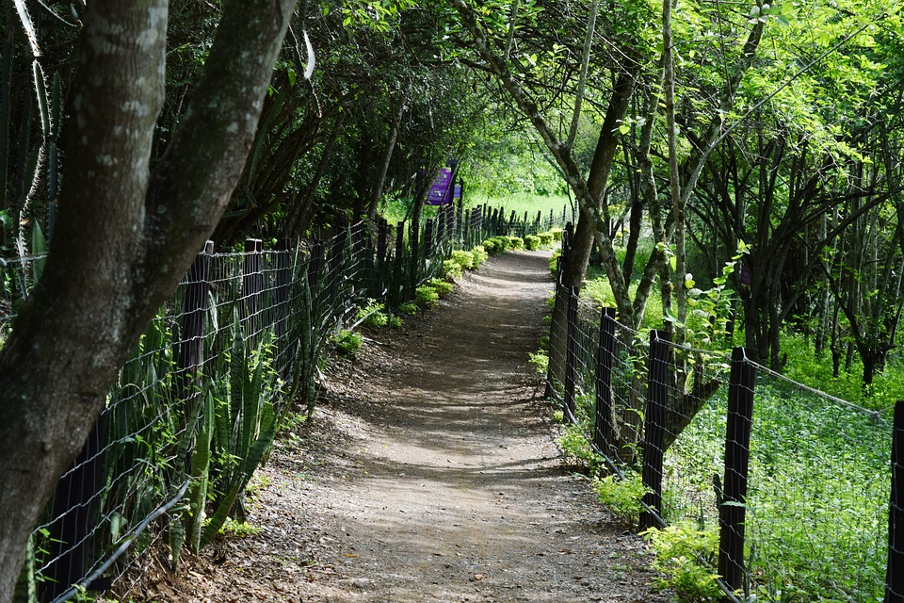
E-TALKING BEST FOR YOU
Lessons From Nature
view
Image from : pixabay.com

Slide 2

E-TALKING BEST FOR YOU
INTRODUCTION
Talk about present hobbies

Slide 3

E-TALKING BEST FOR YOU
GETTING STARTED
Is being outdoors good for one’s awareness? Why or why not?
If yes, can you name things you noticed today on your way to work?

Slide 4
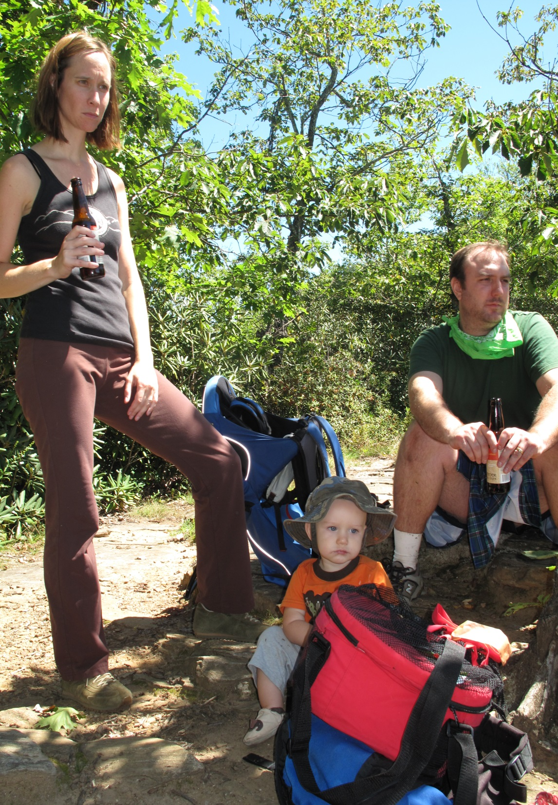

E-TALKING BEST FOR YOU
01 Reading time:
Let’s read about the benefits of going outdoors
It brings families together In my family we take turns choosing where to go and what to do outside. This brings us together and it's a lot of fun!
Attention (noun): notice, interest, or awareness
Image from : commons.wikimedia.org

Slide 5
E-TALKING BEST FOR YOU
01 Reading time:
Let’s read about the benefits of going outdoors
You pay attention to the world around you. When you are in nature you start noticing things you didn't notice before. Enjoy this.
Noticing (verb): to become aware of something by seeing or hearing
Image from : commons.wikimedia.org

Slide 6
E-TALKING BEST FOR YOU
01 Reading time:
Let’s read about the benefits of going outdoors
You notice things in your backyard If you have a big backyard or live in the city, you will see things that were always there. You will see things you didn't notice before.
Break (noun): a brief period of time during which someone stops an activity
Image from : commons.wikimedia.org

Slide 7
E-TALKING BEST FOR YOU
01 Reading time:
Let’s read about the benefits of going outdoors
You will take a break from electronics We are used to our electronics, but it's good to take a break.
Electronics (noun): devices (such as televisions, radios, and computers) that operate using many small electrical parts
Image from : commons.wikimedia.org

Slide 8
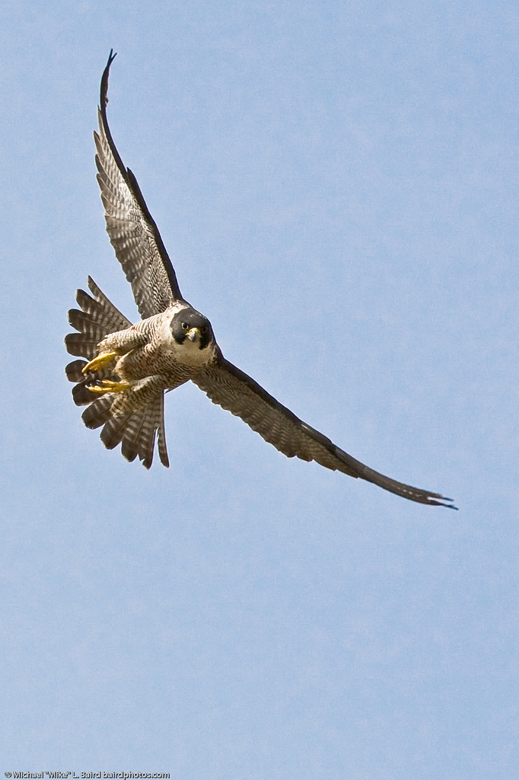
E-TALKING BEST FOR YOU
02 Reading time cont…
It helps you to be a good influence on others When your family and friends see you going outside they will want to make this change too.
Influence (noun): a person or thing that affects someone or something in an important way
Appreciate (verb): to understand the worth or importance of something or someone
Image from : flickr.com

Slide 9
E-TALKING BEST FOR YOU
02 Reading time cont…
You will appreciate birds. Everywhere you go outside you will see birds. Birds are comforting and reliable. You will look forward to seeing them whenever you go out.
Everywhere (verb): in or to every place
Reliable (adjective): able to be trusted to do or provide what is needed
Image from : flickr.com

Slide 10

E-TALKING BEST FOR YOU
03 Comprehension questions:
How does the author get her family involved?
What happens when you pay attention to the world around you?
How is going outdoors more a good influence on others?
Why does the author like seeing birds?
Image from : en.wikipedia.org

Slide 11

E-TALKING BEST FOR YOU
REVIEW DISCUSSION
Do you notice the things in your backyard?
Do you spend time outdoors with family or friends?
Are there many birds in your town?

Slide 12

E-TALKING BEST FOR YOU
SPEAKING TASK
Express Yourself
Summarize the article and add your opinion.

Slide 13

E-TALKING BEST FOR YOU
ASSESSMENT
Complete the sentences using the vocabulary words from this lesson:

Slide 14

E-TALKING BEST FOR YOU
Appreciate everywhere reliable attention noticing break electronics influence
1. The beautiful girl liked the ____________ she got from boys.
2. The boss was very angry when he started _________ the employees leaving early.
3. I need a little ___________ after all of this walking.
4. Some children know how to use __________ better than their parents.
5. Her parents are worried that her new friends might be a bad ______________.
6. Living in a large, diverse city taught me to ____________ the differences in people.
7. His fans ______________ anxiously waited for the famous musician’s new song.
8. The city tests the water to make sure that it is safe and ____________.
ASSESSMENT

Slide 15


E-TALKING BEST FOR YOU
Thank you !

