Slide 1
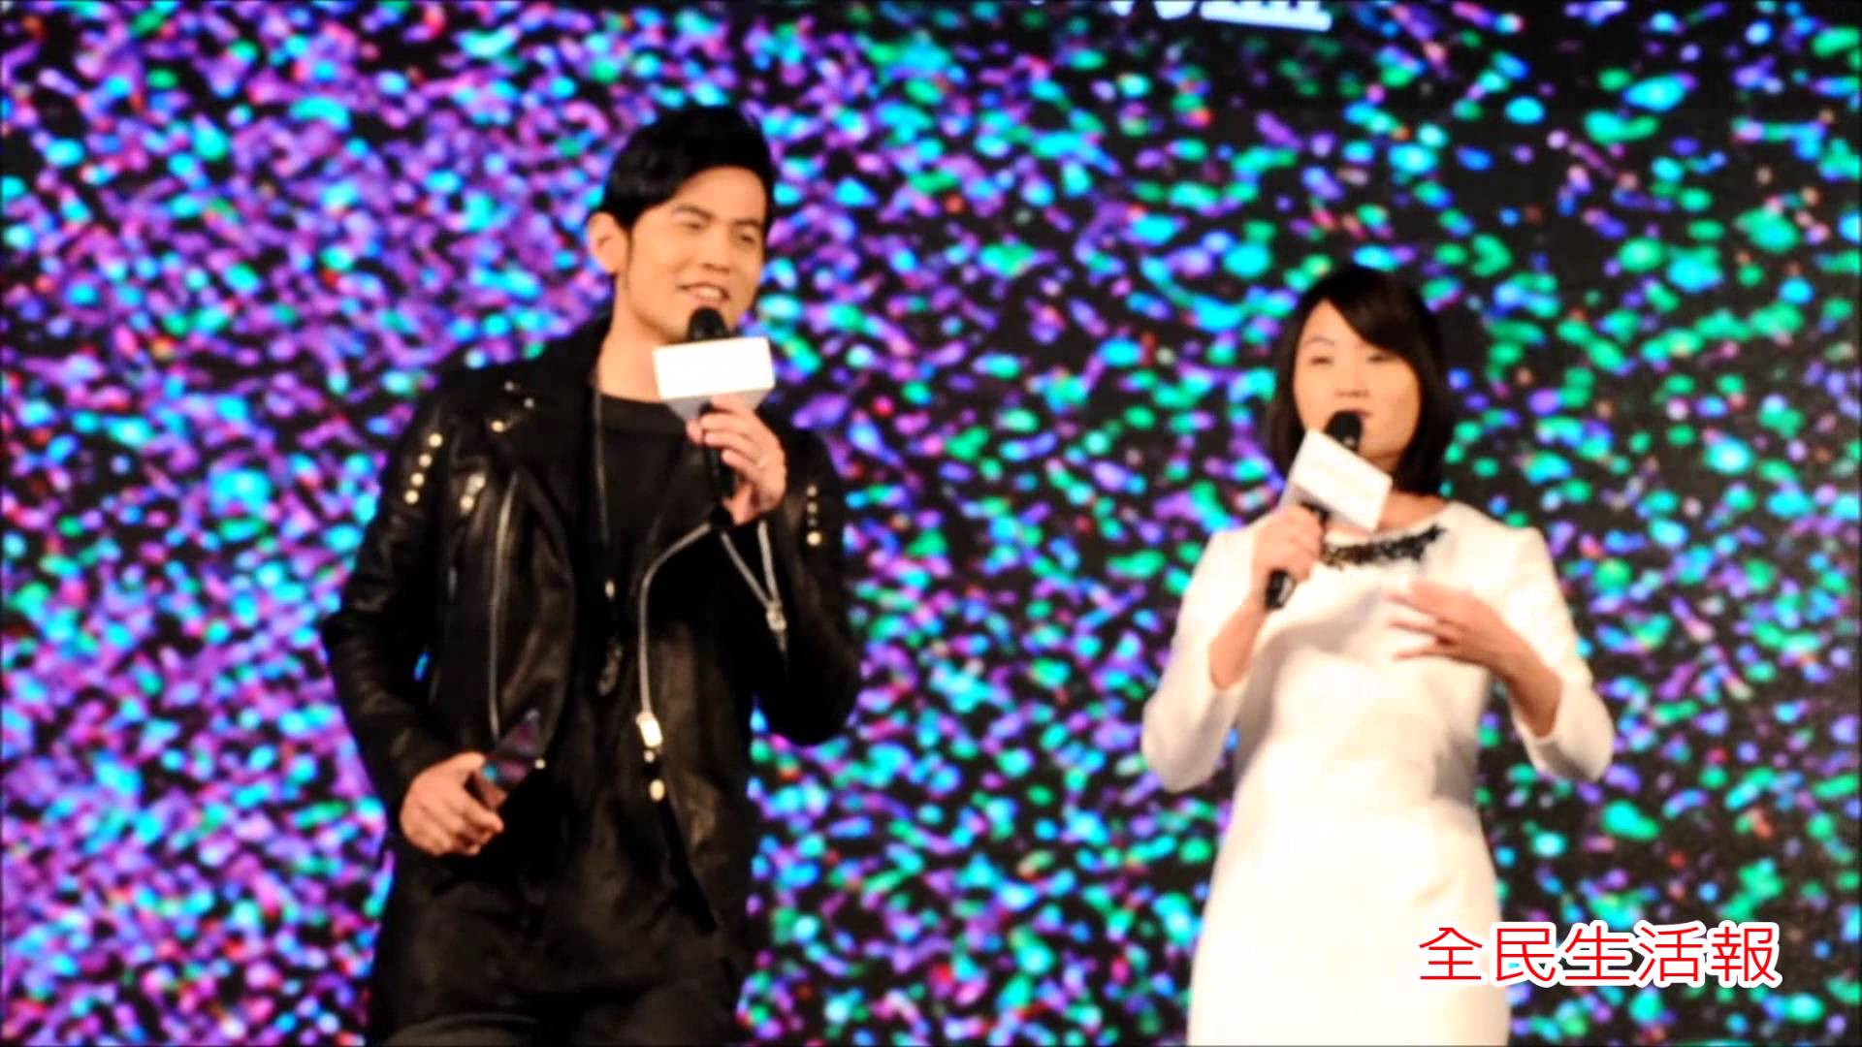
E-TALKING BEST FOR YOU
Jay Chou
The King of Asian Pop
view
Image from : youtube.com

Slide 2

E-TALKING BEST FOR YOU
E-TALKING BEST FOR YOU
INTRODUCTION
Talk about Jay Chou’s life and describe how he is inspiring

Slide 3

E-TALKING BEST FOR YOU
GETTING STARTED
What kind of music do you like?
What do you already know about Jay Chou? Do you like his music?

Slide 4
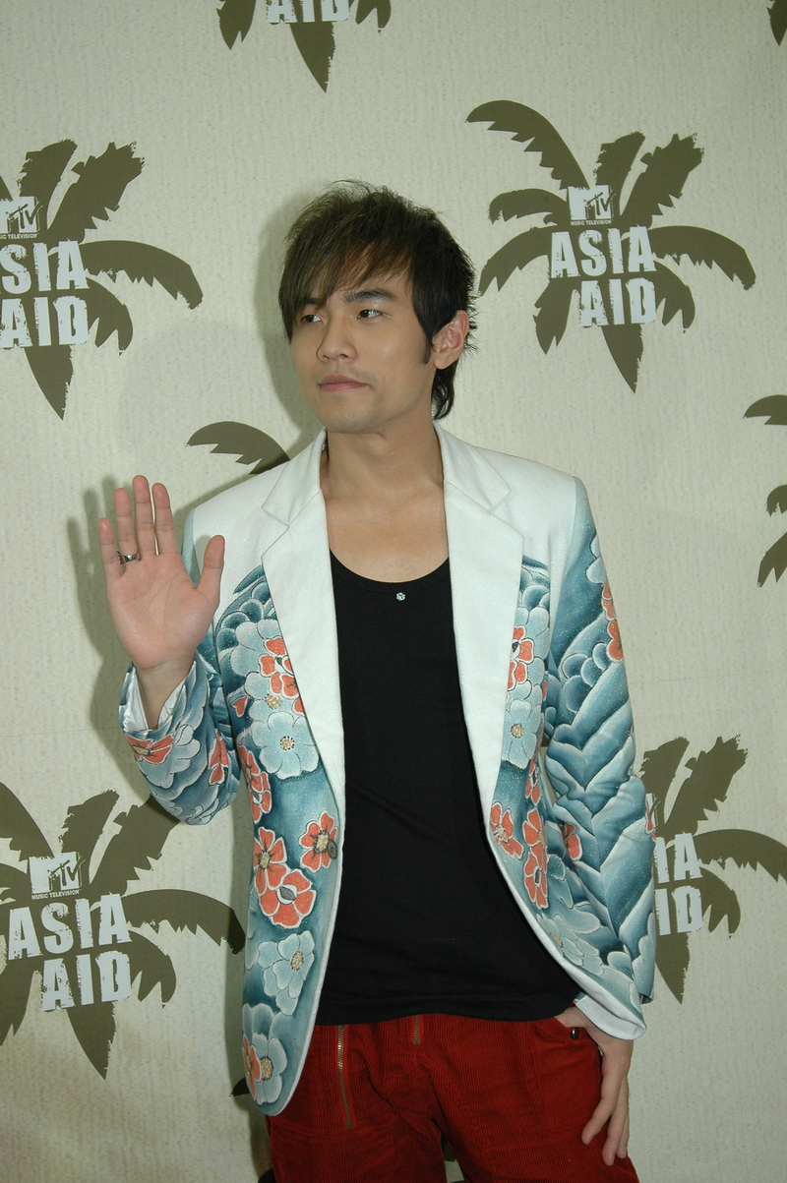

E-TALKING BEST FOR YOU
01 Let’s look at some of the highlights of Jay Chou’s life
Jay Chou is a singer, songwriter and actor who is also a classical musician. Time magazine called him the New King of Asian Pop in 2003, and he has sold millions of albums.
Classical (adjective): music that is considered to be part of a formal European tradition, written by people like Mozart and Stravinsky
Image from : pt.wikipedia.org

Slide 5
E-TALKING BEST FOR YOU
01 Let’s look at some of the highlights of Jay Chou’s life
Jay Chou has also won more than 350 music awards in Asia and has, more recently, become a successful movie director.
Image from : pt.wikipedia.org

Slide 6
E-TALKING BEST FOR YOU
01 Let’s look at some of the highlights of Jay Chou’s life
Born in Taiwan in 1979, Chou learned piano and cello as a child. He was 13 when his parents divorced and he was teased by his classmates.
Tease (verb): to laugh at someone or say unkind things about them
Image from : pt.wikipedia.org

Slide 7
E-TALKING BEST FOR YOU
01 Let’s look at some of the highlights of Jay Chou’s life
Because he had few friends and preferred to be alone, Chou spent his time listening to music and daydreaming. It was this strong love of music that helped him win a talent show in 1998.
Daydream (verb): to have pleasant thoughts about something you like or would like to happen
Talent Show (noun): a TV show in which people compete to show who is the most skilled entertainer
Image from : pt.wikipedia.org

Slide 8
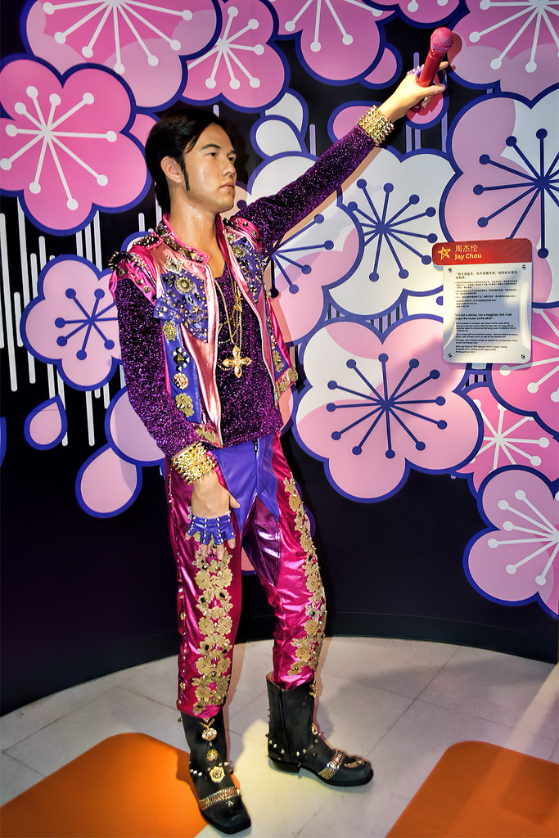
E-TALKING BEST FOR YOU
02 Reading time cont…
His first album, called simply Jay, was a combination of Chinese and Western pop and R&B, all inspired by his classical training. This brought him hits all over Asia.
Combination (noun): the mixture you get when two or more things are mixed or joined together
R&B (noun): a type of popular music, originally by African-American artists, that can have features of soul, jazz, funk, and hip-hop [rhythm & blues]
Image from : flickr.com

Slide 9
E-TALKING BEST FOR YOU
02 Reading time cont…
In addition to gaining fame as a popular Mandarin-language songwriter and recording artist, Jay Chou made his directing debut in 2007. And in 2011, he made his Hollywood acting debut in The Green Hornet.
Direct (verb): to tell/show the actors in a film or play what to do
Debut (noun): when someone performs or presents something to the public for the first time
Image from : flickr.com

Slide 10
E-TALKING BEST FOR YOU
02 Reading time cont…
Marriage and Family
In 2015, Jay Chou married Taiwanese-Australian model and actress Hannah Quinlivan in England. They have one daughter.
Image from : flickr.com

Slide 11
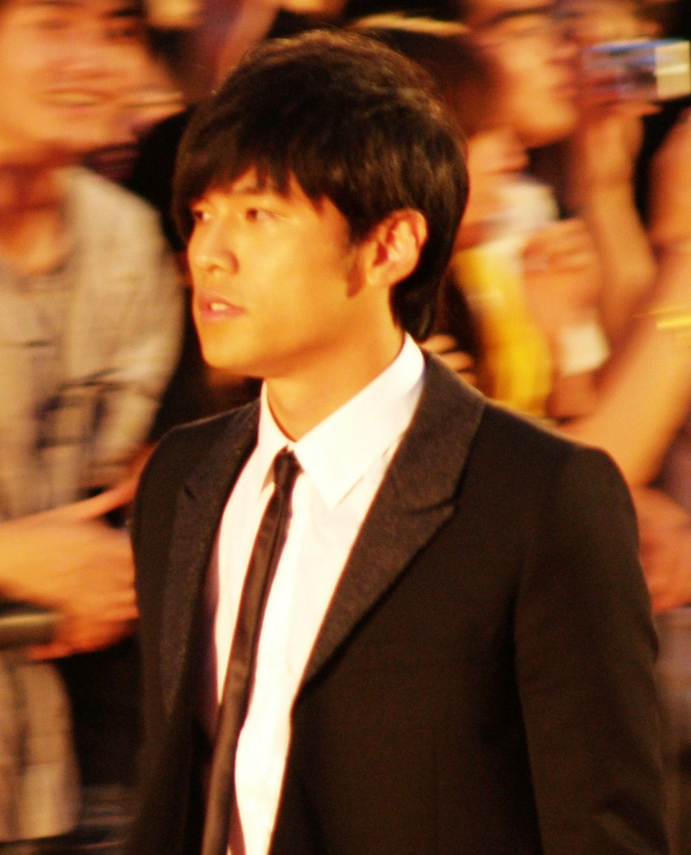
E-TALKING BEST FOR YOU
03 Comprehension questions:
1. What did Time magazine call Jay Chou?
2. What happened when Jay Chou’s parents got divorced?
3. What helped Jay Chou win the talent show?
4. What was Jay Chou’s first movie as an actor?
Image from : commons.wikimedia.org

Slide 12

E-TALKING BEST FOR YOU
REVIEW DISCUSSION
1. What can we learn from Jay Chou’s life?
2. What did Jay Chou have to overcome? How do you think these things helped him become successful?
3. What do you think is the most interesting of Jay Chou’s achievements? Why?
4. Do you think Jay Chou is an inspiration? Why or why not?

Slide 13

E-TALKING BEST FOR YOU
SPEAKING TASK
Express Yourself
Explain in your own words why you think Time magazine described Jay Chou as “The New King of Asian Pop.”

Slide 14

E-TALKING BEST FOR YOU
ASSESSMENT
Complete the sentences using the vocabulary words from this lesson:

Slide 15

E-TALKING BEST FOR YOU
Classical Tease Daydream Combination R&B Debut
1. Sarah will make her dance ___________ at the show on Saturday.
2. ______________ is a type of popular African-American music that originated in the 1940s.
3. Steve finds __________________ music much more relaxing to listen to than pop.
4. This restaurant serves a __________________ of different food styles.
5. He was ________________(ing) on the MRT and nearly missed his stop.
6. It is not kind to ______________ people who do not speak English well.
ASSESSMENT

Slide 16


E-TALKING BEST FOR YOU
Thank you !

