Slide 1
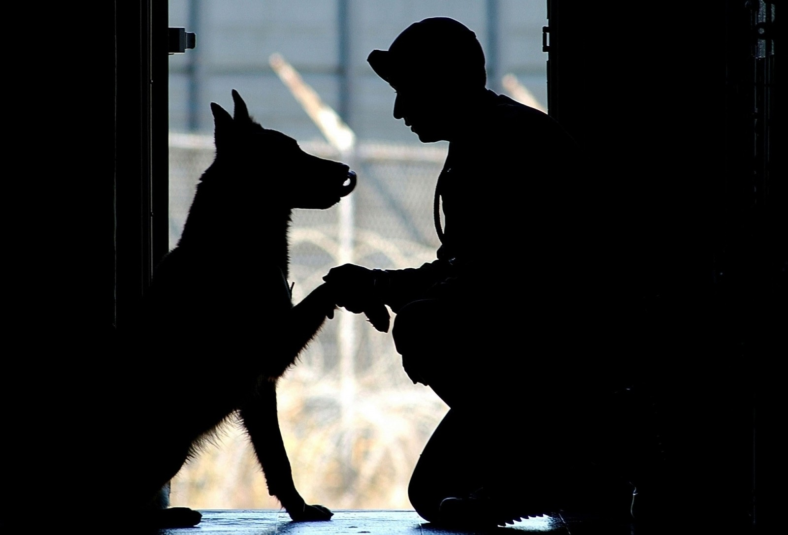
E-TALKING BEST FOR YOU
Stolen Dog is Returned to Owner
view

Slide 2

E-TALKING BEST FOR YOU
INTRODUCTION
Can do:
Talk about ways to solve problems

Slide 3

E-TALKING BEST FOR YOU
GETTING START
Are animals able to feel emotion? Why or why not?
If yes, what kinds of emotions do animals show and how do they do it?

Slide 4
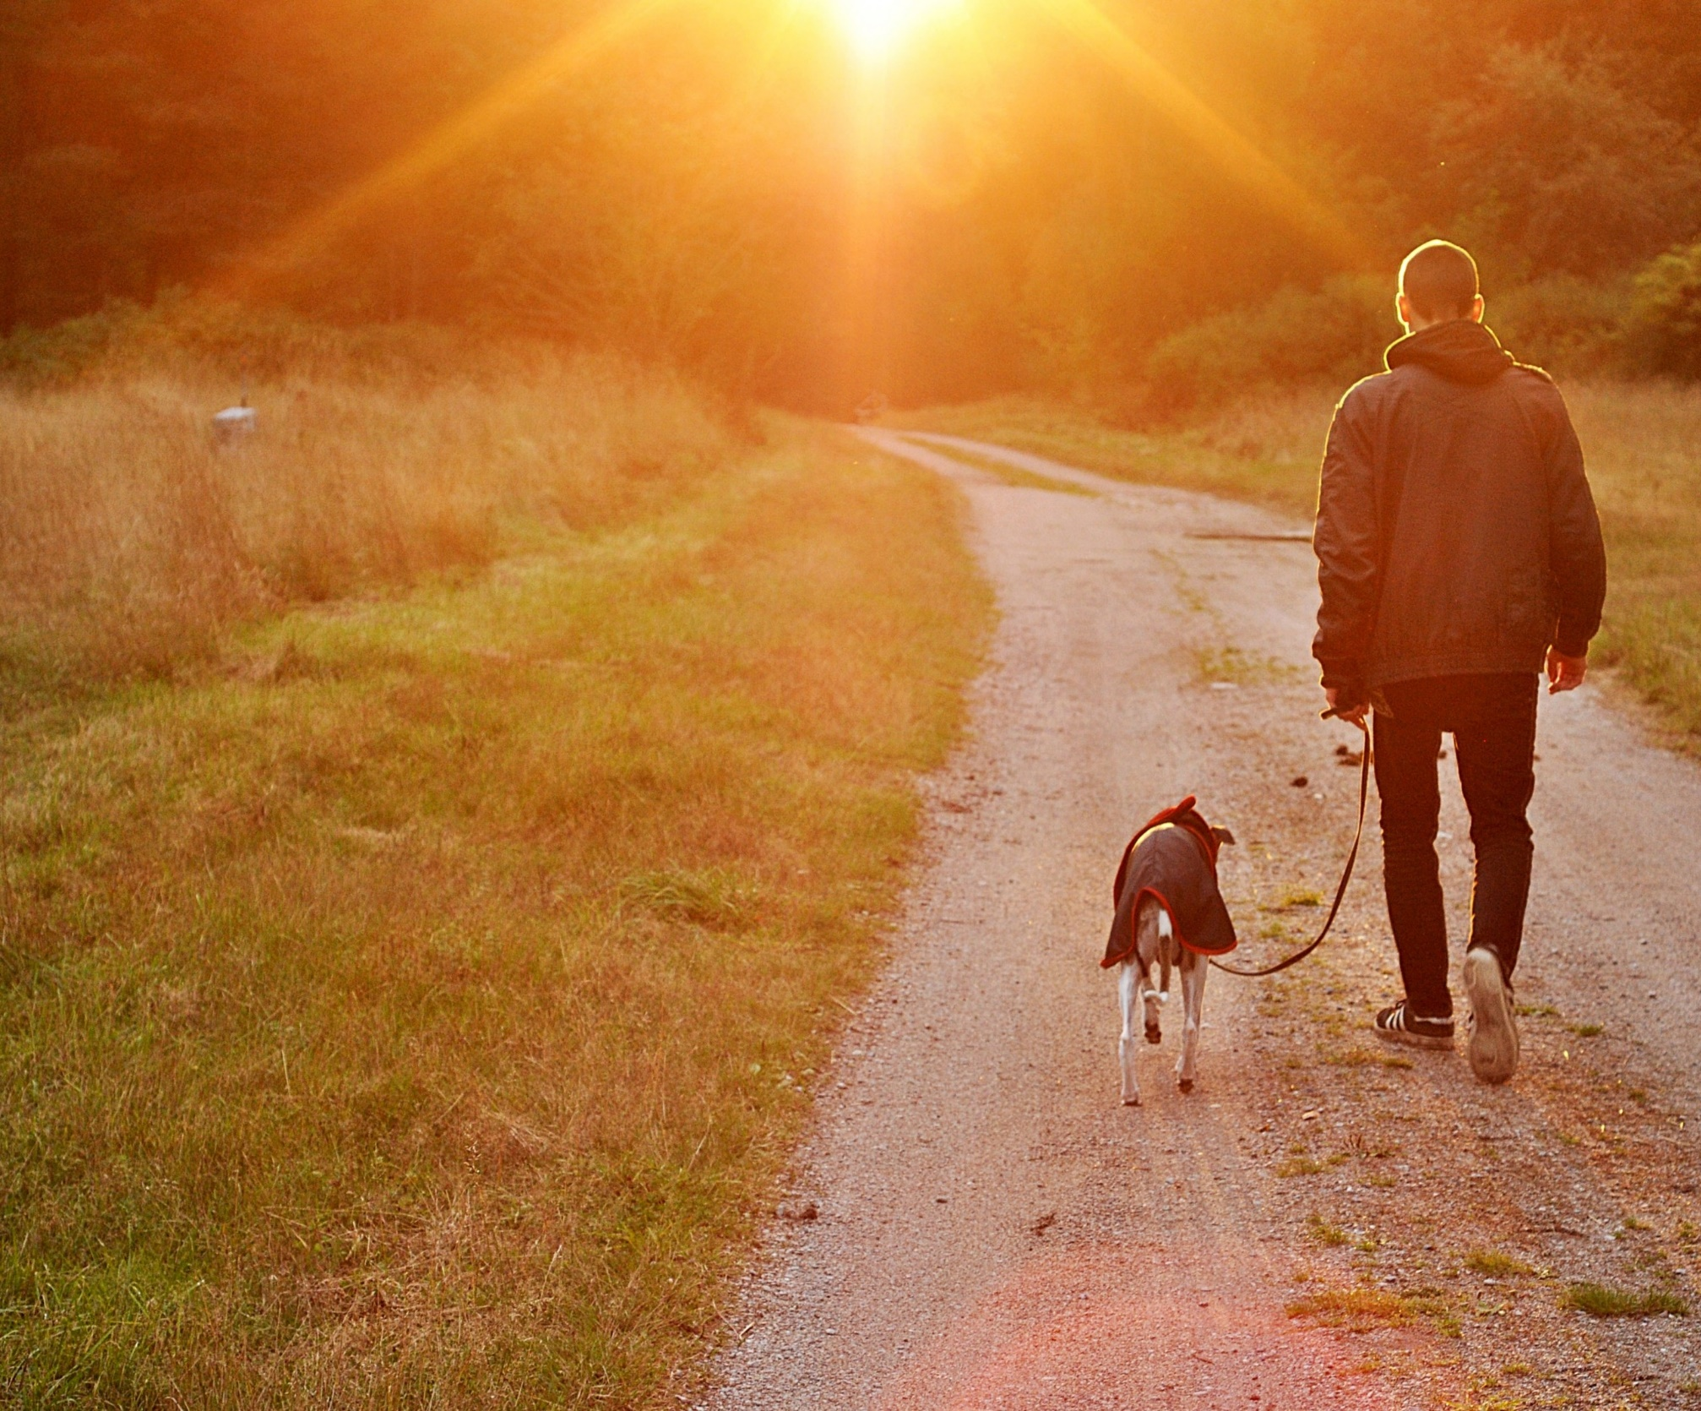

E-TALKING BEST FOR YOU
Vocabulary
Overjoyed (adjective): filled with great happiness
Separated (adjective): located far apart from each other
Stolen (verb): to take something that does not belong to you in a way that is wrong or illegal
Homeless (adjective): having no place to live
Puppy (noun): a young dog
Heartbroken (adjective): filled with great sadness
Reunited (verb): to be together again after being apart for a long time

Slide 5

E-TALKING BEST FOR YOU
Reading time : Let’s read about a man who found his dog
Chaos was overjoyed to see his owner after being separated for two years. The dog was stolen by a friend. The friend would not give the dog back to his owner.
Jose went through many struggles. In Columbus, Wisconsin Jose went through a divorce, lost his house, and became homeless. He has no choice and had to live in his car.

Slide 6
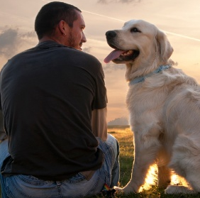
E-TALKING BEST FOR YOU
Reading time : Let’s read about a man who found his dog
Jose had Chaos since he was a puppy and he says, “Chaos helped me through so much in my life, I took him everywhere with me! “A friend offered to take Chaos and three months later Jose was better. He went to get Chaos and the friend refused to give him back. Jose was heartbroken. I didn’t think I would ever see my dog again,”

Slide 7
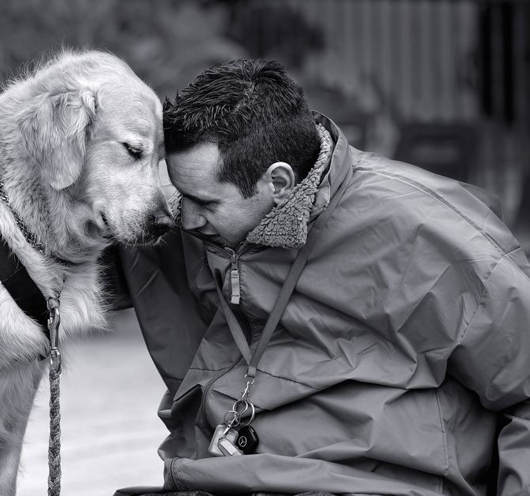
E-TALKING BEST FOR YOU
Reading time
One day Jose was reading email. He had a notice to update Chaos' information. Jose was upset and sad. He thought about his friend and wondered what happened to him. He began to look at old photos of Chaos. Suddenly, the phone rang. His dog Chaos was at an animal shelter in another county! Soon the two were reunited.

Slide 8
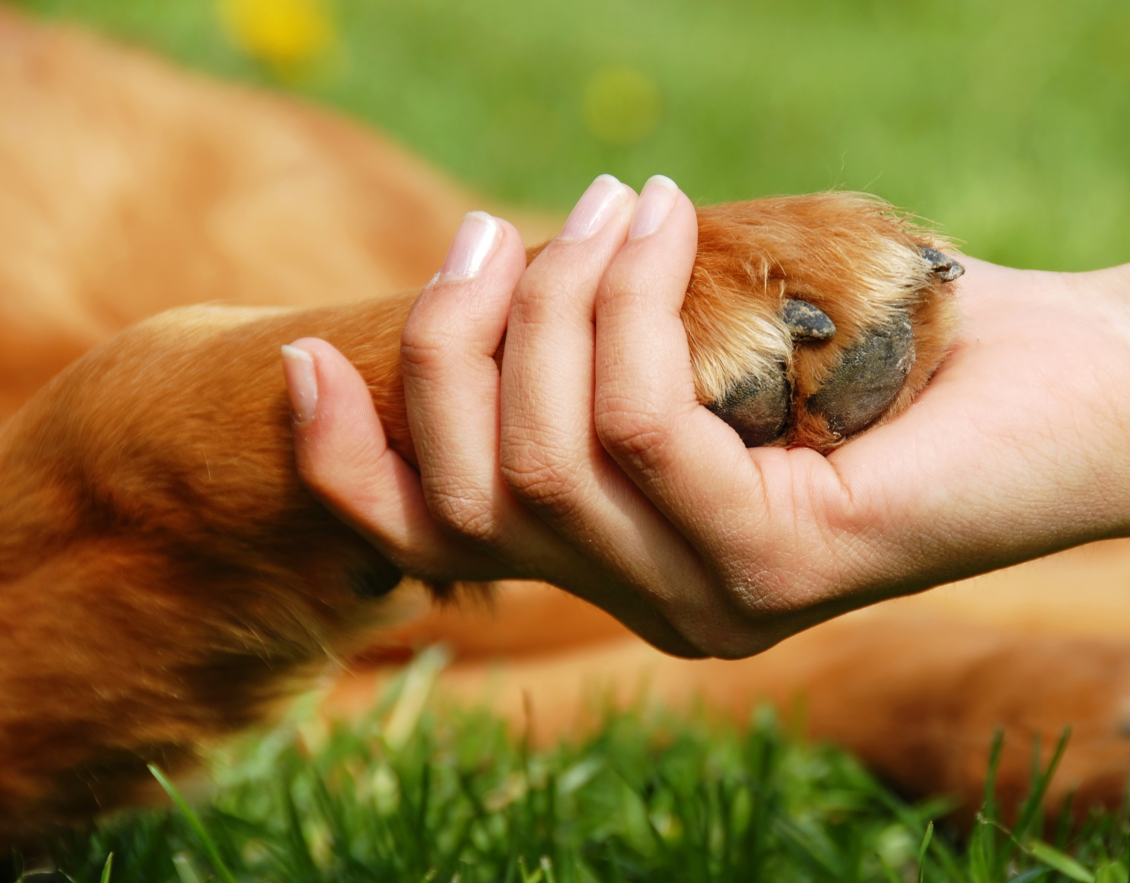
E-TALKING BEST FOR YOU
Comprehension questions :
How was Chaos Separated from his owner?
Where does Jose live?
Since when did Jose have Chaos?
How did Jose find out where Chaos was?

Slide 9

E-TALKING BEST FOR YOU
DISCUSSION
Do you have a best friend?
Do you think animals can be a best friend?
Do you have a dog, cat, or pet at home?

Slide 10

E-TALKING BEST FOR YOU
SPEAKING TASK
Summarize the article and add your opinion.

Slide 11

E-TALKING BEST FOR YOU
ASSESSMENT
Put it into practice

Slide 12

E-TALKING BEST FOR YOU
Puppy reunited heartbroken overjoyed separated stolen homeless
The charity was _______ to receive a large cash donation.
The friends were _____________ went one went to a university on the east coast and the other went to a university on the west coast.
They immediately called the police when they saw their house was robbed and many items were __________.
Sometimes ______ people sleep on the street, in parks, or in churches.
Our dog just gave birth to one male ___________ and three female ones.
She is ______________ that the situation turned out so badly.
The old band ______________ for one last, special concert.
ASSESSMENT

Slide 13


E-TALKING BEST FOR YOU
Thank you !

