Slide 1
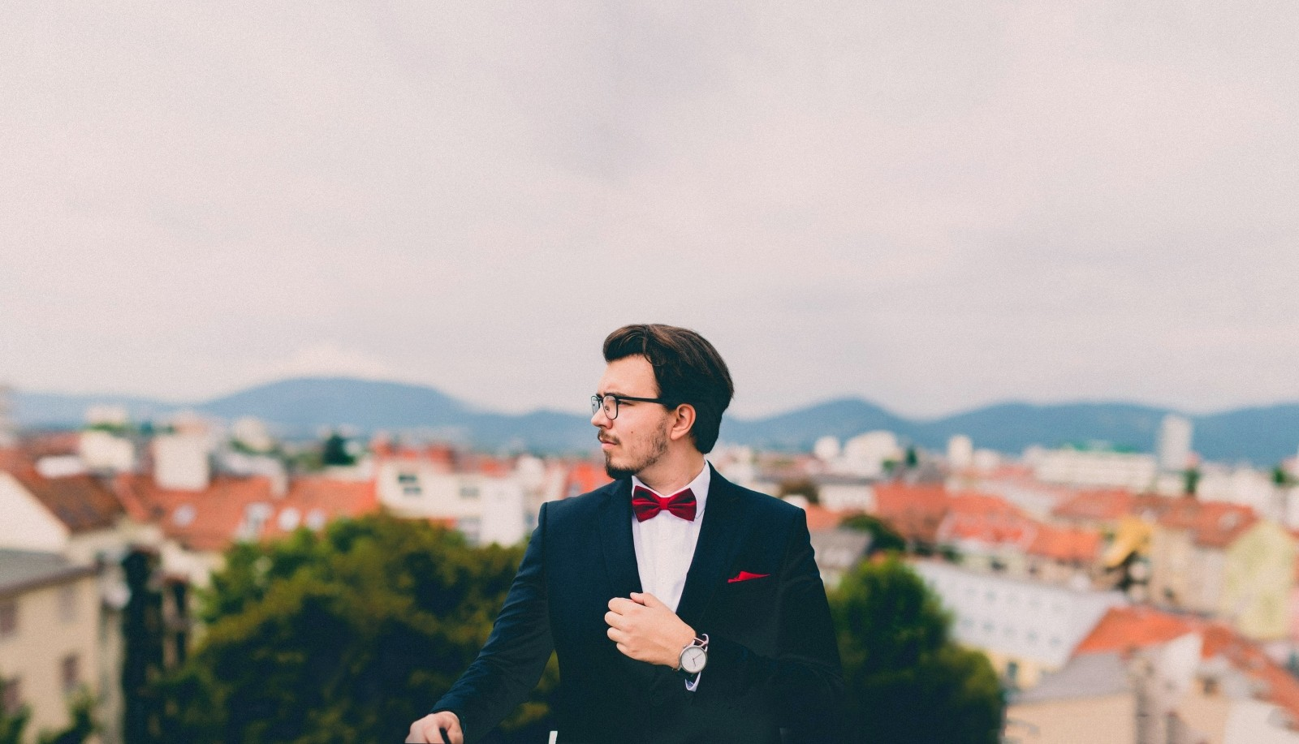
E-TALKING BEST FOR YOU
Customs and Cultures of the United Kingdom
UK Etiquette
view

Slide 2

E-TALKING BEST FOR YOU
INTRODUCTION
CEFR Learning Goal: Describe people skills

Slide 3
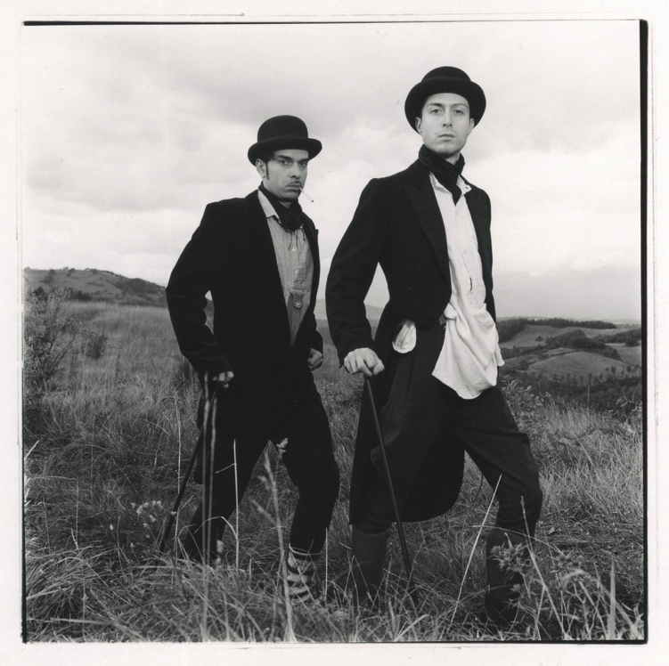
E-TALKING BEST FOR YOU
You may have heard the term “stiff upper lip” when people refer to someone from the United Kingdom. Irish people are often described as liking alcohol too much and Scottish people are considered hard to understand with their unusual accent. Although a lot of these are stereotypes that you should not repeat, there are certain cultural differences that you should take note of when visiting the UK. These are not true for everyone in the UK and while you won’t get in trouble for not following their social rules, it is considered polite and would be appreciated if you tried to follow them. Most of us appreciate it when someone takes an interest in our personal likes and dislikes. In the same way, people will appreciate it if you take the time to learn about their social habits and try to adjust your own to make them feel more comfortable.
START

Slide 4

E-TALKING BEST FOR YOU
VOCABULARY
Lets check whether you know each following word.

Slide 5

E-TALKING BEST FOR YOU
E-TALKING BEST FOR YOU
Etiquette (noun) rules indicating the proper and polite way to behave
Slightly (adjective) very small amount
Mishap (noun) a very small mistake or accident
Politeness (adjective) having or showing good manners or respect for other people
Address (verb) to speak to a person or group
Status (noun) the position or rank of someone or something when compared to others in a society, group or organization
Vocabulary

Slide 6

E-TALKING BEST FOR YOU
UK Etiquette
In the United Kingdom (England, Scotland, Wales and Northern Ireland) there are a set of social rules that are a bit different than what you might have at home. You may think you already know what they are, based on what you know about other countries, but the etiquette in the UK is slightly different from the rest of the world. You should be aware of these differences to avoid a social mishap while visiting or working there. The most important thing to keep in mind is that the British show less emotion than other nations.

Slide 7

E-TALKING BEST FOR YOU
DISCUSSION
Do you think you enjoy showing a lot of emotion?
How might you show less or more emotion?

Slide 8
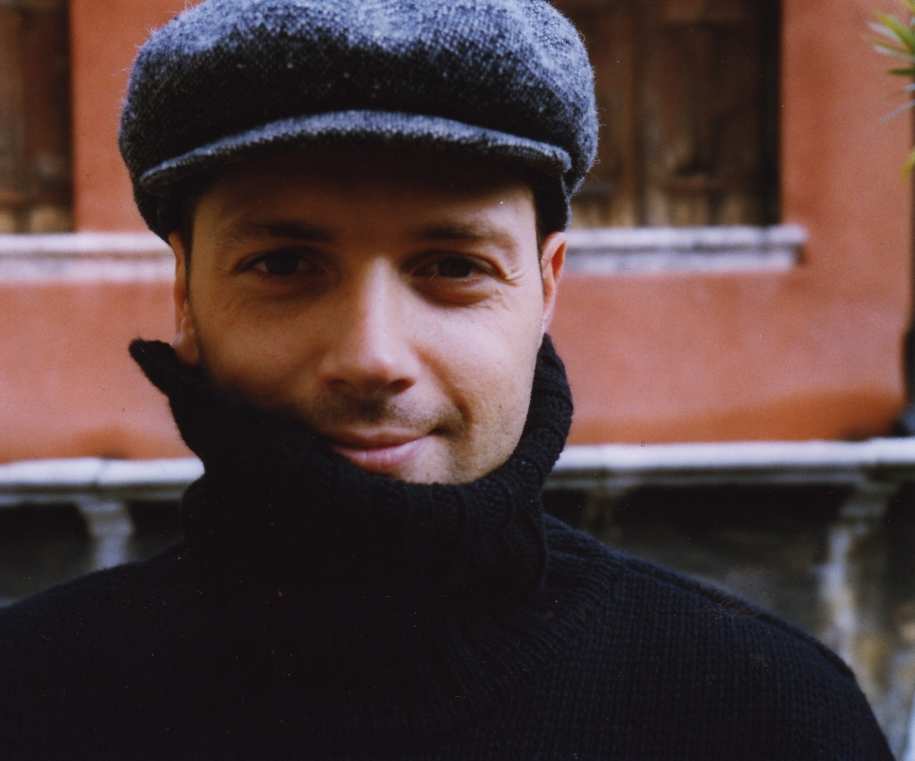
E-TALKING BEST FOR YOU
Introductions
British people take politeness very seriously. They always say please and thank you. In fact, you could probably not use the terms “please, thank you” or “sorry” too many times in British company. It is normal to greet people with a handshake, even close friends. People shake hands when they meet and when they leave. You can make eye contact while shaking hands, but avoid doing so for a long time.
You can use their title and surname to address them until told otherwise. There are so-called social classes in Britain that you may not be aware of. In general a younger person should be introduced to an older person. Someone of lower status should be introduced to someone of higher status. If two people are of similar status then introduce the one you know better to the other one.

Slide 9
E-TALKING BEST FOR YOU
DISCUSSION
Are there social classes in your culture?
Do you follow specific guidelines when it comes to introducing someone?

Slide 10
E-TALKING BEST FOR YOU
REVIEW DISCUSSION
What are the stereotypes surrounding your country or culture? Are they true for everyone or have they been overstated? What other stereotypes can you think of? Do you know if they are all true or why these stereotypes exist?

Slide 11

E-TALKING BEST FOR YOU
SPEAKING TASK
How do you think a stereotype is formed?
Do you think it’s good to know and talk about different stereotypes? Do you think knowing about stereotypes changes how you treat someone? Think about the different skills you use when interacting with people and how they might change based on who you are dealing with.

Slide 12

E-TALKING BEST FOR YOU
ASSESSMENT
Match the vocabulary words from the reading with their appropriate definition:

Slide 13

E-TALKING BEST FOR YOU
Words
Etiquette
Slightly
Mishap
Politeness
Address
Status
Definitions
the position or rank of someone or something when compared to others in a society, group or organization
rules indicating the proper and polite way to behave
very small amount
to speak to a person or group
having or showing good manners or respect for other people
a very small mistake or accident
ASSESSMENT

Slide 14


E-TALKING BEST FOR YOU
Thank you !

