Slide 1
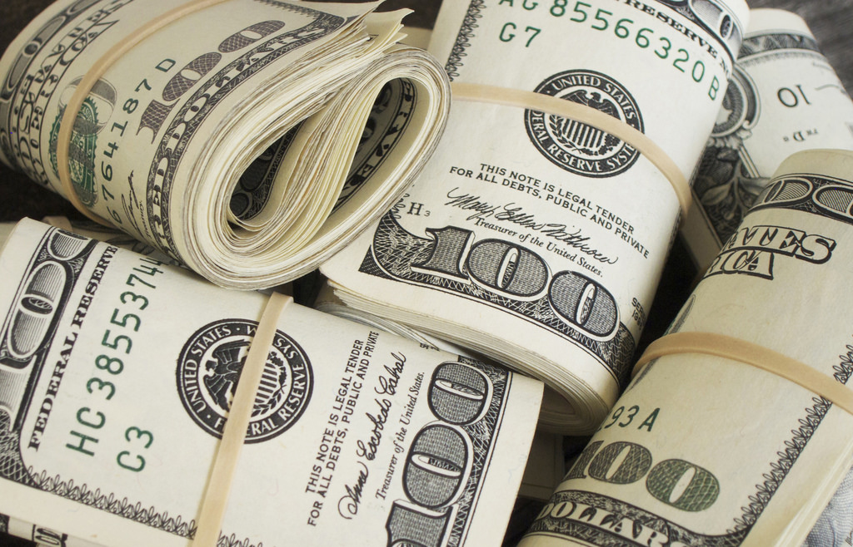
E-TALKING BEST FOR YOU
Money I
Functions of money
view
Image from : flickr.com

Slide 2

E-TALKING BEST FOR YOU
INTRODUCTION
Students can identify the four basic functions of money.

Slide 3
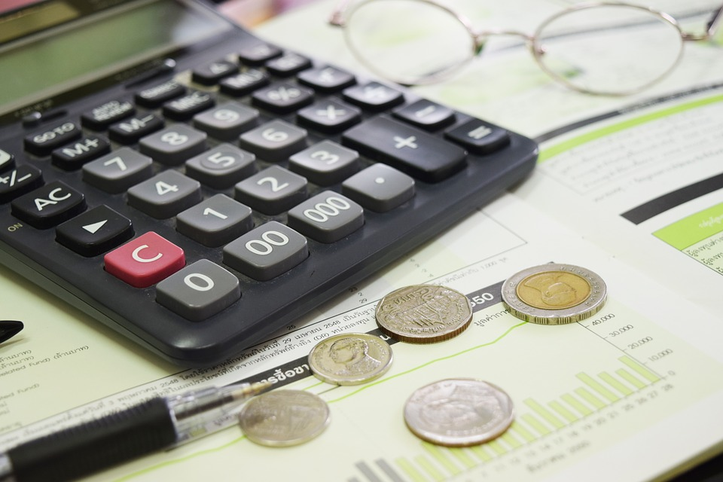
E-TALKING BEST FOR YOU
Meaning of Money
Money can be defined as anything that is generally acceptable by everyone in a community, state or country as a means of settling payments, storing of assets, unit of account, and standard of deferred payment.
START
Image from : pixabay.com

Slide 4

E-TALKING BEST FOR YOU
WARM-UP
List four things you can use money for.

Slide 5
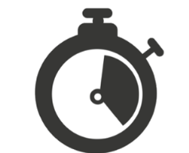
E-TALKING BEST FOR YOU
GETTING STARTED
State four things that can help you identify your country’s currency.

Slide 6
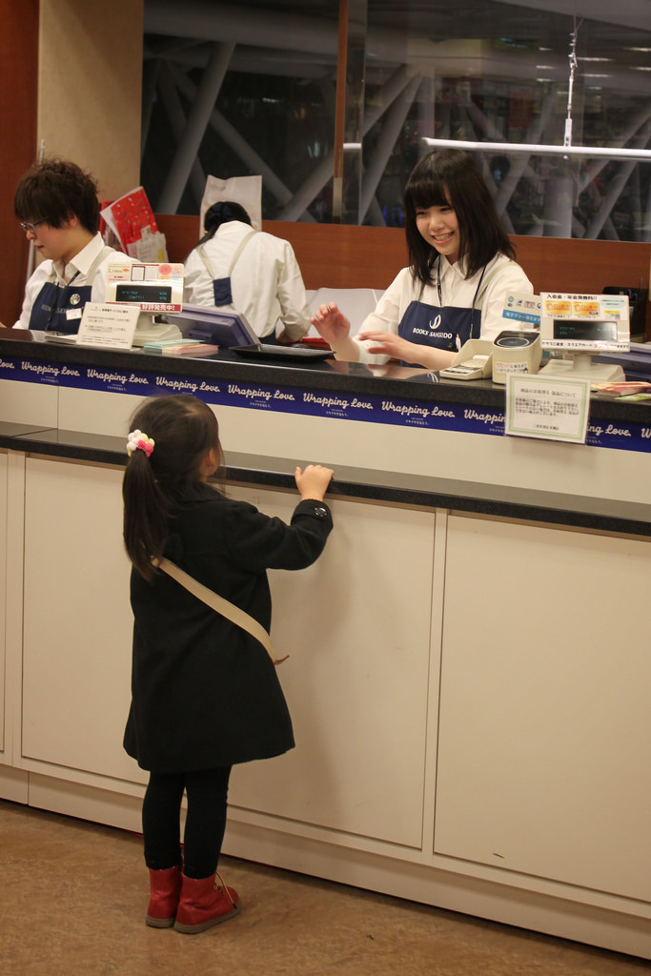

E-TALKING BEST FOR YOU
01 Medium of Exchange
Before you can get what you buy from a seller, you need to redeem it. Money is the means through which you can get what you bought redeemed. By so doing, money serves as a medium of exchange.
Redeem (verb) Pay for
Medium (noun) Means of doing something
Exchange (noun) Giving one thing and receiving another
Image from : flickr.com

Slide 7

E-TALKING BEST FOR YOU
DISCUSSION
Do you think credit cards should be regarded as money?
01

Slide 8
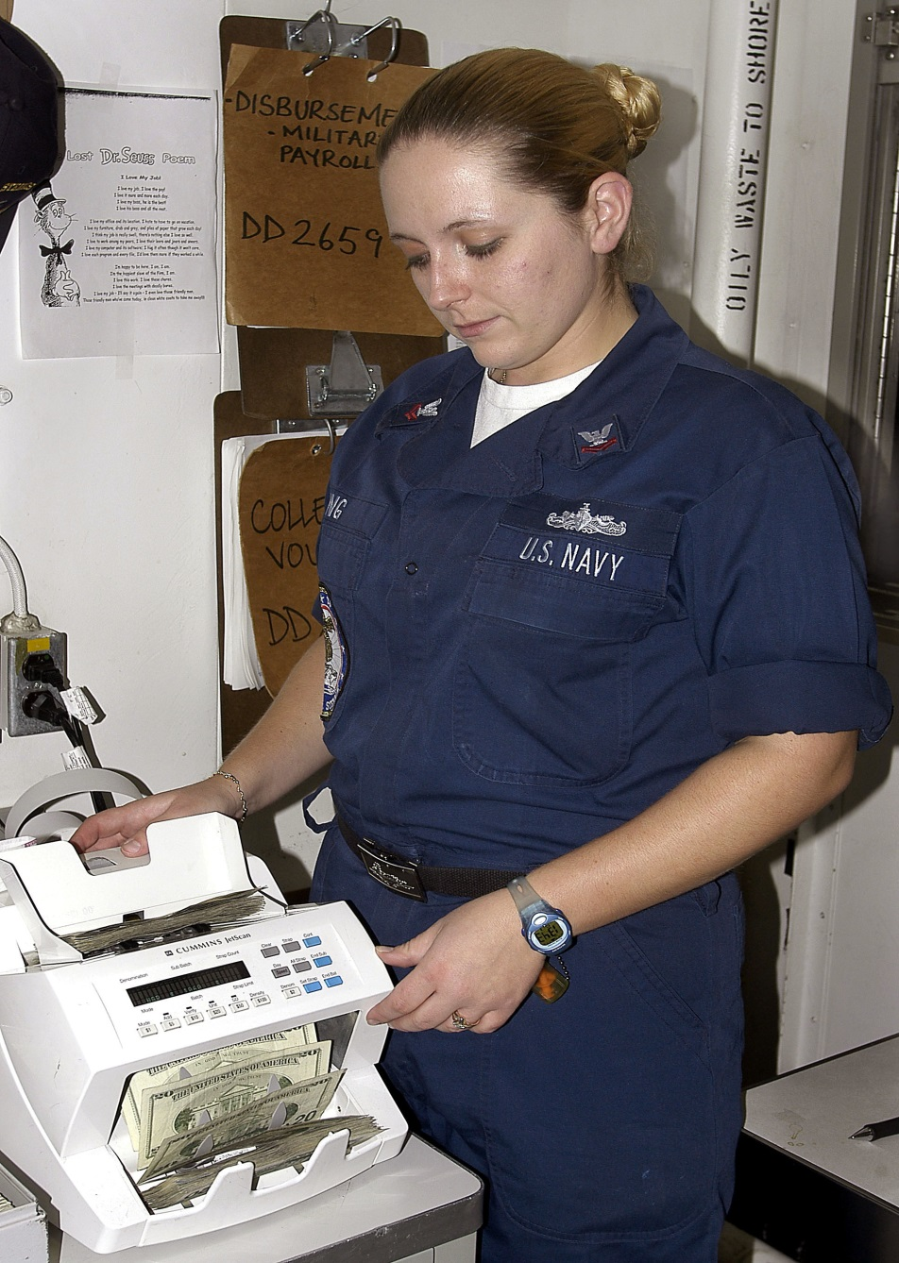
E-TALKING BEST FOR YOU
02 Unit of Accounting
A proper account must be made so as to know the correct worth of what you have or want to buy. In order to avoid being cheated, money is the only accurate means of determining the value of a particular good.
Proper (adjective) Correct
Account (noun) A record of money spent
Avoid (verb) Keep away from
Value (noun) What something is worth
Image from : en.wikipedia.org

Slide 9
E-TALKING BEST FOR YOU
DISCUSSION
How can money stand as a yardstick for keeping of accounts?
02

Slide 10

E-TALKING BEST FOR YOU
03 Store of Value
Money is used to determine how much a particular piece of property is worth. Doing so will enable you to know what the property will be worth in the future, if you want to store it. You can decide to sell it and keep the money for future use.
Property (noun) Asset
Worth (verb) Value
Decide (verb) Come to a conclusion
Image from : flickr.com

Slide 11
E-TALKING BEST FOR YOU
DISCUSSION
Discuss how money can serve as a store of value.
03

Slide 12
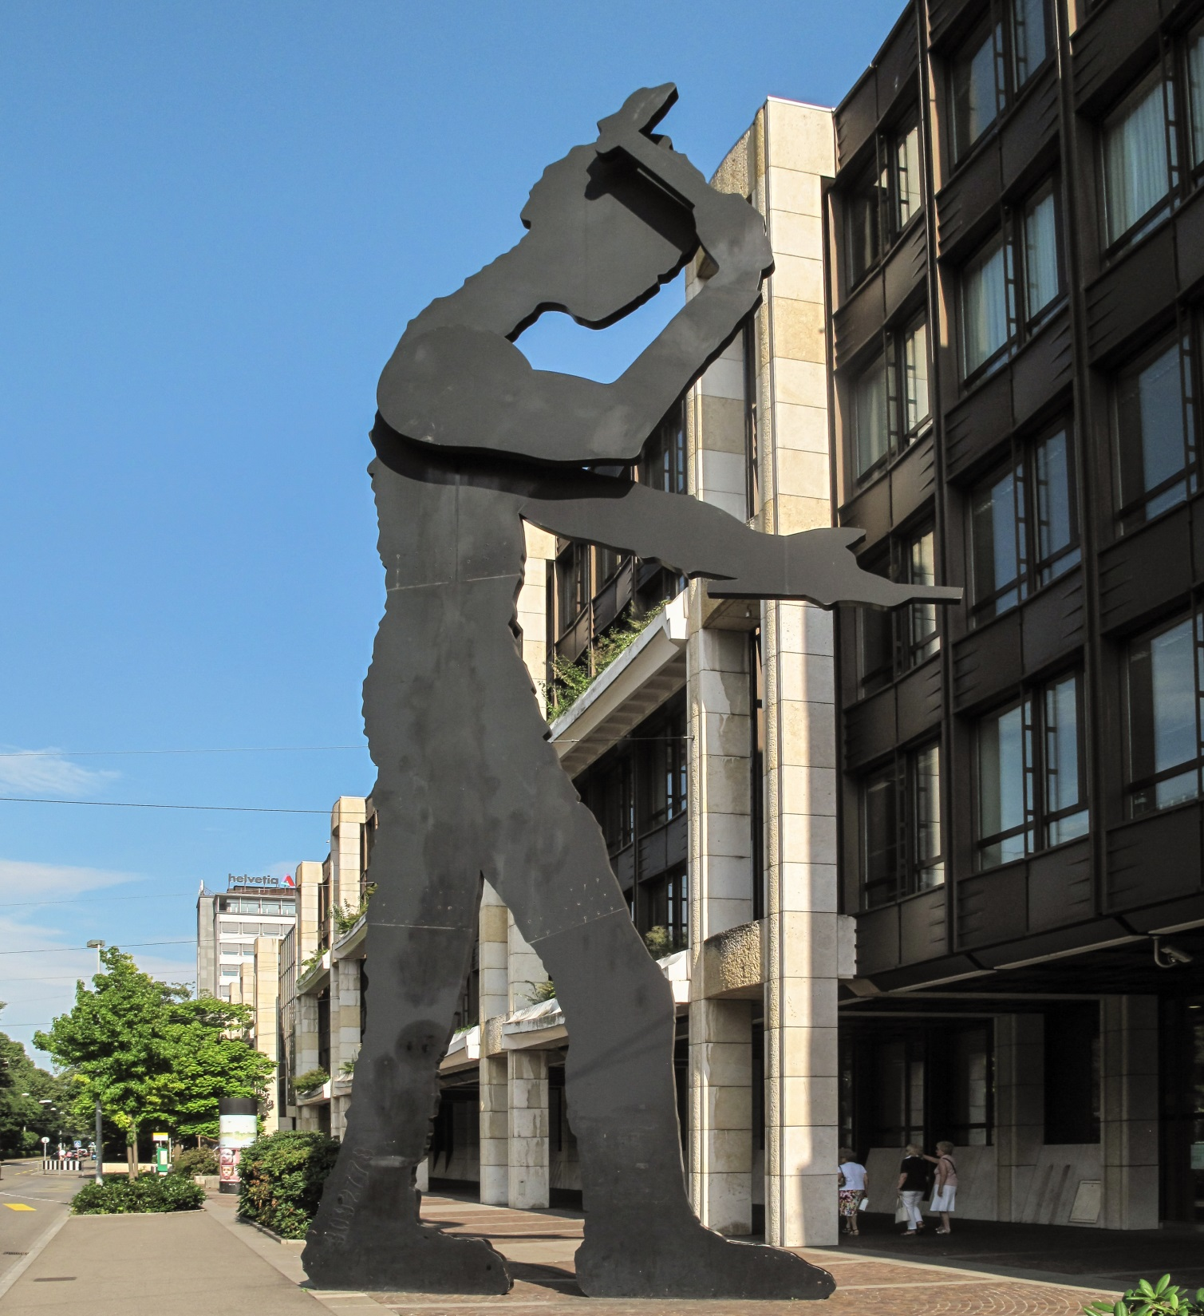
E-TALKING BEST FOR YOU
04 Standard of Deferred Payment
Most business transactions are settled at later dates. Money will help you to know how much you owe someone or how much debt you have to pay. This is how money serves as standard for deferred payment.
Defer (verb) Push to a later date
Transaction (noun) Buying or selling of something
Debt (noun) Amount owed
Image from : en.wikipedia.org

Slide 13
E-TALKING BEST FOR YOU
DISCUSSION
Give examples of business transactions that are carried out on credit.
04

Slide 14

E-TALKING BEST FOR YOU
SPEAKING TASK
Make sentences with the following words.
yardstick, financial records, purchasing power, checking account

Slide 15

E-TALKING BEST FOR YOU
ASSESSMENT
Complete the sentences using the vocabulary words from this lesson:

Slide 16

E-TALKING BEST FOR YOU
Answer the following questions based on today’s lesson.
What is money?
How can money serve as a store of value?
Identify other functions of money
ASSESSMENT

Slide 17


E-TALKING BEST FOR YOU
Thank you !

