Slide 1
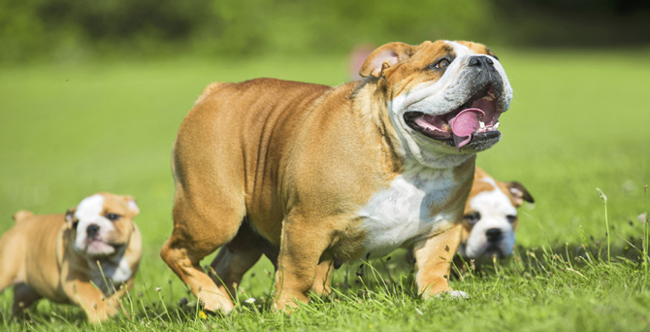





E-TALKING BEST FOR YOU
Robot Gym
view
Image from : http://charltonpark.org.uk/index.php/hello/gym-squash/

Slide 2

E-TALKING BEST FOR YOU
E-TALKING BEST FOR YOU
INTRODUCTION
CEF Learning Goal: Learn about a new gym made for robots. Express your opinion relating to this topic. Learn topic-related vocabulary.

Slide 3

E-TALKING BEST FOR YOU
E-TALKING BEST FOR YOU
GETTING STARTED
Do you like to go to the gym? Why or why not?
What do you think about robots?

Slide 4

E-TALKING BEST FOR YOU
01 VOCABULARY CORNER
E-TALKING BEST FOR YOU
Code (n.): The language that computers use to work.
To share (v.): To give our things or information to others.
Goal (n.): Something that you work to make happen in the future.
Digital (adj.): Things that express themselves in series of 0 and 1s (like a digital watch).
Ideas (n.): Thoughts that one has about a subject.
Prize (n.): Something that you win because you did something good.
Image from : https://blog.westmonroepartners.com/are-you-engaged-with-the-right-customers-when-designing-your-digital-customer-experience/

Slide 5
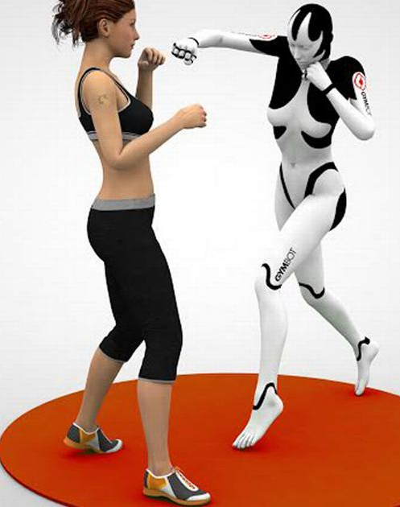
E-TALKING BEST FOR YOU
E-TALKING BEST FOR YOU
02 Reading time:
Elon Musk has opened a gym for robots, called OpenAI Gym. Mr. Musk also started the companies Tesla Motors and PayPal. OpenAI Gym is free for people who write computer code so that they can test their work on robots and share what they know. The robot gym can also help people who write code to fix problems and share a lot of computer information.
Image from : http://www.mirror.co.uk/news/technology-science/technology/would-you-fight-robot-expert-7135089

Slide 6
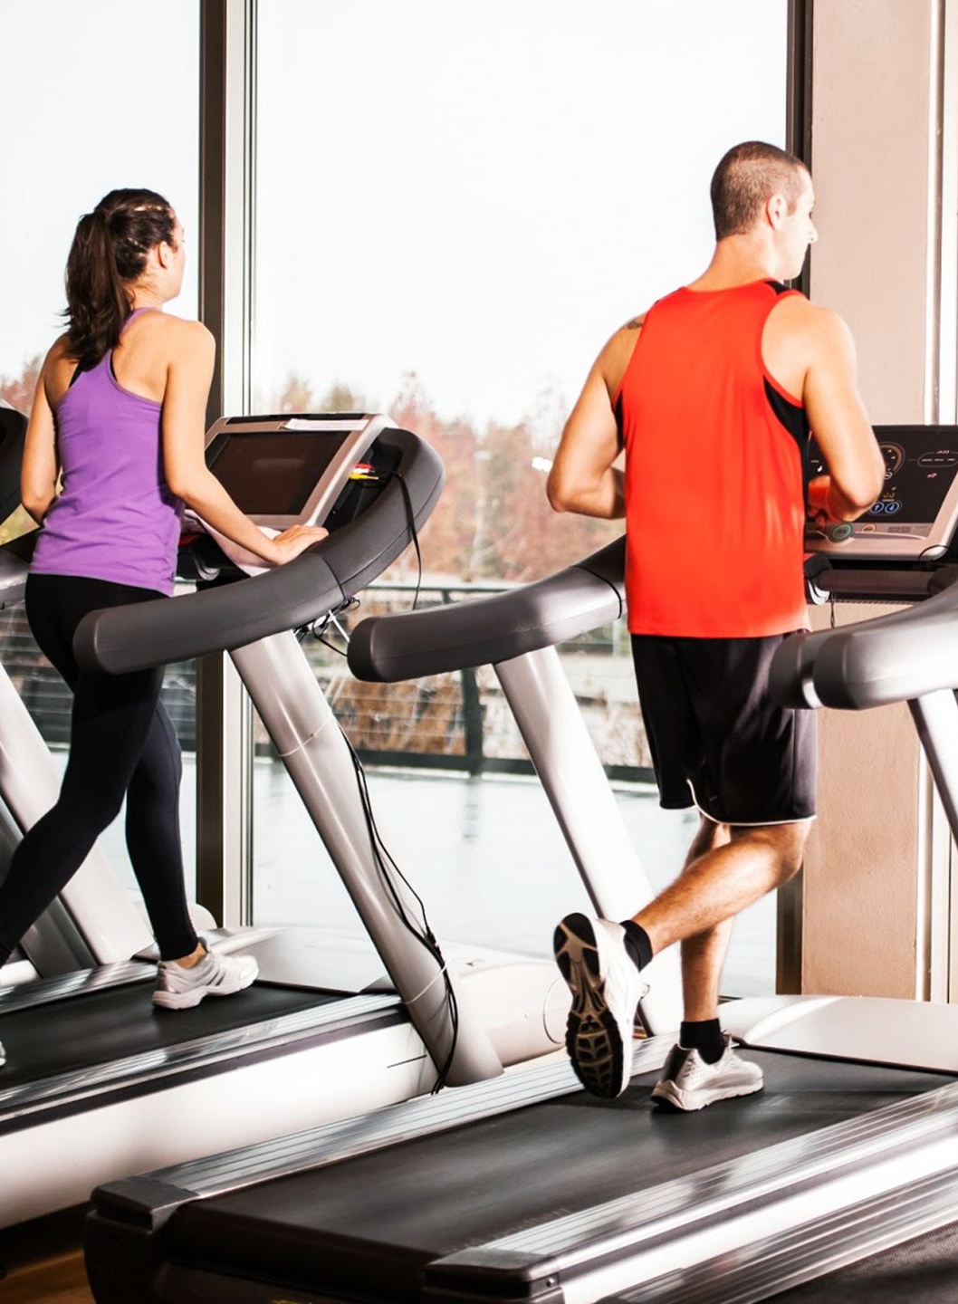
E-TALKING BEST FOR YOU
03 Reading time cont…
E-TALKING BEST FOR YOU
Mr Musk explained why OpenAI Gym is free. He said that his goal is to improve digital information in the way that is helpful to people as a whole. It is the same as when a dog gets a snack when it learns something new. If someone shares a good idea in the gym, they get a prize. If the idea fails, no prizes are given.
Image from : http://bodyhacks.com/heres-avoiding-injuries-gym/

Slide 7
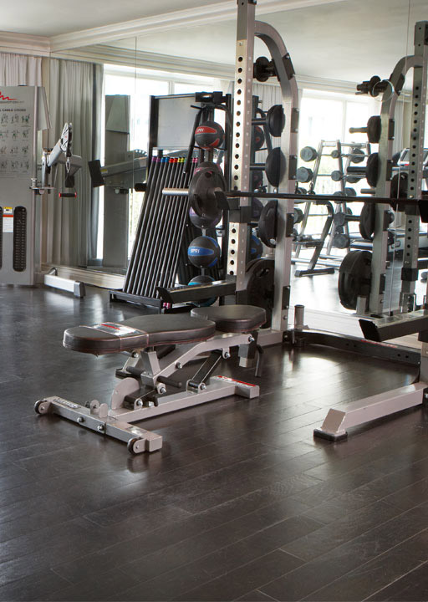
E-TALKING BEST FOR YOU
04 Comprehension questions:
E-TALKING BEST FOR YOU
What kind of place is this article about?
Elon Musk is a famous and rich businessman, which other companies did he start?
Who is invited to visit the robot gym?
What do the code writers share with each other in this gym?
How much does it cost to join this club?
Image from :http://www.viceroyhotelsandresorts.com/en/santamonica/spa_and_wellness

Slide 8

E-TALKING BEST FOR YOU
E-TALKING BEST FOR YOU
REVIEW DISCUSSION
Do you think the robot gym is a good idea?
Why or why not?
Why do you think computer code writers visit this gym?
How can improving digital information make things better for people as a whole?

Slide 9

E-TALKING BEST FOR YOU
E-TALKING BEST FOR YOU
SPEAKING TASK
Express yourself
Take turns telling each other about OpenAI. What is OpenAI?
Who created it?
What is the goal of the gym described in the article?
(Add any other questions that you can think of about the topic)

Slide 10

E-TALKING BEST FOR YOU
E-TALKING BEST FOR YOU
ASSESSMENT
Complete the sentences using the vocabulary words from this lesson:

Slide 11

E-TALKING BEST FOR YOU
E-TALKING BEST FOR YOU
Code, Share, Goal, Digital, Ideas, Prize
Elon Musk opened the gym because he wanted computer code writers come and _______ their ideas.
The __________ of OpenAI Gym is to help people as a whole.
Did Steve Jobs know how to write computer _________?
The code writers at OpenAI Gym often share their _________ about digital information.
The winner of the race really wants to win the grand ____________.
My grandfather got a _________ watch for his birthday.
ASSESSMENT

Slide 12


E-TALKING BEST FOR YOU
E-TALKING BEST FOR YOU
Thank you !
See you tomorrow

