Slide 1

E-TALKING BEST FOR YOU
E-TALKING BEST FOR YOU
Expressing Confirmation and Agreement.
How to Use Question Tags.
view
Image from : pixabay.com

Slide 2

E-TALKING BEST FOR YOU
E-TALKING BEST FOR YOU
What Are Question Tags
Question tags are short questions that we put at the end of sentences. We use question tags in spoken language to confirm that something is true or not. It is also used to encourage a reply from the person we are speaking to.
START
Image from : publicdomainpictures.net

Slide 3

E-TALKING BEST FOR YOU
E-TALKING BEST FOR YOU
GETTING STARTED
Think about three statements that can be turned into question tags. Practice turning them into question tags.

Slide 4
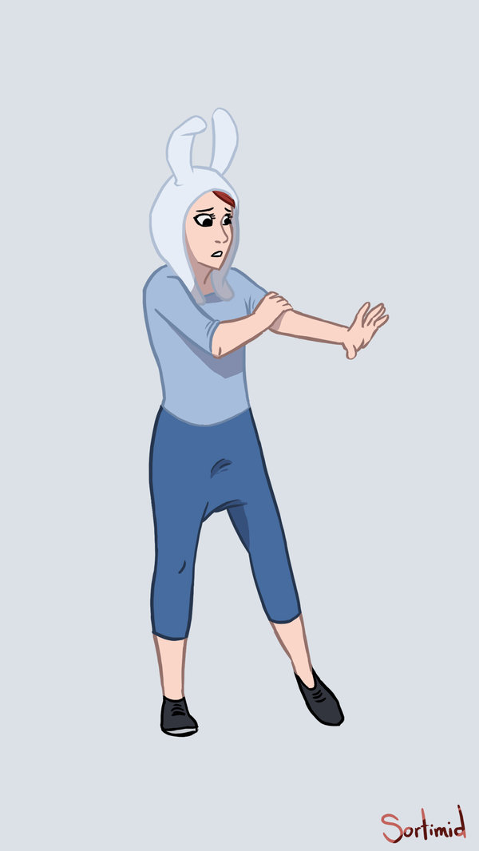

E-TALKING BEST FOR YOU
E-TALKING BEST FOR YOU
01 Negative Question Tags
Question tags are formed with the modal verb from the sentence and the subject. A positive statement is followed by a negative question tag.
To form (verb) Bring together parts to create
something.
Image from : sortimid.deviantart.com

Slide 5
E-TALKING BEST FOR YOU
E-TALKING BEST FOR YOU
01 Negative Question Tags
For instance, if you want confirm whether the deadline of a project, you could say ‘This project is due on Monday’ followed by a negative question tag ‘isn’t it?’
Examples:
Benjamin is coming to the event, isn’t he?
Agatha has seen the result, hasn’t she?
Image from : sortimid.deviantart.com

Slide 6
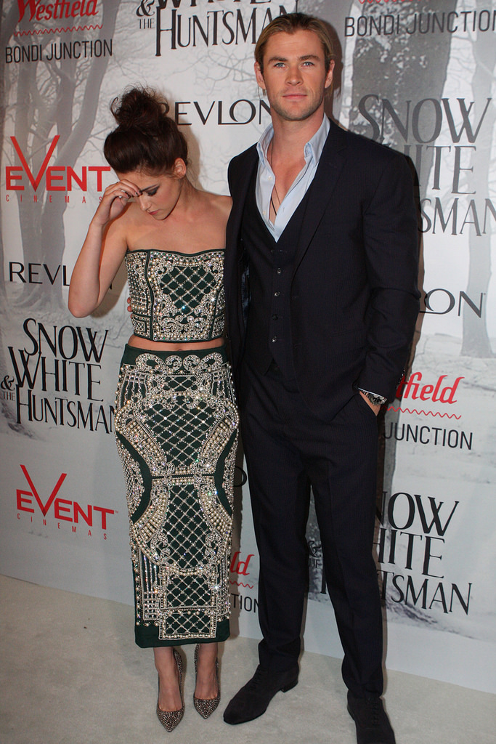
E-TALKING BEST FOR YOU
E-TALKING BEST FOR YOU
02 Positive Question Tags
If the main part of the sentence is negative, the question tag is positive. For instance, if you want to know whether someone is not attending an event, you could say ‘Jane isn’t coming to the event’ with a positive question tag – ‘is she?’
Image from : flickr.com

Slide 7
E-TALKING BEST FOR YOU
02 Positive Question Tags
E-TALKING BEST FOR YOU
Keep in mind that the verb tense of the question tag needs to be consistent with the statement.
Examples:
She didn’t show up yesterday, did she?
We shouldn’t tell anyone, should we?
Consistent (adjective) Unchanging over a
period of time.
Image from : flickr.com

Slide 8
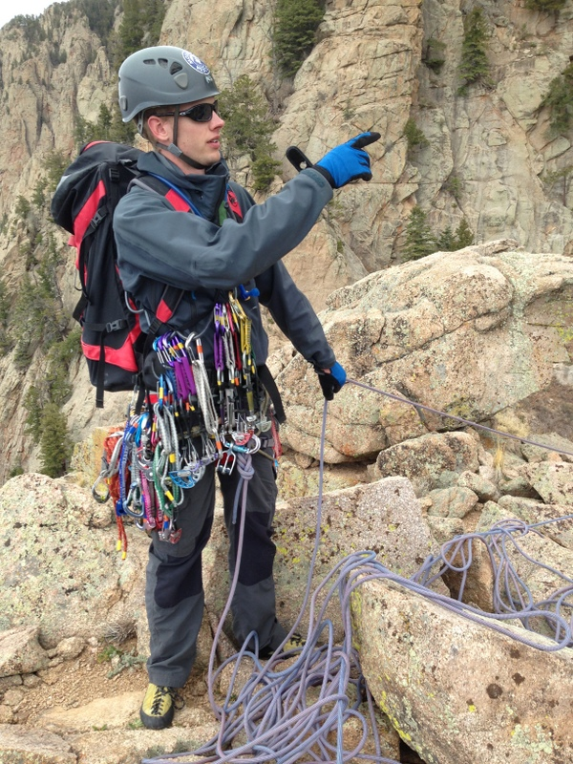
E-TALKING BEST FOR YOU
03 Exceptions
E-TALKING BEST FOR YOU
There are some expressions that don’t follow the rules we talked about. Pay extra attention on how question tags are used in the following expressions.
Examples:
I am part of this project, aren’t I?
Let’s get started on this, shall we?
This/that is your laptop, isn’t it?
E-TALKING BEST FOR YOU
Expression (noun) The process of making known one’s thoughts.
Extra (adjective) Added to an existing amount.
Image from : adventurejay.com

Slide 9

E-TALKING BEST FOR YOU
E-TALKING BEST FOR YOU
DISCUSSION
Compare the following sentences and talk about how different they sound:
She’s from the sales department.
She’s from the sales department, isn’t she?
They’re late again.
They’re late again, aren’t they?
01

Slide 10
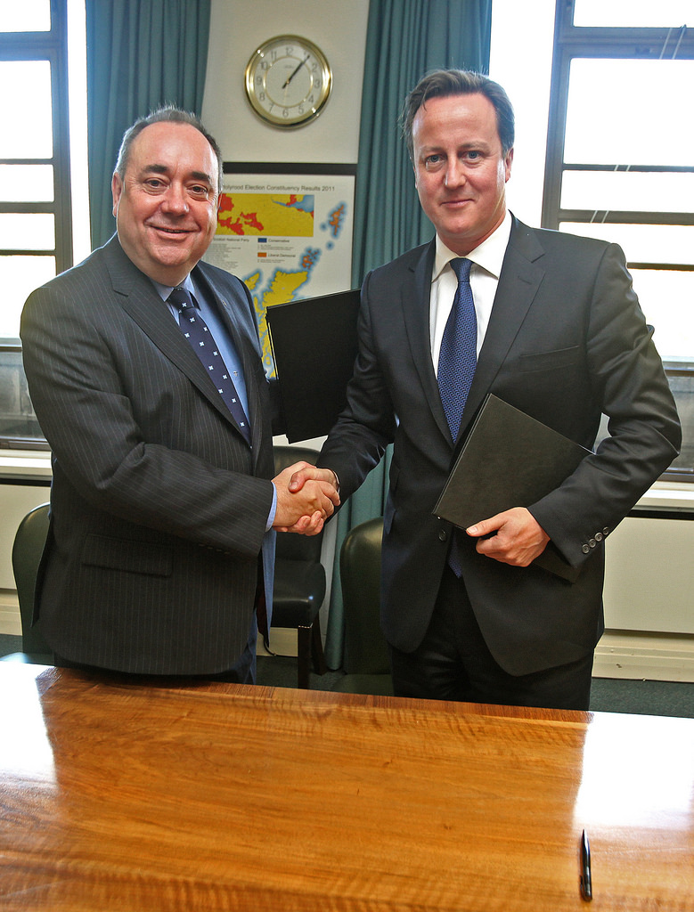
E-TALKING BEST FOR YOU
04 Intonation
Question tags are used in two main situations. First, it can be real questions where we want to know the answer. In this situation, our tone of voice rises when we say question tags.
Situation (noun) A set of circumstances.
Tone (noun) A vocal sound.
Image from : flickr.com

Slide 11
E-TALKING BEST FOR YOU
E-TALKING BEST FOR YOU
04 Intonation
On the other hand, when we already know the answer, question tags are used for asking for agreement or confirmation. In this case, our tone of voice falls.
Agreement (noun) The act of coming to a mutual decision.
Confirmation (noun) The act of making something certain.
Image from : flickr.com

Slide 12

E-TALKING BEST FOR YOU
E-TALKING BEST FOR YOU
SPEAKING TASK
Think about two work scenarios in which question tags with rising tone can be used, and two work scenarios in which question tags with falling tone can be used.

Slide 13

E-TALKING BEST FOR YOU
E-TALKING BEST FOR YOU
ASSESSMENT
Complete the sentences using the vocabulary words from this lesson:

Slide 14

E-TALKING BEST FOR YOU
E-TALKING BEST FOR YOU
Add a suitable question tag to each sentence:
The trip is expensive, _______________?
You are Charles, _______________?
The project isn’t due tomorrow, _______________?
We’re part of team, _________________?
She doesn’t want to participate, ______________?
You wouldn’t accept this deal, ____________?
He wasn’t here yesterday, ___________?
He didn’t recognize me, ____________?
ASSESSMENT

Slide 15


E-TALKING BEST FOR YOU
E-TALKING BEST FOR YOU
Thank you !

