Slide 1
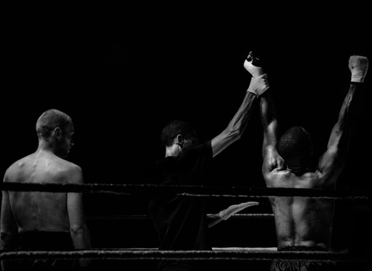
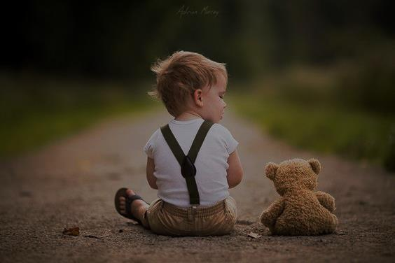
E-TALKING BEST FOR YOU
Boxing legend Muhammad Ali dies at 74
view

Slide 2

E-TALKING BEST FOR YOU
INTRODUCTION
CEF Learning Goal: Talk about someone you know well. Practice the vocabulary words in the lesson, as well as the use of

Slide 3

E-TALKING BEST FOR YOU
START
Image from : keithrosen.com

Slide 4

E-TALKING BEST FOR YOU
E-TALKING BEST FOR YOU
WARM-UP

Slide 5

E-TALKING BEST FOR YOU
GETTING STARTED
Do you like to watch boxing? Is boxing popular in your country?
Have you heard of Muhammad Ali? What do you know about him?

Slide 6
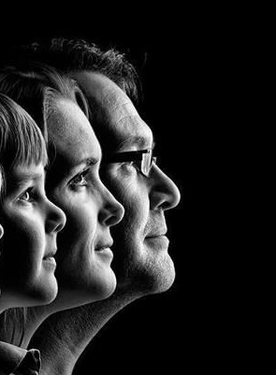
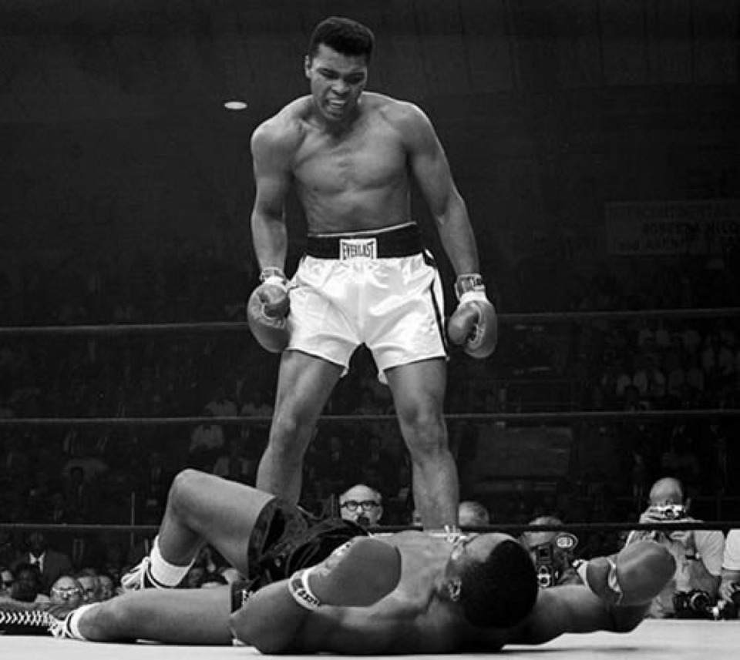
E-TALKING BEST FOR YOU
01 VOCABULARY CORNER
Hero (n.) - The hero of a book, play, film, or story is the main male character, who usually has good qualities.
Nickname (n.) - An informal name for someone or something.
Outside of (prep.) - except, apart from, aside from.
Peace (n.) - If there is peace in a country or in the world, there are no wars or violent conflicts going on.
Image from : comicvine.gamespot.com

Slide 7
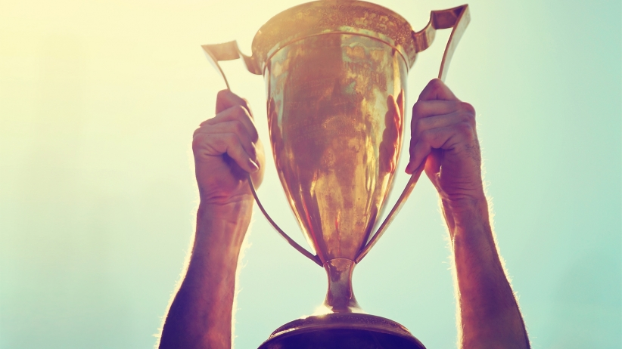
E-TALKING BEST FOR YOU
01 VOCABULARY CORNER
Champion (n.) - A champion is someone who has won the first prize in a competition, contest, or fight.
Unite (v.) - If a group of people or things unite or if something unites them, they join together and act as a group.
Treat (v.) - If you treat someone or something in a particular way, you behave towards them or deal with them in that way.
Faith (n.) - Faith is strong religious belief in a particular God or Gods.
Image from : entrepreneur.com

Slide 8

E-TALKING BEST FOR YOU
E-TALKING BEST FOR YOU
DISCUSSION
01

Slide 9
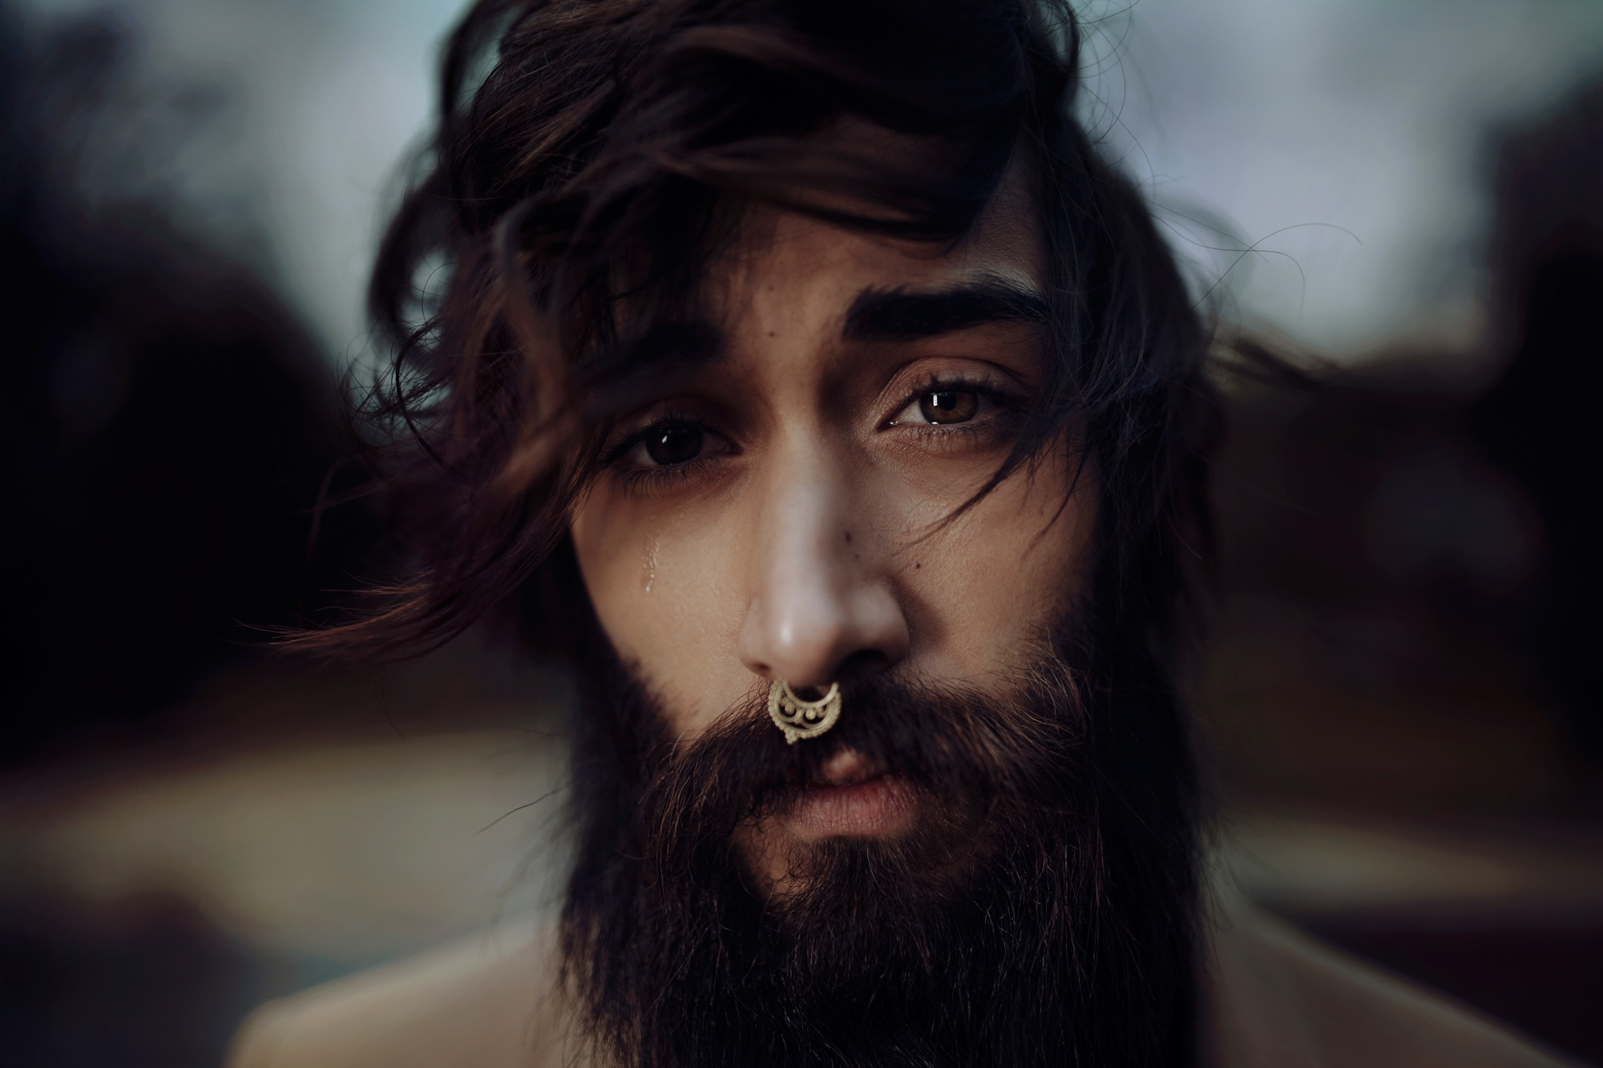
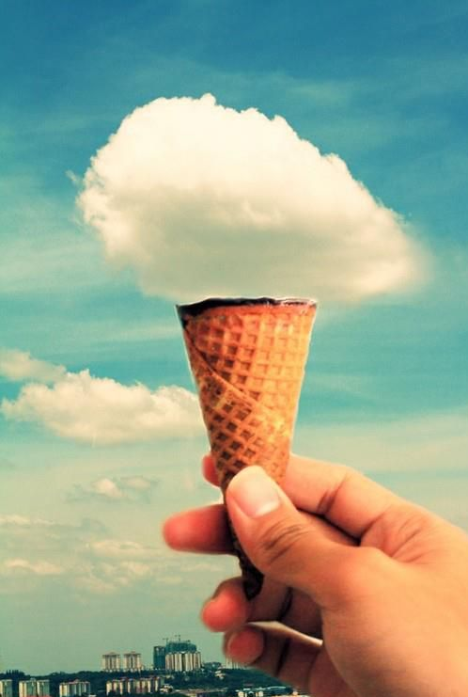
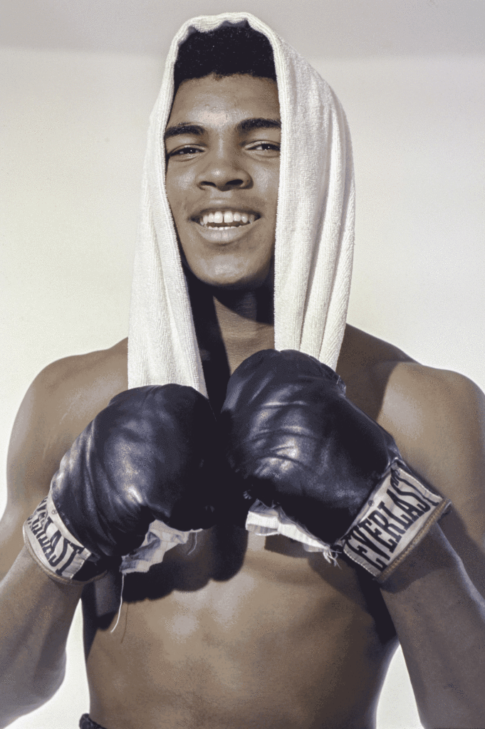
E-TALKING BEST FOR YOU
02 Reading
Muhammad Ali, the world's greatest sporting hero, has died, aged 74. He was in hospital with breathing problems. His children flew to be with him at the end. People say Ali was the best boxer ever. He was a world boxing champion three times.
Image from: birminghamtimes.com

Slide 10
E-TALKING BEST FOR YOU
02 Reading
His nickname is 'The Greatest'. People think he was the greatest because of what he did outside of boxing. He worked for world peace for over 50 years.
Image from: birminghamtimes.com

Slide 11
E-TALKING BEST FOR YOU
DISCUSSION
02

Slide 12
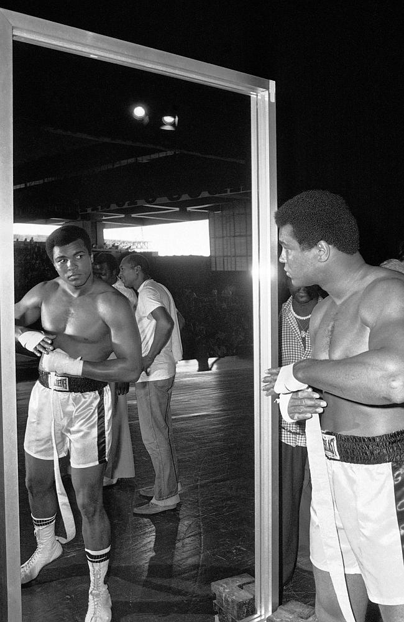
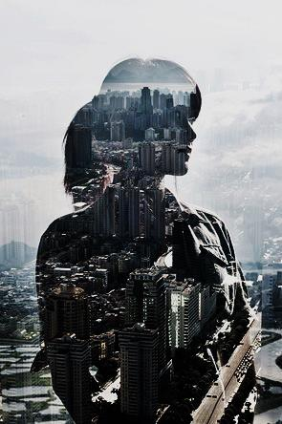

E-TALKING BEST FOR YOU
03 Reading time cont…
Many people were sad to hear Ali had died. One person said: "Ali has really changed the world.” The U.N. Secretary-General said Ali fought for a better world. Martin Luther King's daughter said he was, "a champion in so many ways".
Image from : birminghamtimes.com

Slide 13
E-TALKING BEST FOR YOU
03 Reading time cont…
Mr. Ali once said: "I would like to be remembered as a man who treated everyone right and tried to unite all people through faith and love."
Image from : birminghamtimes.com

Slide 14
E-TALKING BEST FOR YOU
DISCUSSION
03

Slide 15
E-TALKING BEST FOR YOU
REVIEW DISCUSSION
Why was Muhammad Ali in the hospital?
How many times did Ali become world boxing champion?
What is Ali’s nickname?
How long did Ali work for world peace?
How did Ali treat everyone?
How did Ali try to unite people?

Slide 16

E-TALKING BEST FOR YOU
SPEAKING TASK
Ali’s nickname is “the Greatest”. Do you have a nickname?
Ali was a boxing “champion”. Are you good at anything? Do you have any special skills?
Outside of boxing, Ali tried to make the world a better place. Do you volunteer outside of work or school? How do you make the world a better place?

Slide 17
E-TALKING BEST FOR YOU
SPEAKING TASK
Take turns summarizing the article that we studied today. Who is it about?
Is there someone in your country who is also a sporting hero?
What did he or she do?
Remember to use the words and phrases that we learned in the lesson.

Slide 18

E-TALKING BEST FOR YOU
ASSESSMENT
Put it into practice

Slide 19

E-TALKING BEST FOR YOU
Hero Outside of Nickname
Champion Peace Treat Faith
Unite
My father is a firefighter, and has saved many people’s lives. He’s my __________.
People will remember Muhammad Ali for what he did __________ boxing. He fought for world peace for 50 years.
Martin Luther King is a famous activist in America, he worked for ________ between people of different skin colors.
Gandhi believed that people of the world can __________ together to fight for world peace.
My mother always told me to ___________ people equally. Everyone is the same, and everyone has feelings.
People in Asia believe in many different _________. People in the Philippines are Christian, People in Thailand are Buddhist, and people in India are Hindu.
ASSESSMENT

Slide 20


E-TALKING BEST FOR YOU
Thank you !

