Slide 1
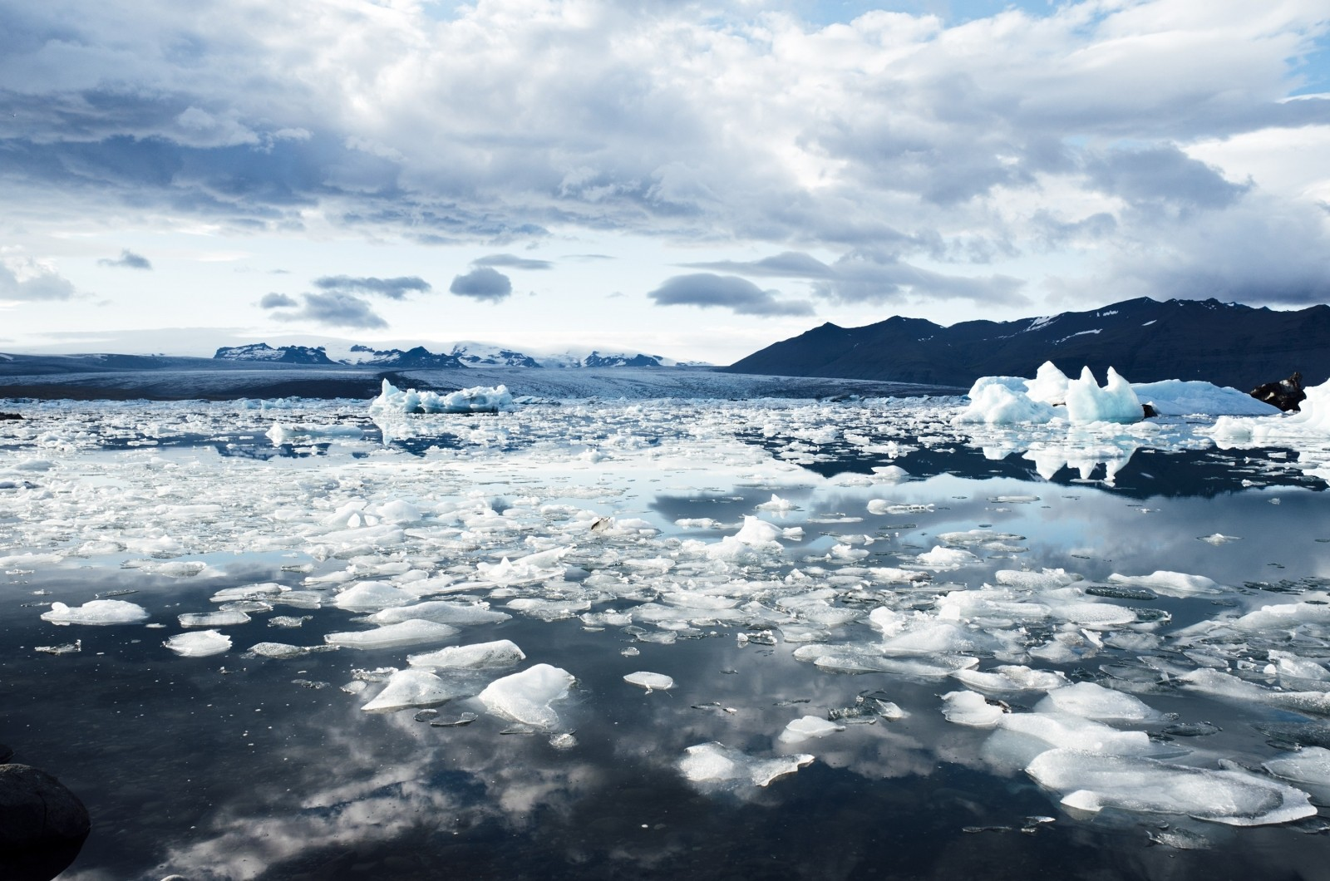
E-TALKING BEST FOR YOU
Changing Climates Climate Change and Its Effects
view

Slide 2

E-TALKING BEST FOR YOU
INTRODUCTION

Slide 3
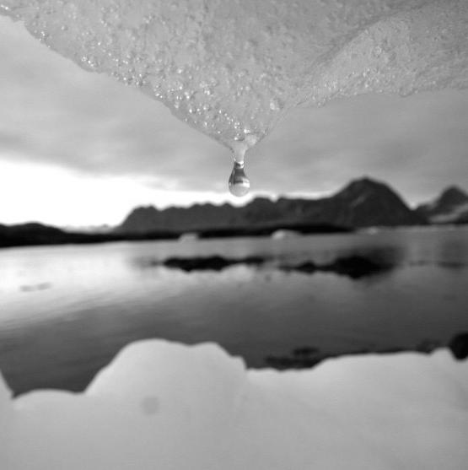
E-TALKING BEST FOR YOU
Talking About Climate Change
Climate is the pattern of weather in a particular place. It includes things like the wind speeds, the amount of sunlight a place gets, and how much rain falls in an area.
START

Slide 4

E-TALKING BEST FOR YOU
VOCABULARY
Lets check whether you know each following word.

Slide 5

E-TALKING BEST FOR YOU
E-TALKING BEST FOR YOU
Rotate (verb) To move in a circle.
Region (noun) A specific area of land.
Phenomenon (noun) A naturally occurring event with almost mystical properties.
Greenhouse (noun) A glass building where plants and vegetables are grown.
Vocabulary

Slide 6
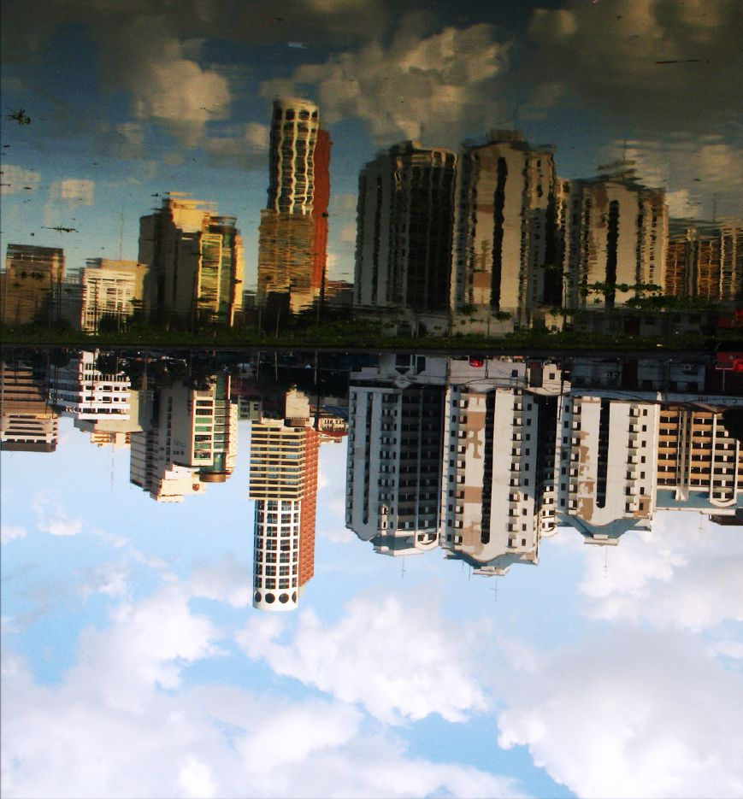
E-TALKING BEST FOR YOU
What Is Climate
Climate is the pattern of weather in a particular place. It measures the wind speeds, the sunlight, the rainfall, and the temperature. Different places have different climates because the earth rotates on a tilted axis. This means that different parts of the planet are heated at different amounts at different times. This creates different seasons and makes some regions hotter than others.

Slide 7

E-TALKING BEST FOR YOU
DISCUSSION
How would you describe the climate in your country?
How does it compare with a different country in Europe such as Denmark or Holland?

Slide 8
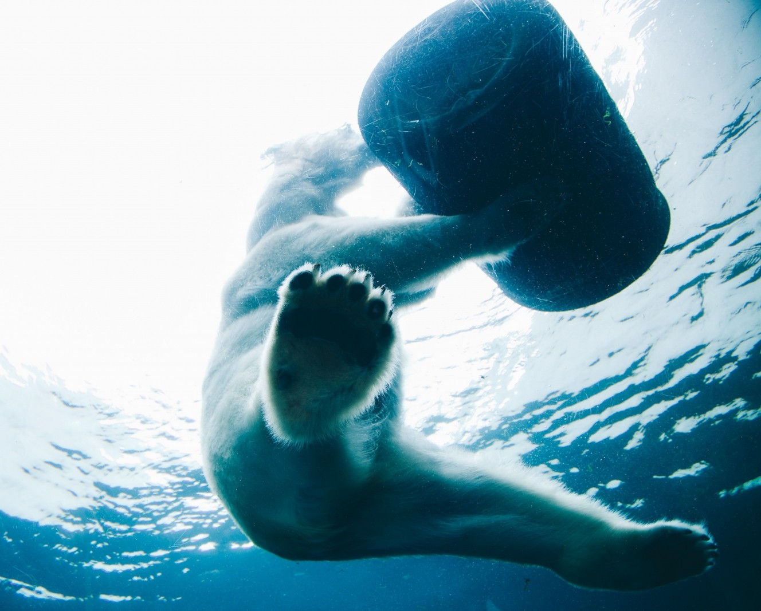
E-TALKING BEST FOR YOU
What Causes Climate Change
Climate change is primarily caused by global warming. Global warming is caused by a phenomenon known as the greenhouse effect. This is where heat gets trapped behind gases in the atmosphere, such as carbon dioxide and methane, acting like a greenhouse.

Slide 9
E-TALKING BEST FOR YOU
REVIEW DISCUSSION
What do you think climate change is?
Have you heard about it on the news?
Do you think climate change is a pressing issue?

Slide 10

E-TALKING BEST FOR YOU
SPEAKING TASK
One of the main effects of climate change is the melting of the polar icecaps. Discuss what the possible effects of this might be.

Slide 11

E-TALKING BEST FOR YOU
ASSESSMENT
Complete the sentences using the vocabulary words from this lesson:

Slide 12

E-TALKING BEST FOR YOU
rotates / region / phenomenon / greenhouse
The Northern Lights are a natural .
You can play American DVD's in Taiwan if the DVD is free.
The earth on its axis once every 24 hours.
Farmers often grow vegetables inside a .
ASSESSMENT

Slide 13


E-TALKING BEST FOR YOU
Thank you !

