Slide 1


E-TALKING BEST FOR YOU
Famous People Who Changed Their Names
view

Slide 2

E-TALKING BEST FOR YOU
INTRODUCTION
CEFR Learning Goal: Talk about well-known people

Slide 3

E-TALKING BEST FOR YOU
Many of the world’s most famous people changed their names at one point in their past. Let’s learn about two people in history who did just that.
START

Slide 4

E-TALKING BEST FOR YOU
VOCABULARY
Lets check whether you know each following word.

Slide 5

E-TALKING BEST FOR YOU
E-TALKING BEST FOR YOU
Communist (adjective) the belief in a society without different social classes. A political system in which the government controls the production of all goods, and where everyone is treated equally
Alias (noun) a false name, especially one used by a criminal
Founded (verb)- to bring something into existence
Relief (noun) an end or pause in a feeling of pain
Mission (noun) an important job, usually travelling somewhere
Vocabulary

Slide 6
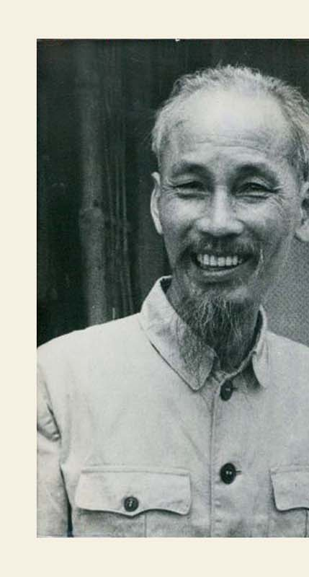
E-TALKING BEST FOR YOU
Ho Chi Minh Brings Change to Vietnam
Do you have a city named after one person in your country? Saigon in Vietnam, changed its name to Ho Chi Minh City. The name change was in honor of the Communist revolutionary, Ho Chi Minh. Many people do not know the revolutionary’s given name. His parents called him Yet Hi Chi. Reports say Ho Chi Minh had ten aliases or more. His different names helped to distract the Chinese government. They had trouble finding out who he really was. Ho Chi Minh means “bringer of light”. He was fluent in French, English, Russian, Cantonese and Mandarin in addition to his mother tongue Vietnamese.

Slide 7

E-TALKING BEST FOR YOU
DISCUSSION
Do you think it’s a good idea to honor people by naming a city or building after them? Even criminals or revolutionaries who might have done bad things?

Slide 8
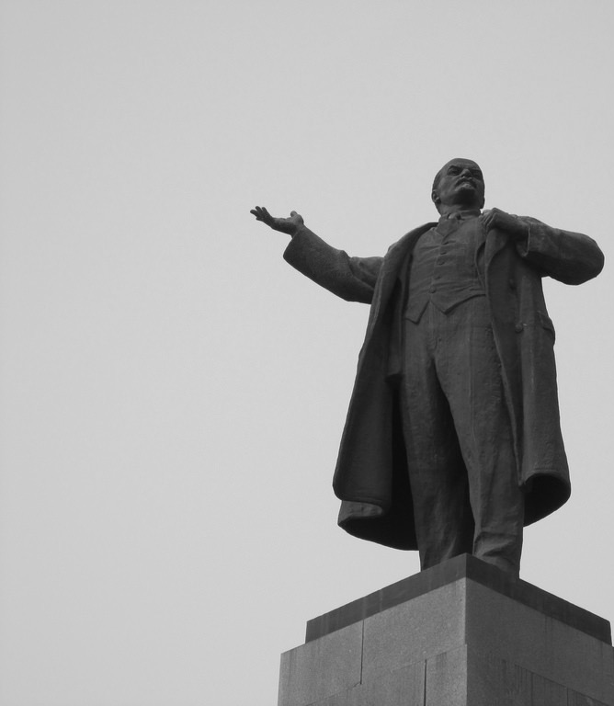
E-TALKING BEST FOR YOU
Lenin’s Exile in Siberia Made Him Change His Name
Vladimir Ulyanov founded the Russian Communist Party. Not many people know that this is Vladimir Lenin’s given name. He was later forced to live in Siberia, where he decided to change his name to Lenin. People think he chose this name from the nearby Lena river. A fake name offered Lenin necessary relief. The police often targeted his writings. Lenin was not the only person in his family causing trouble. His older brother tried to kill Alexander III. The government killed his brother because of this. This left Lenin to take care of his family, and continue his mission.

Slide 9
E-TALKING BEST FOR YOU
DISCUSSION
What do people use as inspiration for their name or their children’s names?
Would you name your child or pet after someone famous or after a place or book?

Slide 10
E-TALKING BEST FOR YOU
REVIEW DISCUSSION
Talk about the people you learnt about. Have you ever heard of them before?
Can you think of other famous people who changed their names? Discuss the reasons someone might change their name. What are the benefits of changing your name?

Slide 11

E-TALKING BEST FOR YOU
SPEAKING TASK
Discuss the buildings, streets or cities in your country that are named after famous people.
Explain why they were honored in this way.

Slide 12

E-TALKING BEST FOR YOU
ASSESSMENT
Match the vocabulary words from the reading with their appropriate definition:

Slide 13

E-TALKING BEST FOR YOU
Definitions
an important job, usually travelling somewhere
to bring something into existence
the belief in a society without different social classes. A political system in which the government controls the production of all goods, and where everyone is treated equally
a false name, especially one used by a criminal
an end or pause in a feeling of pain
Words
Communist
Alias
Founded
Relief
Mission
ASSESSMENT

Slide 14


E-TALKING BEST FOR YOU
Thank you !

