Slide 1
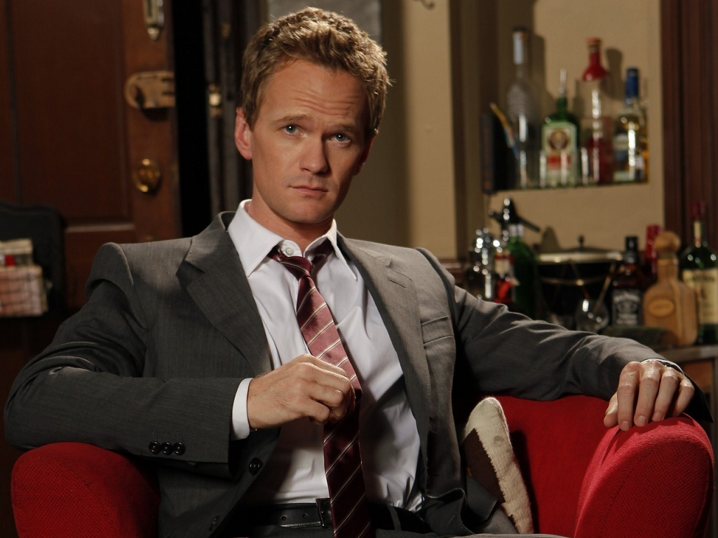
E-TALKING BEST FOR YOU
My Favorite Suit
Today, we are going to talk about your favorite things.

Slide 2

E-TALKING BEST FOR YOU
INTRODUCTION
Lesson objectives:
Reviewing colors.
Reviewing clothes vocabulary.

Slide 3
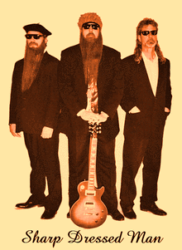
E-TALKING BEST FOR YOU
What is your favorite piece of clothing?
START

Slide 4

E-TALKING BEST FOR YOU
WARM-UP
How do you like to dress?
What is your favorite color?

Slide 5

E-TALKING BEST FOR YOU
GETTING STARTED
Choose the correct answer and fill the blank:
Sales Manager: Hello. I can/Can I help you?
Customer: Yes, please. I am looking for a ________ .

Slide 6
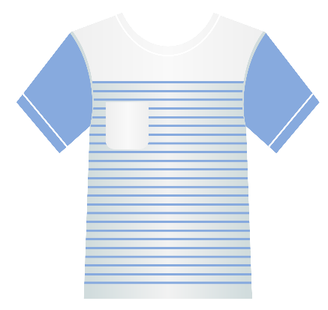

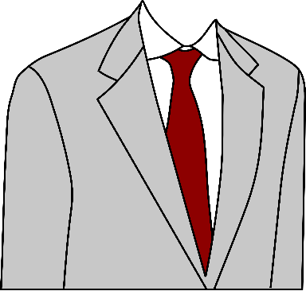
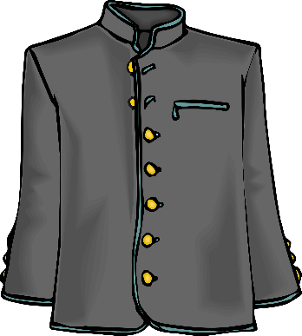

It’s my favorite - Vocabulary for clothes
E-TALKING BEST FOR YOU
E-TALKING BEST FOR YOU
a suit
a tie
a T-shirt
a jumper
a jacket

Slide 7

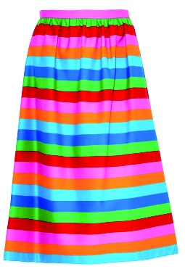
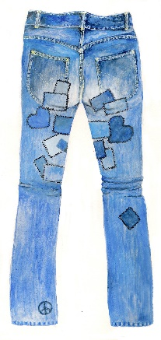
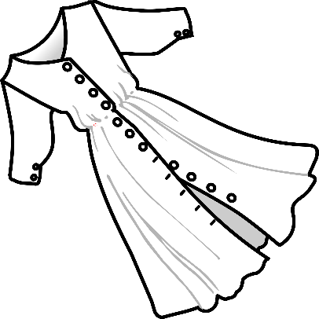
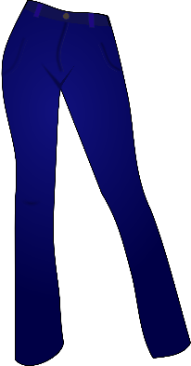
It’s my favorite - Vocabulary for clothes
E-TALKING BEST FOR YOU
E-TALKING BEST FOR YOU
a coat
a skirt
a dress
Pair trousers
Blue jeans

Slide 8

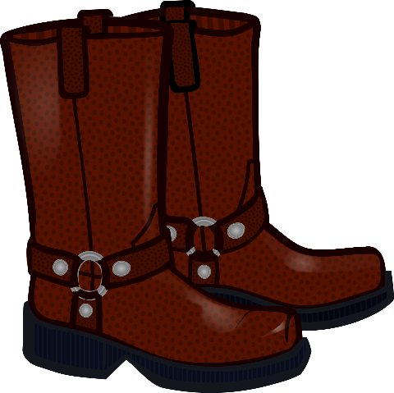
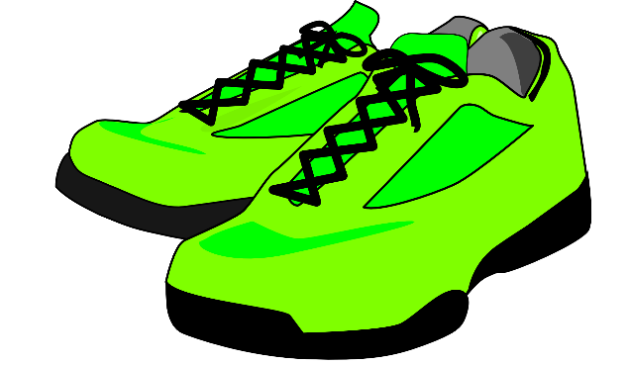
E-TALKING BEST FOR YOU
E-TALKING BEST FOR YOU
It’s my favorite - Vocabulary for clothes
Pair of shoes
Pair of trainers
Pair of boots

Slide 9
E-TALKING BEST FOR YOU
Colors:
E-TALKING BEST FOR YOU
white
yellow
brown
black
red
grey
pink
green

Slide 10

E-TALKING BEST FOR YOU
It’s my favorite- Vocabularies for clothes
Practice
Read out terms listed above.

Slide 11
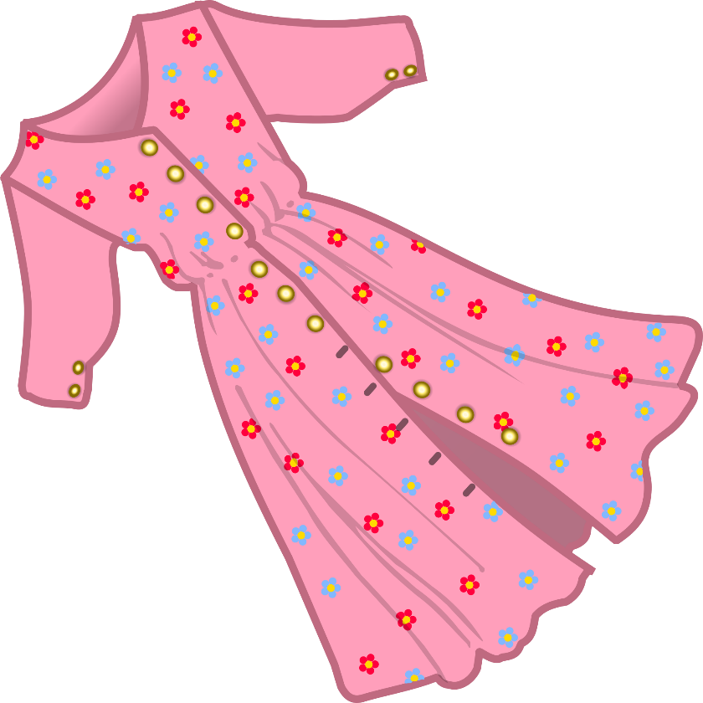
E-TALKING BEST FOR YOU
E-TALKING BEST FOR YOU
Conversation- Clothes & Grammar review
1.What color are Monica’s boots?
They are black.
2.What color is Brad’s jacket?
It is blue.
Fill in: is or are
What color _______ Lisa’s trousers?
They ________ grey.
What color ______ Wayne’s tie?
It __________ yellow.

Slide 12
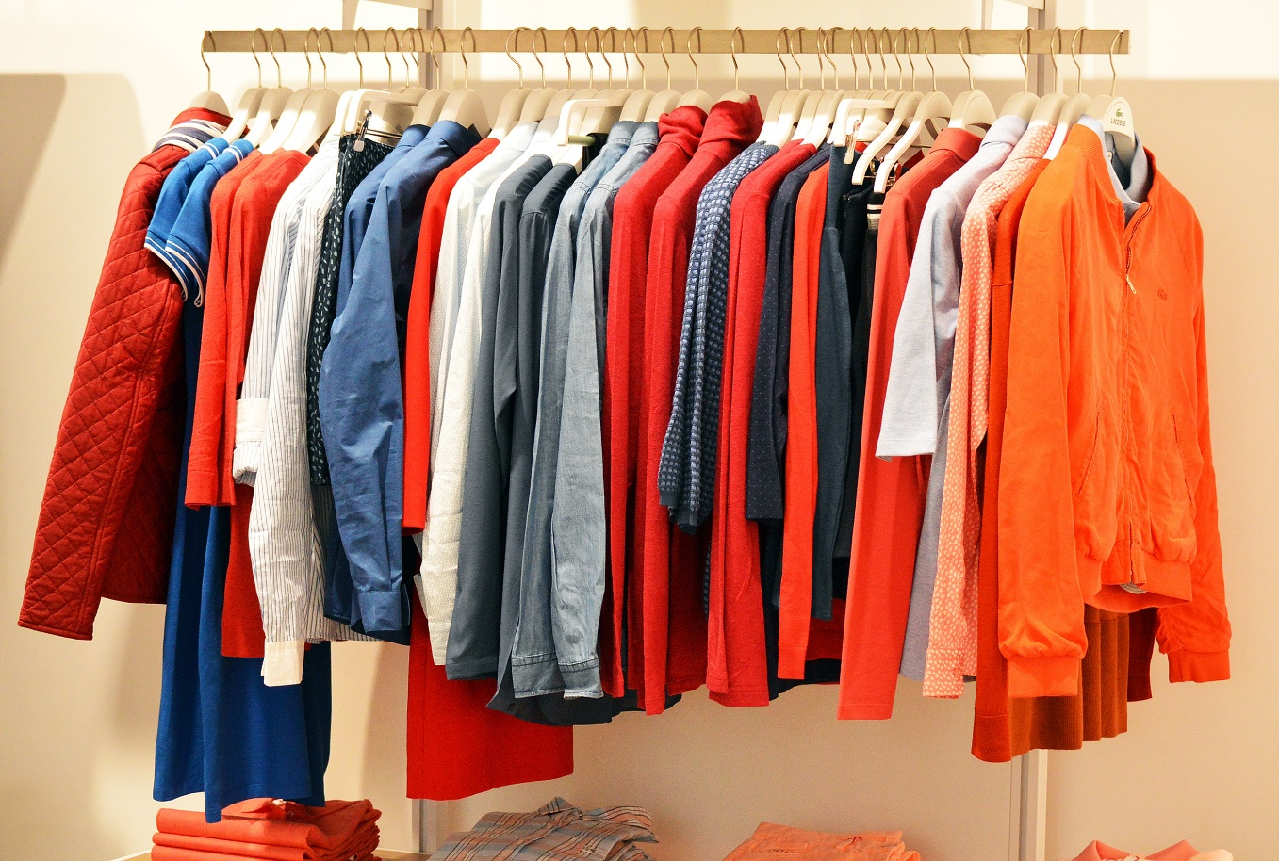
E-TALKING BEST FOR YOU
Conversation- Clothes & Grammar review
Practice
Ask your teacher about the color of his clothes .

Slide 13
E-TALKING BEST FOR YOU
E-TALKING BEST FOR YOU
Reading
My name is Patrick, and I am from Ireland. I arrived in Taiwan last year and I always feel very hot here. I have to wear T-shirts and short trousers all year-long because if I don’t, I feel very uncomfortable. Even in winter, I don’t wear coats or jumpers. I really like it here, Taiwan is awesome I like how green it is!

Slide 14

E-TALKING BEST FOR YOU
SPEAKING TASK
Let’s talk about yourself. What do you wear in winter? What about in summer?

Slide 15

E-TALKING BEST FOR YOU
ASSESSMENT
Fill in the blanks with the following words:

Slide 16

E-TALKING BEST FOR YOU
T-shirts/coats/short/jackets/jumpers/green
1. Patrick never wears any ________ or _______ in winter.
Patrick’s trousers are ________.
Taiwan is very _________ .
Patrick can’t wear any ________. He wears ______ instead.
ASSESSMENT

Slide 17


E-TALKING BEST FOR YOU
Thank you !
See you tomorrow

