Slide 1

Olist Brazilian E-Commerce Data Analysis
End-to-end analysis using Excel, MySQL and Power BI
Notes:
This project takes raw e-commerce data and turns it into business insights, from cleaning to dashboard.

Slide 2
Problem Statement
The Olist dataset has customers, orders, products, sellers, payments, deliveries and reviews across multiple tables
Objective: understand business performance and identify sales trends
Evaluate delivery efficiency
Assess customer satisfaction
Give business recommendations based on the findings
Notes:
Olist is a Brazilian marketplace; the data sits in several related tables.

Slide 3
Project Overview and Workflow
Raw Data → Excel & Power Query → MySQL → SQL Analysis → Power BI → Business Insights
Excel & Power Query: profiling, cleaning and standardization
MySQL: relational database, data integrity checks and analysis
Power BI: interactive dashboard with slicers and DAX measures
Why this approach: separating preparation, querying and visualization keeps data quality high and makes the findings easy to present
Notes:
Preparation, querying and visualisation were kept as separate steps.

Slide 4
Data Cleaning: Excel & Power Query
Profiled every table using column quality, distribution and profile views
Kept valid missing values (delivery dates, product weight and dimensions) instead of filling them with averages
Investigated zero freight and zero payment values before deciding anything
Removed only exact duplicate rows in geolocation; trimmed text fields
Raw data preserved; cleaned files, data dictionary and cleaning log maintained
Notes:
Main idea: understand what each blank or zero means before changing it.

Slide 5
Database Setup: MySQL
Created the olist_ecommerce database with 9 related tables
Imported cleaned CSVs using LOAD DATA INFILE
Used STR_TO_DATE() and NULLIF() to fix date and empty-value issues
Verified row counts against source files (e.g. 112,650 order items, 32,951 products)
Checked for unmatched records with LEFT JOIN ... IS NULL, then added foreign keys
Notes:
Importing needed care with dates and empty strings.

Slide 6
SQL Analysis
Techniques used
Questions answered
Joins and aggregations
CASE WHEN
Subqueries and CTEs
Window functions (RANK, LAG, LEAD)
Top categories, sellers and cities by revenue
Review score groups and on-time vs late delivery
Month-over-month revenue growth
Top 3 sellers in each state
Note: item price and payment value are different measures, so one was chosen per question.
Notes:
I started with simple queries and moved to more advanced ones.

Slide 7
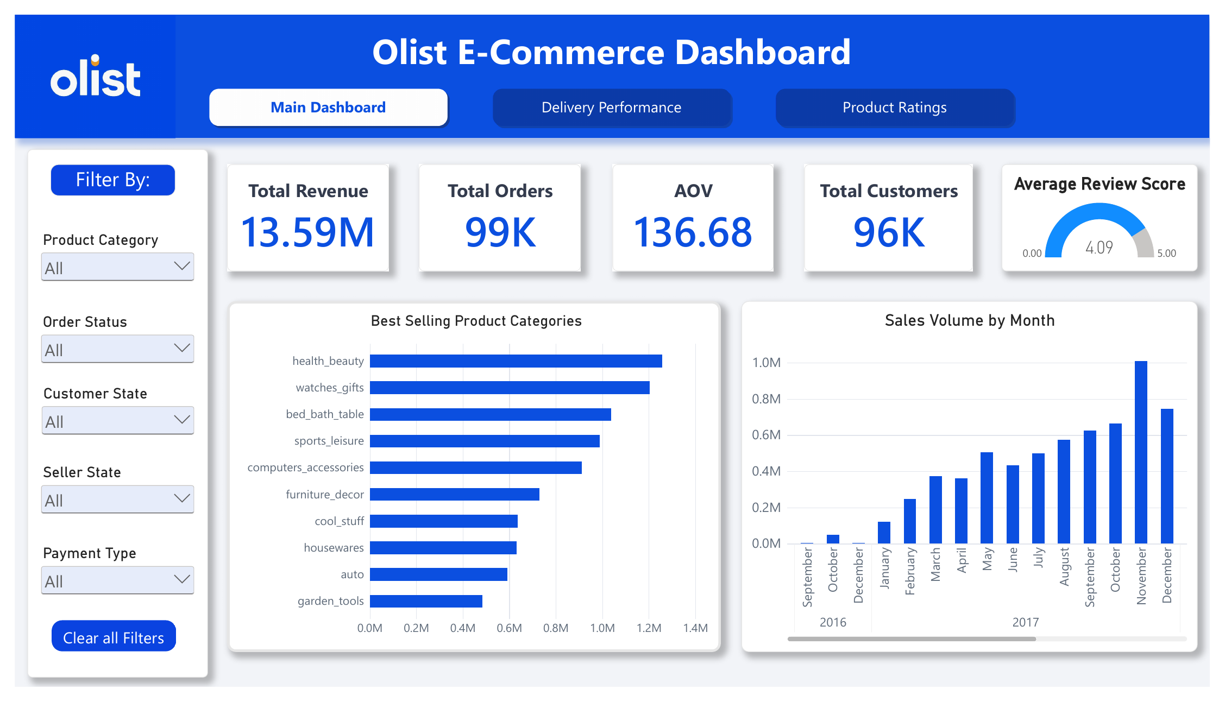
Power BI Dashboard: Sales Overview
Total revenue 13.59M from 99K orders
Average order value 136.68; 96K customers
Revenue peaked in November 2017
Top categories: health_beauty, watches_gifts, bed_bath_table
Notes:
Revenue kept growing through 2017 with a peak in November.

Slide 8
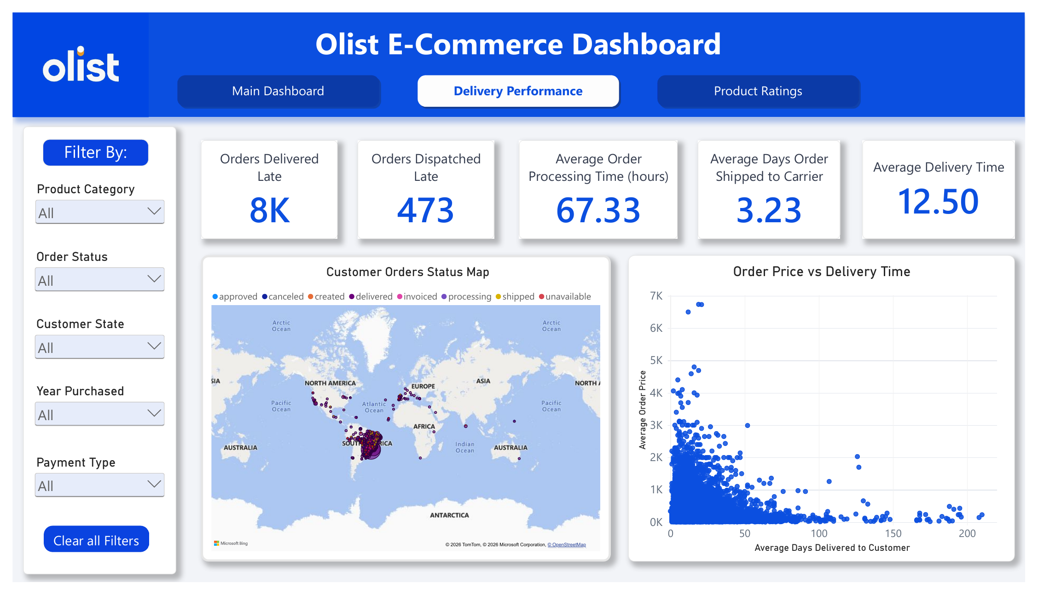
Power BI Dashboard: Delivery Performance
Average delivery time 12.5 days
About 8K orders delivered late; 473 dispatched late
Suggests delays happen mostly in transit
Processing time 67.33 hours; 3.23 days to reach the carrier
Notes:
Few orders were dispatched late, but many arrived late.

Slide 9
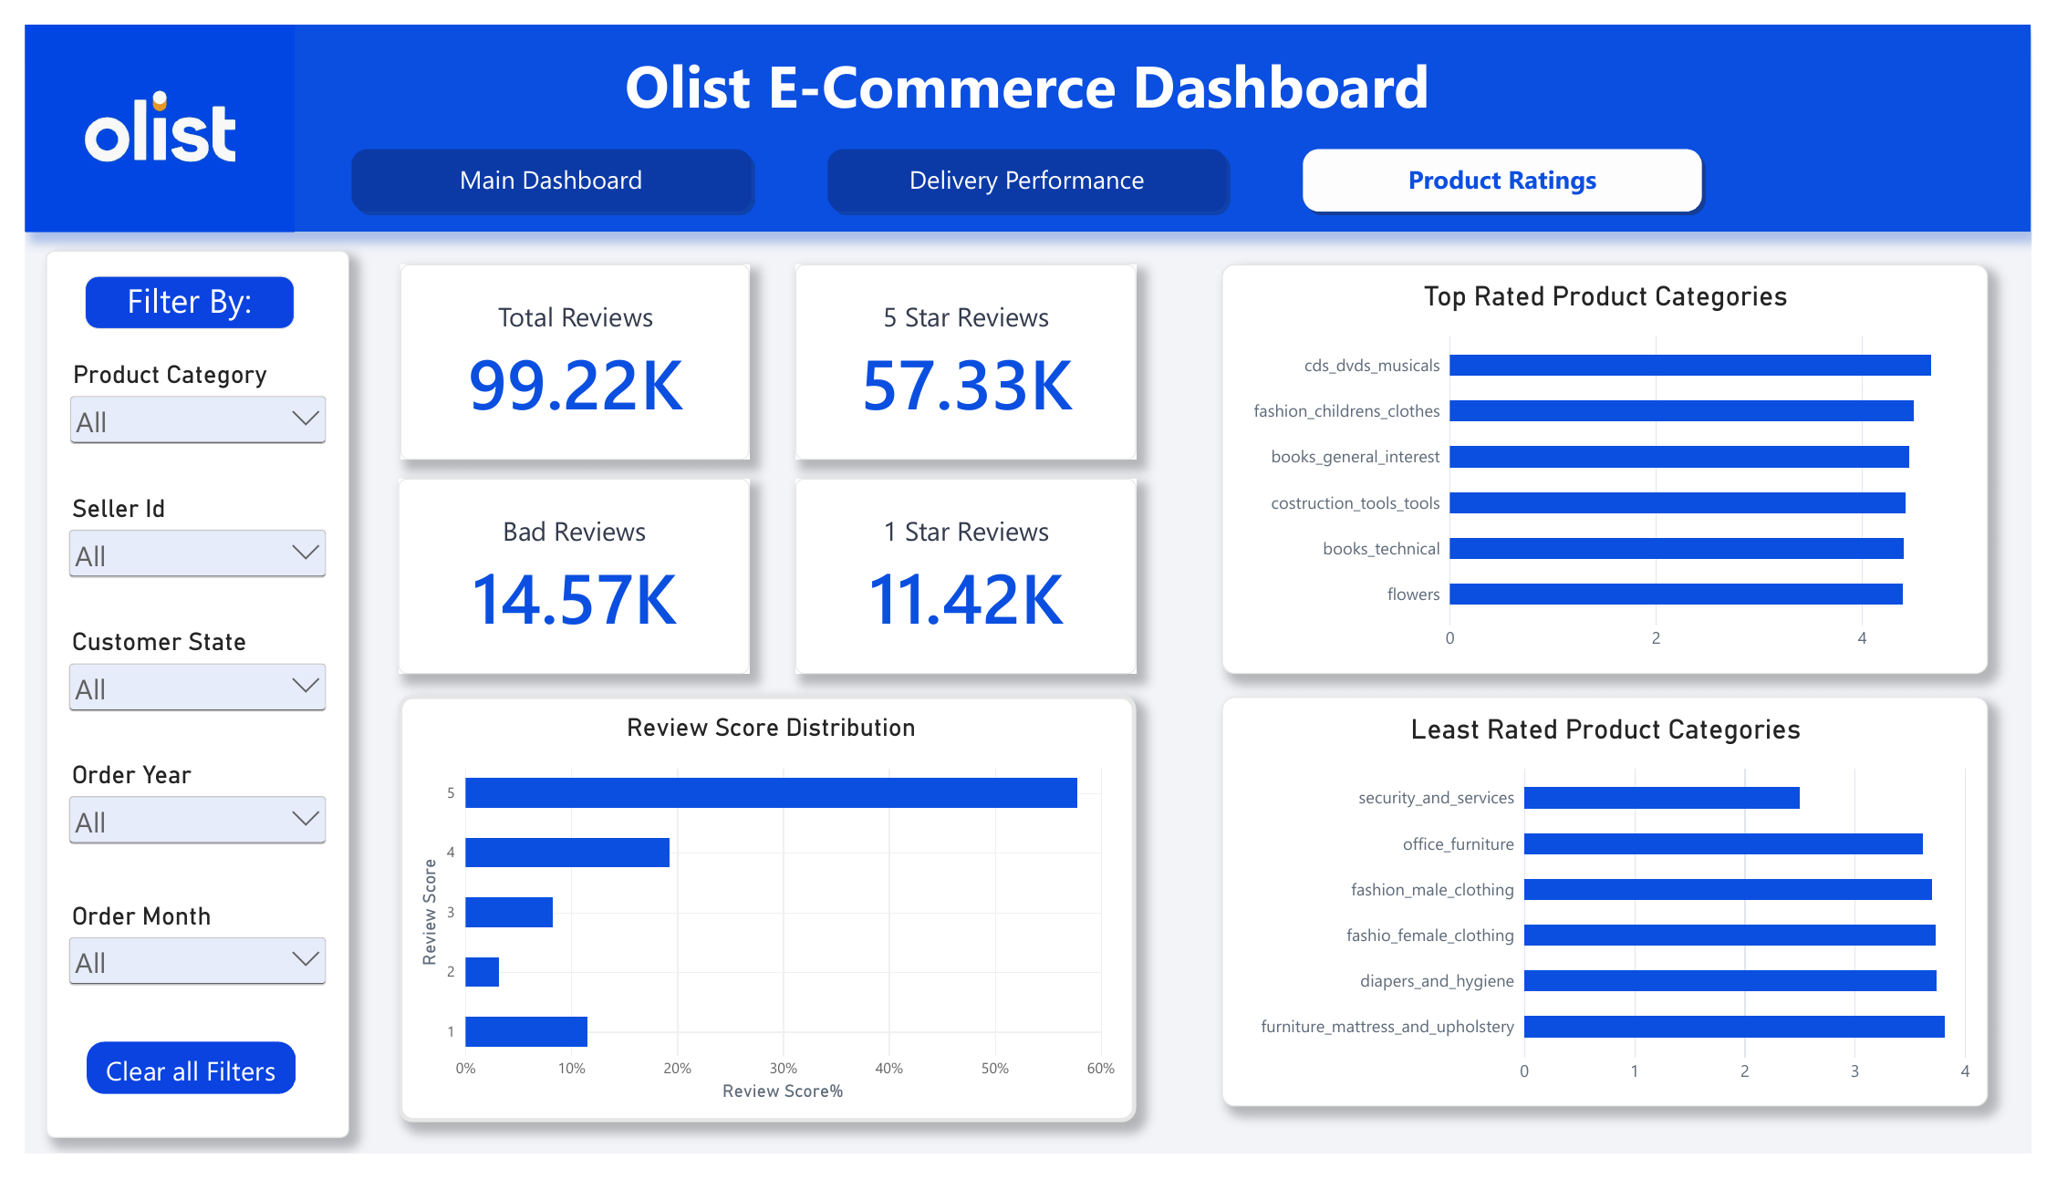
Power BI Dashboard: Product Ratings
Average review score 4.09 out of 5
57.33K of 99.22K reviews are 5-star; 11.42K are 1-star
Highest rated: cds_dvds_musicals, fashion_childrens_clothes, books
Lowest rated: security_and_services, office_furniture
Notes:
Most customers are satisfied; some categories rate lower.

Slide 10
Key Insights and Recommendations
Work with carriers to reduce transit delays and set realistic delivery estimates
Prepare stock and logistics for the November sales peak
Investigate low-rated categories such as office furniture
Keep supply strong in top categories like health and beauty
Notes:
Each point comes from the dashboards.

Slide 11
Conclusion
Completed an end-to-end analytics workflow: cleaning, database, SQL analysis and dashboard
Missing values and zeros were handled based on business meaning
The dashboard covers sales, delivery performance and customer ratings
Repository: data_raw, data_cleaned, docs, sql, powerbi
Notes:
Thank you.

Slide 12
Thank you

