Slide 1


Website and App Analytics Using Power BI
Project Presentation
Submitted by : pearl , riddhi and mehak
Submitted to : mr Ashish Rajput

Slide 2

Introduction
Websites and mobile applications generate huge amounts of user data every day.
Understanding this data helps organizations improve user experience and business performance.
This project uses Power BI to analyze website and app data.
Interactive dashboards are created to visualize trends and key metrics.

Slide 3

Problem Statement
Businesses collect large amounts of website and app data.
Understanding customer behavior and engagement is difficult.
Tracking performance manually is time-consuming.
Organizations need a single platform to monitor important metrics.
Better insights are required for effective decision-making.

Slide 4

Objectives
Objective 1: Understand the Website and App Data Structure and Key Performance Metrics
Objective 2: Pre-process and Clean the Data for Accurate Analysis
Objective 3: Create Data Models and Establish Relationships Between Tables
Objective 4: Create Calculated Fields and DAX Measures to Support Analysis
Objective 5: Analyse User Behaviour and Website/App Performance
Objective 6: Create Visualizations to Identify Trends and Patterns
Objective 7: Develop Interactive Reports and Dashboards for Decision-Making

Slide 5
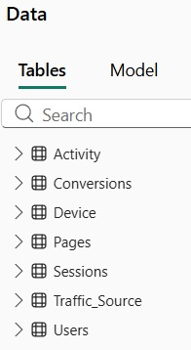
Objective 1:Understand the Website and App Data Structure and Key Performance Metrics
Tasks Performed | Description | Power BI Features Used
Review Datasets and Data Sources | Examined available datasets and understood their structure and content. | Data View
Identify Key Fields and KPIs | Determined important metrics such as users, sessions, page views, and conversions. | Data Profiling
Understand User and Traffic Data | Analyzed user, session, traffic, and engagement-related information. | Summary Statistics
Explore Data Categories | Studied different attributes and their relationships. | Filters
Understand Business Requirements | Identified analytical requirements and reporting needs. | Data View, Filters

Slide 6
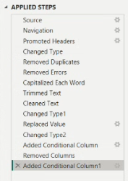
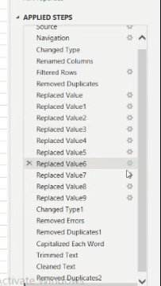
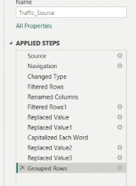
Objective 2:Pre-process and Clean the Data for Accurate Analysis
Tasks Performed | Description | Power BI Features Used
Check for Missing Values | Identified and handled missing or null values to ensure data completeness. | Power Query Editor
Remove Duplicate Records | Eliminated duplicate entries to maintain data accuracy. | Remove Duplicates
Handle Data Inconsistencies | Corrected inconsistent values and standardized formats. | Replace Values
Correct Data Types | Assigned appropriate data types to columns for accurate analysis. | Data Type Conversion
Transform and Standardize Data | Modified and standardized data according to business requirements. | Conditional Columns, Power Query Editor

Slide 7
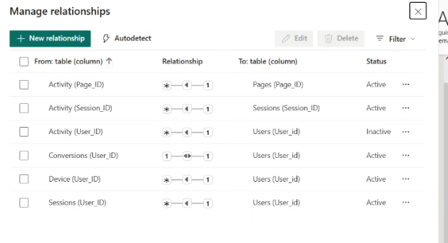
Objective 3:Create Data Models and Establish Relationships Between Tables
Tasks Performed | Description | Power BI Features Used
Connect Related Tables | Linked tables containing user, session, traffic, and engagement data. | Relationship View
Define Primary and Foreign Keys | Established key relationships to ensure data integrity and consistency. | Manage Relationships
Create a Structured Data Model | Organized data into a logical and efficient structure for analysis. | Data Modelling
Implement Star Schema | Designed a star schema to optimize performance and simplify reporting. | Star Schema Concepts
Validate Relationships | Verified relationship accuracy to ensure reliable calculations and insights. | Relationship View, Manage Relationships

Slide 8
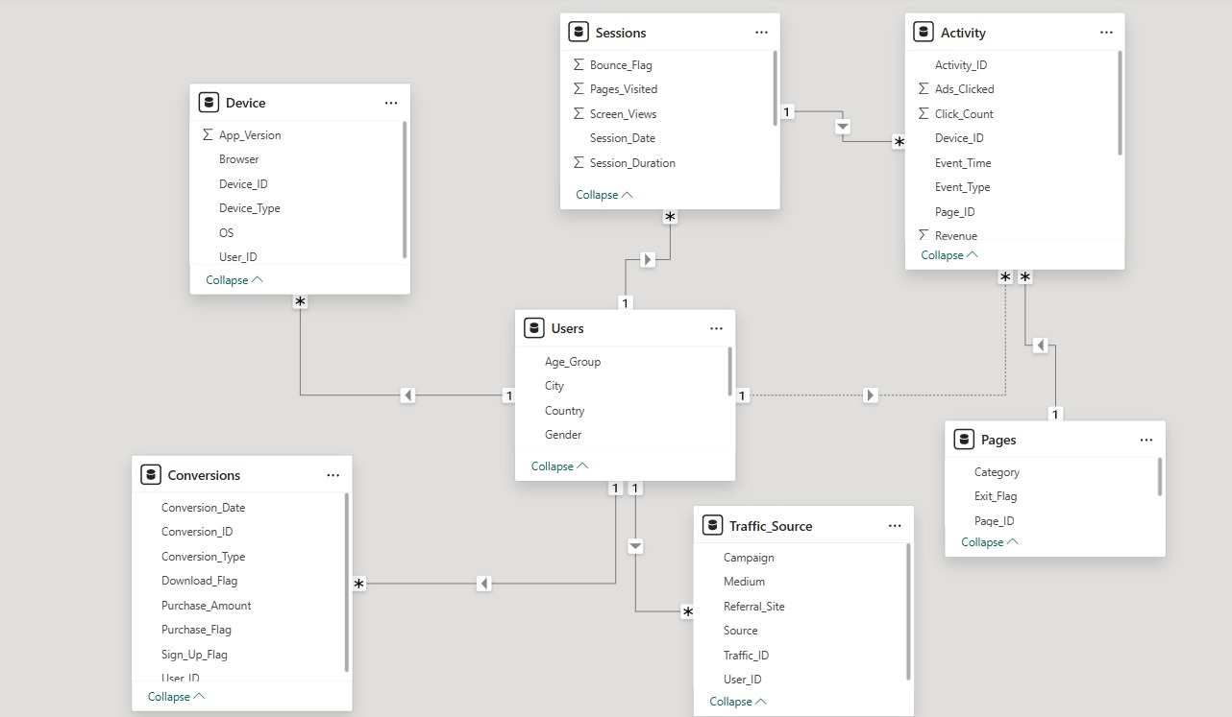
Data Modelling View

Slide 9
Objective 4:Create Calculated Fields and DAX Measures to Support Analysis
Tasks Performed | Description | Power BI Features Used
Create Custom Columns | Added custom columns to derive additional information from existing data. | Custom Columns
Create Calculated Columns | Generated calculated columns to support business analysis. | Calculated Columns
Develop KPIs and Metrics | Created key performance indicators for monitoring website and app performance. | DAX Functions
Calculate Business Metrics | Computed metrics such as session duration, bounce rate, and conversion rate. | COUNT(), DISTINCTCOUNT(), SUM(), DIVIDE()
Apply Conditional Logic | Used logical conditions to categorize and analyze data effectively. | IF()

Slide 10
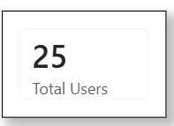
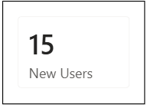
Total Users =
DISTINCTCOUNT(Users[User_ID])
New Users =CALCULATE(COUNTROWS(Users),
Users[User_Type]="New")
Total Purchases = SUM(Conversions[Purchase_Flag])
Total Users =DISTINCTCOUNT(Users[User_ID])
Total Sessions =DISTINCTCOUNT(Sessions[Session_ID])
Page Views = COUNT(Activity[Page_ID])
Avg Session Duration = AVERAGE(Sessions[Duration])
New Users = CALCULATE( COUNTROWS(Users),Users[User_Type]="New")
Returning Users = CALCULATE( COUNTROWS(Users), Users[User_Type]="Returning" )

Slide 11
Objective 5:Analyze User Behavior and Website/App Performance
Tasks Performed | Description | Power BI Features Used
Track Page Views and User Actions | Monitored page visits and user interactions to understand usage patterns. | DAX Measures
Analyze User Navigation and Engagement | Examined how users navigate through the website and app and measured engagement levels. | Segmentation
Compare New and Returning Users | Identified differences in behavior between new and returning users. | Group By
Identify Major Traffic Sources | Analyzed traffic channels to determine the main sources of users. | Aggregation Functions
Measure Conversions and Drop-off Points | Evaluated conversion rates, exits, and user drop-off points to identify improvement areas. | Data Analysis Techniques

Slide 12
Objective 6:Create Visualizations to Identify Trends and Patterns
Tasks Performed | Description | Power BI Features Used
Visualize User Behavior and Engagement | Created charts and graphs to understand user activity and engagement patterns. | Bar Charts, Line Charts
Compare Different User Segments | Analyzed and compared various user groups based on behavior and demographics. | Pie/Donut Charts, Tables and Matrix Visuals
Track Website and App Performance Over Time | Monitored changes in key metrics and performance trends over different periods. | Line Charts, KPI Cards
Analyze Conversions and Traffic Sources | Examined conversion rates and identified the effectiveness of various traffic channels. | Funnel Charts, Bar Charts
Present Key Insights Through Visual Representations | Developed interactive visuals to communicate insights clearly and support decision-making. | Slicers and Filters, KPI Cards

Slide 13
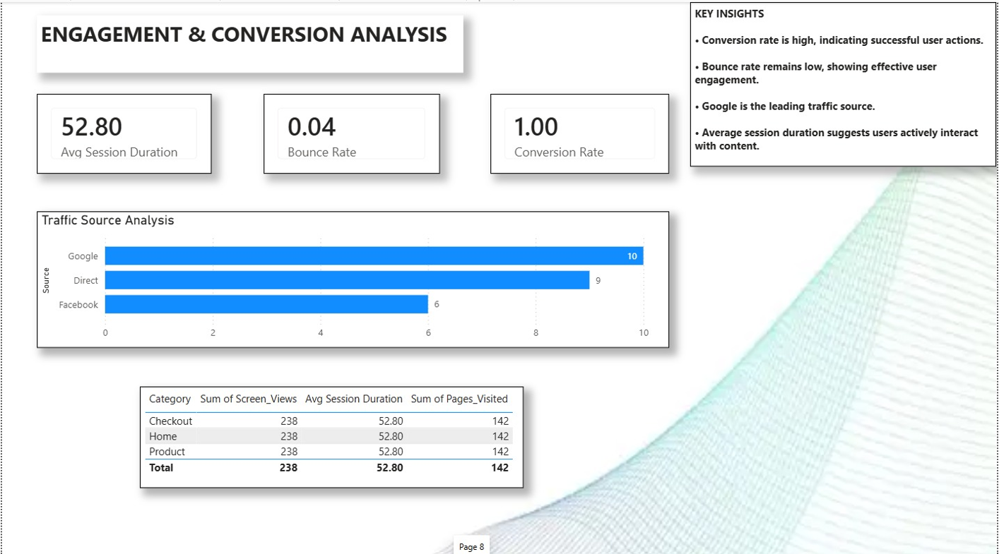
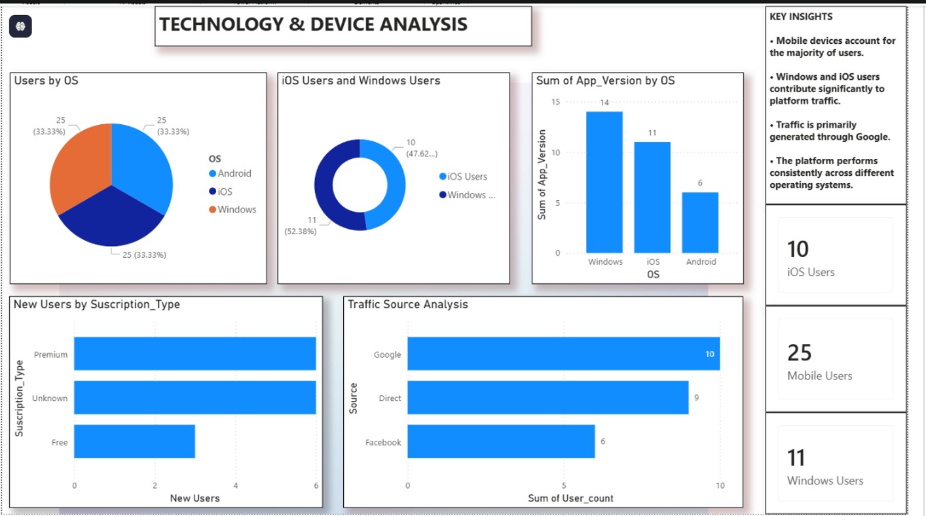
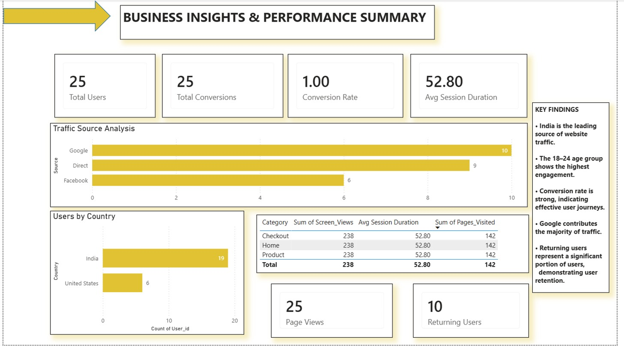
Objective 7:Develop Interactive Reports and Dashboards for Decision-Making
Tasks Performed | Description | Power BI Features Used
Design Dashboard Pages | Created multiple dashboard pages to present different aspects of website and app analytics. | Power BI Dashboard
Add Interactive Visuals and Filters | Implemented interactive charts, slicers, and filters for dynamic analysis. | KPI Cards, Slicers
Implement Drill-Through Functionality | Enabled users to explore detailed information from summary visuals. | Drill Through
Prepare Final Dashboard and Presentation | Designed storytelling visuals and organized insights for effective decision-making. | Bookmarks, Storytelling Visuals

Slide 14
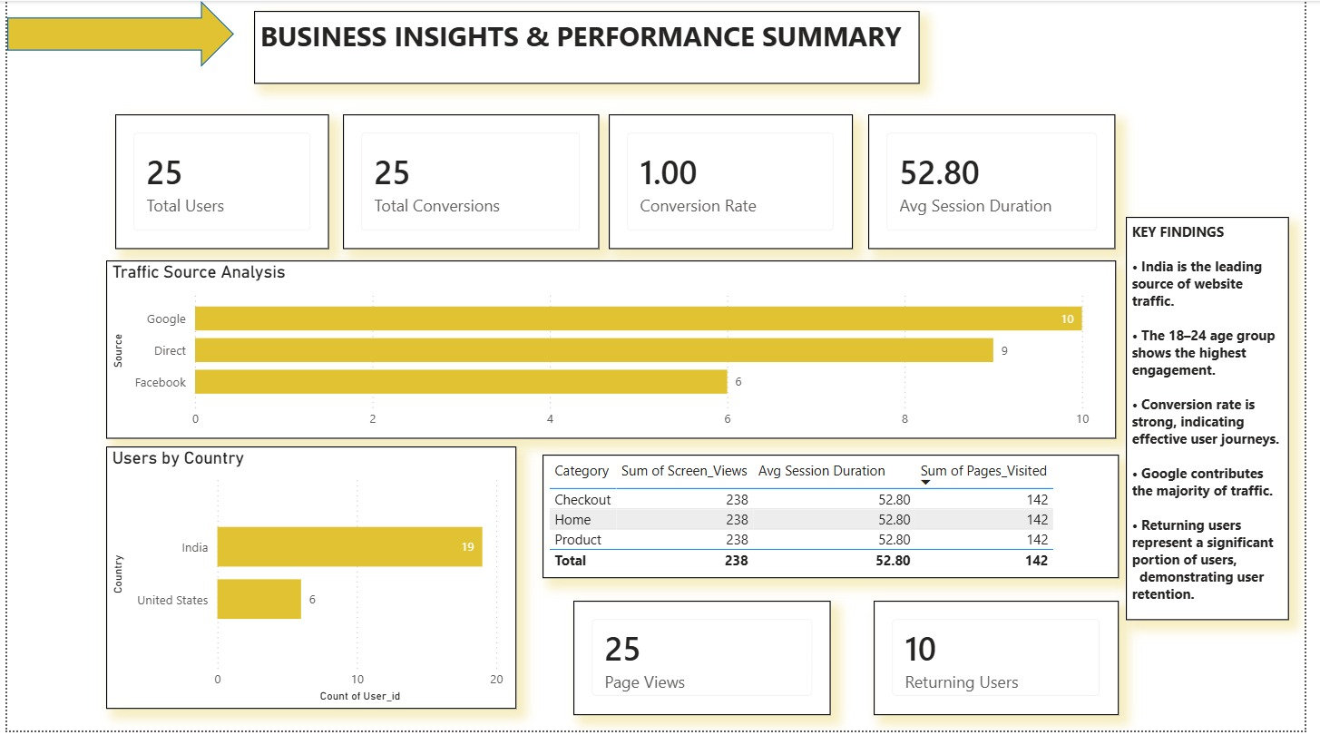
Dashboards

Slide 15


Slide 16


Slide 17
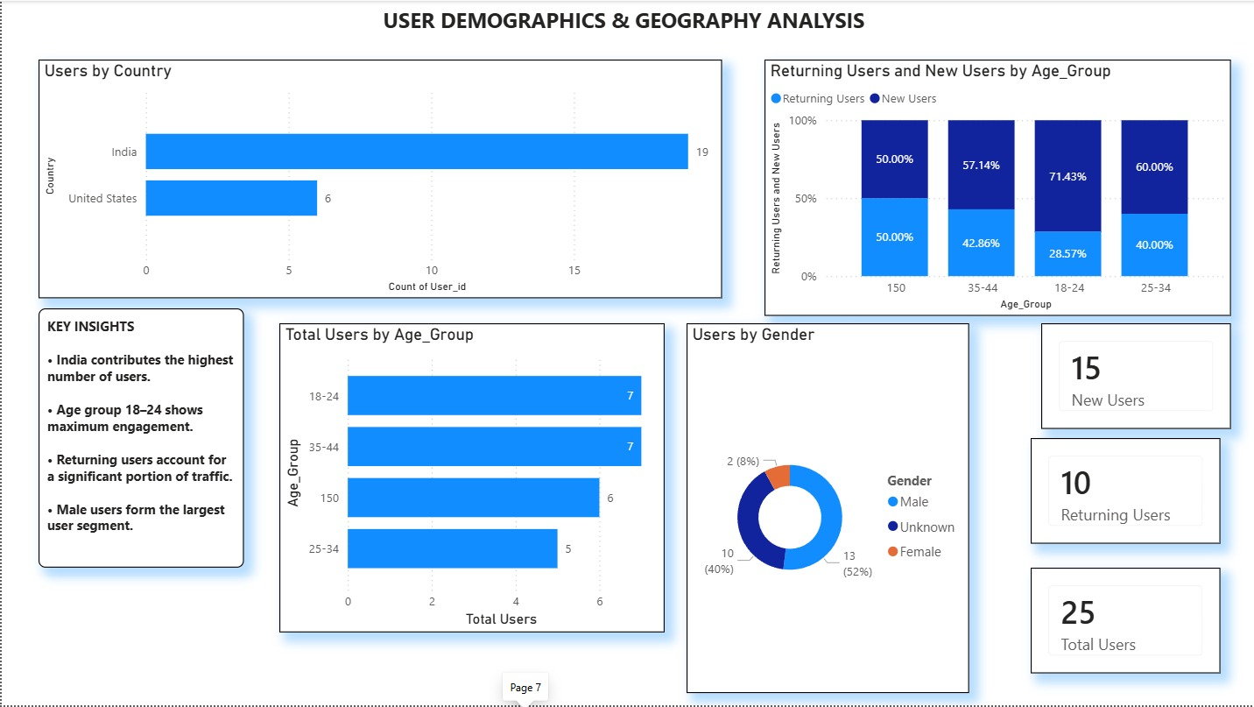

Slide 18
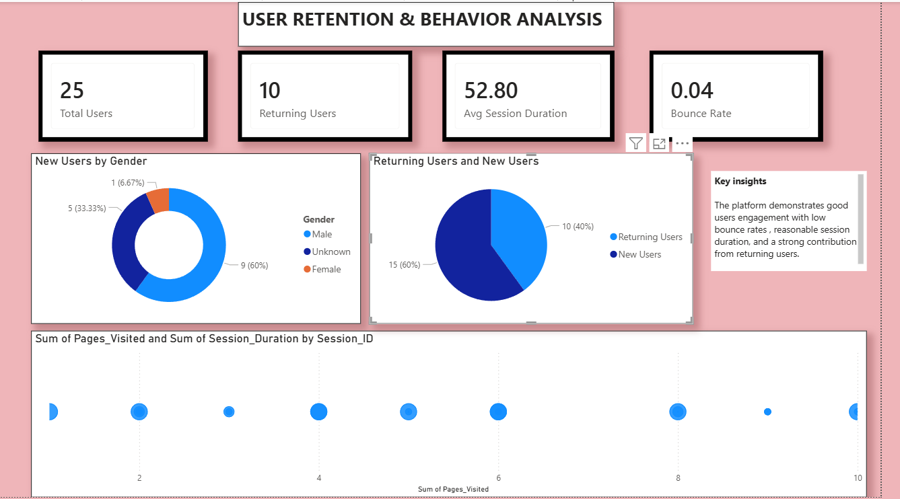

Slide 19
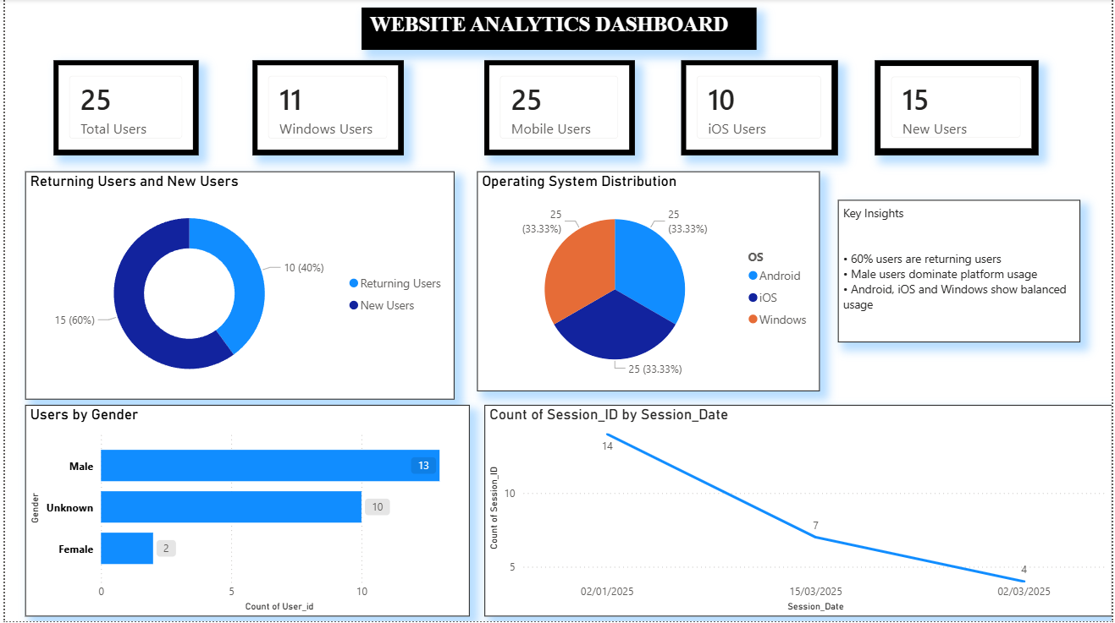

Slide 20
Key Benefits
• Real-time monitoring of website performance. • Better understanding of customer behavior. • Improved conversion tracking and analysis. • Enhanced user engagement measurement. • Effective demographic and geographic analysis. • Faster reporting through interactive dashboards. • Better business decision-making using visual analytics. • Easy identification of trends and patterns.

Slide 21
Limitations
1. Dataset Dependency The analysis is completely dependent on the quality and accuracy of the available dataset. Any missing or incorrect data can impact insights.
2. Historical Data Analysis The dashboards analyze historical data only. Future user behavior and market trends cannot be predicted with certainty.
3. Limited Data Sources The project uses predefined website and app datasets. External factors such as competitor activity, market conditions, or customer feedback are not included.
4. User Behavior Interpretation The dashboards show what users did but not always why they behaved in a certain way. Additional qualitative research may be required for deeper understanding.
5. Sample Dataset Constraints The project is based on a sample dataset for learning and analysis purposes.

Slide 22
Conclusion
This project helps in understanding how users interact with websites and mobile applications.
It provides clear and easy-to-understand insights through interactive dashboards.
The analysis helps identify trends, user preferences, and areas for improvement.
Visual reports make it easier to monitor performance and support better decision-making.
Overall, the project enables organizations to enhance user experience and achieve business growth through effective use of data.

