Slide 1
HTML Basics Elements & Attributes.
Tables & Layouts
Block vs Inline Elements
Forms
Unit Goals
Things We' ll Cover

Slide 2

HTML
What is HTML?
HTML stands for Hyper Text Markup Language
HTML is the standard markup language for creating Web pages
HTML describes the structure of a Web page
HTML consists of a series of elements
HTML elements tell the browser how to display the content
HTML elements label pieces of content such as "this is a heading", "this is a paragraph", "this is a link", etc.
IS A MARKUP LANGUAGE

Slide 3

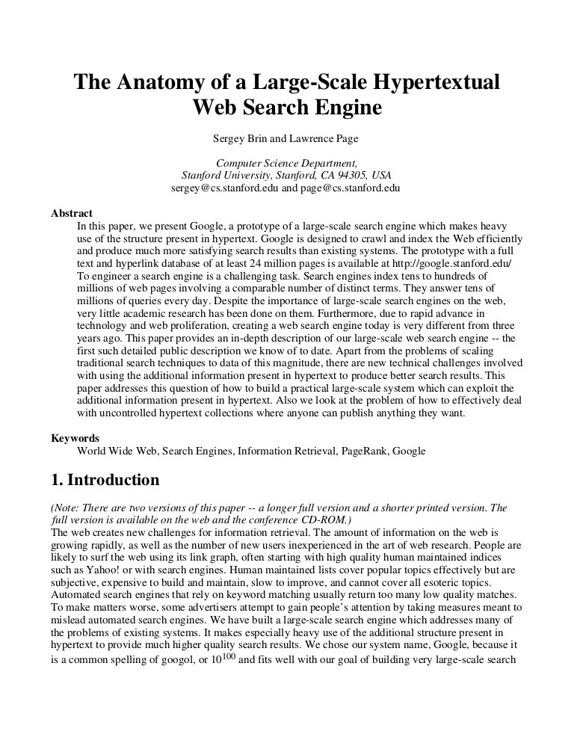
A Simple HTML Document
<!DOCTYPE html> → declaration defines that this document is an HTML5 document <html> → element is the root element of an HTML page <head> → element contains meta information about the HTML page <title>Page Title</title> → element specifies a title for the HTML page (which is shown in the browser's title bar or in the page's tab) </head> <body> → element defines the document's body, and is a container for all the visible contents, such as headings, paragraphs, images, hyperlinks, tables, lists, etc. <h1>My First Heading</h1> → element defines a large heading <p>My first paragraph.</p> → element defines a paragraph </body> </html>

Slide 4
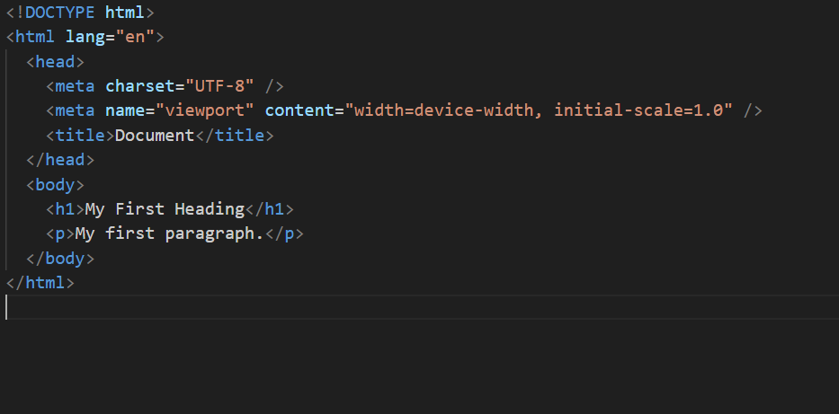
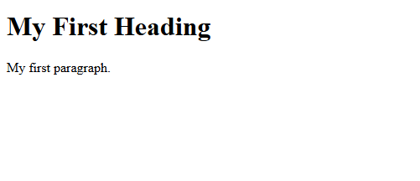
HTML – Elements & Attributes
What is an HTML Element?
An HTML element is defined by a start tag, some content, and an end tag:
<tagname> Content goes here... </tagname>
The <html> element is the root element and it defines the whole HTML document.
It has a start tag <html> and an end tag </html>.
Then, inside the <html> element there is a <body> element:
The <body> element defines the document's body.
It has a start tag <body> and an end tag </body>.
Then, inside the <body> element there are two other elements: <h1> and <p>:
<body> <h1>My First Heading</h1> <p>My first paragraph.</p> </body>

Slide 5
HTML ELEMENTS
To write HTML, we pick from a set of standard Elements that all browsers recognize
Common Elements include:
<p> element - represents a paragraph of text
<h1> element - represents the main header on a page
<img> element - embeds an image
<form> element - represents a form

Slide 6
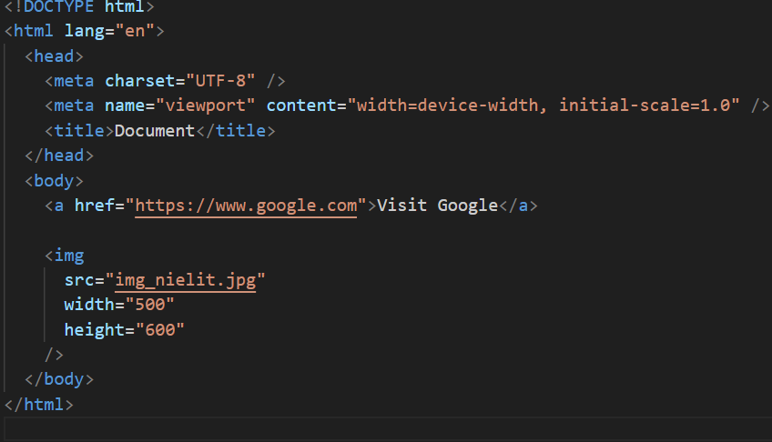

HTML – Elements & Attributes
What is an HTML Attributes?
HTML attributes provide additional information about HTML elements.
Attributes are always specified in the start tag
Attributes usually come in name/value pairs like: name="value“
The href Attribute
The <a> tag defines a hyperlink. The href attribute specifies the URL of the page the link goes to:
Example
<a href="https://www.google.com">Visit Google</a>
The src Attribute
The <img> tag is used to embed an image in an HTML page. The src attribute specifies the path to the image to be displayed:
Example
<img src=“nielit.jpg">
The width and height Attributes
The <img> tag should also contain the width and height attributes, which specify the width and height of the image (in pixels):
Example
<img src=“nielit.jpg" width="500" height="600">

Slide 7
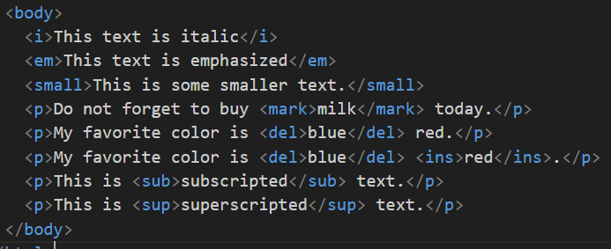
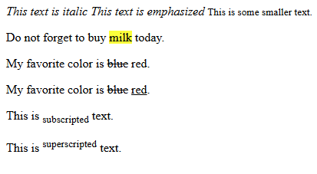
HTML – Text Formatting
What is an HTML Text Formatting?
HTML contains several elements for defining text with a special meaning.
HTML Formatting Elements
Formatting elements were designed to display special types of text:
<b> - Bold text → element defines bold text, without any extra importance
<strong> - Important text → The content inside is typically displayed in bold.
<i> - Italic text → The content inside is typically displayed in italic.
<em> - Emphasized text→ element defines emphasized text. The content inside is typically displayed in italic.
<mark> - Marked text → element defines text that should be marked or highlighted
<small> - Smaller text → element defines smaller text
<del> - Deleted text → Browsers will usually strike a line through deleted text
<ins> - Inserted text → element defines a text that has been inserted into a document. Browsers will usually underline inserted text
<sub> - Subscript text → text can be used for chemical formulas, like H₂O
<sup> - Superscript text → text can be used for footnotes, like WWW^{[1]}

Slide 8
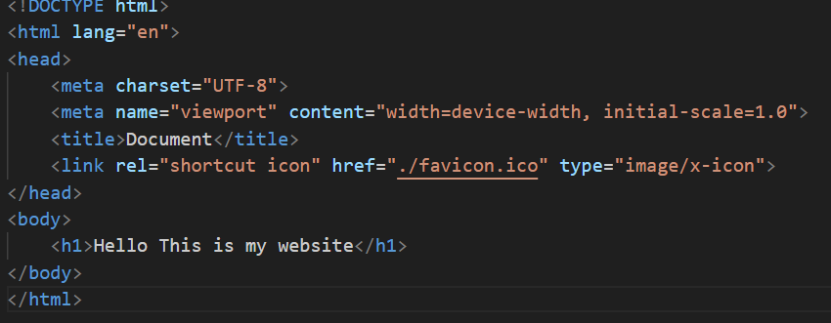
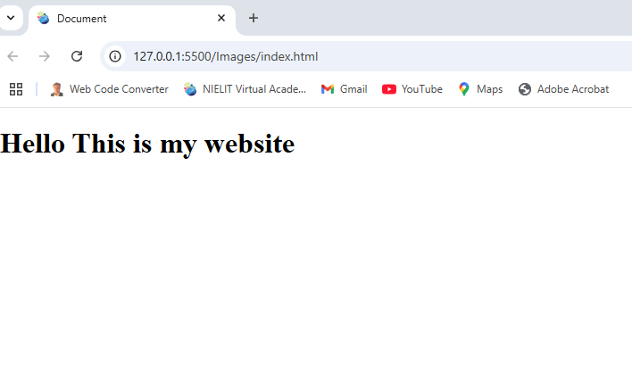
HTML – Favicon
What is an HTML favicon?
A favicon is a small image displayed next to the page title in the browser tab.
How To Add a Favicon in HTML
To add a favicon to your website, either save your favicon image to the root directory of your webserver, or create a folder in the root directory called images, and save your favicon image in this folder. A common name for a favicon image is "favicon.ico".
Example
<!DOCTYPE html> <html> <head> <title>My Page Title</title> <link rel="icon" type="image/x-icon" href="/images/favicon.ico"> </head> <body> <h1>This is a Heading</h1> <p>This is a paragraph.</p> </body> </html>

Slide 9
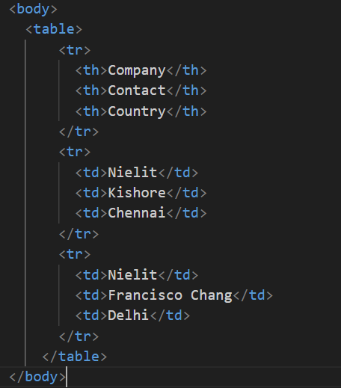

HTML – Tables
What is an HTML Tables?
HTML tables allow web developers to arrange data into rows and columns.
A table in HTML consists of table cells inside rows and columns.
Example
A simple HTML table:
<table> → Defines a table <tr> → Defines a row in a table <th>Company</th> → Defines a header cell in a table <th>Contact</th> <th>Country</th> </tr> <tr> <td>Nielit</td> → Defines a cell in a table <td>Kishore</td> <td>Chennai</td> </tr> <tr> <td>Nielit</td> <td>Arun</td> <td>Delhi</td> </tr> </table>

Slide 10
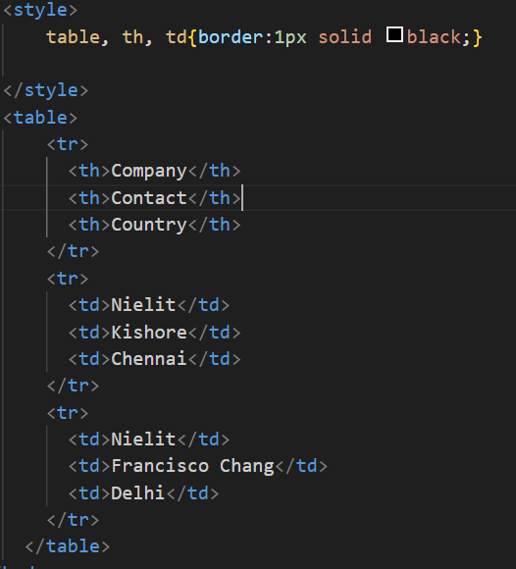
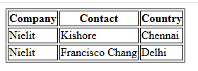
HTML – Tables
HTML Table Borders
HTML tables can have borders of different styles and shapes.
How To Add a Border
To add a border, use the CSS border property on table, th, and td elements:
Example
table, th, td { border: 1px solid black; }

Slide 11
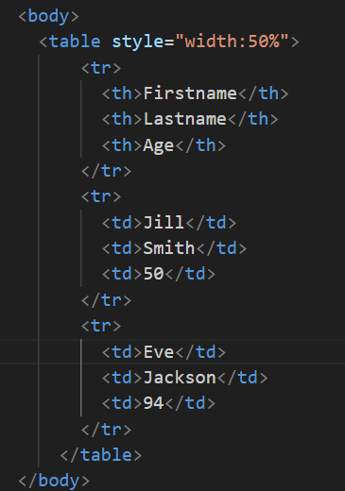
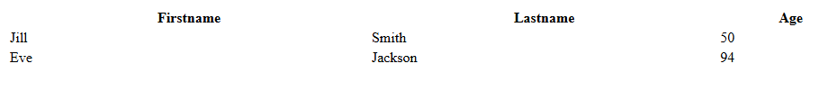
HTML – Tables
HTML Table Sizes
HTML tables can have different sizes for each column, row or the entire table.
Use the style attribute with the width or height properties to specify the size of a table, row or column.
Example
Set the height of the second row to 200 pixels:
<table style="width:100%"> <tr> <th>Firstname</th> <th>Lastname</th> <th>Age</th> </tr> <tr style="height:200px"> <td>Jill</td> <td>Smith</td> <td>50</td> </tr> <tr> <td>Eve</td> <td>Jackson</td> <td>94</td> </tr> </table>

Slide 12
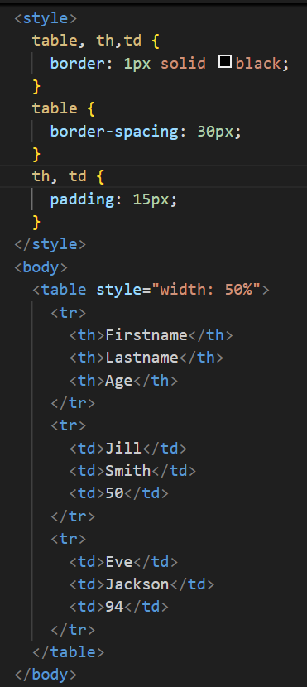
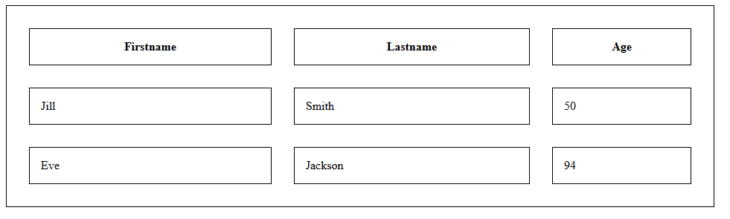
HTML – Tables
HTML Table Padding & Spacing
HTML tables can adjust the padding inside the cells, and also the space between the cells.
HTML Table - Cell Padding
Cell padding is the space between the cell edges and the cell content.
By default the padding is set to 0.
To add padding on table cells, use the CSS padding property:
Example
th, td { padding: 15px; }
HTML Table - Cell Spacing
Cell spacing is the space between each cell.
By default the space is set to 2 pixels.
To change the space between table cells, use the CSS border-spacing property on the table element:
Example
table { border-spacing: 30px; }

Slide 13
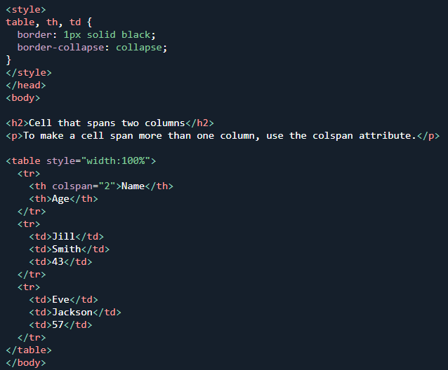
HTML – Tables & Lists
HTML Table Colspan & Rowspan
HTML tables can have cells that span over multiple rows and/or columns.
HTML Table - Colspan
To make a cell span over multiple columns, use the colspan attribute
Example
<table> <tr> <th colspan="2">Name</th> <th>Age</th> </tr> <tr> <td>Jill</td> <td>Smith</td> <td>43</td> </tr> <tr> <td>Eve</td> <td>Jackson</td> <td>57</td> </tr> </table>

Slide 14
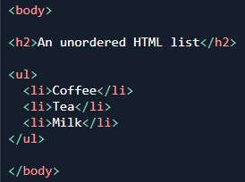
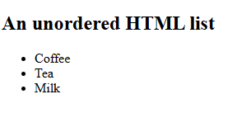
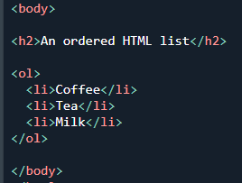
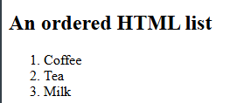
HTML – Lists
HTML Lists
HTML lists allow web developers to group a set of related items in lists.
Unordered HTML List
An unordered list starts with the <ul> tag. Each list item starts with the <li> tag. The list items will be marked with bullets (small black circles) by default:
Example
<ul> <li>Coffee</li> <li>Tea</li> <li>Milk</li> </ul>
Ordered HTML List
An ordered list starts with the <ol> tag. Each list item starts with the <li> tag.
The list items will be marked with numbers by default:
Example
<ol> <li>Coffee</li> <li>Tea</li> <li>Milk</li> </ol>

Slide 15
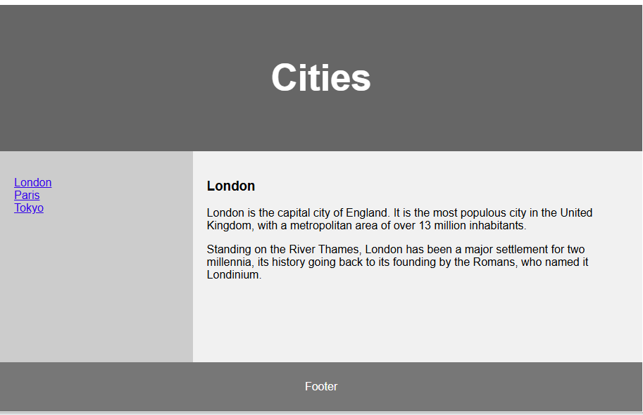
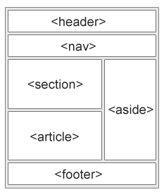
HTML – Layout
HTML Layout Elements
HTML has several semantic elements that define the different parts of a web page
<header> - Defines a header for a document or a section
<nav> - Defines a set of navigation links
<section> - Defines a section in a document
<article> - Defines an independent, self-contained content
<aside> - Defines content aside from the content (like a sidebar)
<footer> - Defines a footer for a document or a section
<details> - Defines additional details that the user can open and close on demand
<summary> - Defines a heading for the <details> element

Slide 16
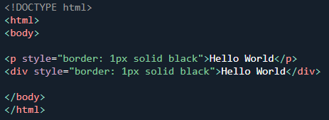
HTML – Block & Inline Elements
HTML Block Elements
Every HTML element has a default display value, depending on what type of element it is.
The two most common display values are block and inline.
Block-level Elements
A block-level element always starts on a new line, and the browsers automatically add some space (a margin) before and after the element.
A block-level element always takes up the full width available (stretches out to the left and right as far as it can).
Two commonly used block elements are: <p> and <div>.
The <p> element defines a paragraph in an HTML document.
The <div> element defines a division or a section in an HTML document.
Example
<p>Hello World</p> <div>Hello World</div>
Here are the block-level elements in HTML:
<address> <article> <aside> <blockquote> <canvas> <dd> <div>
<dl> <dt> <fieldset> <figcaption> <figure> <footer> <form>
<h1>-<h6> <header> <hr> <li> <main> <nav> <noscript> <ol>
<p> <pre> <section> <table> <tfoot> <ul> <video>

Slide 17
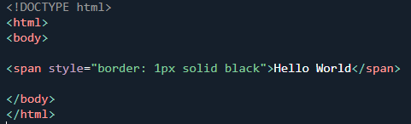

HTML – Block & Inline Elements
HTML Inline Elements
An inline element does not start on a new line.
An inline element only takes up as much width as necessary.
This is a <span> element inside a paragraph.
Example
<span>Hello World</span>
Here are the inline elements in HTML:
<a> <abbr> <acronym> <b> <bdo> <big> <br> <button> <cite>
<code> <dfn> <em> <i> <img> <input> <kbd> <label> <map>
<object> <output> <q> <samp> <script> <select> <small> <span>
<strong> <sub> <sup> <textarea> <time> <tt> <var>

Slide 18
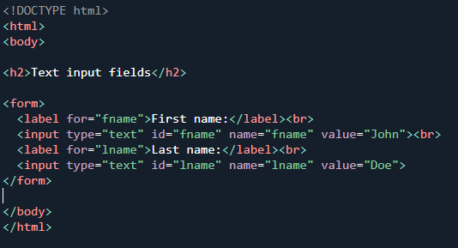
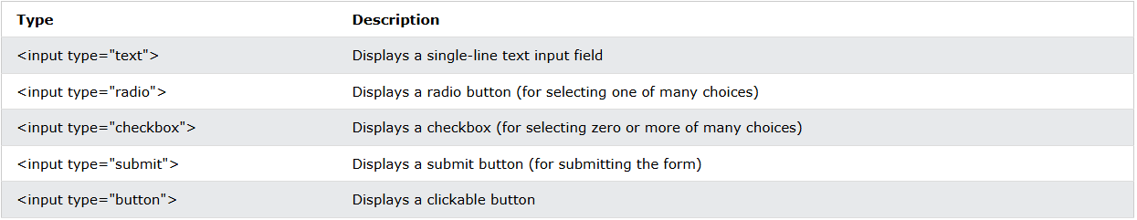
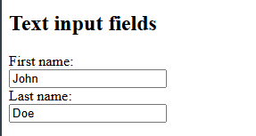
HTML – Forms
HTML Forms
An HTML form is used to collect user input. The user input is most often sent to a server for processing.
The <form> Element
The HTML <form> element is used to create an HTML form for user input:
The <form> element is a container for different types of input elements, such as: text fields, checkboxes, radio buttons, submit buttons, etc.
The <input> Element
The HTML <input> element is the most used form element.
An <input> element can be displayed in many ways, depending on the type attribute.

Slide 19
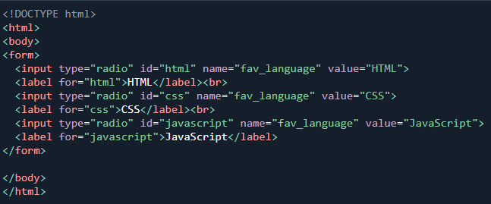
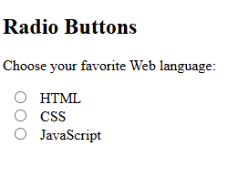
HTML – Forms
Radio Buttons
The <input type="radio"> defines a radio button.
Radio buttons let a user select ONE of a limited number of choices.
Example <form> <input type="radio" id="html" name="fav_language" value="HTML"> <label for="html">HTML</label><br> <input type="radio" id="css" name="fav_language" value="CSS"> <label for="css">CSS</label><br> <input type="radio" id="javascript" name="fav_language" value="JavaScript"> <label for="javascript">JavaScript</label> </form>
Checkboxes
The <input type="checkbox"> defines a checkbox.
Checkboxes let a user select ZERO or MORE options of a limited number of choices.
Example
<form> <input type="checkbox" id="vehicle1" name="vehicle1" value="Bike"> <label for="vehicle1"> I have a bike</label><br> <input type="checkbox" id="vehicle2" name="vehicle2" value="Car"> <label for="vehicle2"> I have a car</label><br> <input type="checkbox" id="vehicle3" name="vehicle3" value="Boat"> <label for="vehicle3"> I have a boat</label> </form>

Slide 20
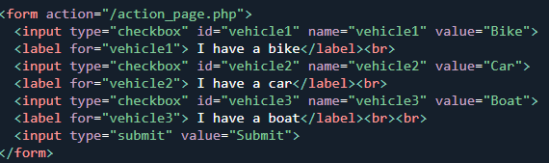

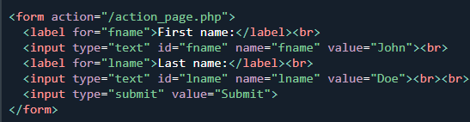
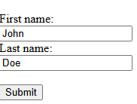
HTML – Forms
The Submit Button
The <input type="submit"> defines a button for submitting the form data to a form-handler.
The form-handler is typically a file on the server with a script for processing input data.
The form-handler is specified in the form's action attribute.
Example
A form with a submit button:
<form action="/Nielit.gov.php"> <label for="fname">First name:</label><br> <input type="text" id="fname" name="fname" value="John"><br> <label for="lname">Last name:</label><br> <input type="text" id="lname" name="lname" value="Doe"><br><br> <input type="submit" value="Submit"> </form>

Slide 21
HTML – Forms
HTML Input Types
Here are the different input types you can use in HTML:
<input type="button">
<input type="checkbox">
<input type="color">
<input type="date">
<input type="datetime-local">
<input type="email">
<input type="file">
<input type="hidden">
<input type="image">
<input type="month">
<input type="number">
<input type="password">
<input type="radio">
<input type="range">
<input type="reset">
<input type="search">
<input type="submit">
<input type="tel">
<input type="text">
<input type="time">
<input type="url">
<input type="week">

Slide 22
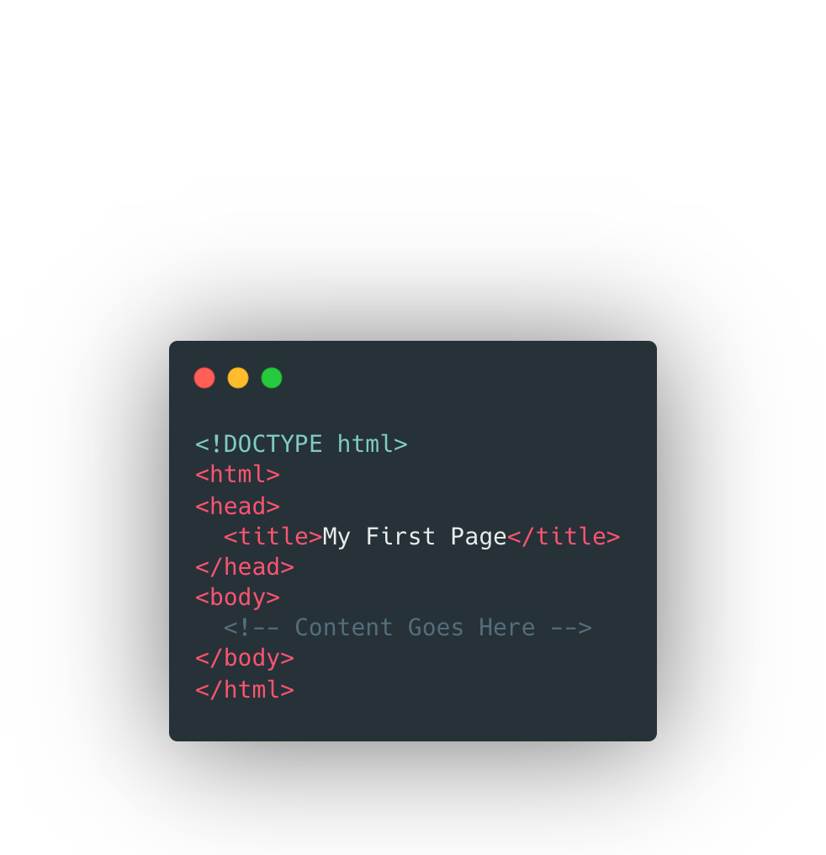

HTML SKELETON
We write our HTML in a standard "skeleton"

Slide 23
THE END

