Slide 1
Frozen In Line: An Analysis of Amusement Park Wait Times
Amy Bertelsman, Pearl Muensterman, & Ethan Morlock

Slide 2
Introduction
Model wait time for amusement park attractions
Why important?
Park managers
Park visitors
Hypotheses about longer wait times
Attraction length
Higher interest
Main attractions
New attractions
Roller coasters
Outdoor attractions

Slide 3
Data
Collected for a senior thesis
Collected in 2018
Three Amusement Parks
Disney World
Disneyland
Universal Studios (Orlando)
128 observations
17 variables

Slide 4
Variables
Attraction Name
Main Ticket Attraction
Attraction Age
Attraction Length
Height Requirement
Interest Level of Preschool
Interest Level of Grade School
Interest Level of Teens
Interest Level of Young Adults
Interest Level of Adults
Interest Level of Seniors
Attraction Vehicle Type
Average Wait Time (response)
Based on Popular Story
Attraction Environment
Average Thrill Level
Average Sensory Level

Slide 5
Model One - All Attractions
Compared results of variable selection methods
Forward selection
Backward elimination
Step-wise regression
All-possible regression
Best model from all-possible regression
Length, teen interest, young adult interest, senior interest, thrill level, based on story, outdoor
Adjusted R-squared: 0.4633

Slide 6
Model Two - No Shows
Decided to get rid of shows
Influential points, outliers
Rides and shows length difference
Best Model
Main attraction, age, length, teen interest, young adult interest, senior interest, based on story, sense level, indoor, outdoor
Adjusted R-Squared: 0.4923

Slide 7
Model Three - Aggregating Interest Level
Noticed three variables were similar
Collinearity
Created a variable average adult interest
Combined teen interest, young adult interest, adult interest
Best Model
Main attraction, age, length, based on story, sense level, indoor, outdoor, average adult interest
Adjusted R-Squared = 0.4970

Slide 8
Model Four - Ride vs Show
Returned shows
Differentiating between rides and shows
Used vehicle to create an indicator variable for ride (1) and show (0)
Best Model
Length, preschooler interest, based on story, thrill level, outdoor, average adult interest, ride
Adjusted R-squared: 0.6141
Best overall model
Investigated possibility of transformation

Slide 9
Conclusion
Less than stellar results
Need more relevant variables to determine wait time
Location in park (ride groupings)
Number of people serviced in an hour
Daily records of number of people in park for a year
Time and money spent on advertising (in general or specific ride)
Cost of each ride, if applicable
Residual analysis shows evidence of nonlinear relationship

Slide 10
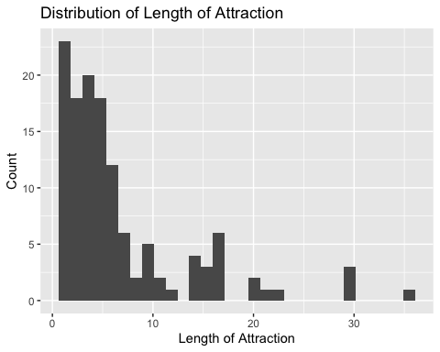
Appendix

Slide 11
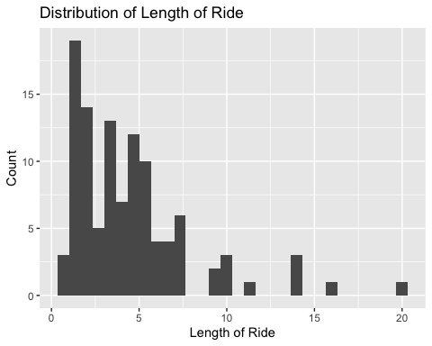
Appendix

Slide 12
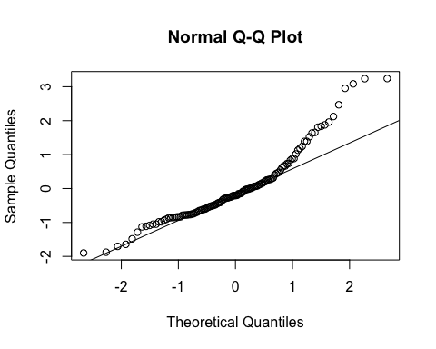
Appendix

Slide 13
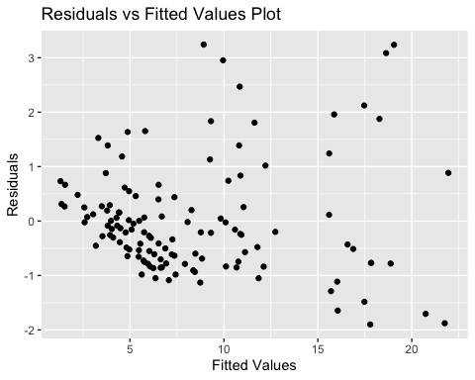
Appendix

Slide 14
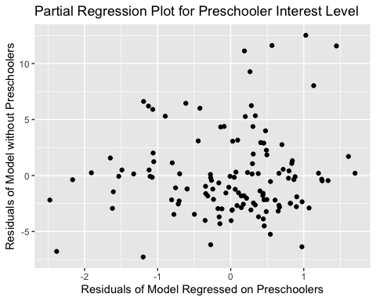
Appendix

Slide 15
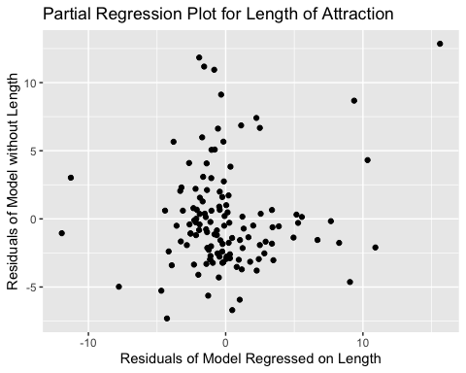
Appendix

Slide 16
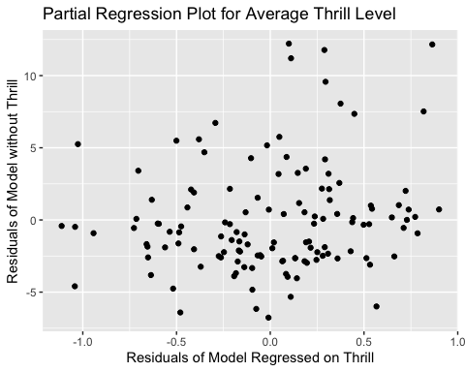
Appendix

Slide 17
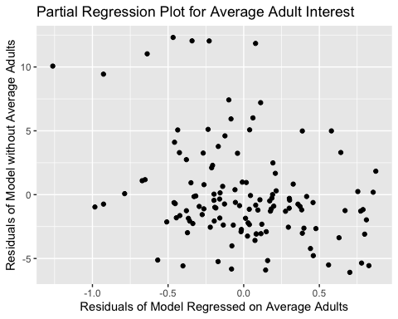
Appendix

