Slide 1
Credit Limit
Prediction
30,000
CUSTOMERS ANALYSED
credit card holders
25
What determines how much credit limit a bank gives?
DATA POINTS PER CUSTOMER IN THE CSV
financial behaviour signals
Dataset: 30,000 credit card customers
Goal: Build a model that predicts credit limits
Result: Model explains 47% of variation in limits
0.47
MODEL ACCURACY (R²)

Slide 2
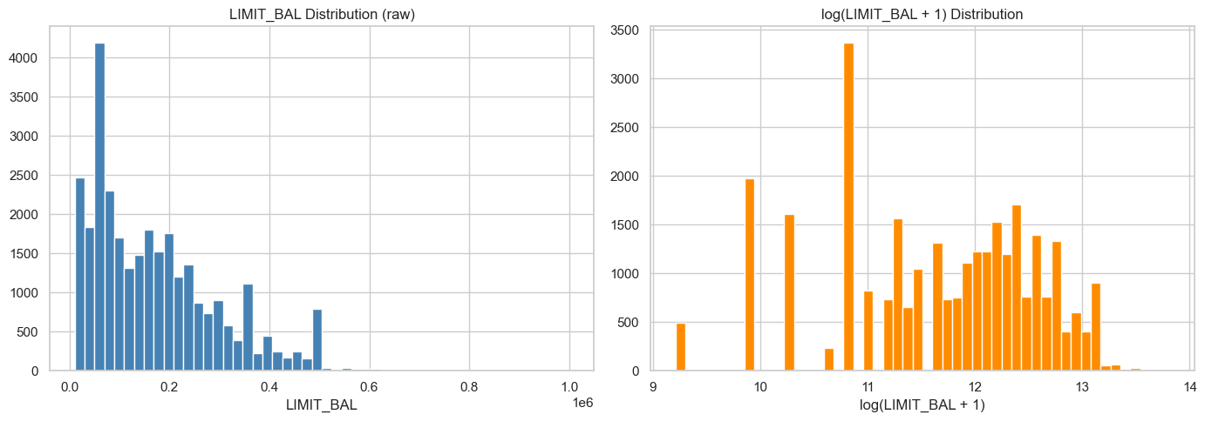
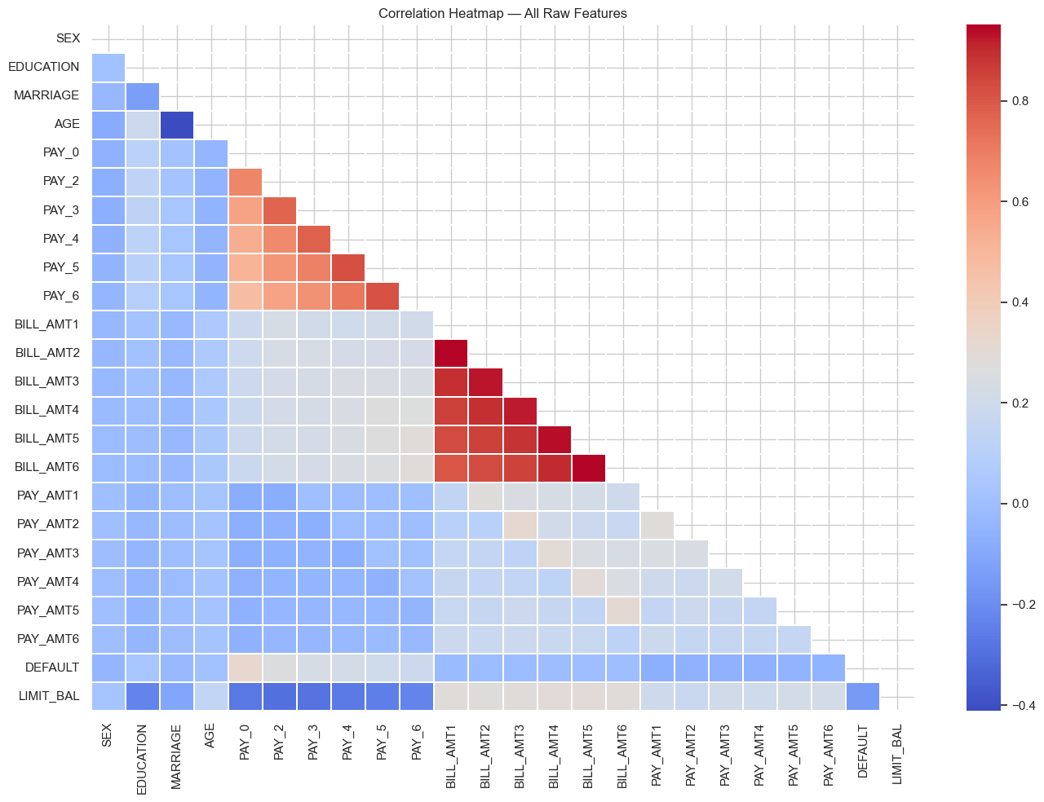
How Are Credit Limits Spread Across Customers?
Understanding the shape of our target variable before building the model
Credit Limit Distribution
Feature Correlation Heatmap
📊 What this tells us
Most customers have limits below ₹200,000. A small group has very high limits — creating a skewed, uneven distribution.
Impact on model:
We applied a log transformation to make the data more balanced, which helps the model learn patterns more accurately.
📊 What this tells us
No single factor strongly predicts a customer's limit on its own. The information is spread across many variables.
Impact on model: We had to combine multiple signals together rather than relying on any one factor.

Slide 3
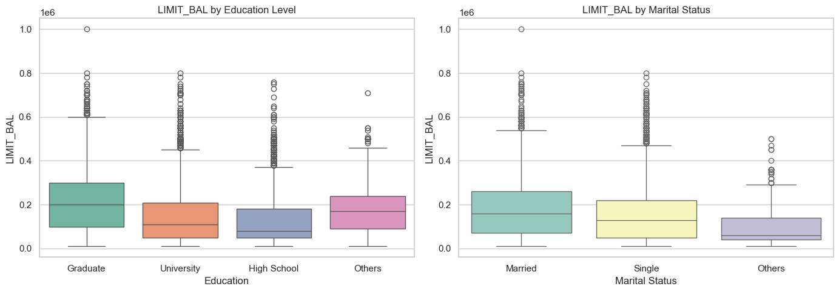
Does Education Level Affect Your Credit Limit?
Comparing credit limits across education and marital status groups
🎓 Graduates get more credit
💡 Marital status has some effect
⚙️ Impact on the model
Customers with graduate-school education have noticeably higher credit limits on average. Banks associate higher education with higher earning potential and lower risk.
Single customers tend to have slightly higher limits than married ones though the difference is smaller than education. This may reflect age or income patterns.
Education was included using a technique that avoids assuming 'graduate = 3 times better than high school.' The model treats each group fairly and independently.

Slide 4
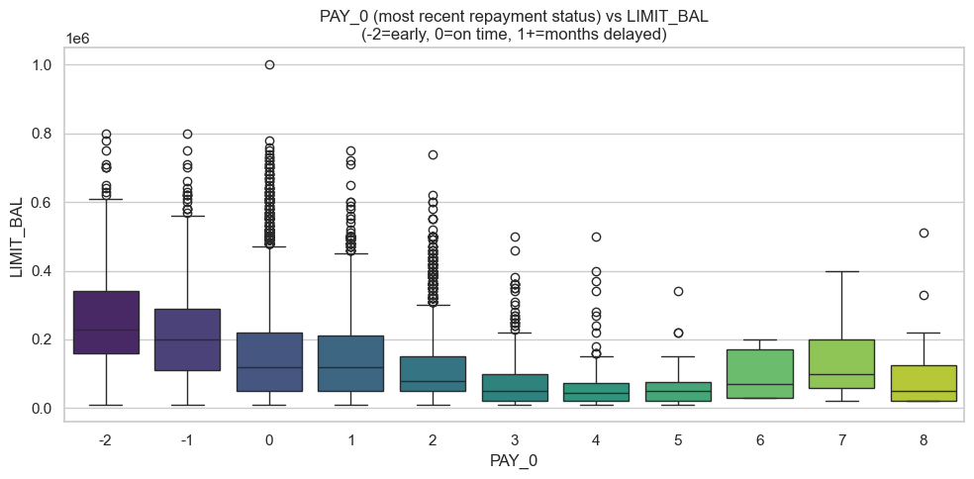
Does Missing a Payment Hurt Credit Limit?
How recent repayment behaviour relates to the credit limit a customer receives
✅ On-time payers are rewarded
⚠️ Even one missed payment hurts
⚙️ Impact on the model
Customers who pay early (-2) or on time (0) consistently receive the highest credit limits. Banks reward reliable behaviour.
As soon as a customer delays by even 1 month, their typical credit limit drops sharply. The penalty increases with each additional month of delay.
We created a 'Payment Behaviour Score' that summarises 6 months of payment history into a single number — one of the most powerful features in the final model.

Slide 5
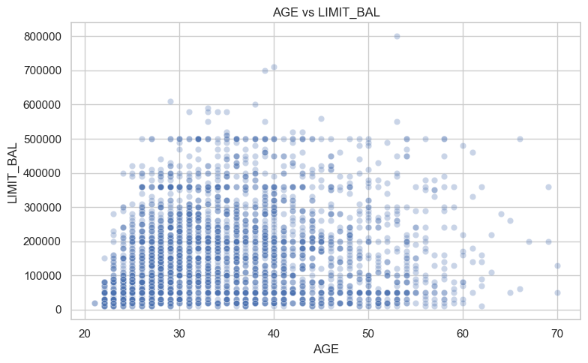
Does Age Play a Role in Credit Limits?
Exploring how age relates to the limit a customer receives — and why it's not a straight line
Age vs Credit Limit
📈 Limits grow in your 30s
Customers in their 30s and early 40s tend to carry higher limits. This likely reflects rising incomes and longer credit histories.
📉 Growth slows after 50
The relationship flattens for older customers. A simple straight-line model would miss this — limits don't keep rising with age forever.
⚙️ Impact on the model
We added Age² (age squared) so the model could capture this curve — rising limits in younger years, levelling off later. This improved accuracy.

Slide 6
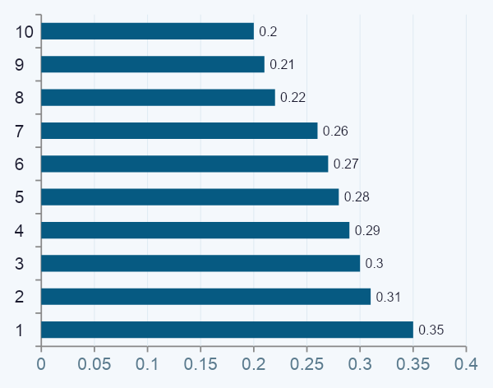
Exploratory Data Analysis - Summary
Key patterns discovered in the raw dataset
1
Education & Limits
Top Feature Correlations with LIMIT_BAL
Graduate-school holders receive systematically higher credit limits than university or high-school-educated customers. Education is a meaningful signal.
2
Payment Delays Matter
Customers with PAY_0 = +1 or +2 (months delayed) show noticeably lower limits. Banks penalise even a single missed payment.
3
Age Has Diminishing Returns
Older customers tend to have higher limits, but the relationship is nonlinear. AGE² was added to capture this curvature.
4
Bill Size as Proxy for Income
AVG_BILL correlates ~0.28 with LIMIT_BAL, suggesting banks use spending behaviour as an income proxy when setting limits.

Slide 7
The Core Challenge
Why predicting LIMIT_BAL is hard — and how we overcame it
1
2
3
No Strong Single Predictor
Distributed Signal
Skewed, Discrete Target
The highest individual feature correlation with LIMIT_BAL is only ~0.30 (PAY columns). Raw features alone top out at R² = 0.36.
Information is spread thin across 6 months each of PAY, BILL_AMT, and PAY_AMT columns. Individual columns are weak; combined they are powerful.
LIMIT_BAL clusters at round multiples of 10,000 and is right-skewed, adding structural noise to regression predictions.

Slide 8
Feature Engineering Strategy
Six layers of engineered features transformed a weak raw dataset into a predictive model
①
②
③
Bill & Payment Aggregates
Payment Ratios
Log Transforms
AVG_BILL, MAX_BILL, TOTAL_BILL, AVG_PAID, TOTAL_PAID, BILL_TREND — compressed 6 months into summary statistics.
Per-month payment-to-bill ratios (RATIO_1–6), AVG_UTIL, TOTAL_UTIL — how much of each bill was actually paid back.
log1p applied to all 6 PAY_AMT columns to linearise the heavy right-skew from occasional large lump-sum payments.
④
⑤
⑥
AGE Nonlinearity
Calculated Credit Score
Polynomial Degree-2
AGE² added to capture the diminishing returns of age on credit limits — the relationship flattens after ~40.
A 0–100 score: 50% from repayment behaviour (prompt vs. delayed), 50% from average payment-to-bill ratio.
Degree-2 expansion on 16 key features (153 terms). This single step added +0.04 R² — the largest gain in the pipeline.

Slide 9
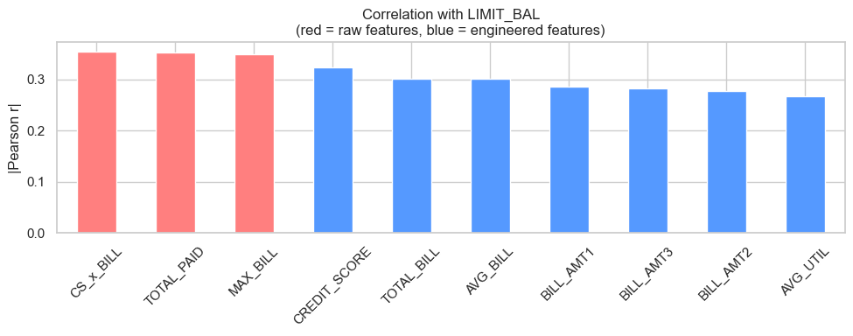
Building Better Signals from Raw Data
How combining raw data points into smarter features dramatically improved our model
Raw vs Engineered Feature Strength
🔴 Raw data alone isn't enough
Red = original data columns · Blue = features we created
Individual monthly billing columns (BILL_AMT1, BILL_AMT2...) each had weak relationships with credit limits. No single month tells the full story.
🔵 Combined signals are much stronger
When we combined spending across all 6 months (CS×BILL, TOTAL_PAID, MAX_BILL), those new features became the strongest predictors in the model.
⚙️ Impact on the model
Feature engineering lifted model accuracy from R² = 0.36 to 0.47 — a 30% relative improvement. The engineered features, not the raw data, drive most of the model's predictive power.

Slide 10
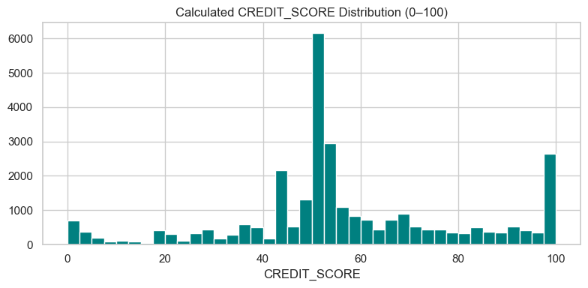
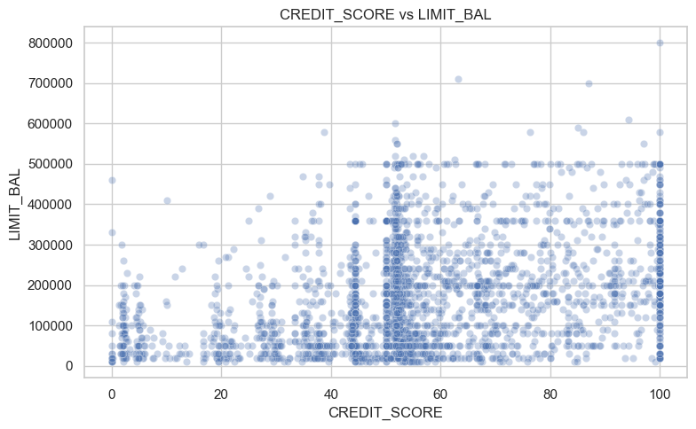
Custom Credit Score: Summarising Payment Behaviour
A 0–100 score that summarises 6 months of payment behaviour — created specifically for this model
Credit Score = 50 points from payment history + 50 points from how much of each bill was paid back
Score Distribution
Score vs Credit Limit
📊 Most score in the middle
📈 Higher score = higher limit
⚙️ Impact on the model
Spikes at 0 and 100 = extreme cases (habitual late payers vs. perfect payers). Most cluster around 40–60.
Customers who score well tend to have higher limits. Not perfect, but the trend is clear.
This score, combined with average spending, became the strongest predictor — beating every original data column.

Slide 11
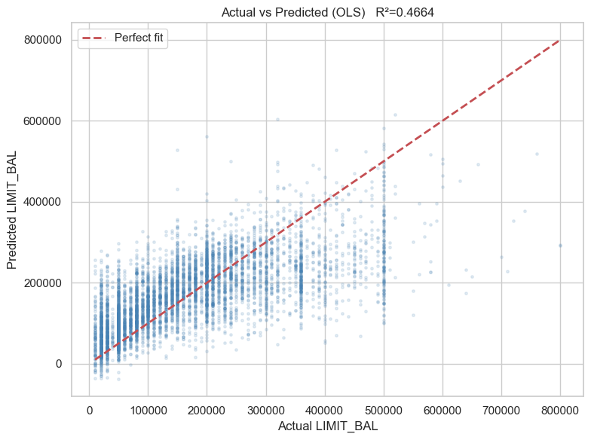
How Well Does the Model Predict Credit Limits?
OLS Linear Regression results — each dot is one customer's actual vs. predicted limit
Model Accuracy (R²)
Consistency (CV R²)
Avg Prediction Error
Typical Error (MAE)
0.47
0.46 ± 0.01
~₹92,000
~₹67,000
Stable across all test groups
RMSE on unseen customers
Most predictions within this range
Actual vs Predicted Credit Limit
🎯 The diagonal line = perfect accuracy
Points closer to the red dashed line are accurate predictions. Most low-to-mid range customers are predicted well.
📐 High limits are harder to predict
At very high limits (above ₹500,000), the spread widens. This is expected — high earners have more unique circumstances.
✅ R²
An R² of 0.47 means the model explains 47% of why customers have different limits

Slide 12
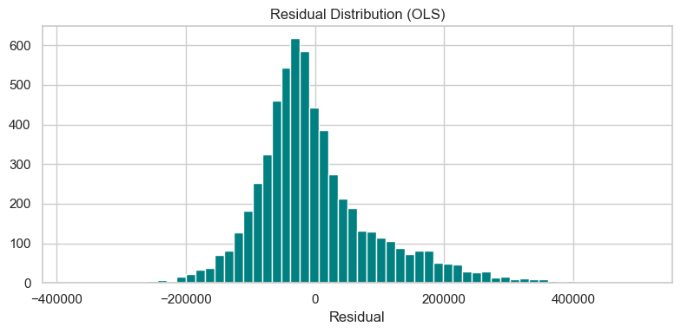
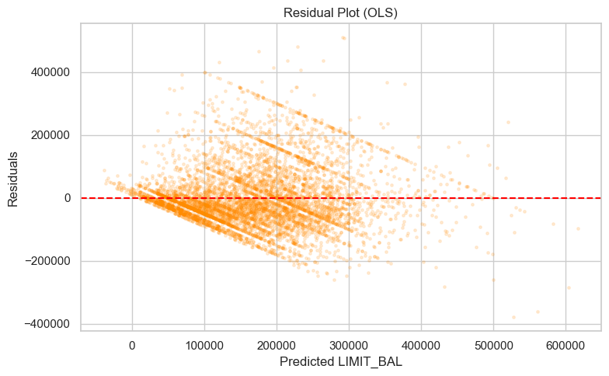
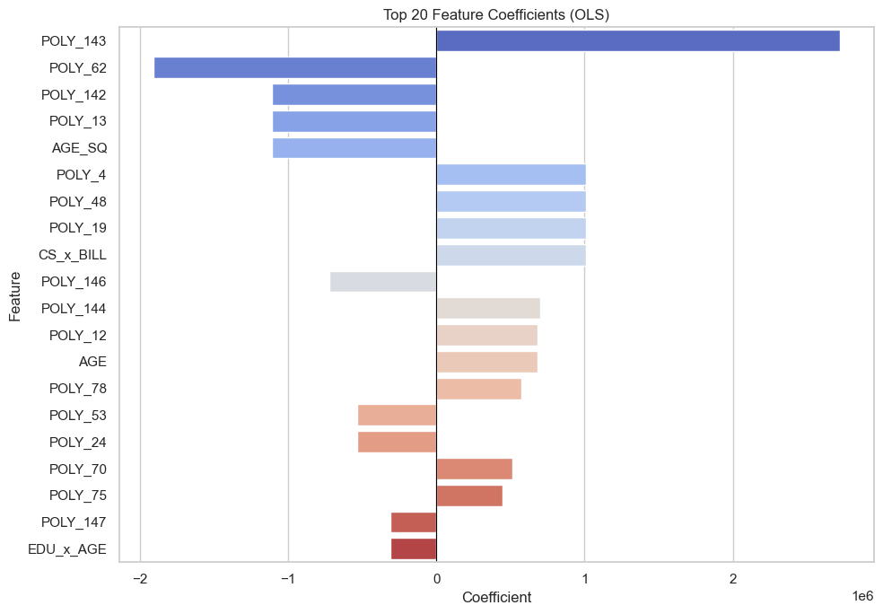
Where Does the Model Struggle?
Analysing prediction errors to understand the model's limitations and what could improve it
Prediction Errors by Estimated Limit
Error Distribution
Each dot = one customer. Points above the line = model underestimated. Below = overestimated.
Top Factors in the Model

