Slide 1



NEISS 2024 Injury Analysis
DAB304 Healthcare Analytics
Professor: A. Sodiq Shofoluwe
Ameenat Ali · Foluso Ojo · Gurpreet Kaur · Pei-Ru Chen

Slide 2

Hospital admission is a proxy for injury severity
— but what drives it?
Understanding which patient and incident characteristics predict hospital admission helps clinicians prioritize triage, allocate resources, and intervene early.

Slide 3


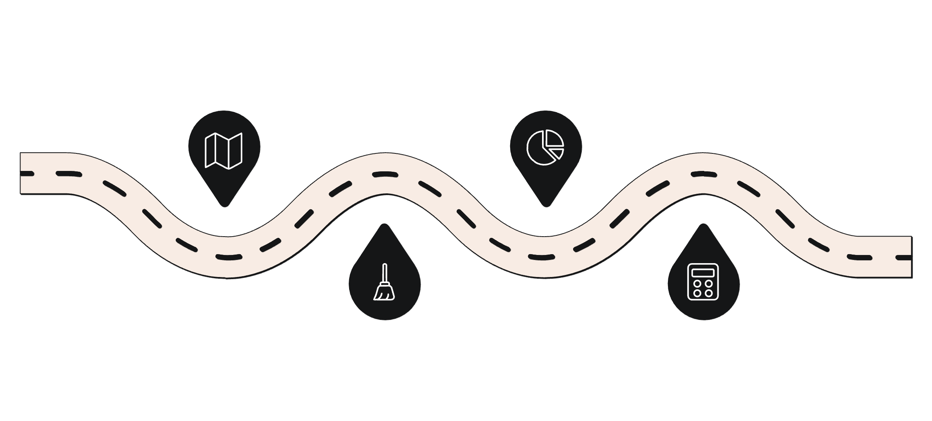


Project Overview
Objective
Identify factors linked to hospital admission after ED injury visits.
Data
2024 NEISS dataset — a nationally representative sample of emergency department injury visits across the United States.
Analytical Pipeline
Overview
EDA
Model
Project goals and dataset summary
Explore distributions and key patterns
Support early risk detection
Data Cleaning
Statistical Analysis
APP
Prepare and standardize NEISS records
Catch high-risk patients
Assess factors linked to admission

Slide 4
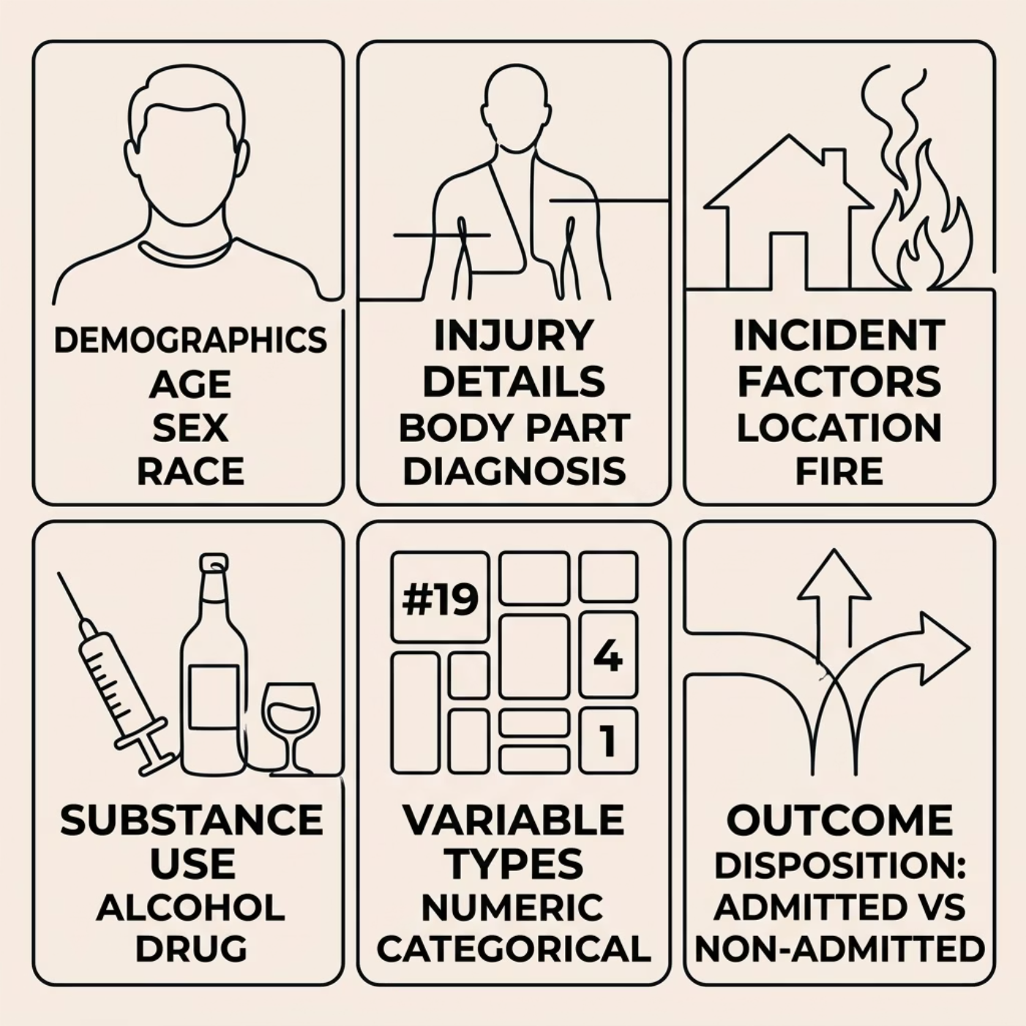

Data Overview
Sample
361,672 ED injury cases from the National Electronic Injury Surveillance System (NEISS), with 25 variables spanning demographics, injury type, incident context, and outcome.
Outcome Variable
Disposition: admitted vs. non-admitted serves as the binary target for all statistical and predictive analyses.

Slide 5
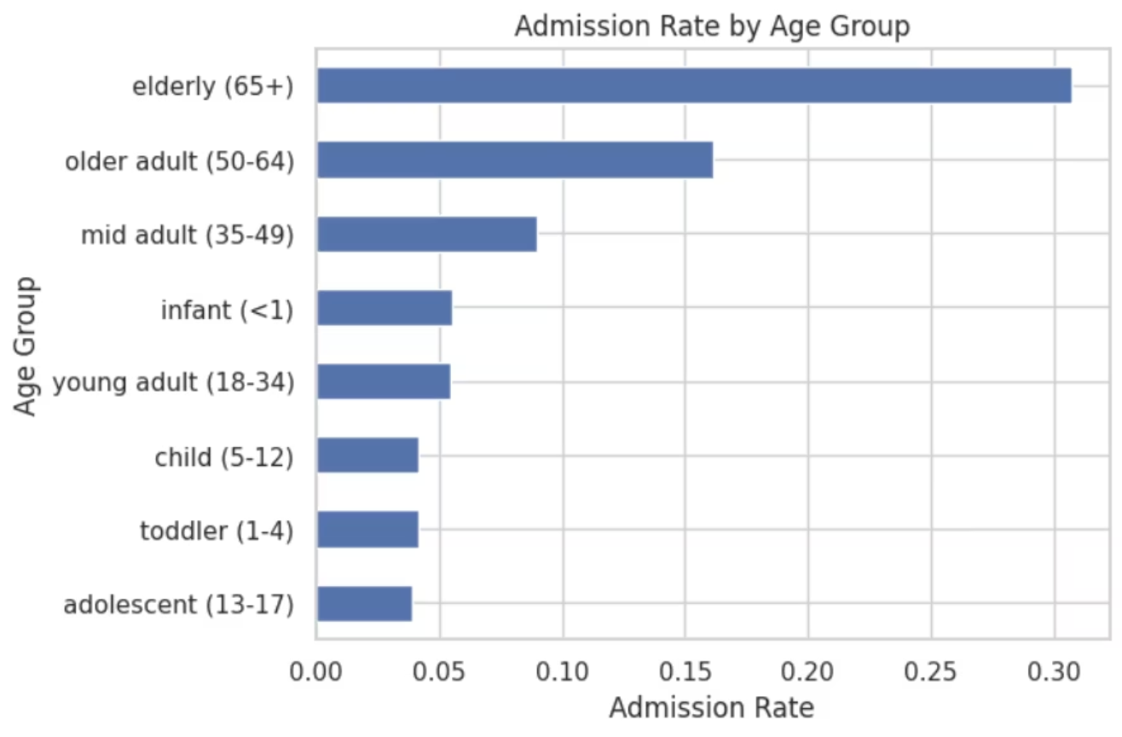
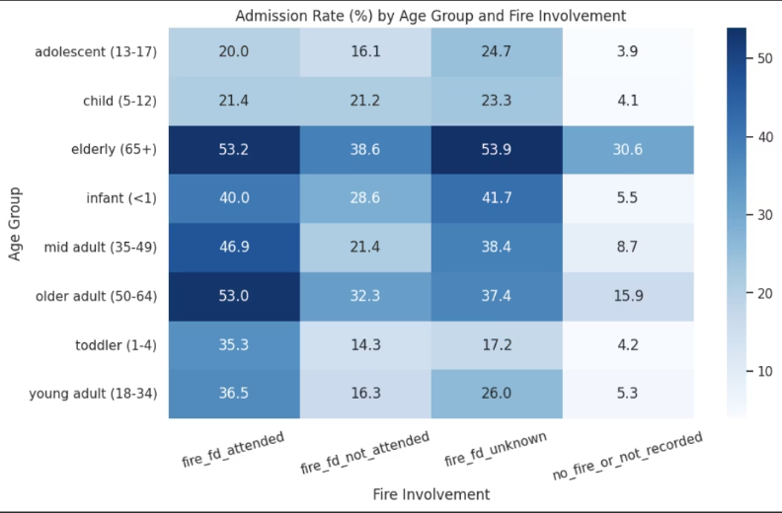
Exploratory Data Analysis
Age Effect
Fire Involvement
Admission rates rise sharply with age — patients 65+ show the highest rates, exceeding 30%.
Fire-attended cases correlate with substantially elevated admission risk across all age groups.
Injury Severity
Weak Predictors
Injuries affecting large body areas are strong predictors of admission over minor localized injuries.
Sex, race, ethnicity, and substance use showed minimal independent effect on admission outcome.

Slide 6
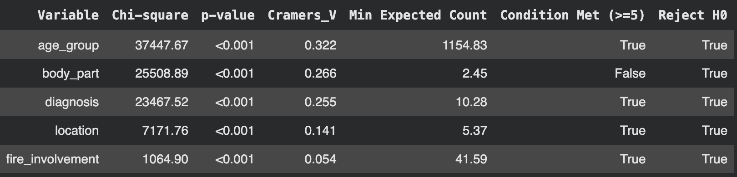

Hypothesis Testing
Numerical — T-test
Categorical — Chi-square
Age differed significantly between admitted and non-admitted patients (p < 0.001), with a large effect size (Cohen's d ≈ 1.00), confirming age as a clinically meaningful predictor.
All categorical variables were statistically significant. The strongest associations were with age group (Cramér's V = 0.322), body part (V = 0.266), and diagnosis (V = 0.255).

Slide 7

Logistic Regression
Age Is the Dominant Predictor
9.3×
#1
Higher Odds — Elderly
Top Predictor
Patients aged 65+ are 9.3× more likely to be admitted.
Age is the strongest driver of hospital admission.
Secondary factors: including injury body part, diagnosis.
Location & fire involvement: contributed meaningful but smaller effects.
Admission risk is primarily driven by age and injury severity, not other demographic or substance use variables.
Notes:
Age is the strongest predictor in our model. Elderly patients are about 9 times more likely to be admitted.
Overall, admission is primarily driven by age and injury severity.

Slide 8
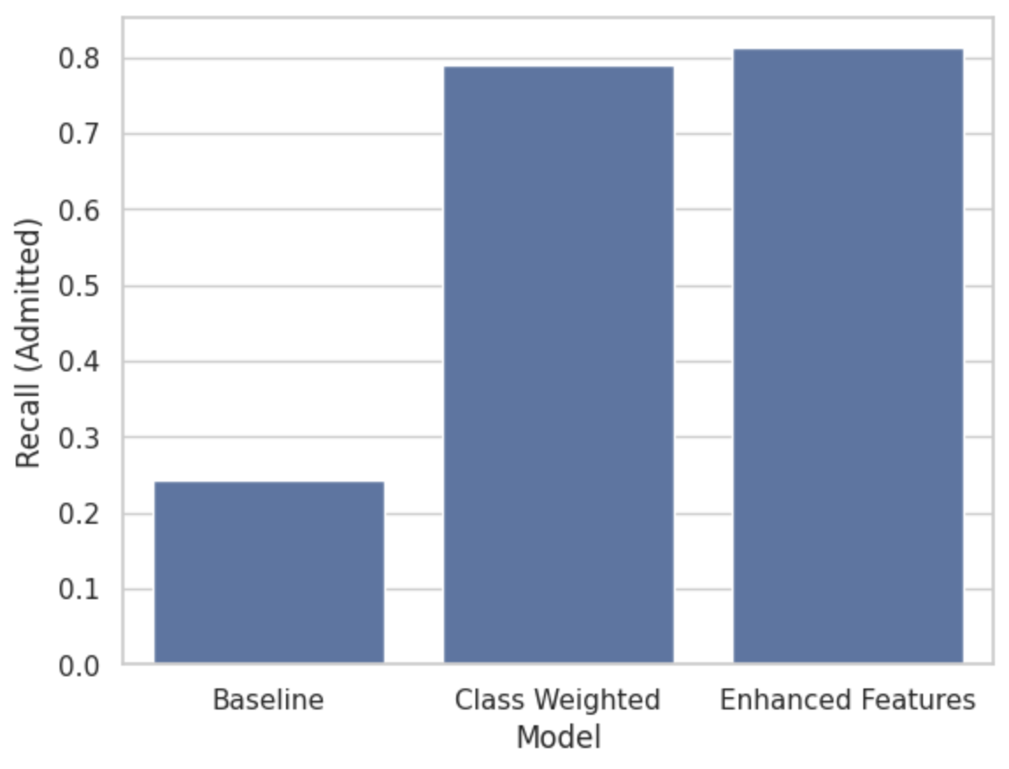
Model Performance
Recall (Admitted): 0.24
Baseline model fails to capture admitted cases.
Recall (Admitted): 0.79 -> 0.81
Class weighting dramatically improves recall.
Final model prioritizes high-risk detection.
Precision Trade-off
Low precision (0.30) is an acceptable trade-off when the goal is to catch high-risk patients and avoid missed admissions.
Model | Recall (Admitted) | ROC-AUC
Baseline | 0.2422 | 0.8487
Class Weighted | 0.7904 | 0.8505
Enhanced Features | 0.8127 | 0.8562
Notes:
Our baseline model failed to capture admitted cases, with recall only at 24%.
After applying class weighting, recall improved significantly to 79%. With enhanced features, it further increased to 81%.
This shows that both imbalance handling and feature engineering are effective. This reflects a deliberate trade-off between precision and recall, prioritizing high-risk detection.
However, precision dropped to 30%, indicating more false positives. In healthcare, this trade-off is acceptable,
because missing high-risk patients is more critical than over-predicting.

Slide 9
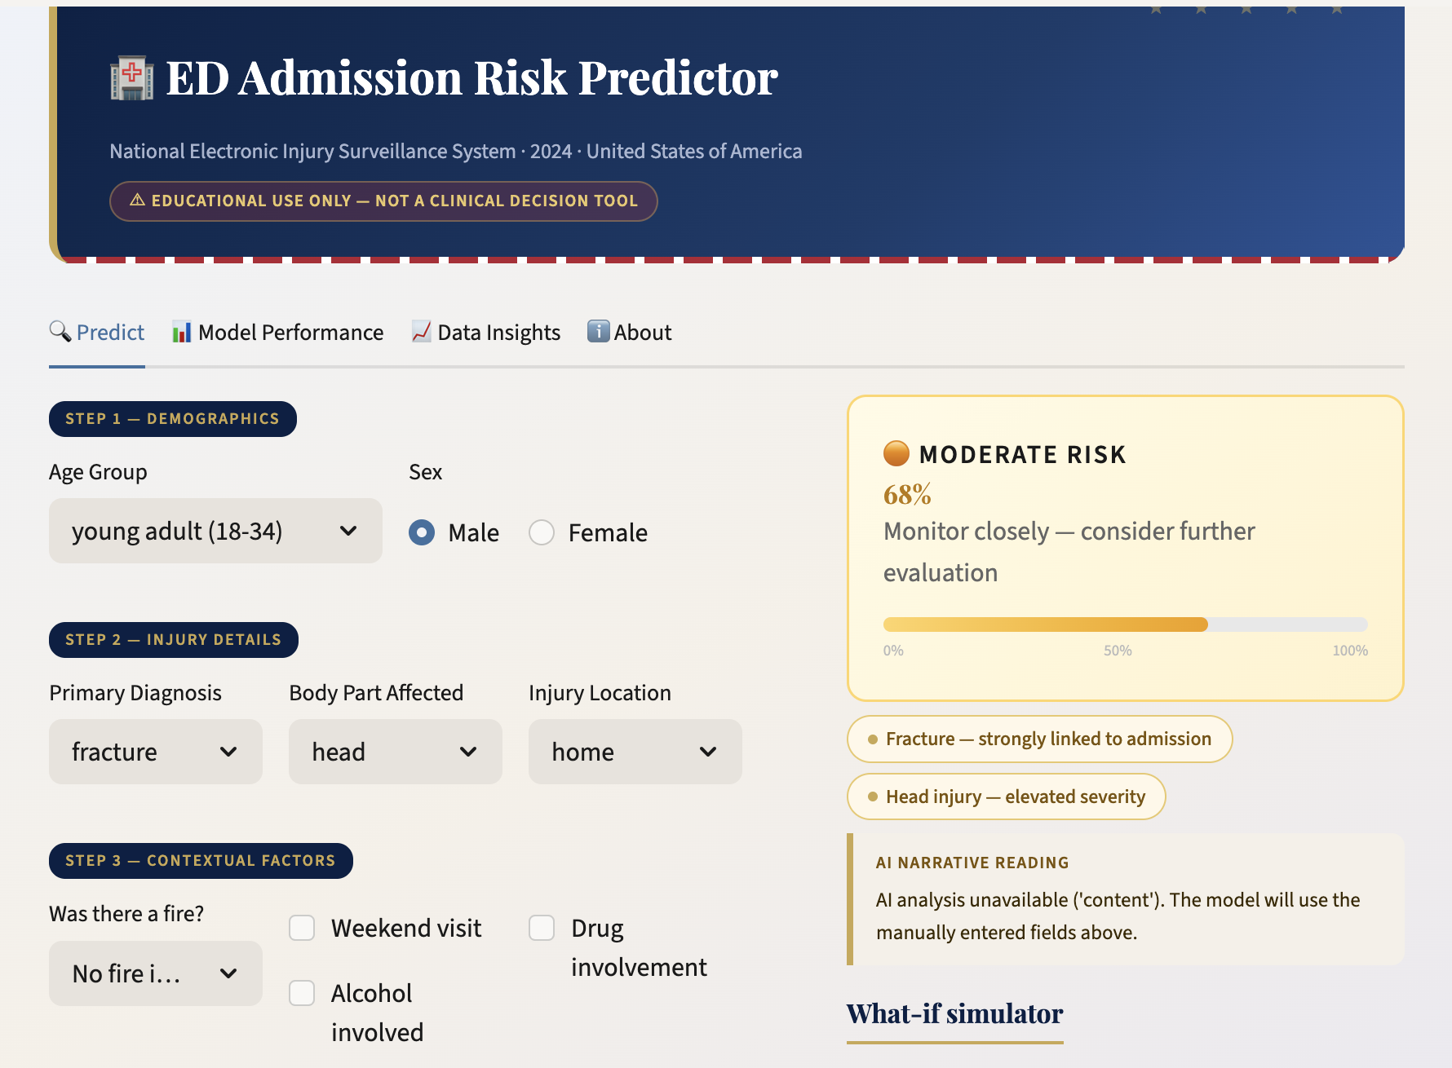
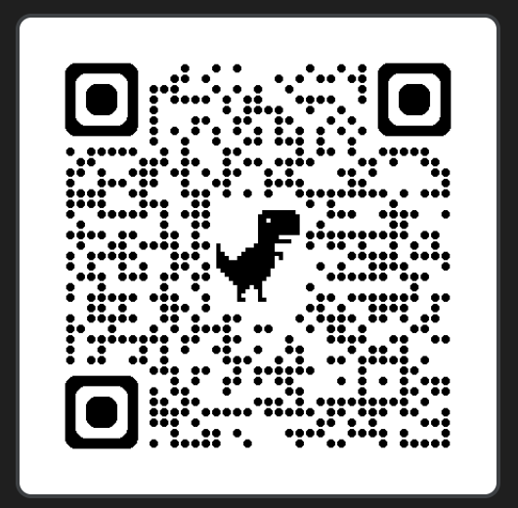
From Model to Clinical Tool
https://neiss2024injuryanalysis-ed-admission-risk-predictor.streamlit.app/

Slide 10

Conclusion
Age Dominates Risk
Age is the strongest predictor of admission risk.
Injury Characteristics Matter
Injury characteristics provide additional predictive power.
Model Supports Early Detection
Model enables early identification of high-risk patients.
Notes:
Age is the strongest predictor of admission risk, with elderly patients having over 9 times higher odds of being admitted.
Injury characteristics such as body part and diagnosis further contribute to understanding admission risk.
Finally, our model achieves strong performance with high recall, allowing early identification of high-risk patients.
This aligns well with real-world healthcare priorities,
where missing high-risk patients must be minimized.

Slide 11
Future Recommendation
1
Enhance narrative features using NLP
Extract clinically meaningful signals from injury narratives, such as indicators of severity (e.g., loss of consciousness, severe bleeding).
2
Incorporate patient health conditions
Integrate comorbidity data (e.g., diabetes, cardiovascular disease) to improve prediction of admission risk.
3
Improve model precision
Optimize the balance between recall and precision through threshold tuning and resampling techniques.
4
Deploy as a clinical decision support tool
Extend the current prototype into a real-time triage support system to assist emergency departments in early admission decisions.
Notes:
Future improvements include enhancing narrative features using NLP,
incorporating patient health conditions,
improving model precision,
and deploying the model as a real-time clinical decision tool.

Slide 12


Thank you

