Slide 1

Sequential Clinical Trials
Aaron Mendonca | Pearlyn Rodrigues

Slide 2

Objectives
To define sequential clinical trials
Traditional Clinical Trials v/s Sequential Clinical Trials
To solve a Numerical Example
To Simulate a trial in Python
Our Inference and conclusions

Slide 3

What are sequential clinical trials?
•Sequential clinical trials are a type of clinical trial design where patient enrollment occurs in stages and interim analyses are performed to determine whether the trial should continue or be stopped early.
Interim analyses - in clinical trials are like checkpoints during a long journey where the researchers take a break and look at the data they have collected so far. They check to see if the treatment they are testing is working well, if it's safe, or if it's not worth continuing the trial.

Slide 4
How is it different from a normal clinical trial?
Traditional Clinical Trials
Sequential Clinical Trials
Fixed sample size is determined upfront.
Patients are randomized and followed for the duration of the study.
There is only one final analysis at the end of the study.
No interim analyses are performed to modify the trial during its course.
Can be less flexible if the treatment is not effective or if there are safety concerns.
Can be more straightforward to design and analyze than sequential trials.
Patients are enrolled in stages.
Interim analyses are conducted after each stage to determine whether the trial should continue or be modified.
Sample size and treatment assignments may be modified during the trial.
May be more efficient because they can stop early if the treatment is found to be ineffective or harmful, or they can enroll more patients if the treatment appears promising.
Can be more complex to design and analyze than traditional trials.

Slide 5

P = [ 0.7833 0.2167
0.33 0.67]
Next, we need to apply P to the initial state vector [0, 1]:
After 1st trial: [0.7833*0 + 0.2167*1, 0.33*0 + 0.67*1] = [0.2167, 0.67]
Then, we need to apply P again to the resulting vector:
After 2nd trial: [0.78330.2167 + 0.21670.67, 0.330.2167 + 0.670.67] = [0.2881, 0.7119]
Therefore, after 2 trials, approximately 28.81% of people are in stage 0, and approximately 71.19% of people are in stage 1.
P^10 = [0.524476 0.475524; 0.524476 0.475524]
After 10 stages: [0.5245, 0.4755]

Slide 6

Simulation to compare sequential clinical trials and traditional trials

Slide 7
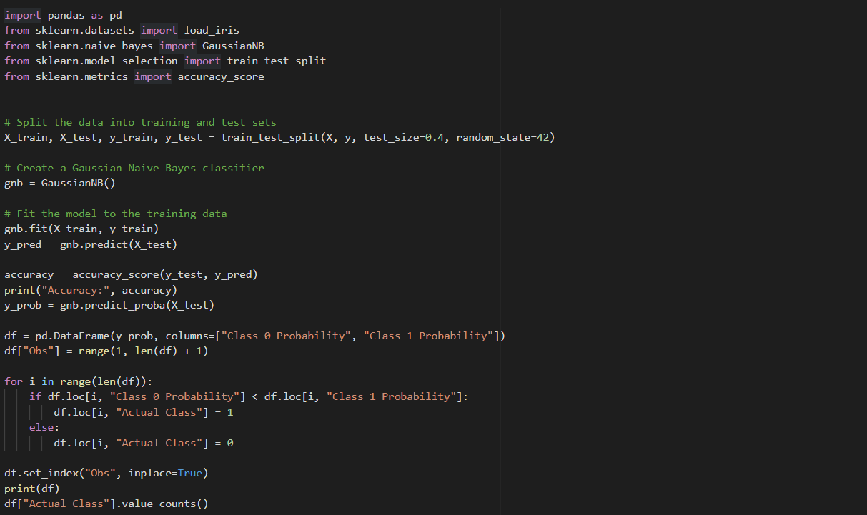

Slide 8
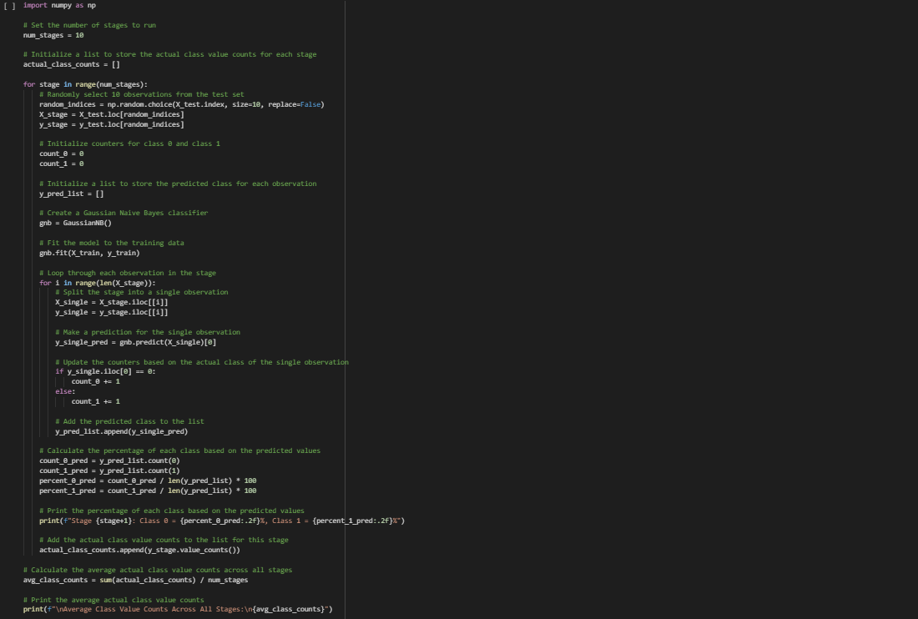

Slide 9
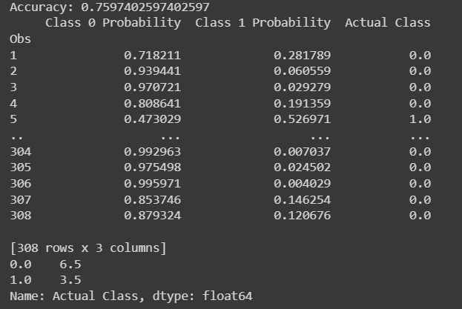
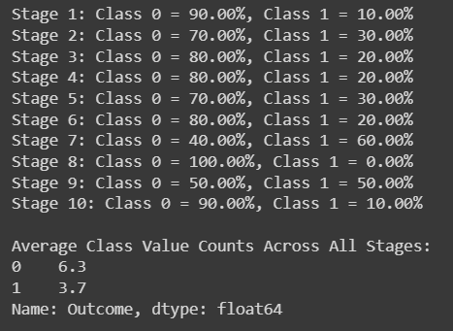
Traditional Clinical Triall
Sequential Clinical Trial
As we can observe, the percentage of Class 0 probabilty for both Traditional and Sequential Trials are almost the same

Slide 10
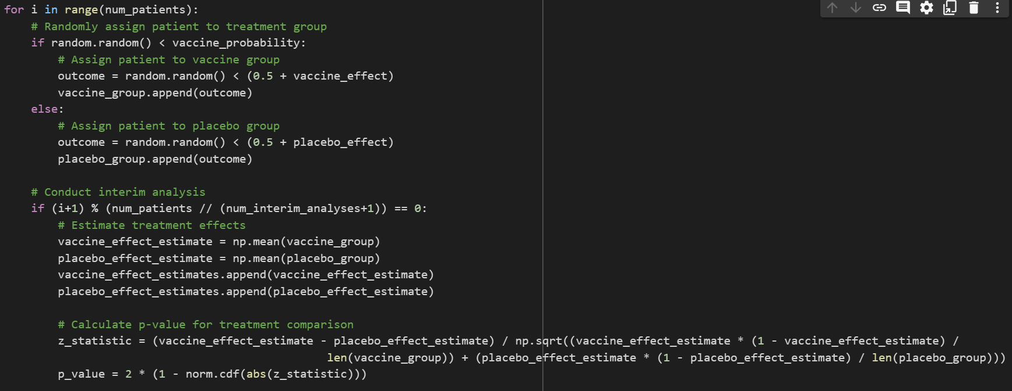

Slide 11
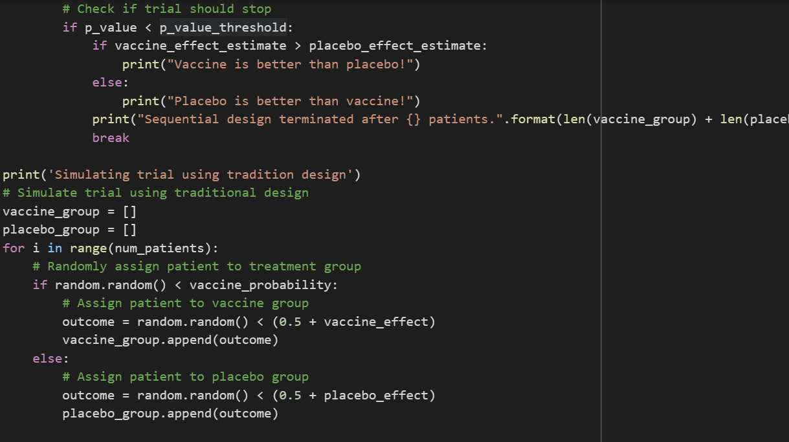

Slide 12
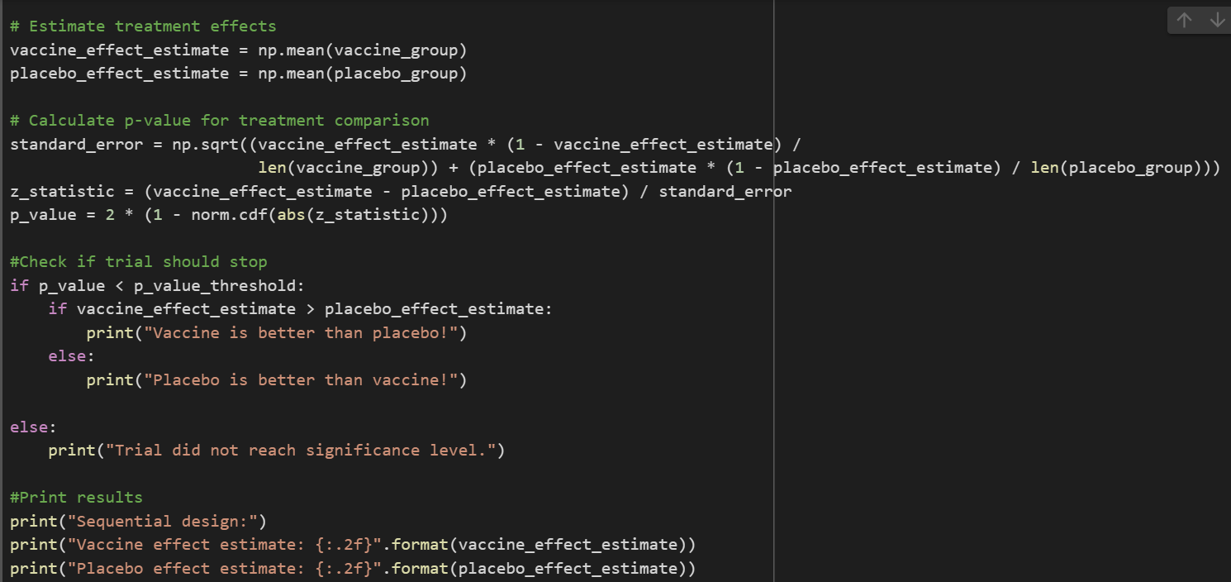

Slide 13
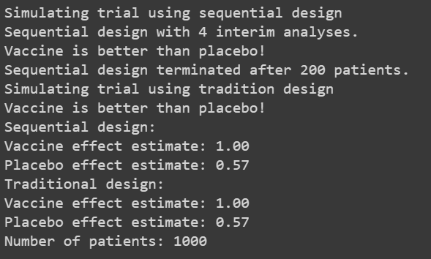
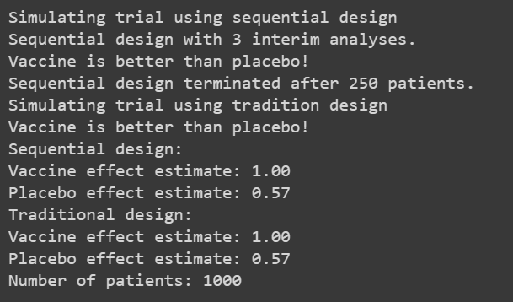
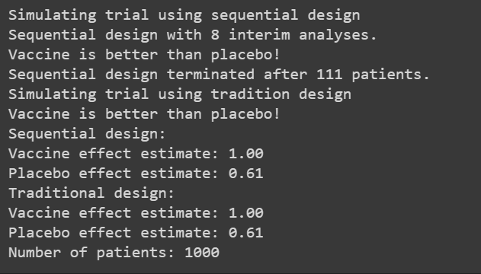

Slide 14

How can we improve?
Bootstrapping
Adaptive designs
Bayesian methods
Data monitoring committees

Slide 15

Inferences
A disadvantage of sequential trials is the estimated magnitude of the treatment effect is slightly less accurate than that of conventional fixed-sample-size trials.
Sequential trials allow for more efficient use of resources by allowing for interim analyses and stopping the trial early if the treatment effect is clear.
This can save time, money, and reduce the number of patients needed to complete the trial
The theoretical properties of sequential trials are confirmed by our simulations and make this trial design advantageous for many clinical trials in emergency medicine.

