Slide 1

EMPLOYEE ATTRITION ANALYSIS
- BY PEARLY MERIN PAUL (DDS ANALYTICS)

Slide 2


Agenda
Summary
Data Overview
Exploratory Data Analysis
Factors that Impact Attrition
Factors that lead to High Monthly Income
Predicting Employee Monthly Income/Employee Attrition

Slide 3
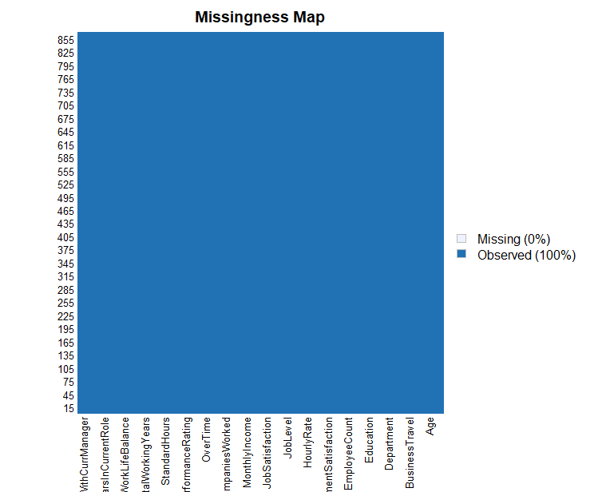
DATA OVERVIEW
Our firm DDS Analytics were provided with 3 datasheets for this task.
Sheet 1 : CaseStudy.csv
36 Features of 870 Employees with no data was missing. Our Goal here was to do EDA on the data and produce useful insights.
Sheet 2: CaseStudy2CompSet No Attrition.csv
35 Features of 270 employees. Our Goal predict attrition of the employee based on the provided features
Sheet 3: CaseStudy2CompSet No Salary.csv
Monthly Income data missing. Our Goal predict Salary of the employee based on the provided features

Slide 4
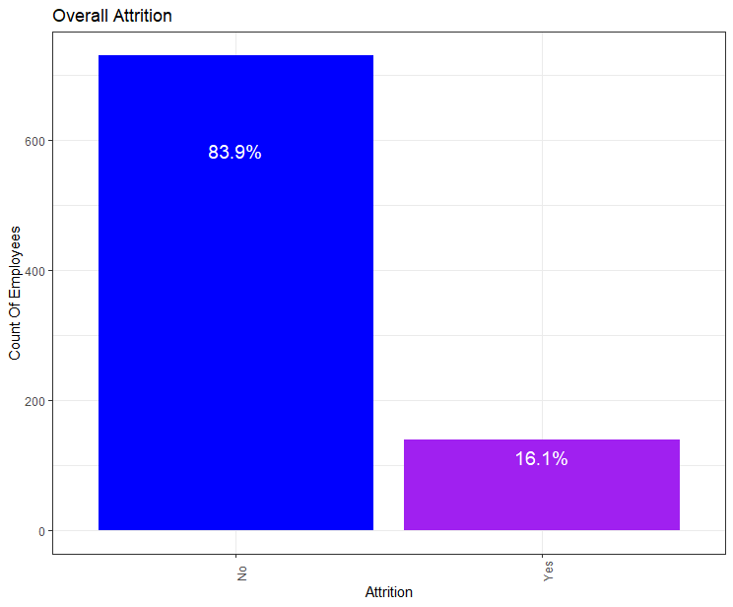
Overall Attrition

Slide 5
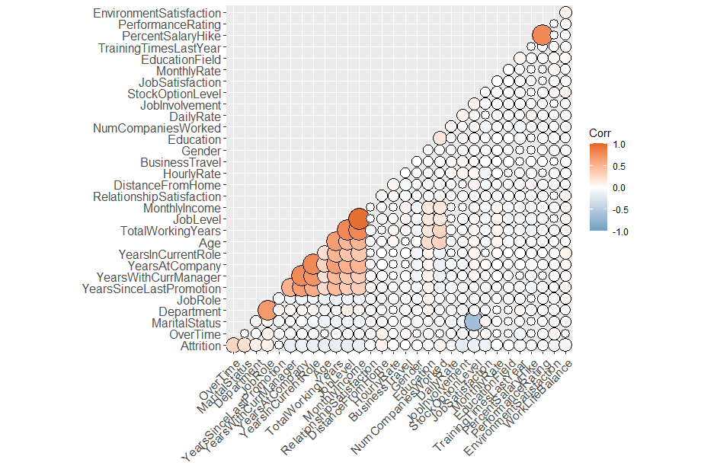
TOP FACTORS THAT IMPACT ATTRITION
Upon analyzing the data and p value of the features, we were able to find that the most influential factors that impact Attrition are the below :
Overtime
Stock level Options
Job Level

Slide 6
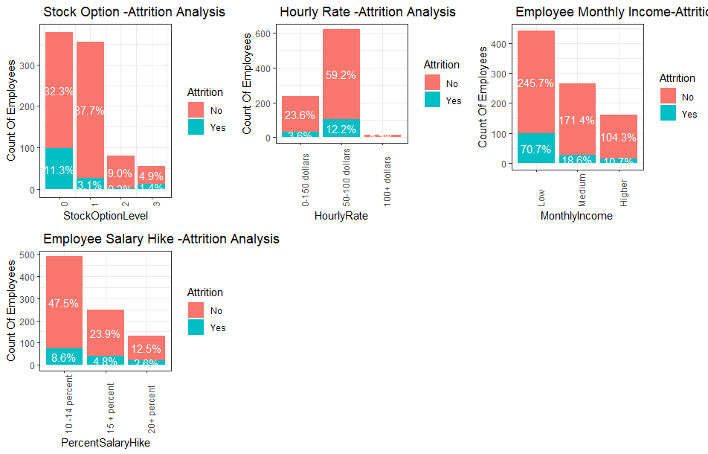
BENEFITS VS ATTRITION
Upon Analyzing the benefits received by the employee we can conclude:
Attrition is mostly observed in an employee who :
Receives No stock option benefits
Medium Hourly Rate
Very Low Monthly Income
Very Less Percentage of Salary Hike .

Slide 7
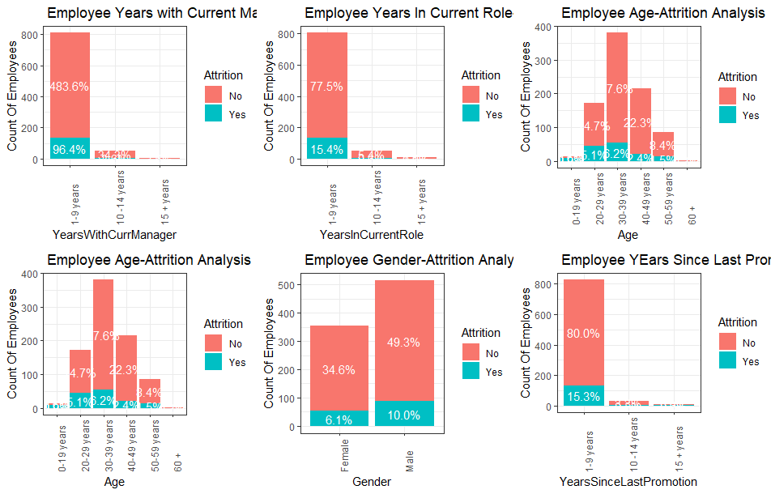
EMPLOYEE EXPERIENCE VS ATTRITION
Characteristics of Employee with highest Attrition Rate are below :
Employee who mostly falls in the Age group 30-39 years
Low experience in current Role and low overall working experience
Not Promoted for 1-9 years

Slide 8
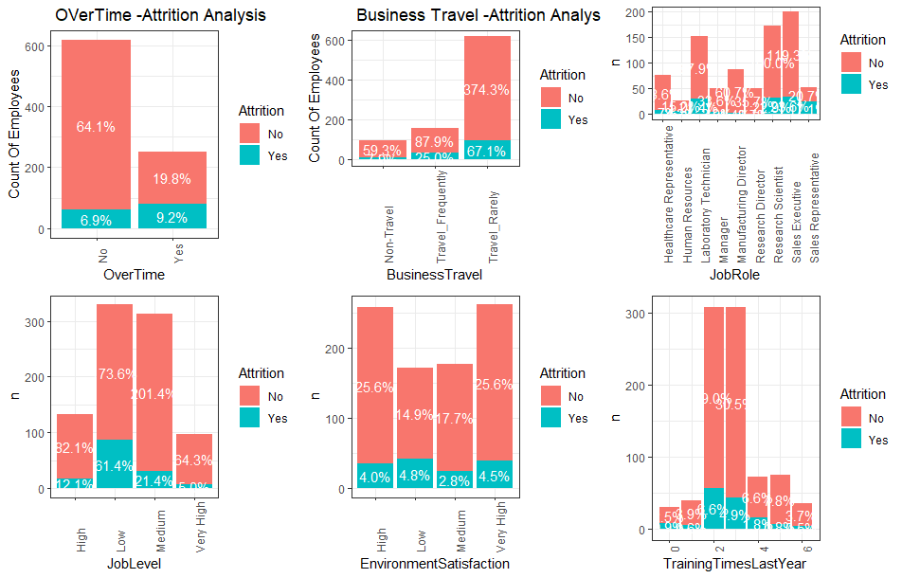
WORK ENVIRONMENT VS ATTRITION
With this analysis we can observe how work environment impacts Attrition. Employee with highest Attrition :
Employees who do a lot Overtime
Works as Sales Executive/Research Scientist
Low Environment Satisfaction
Low Job Level

Slide 9
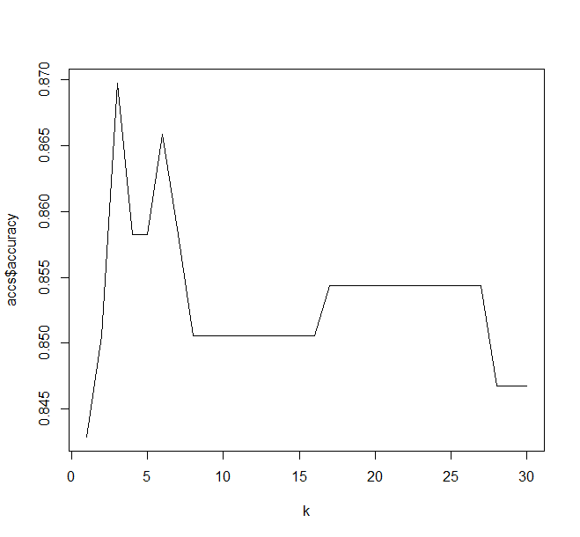
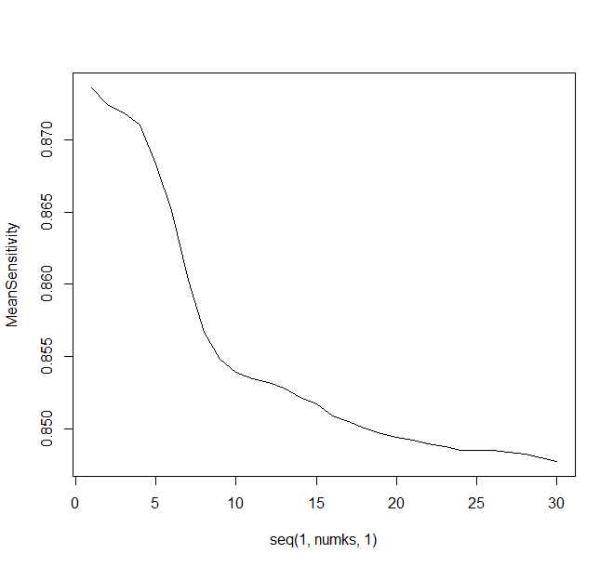
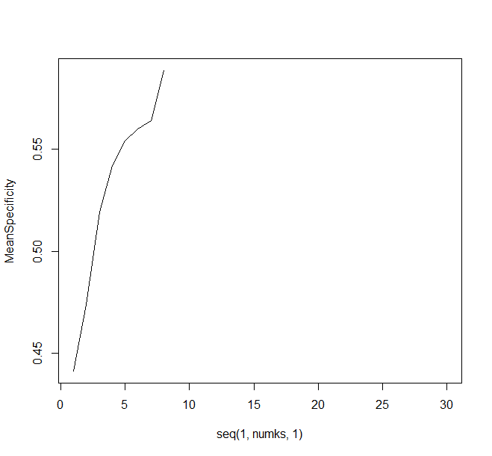
EMPLOYEE ATTRITION PREDICTION - 1
KNN MODEL
ACTUAL
NO
YES
Accuracy : 84%
Specificity : 89.07%
Sensitivity : 55.07%
NO
216
12
PREDICTION
YES
73
35
CONCLUSION: KNN – Model has very low Sensitivity and Specificity.
Hence this model cannot be used for predicting Attrition.
This model was very inaccurate to predict Attrition of the employee.

Slide 10
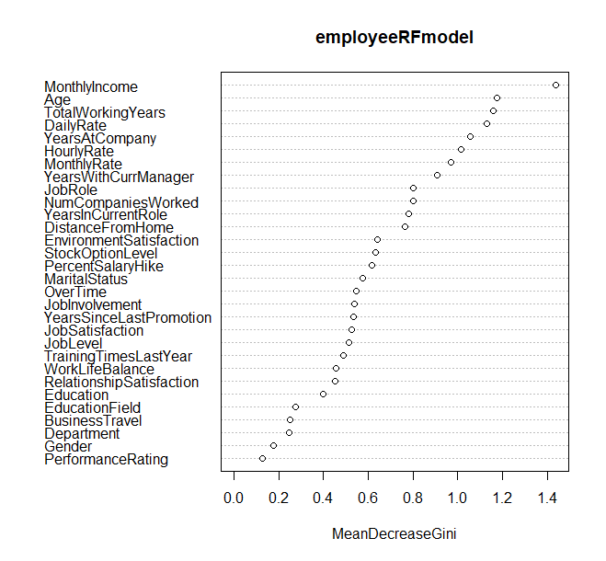
EMPLOYEE ATTRTION MODEL 2
RANDOM FORREST MODEL
ACTUAL
YES
NO
PREDICTION
YES
28
49
SAMPLE 1 :
Accuracy : 83.01%
Sensitivity : 60.465 %
Specificity : 83.486 %
NO
15
169
CONCLUSION : Upon analysis with multiple sample sizes, from which we can conclude by stating random Forest model is better for predicting Attrition.
Model has Specificity and Sensitivity above 60% for all sample sizes
Hence, we have used this model to predict Attrition for the 270 employees provided by Frito Lay.

Slide 11
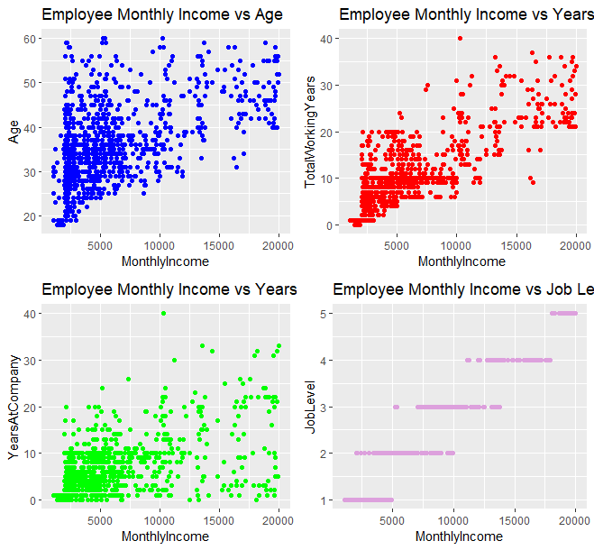
EMPLOYEE MONTHLY INCOME
Upon Analysis of the Correlation and significance of the features we are able to see that the below Features are positively Linear correlated to the monthly Income of the Employee:
Age
Total Working Years
Years in Company
Job Level

Slide 12
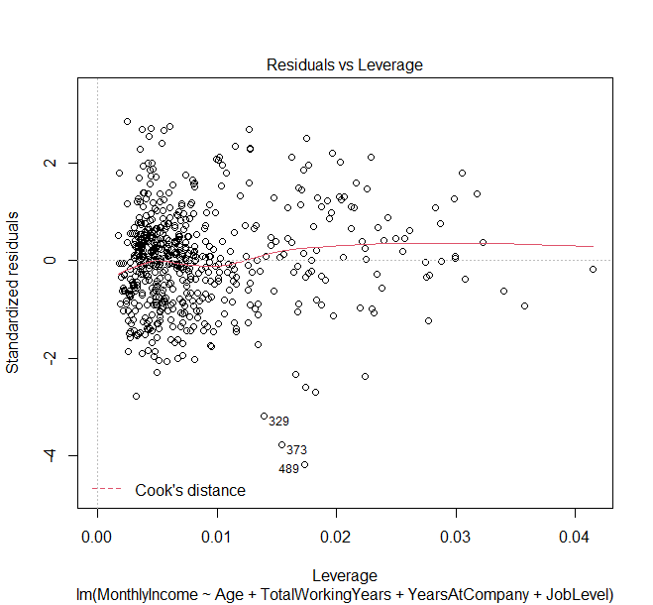

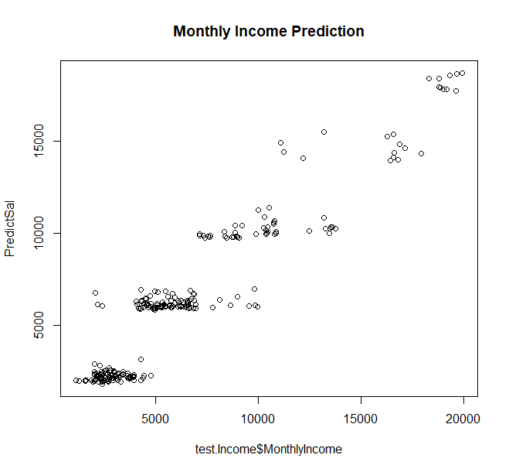
MONTHLY INCOME PREDICITON : LINEAR REGRESSION MODEL
Upon using the predictors, we were able to predict the Monthly Income of the employee we were able to get an RMSE of $1449.3437.
There seems to a distribution between the predicted and original values with not much outliers. Hence, we have used this model to predict salary of the employees.

Slide 13

EMPLOYEE ATTRITION SUMMARY
SUMMARY :
Based on our analysis we can conclude the below:
Employees who quit their commonly fall in the below category
Comparatively less experience so they might be still exploring new opportunities.
Are Overworked by doing overtime and but do not get any benefits like Salary hike, Monthly Income etc.
These employees are mostly not satisfied with the environment that they work in.
RECOMMENDATIONS FROM DDS ANALYTICS :
1) Career counseling and coaching should be provided for new employees
2) Junior Employees should be getting Stock Options as part of their salary package.
3) Employees should not be overloaded by extra work that they are forced to do Overtime
4) Company Promotion criteria should be reviewed regularly at least on a yearly basis.
5) Working environment should be improved . Employees should be able to work were they feel comfortable whether it is the office or at home.
6)We would recommend HR to analyze the Employees in the Research/Sales Department to check if there are any environment issues or work issues that is causing employees to leave the company.

Slide 14


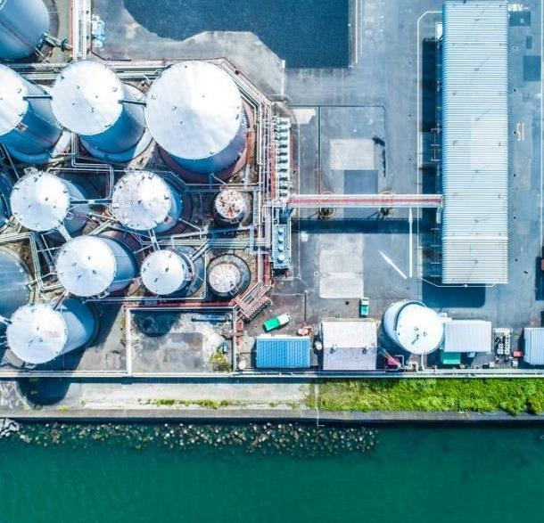
THANK YOU
Shiny application :
https://pearlypaul.shinyapps.io/Shinyapplication/
https://www.youtube.com/watch?v=NZlRdzaXUwI
https://github.com/pearlypaul2712/Case-Study-2---Employee-Attrition-Analysis-

