Slide 2
Plan for today
Mosaics with zero-crossing
Discovered that we can get a full mosaic by “fusing” 2 types!
3. Fixed an important bug: Parameters were not initialized randomly
3. Talk about GPU memory limit
4. Higher learning rate?
2. Looking back at 500 neurons 12x12x3
Looking back at PCA splits: Neurons encode individual cone inputs

Slide 3
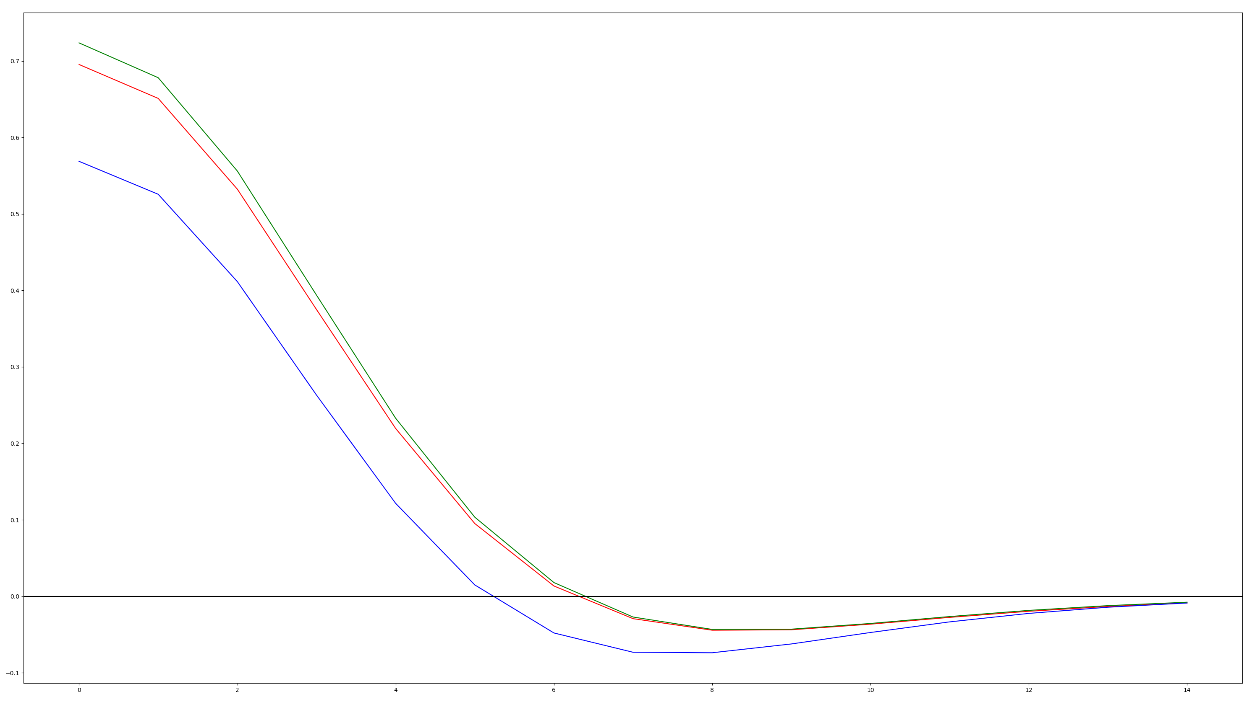
How I determined zero-crossings

Slide 4
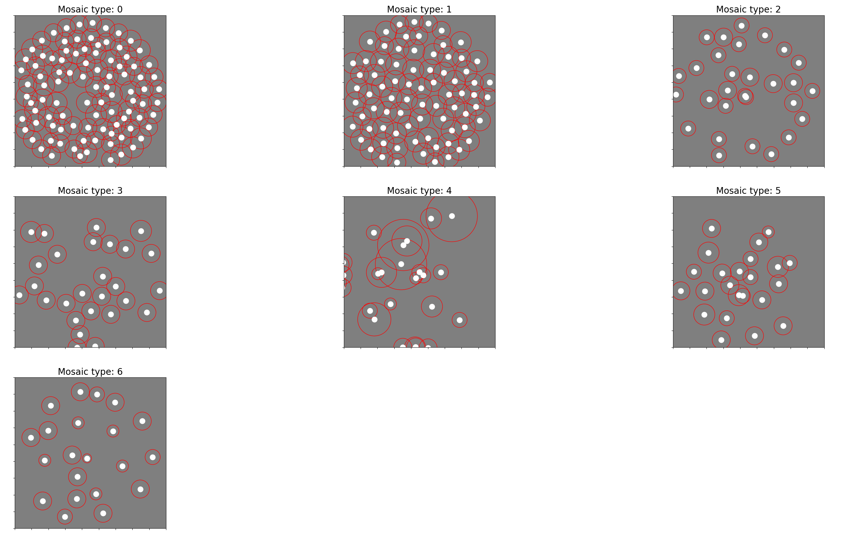
Mosaics 2 and 3 “complement” each other!!!
Mosaic 2: OFF midget
Mosaic 3: OFF midget + OFF S inputs
240125-183448

Slide 5
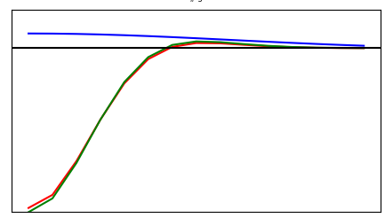
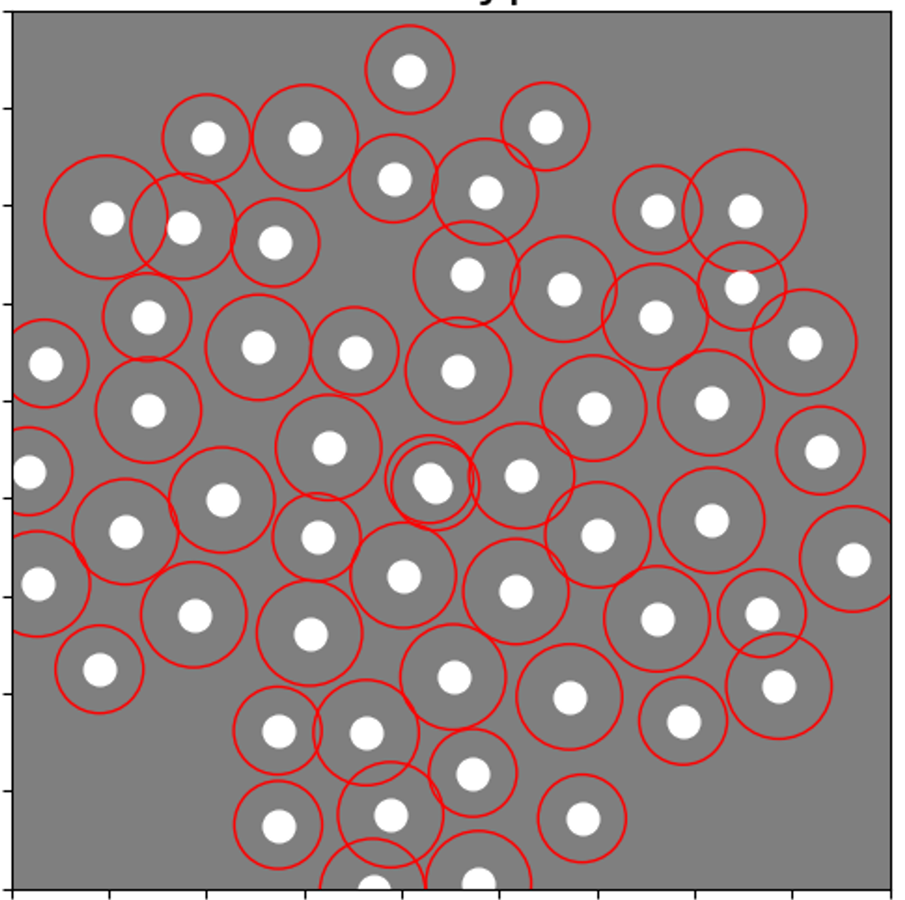
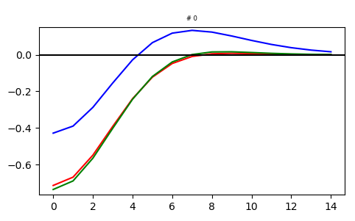
Mosaic 2 + Mosaic 3
Mosaic 2 example:
Mosaic 3 example:

Slide 6
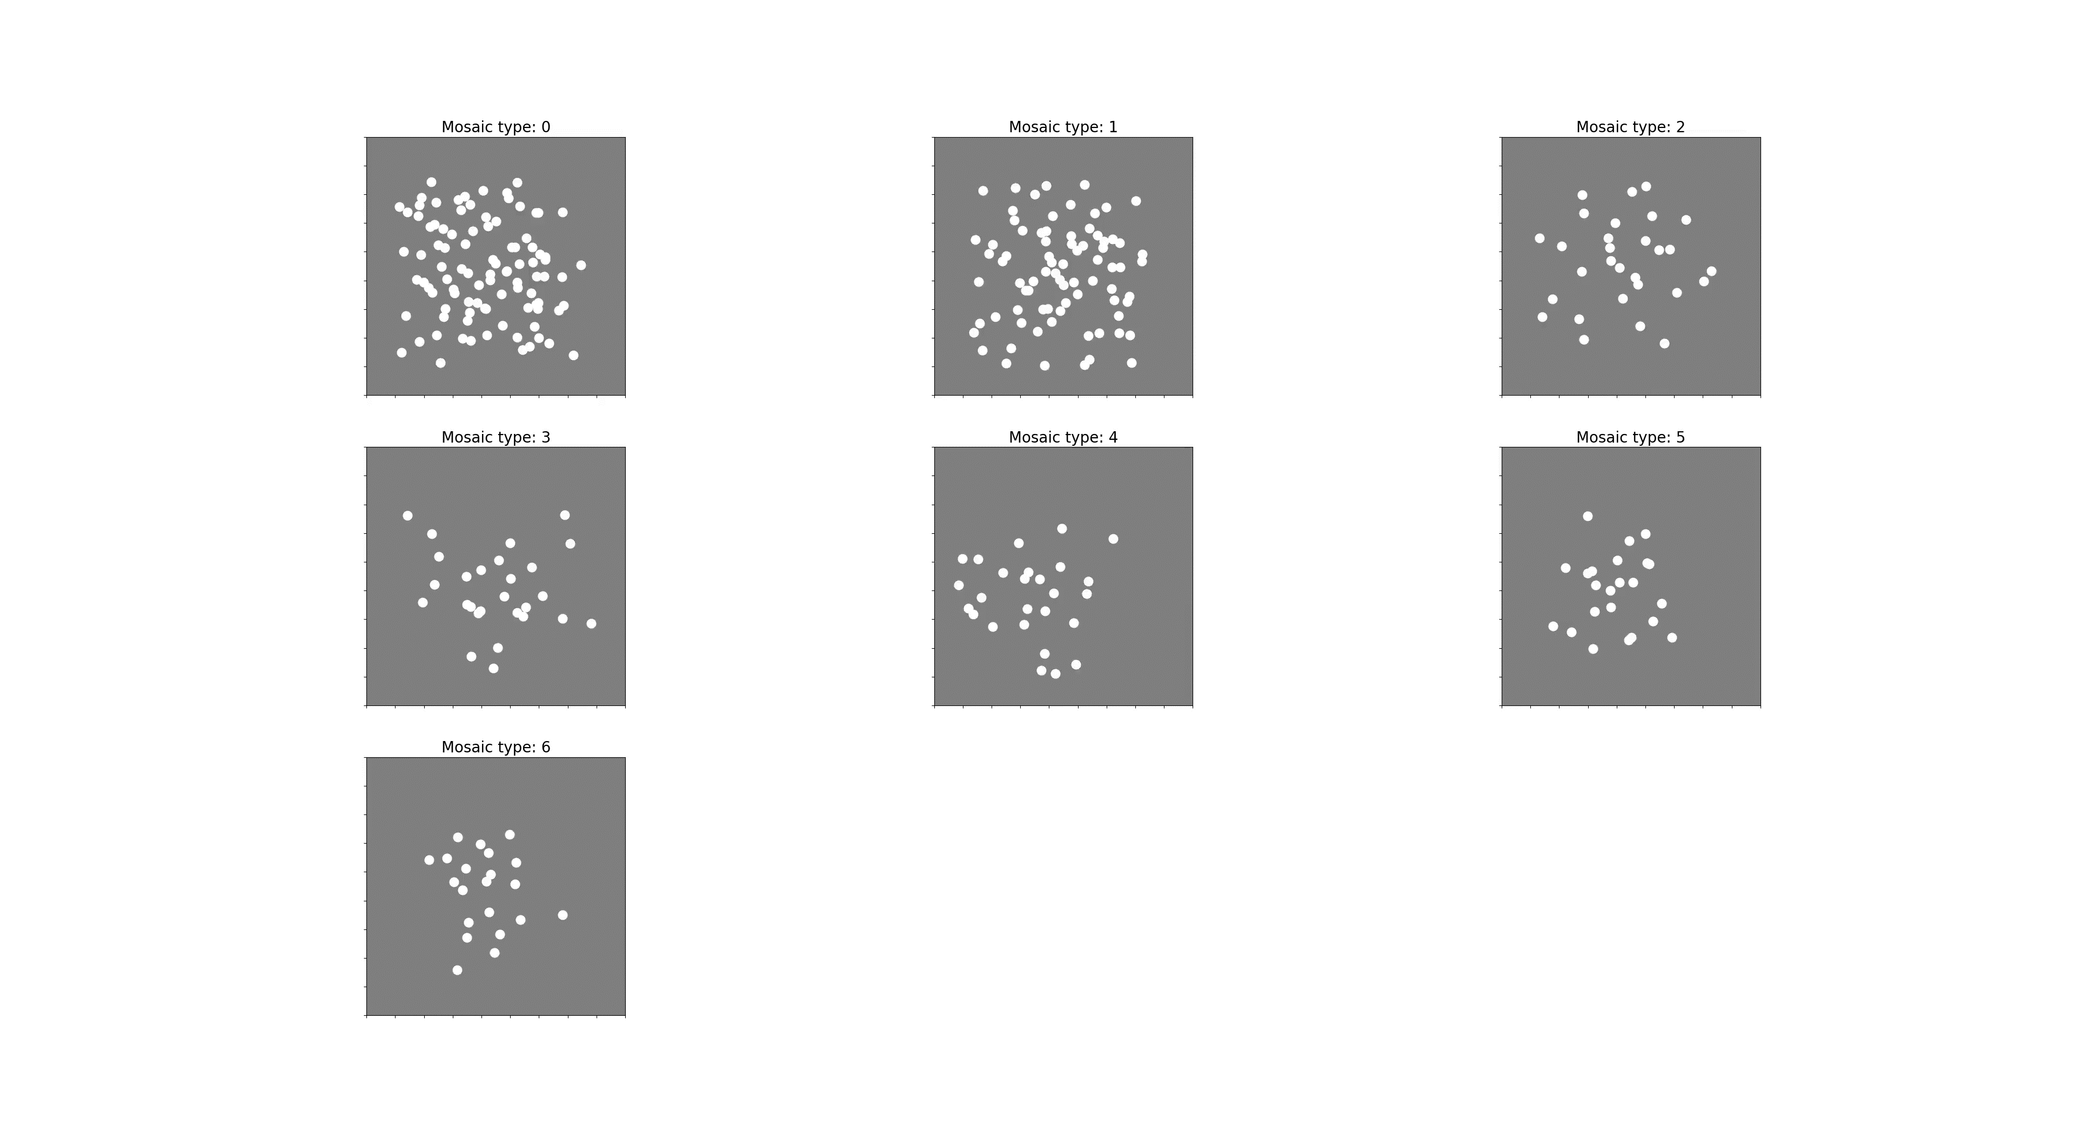
Video: 300 neurons 18x18x3

Slide 7
Memory limit
What does influences the limit:
Number of neurons, batch size
What doesn’t influence the limit:
Kernel size, number of channels
Why is that?
It would be possible to run 1000 neurons with a batch size of 16.
For 3M epochs, it would take ~55 hours.

Slide 8
Fixing bugs
What I thought I was doing:
Sampling the initial parameters for each neuron from a normal distribution with means (-3, -3, 0, 0) and standard deviation of 1.
What I was actually doing:
All parameters but d were initialized to be the same for each neuron.
d was drawn from a normal distribution with mean = 0 and std = 1.
What I’m doing now
Sampling initial parameters from each neuron from a normal distribution with means that correspond to the converged parameter values and std = 1.
Unfortunately, that didn’t fix the mosaics

